Slide 1


VISUAL INSPECTION FOR DEFINING SAFETY UPGRADING STRATEGIES FOR SCHOOL BUILDINGS- VISUS
Mitja Brilly¹, Mojca Šraj¹ and Stefano Grimaz²
¹UNESCO Chair on Water-related Disaster Risk Reduction, University of Ljubljana
²UNESCO-Chair on Intersectional Safety for Disaster Risk Reduction and Resilience Università di degli Studi di Udine
University of Ljubljana, Faculty of Civil and Geodetic Engineering, Department of Environmental Civil Engineering, Ljubljana, Slovenia
Kyiv, Ukraine, November 6-8, 2019

Slide 2
Introduction
VISUS has been recently adopted by UNESCO and positively tested in prototypal projects within of the Comprehensive School Safety (CSS) framework. Meeting of UNESCO-VISUS Experts (MUVEx) under umbrella of UNESCO Section on Earth Science and Geo-Hazards Risk Reduction establish the network. The task of the network is to ensure the implementation of the methodology in the field of protection of school buildings against natural disasters including water related hazard.

Slide 3
Development
VISUS guidlines
the 1st MUVEx - from 11-12 September 2018 in Udine, Italy
the 2nd MUVEx - from 29-30 October 2019 in Ljubljana, Slovenia
“School safety upgrading strategies in multi-hazard prone areas”

Slide 4
Objectives
The VISUS methodology helps decision-makers at line ministries of education, national disaster management bodies and other relevant institutions to learn about the risks of school facilities and how to find economically optimal solutions for their higher level of security.

Slide 5
HAZARD
VULNERABILITY
10-year return period
100-year return period
1000-year return period
probable maximum floods
Climate change
Antropogenic impacts
agriculture
urban areas
victims
important structures
environment
exposure
RISK

Slide 6
Uncertainty!!???
Probabilty estimation
Climate change calculation
Antropogenic impacts
Modelling – parameter estimation by regularization

Slide 7
Probability estimation – Savinja River WS Celje

Slide 8
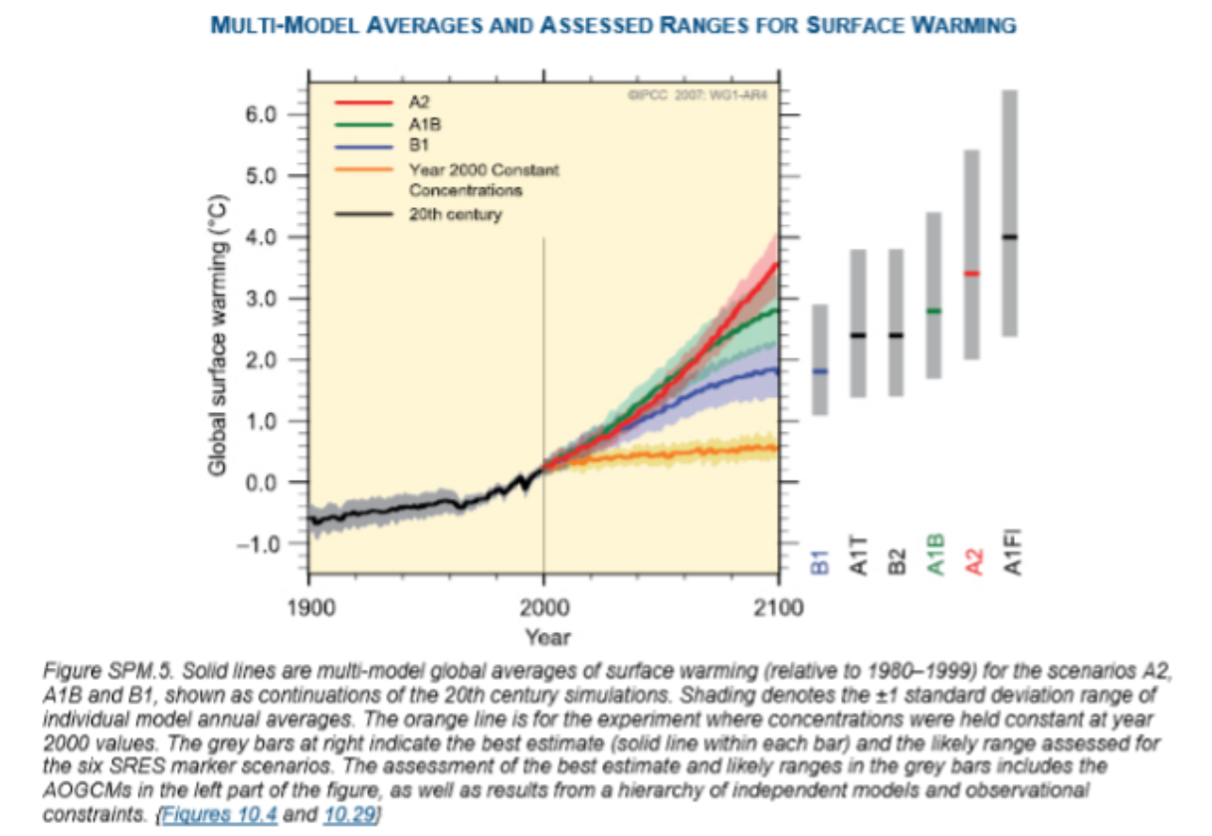

Slide 9
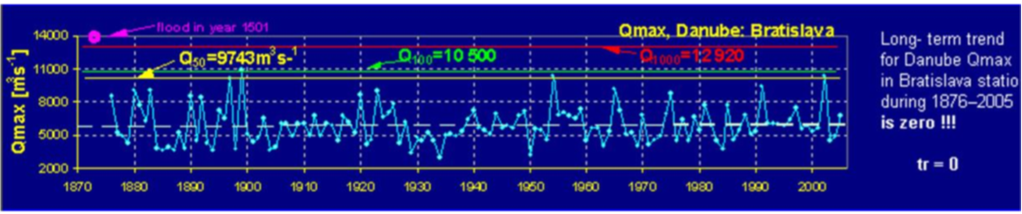
Result of the research of the maximum flows of the Danube River (Miklanek P.)

Slide 10
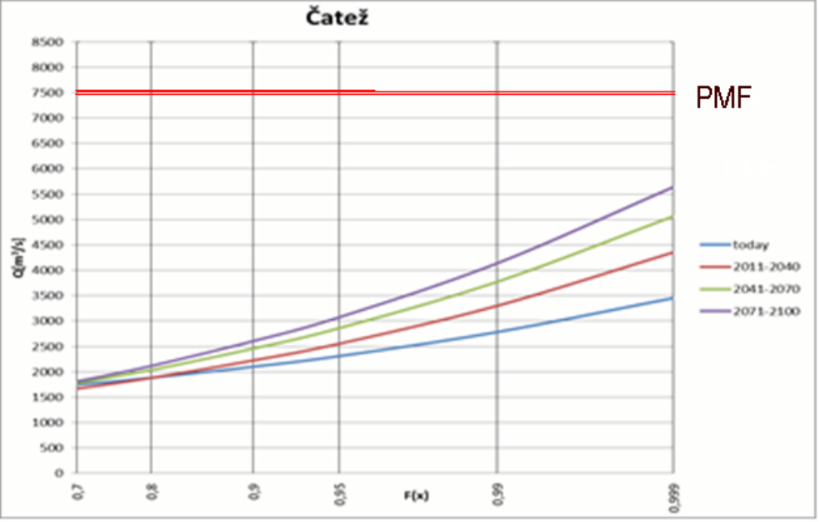
Probability of peak discharges on the Sava River
WS Čatež

Slide 11
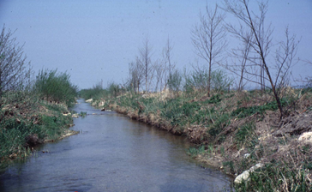
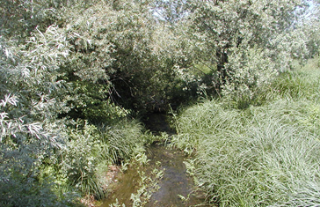
Improper maintenance of river remediation
River bed discharge on the Želimščica river drop from 20 m³/s in 1991 to 5 m³/s in 2015

Slide 12
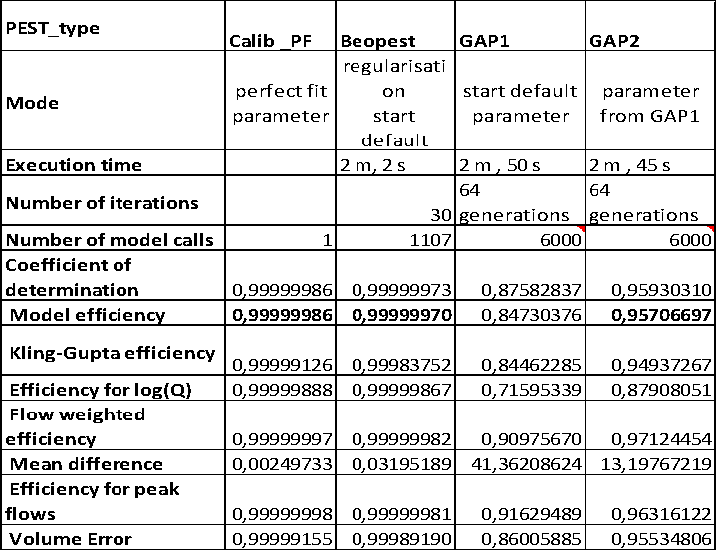
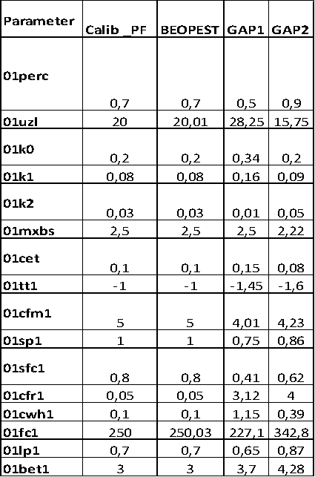
Modelling – parameter estimation by regularization

Slide 13
Social development – future transition
Social structure by labour force
Urban development
Victims
Damage

Slide 14
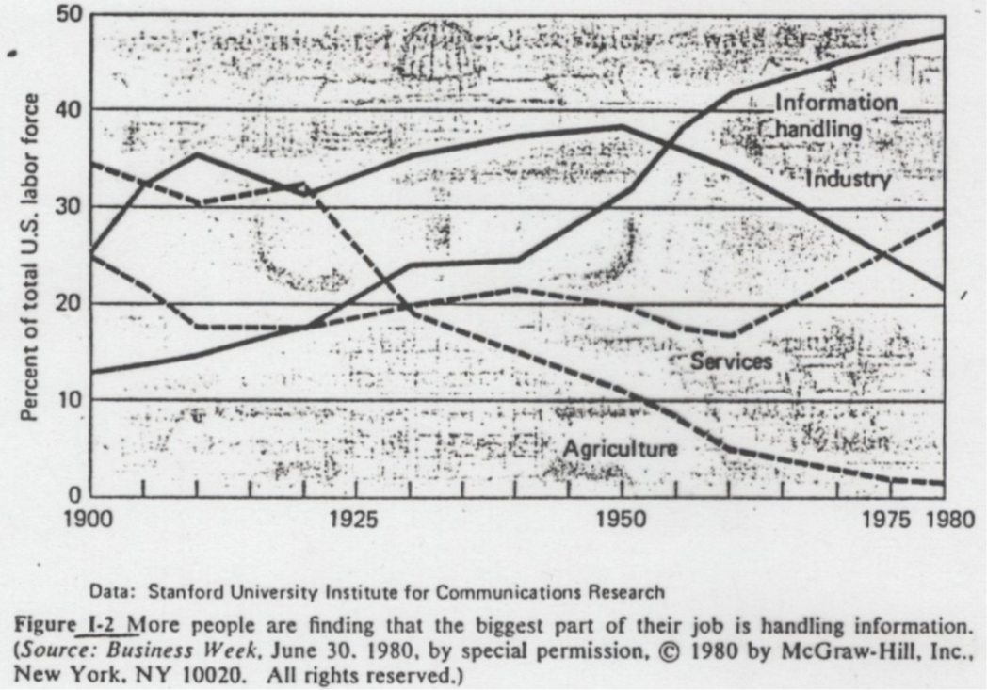
Labor force in US

Slide 15
Labor Force structure CIA 2008-2014
država | kmetijstvo | Industrija in transport | upraljanje | usluge | Prodaja in uradi
US | 0,7 | 20,3 | 37,3 | 17,0 | 24,2
Germany | 1,6 | 24,6 | 73,8
GB | 1,3 | 15,2 | 83,5
Albania | 41,8 | 11,4 | 46,8
Armenia | 39 | 17 | 44
Azerbaijan | 38,3 | 12,1 | 49,6
Belarus | 9,3 | 32,7 | 58
BiH | 19 | 30 | 51
Bulgaria | 6,7 | 30,2 | 63,1
Croatia | 1,9 | 27,6 | 70,4
Czeh Republic | 2,6 | 37,4 | 60
Estonia | 3,9 | 28,4 | 67,7
Georgia | 55,6 | 8,9 | 35,5
Hungary | 7,1 | 29,7 | 63,2
Latvia | 8,8 | 24 | 67,2
Lithuania | 7,9 | 19,6 | 72,5
Macedonia | 18,3 | 29,1 | 52,6
Moldova | 26,4 | 13,2 | 60,4
Montenegro | 5,3 | 17,9 | 76,8
Poland | 12,6 | 30,4 | 57
Romania | 27,9 | 28,2 | 43,9
Russia | 9,4 | 27,6 | 63
Srbija | 21,9 | 15,6 | 62,5
Slovakia | 3,5 | 25,9 | 70,6
Slovenija | 8,3 | 30,8 | 60,9
Ukraine | 5,6 | 26 | 68,4

Slide 16
Vulnerability – flood victims

Slide 17
Gaps in future of flood policy
School buildings should be protected for more than 100 year return period of flood
High risk is on the road near school
Some school buildings in villages will be abounded
New school buildings will be constraced in urban area

Slide 18

When dealing with water, always take a full picture in mind!

