Slide 1
PRESENT ACTIONS REGARDING FLOOD RISK ASSESSMENT AND REDUCTION
IN ROMANIA
Simona-Olimpia NEGRU
Viorel CHENDEŞ
Sorin RÎNDAŞU
Marius MATREAŢĂ
Andreea GĂLIE
Ministry of Water and Forests
National Institute of Hydrology and Water Management
“Romanian Waters” National Administration

Slide 2
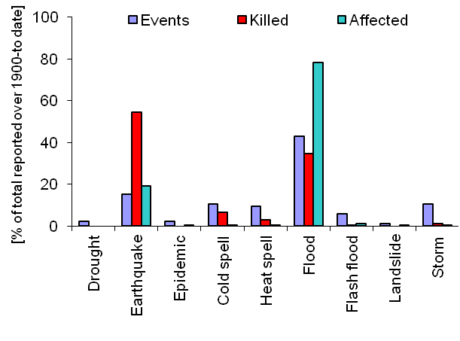
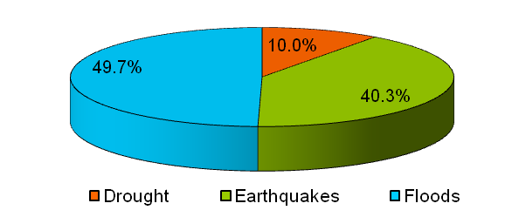
HISTORICAL FLOODS IN ROMANIA
Romania is highly exposed to natural disasters. Hydrological hazards mostly include floods, flash-floods and slope overflows, frequently registered in Romania.
According to EM-DAT (Emergency Events Database, http://www.emdat.be/), in terms of numbers of total affected people, 9 of top 10 natural disasters in Romania are floods, they producing the greatest economic damage. The exception is the 1977 earthquake, which had the biggest economic impact and drought in June 2000.

Slide 3
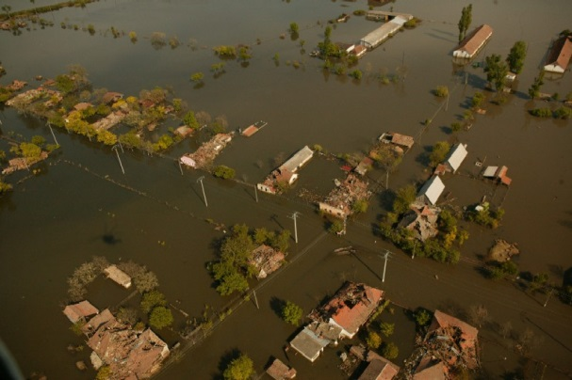
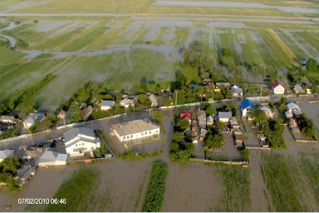
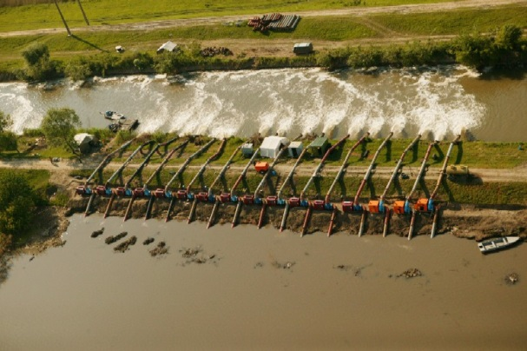

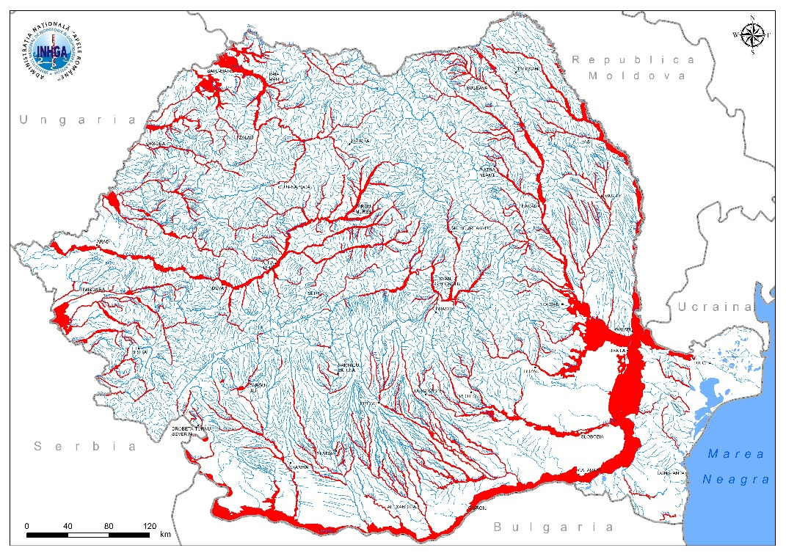
Banat Region, April 2005
Siret River, July 2010
2005-2010 interval: 62.000 affected residences, 15.600 destroyed residences, >3 mld. Euro total loss, 233 mil. Euro aid (Natural Disaster Insurance Poll - PAID, source: www.paidromania.ro).
(Source: ECP)
(Source: IGSU)
Main areas exposure to floods
in Romania

Slide 4
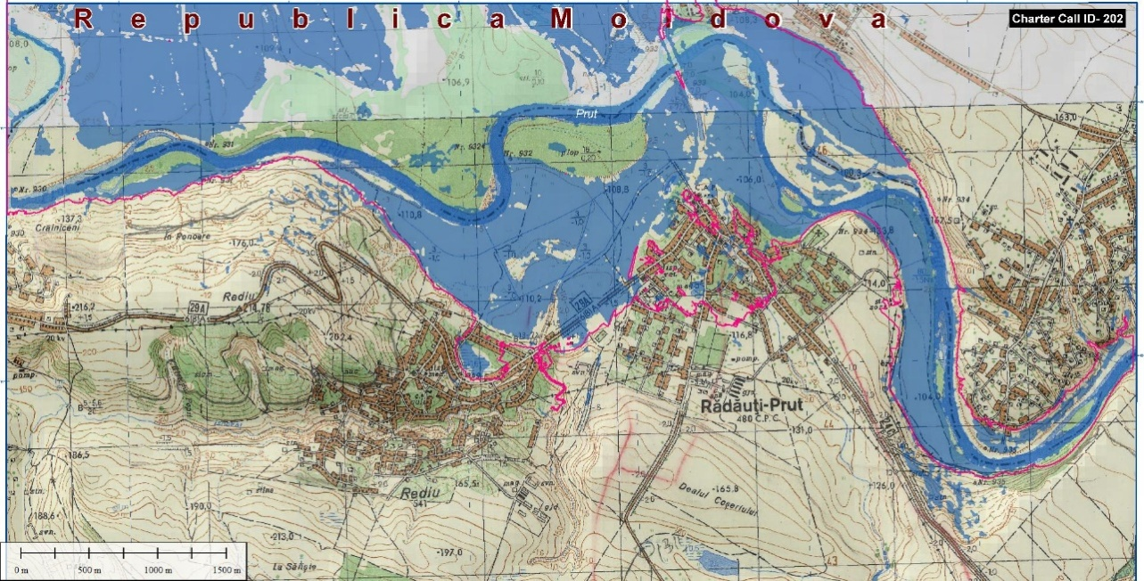
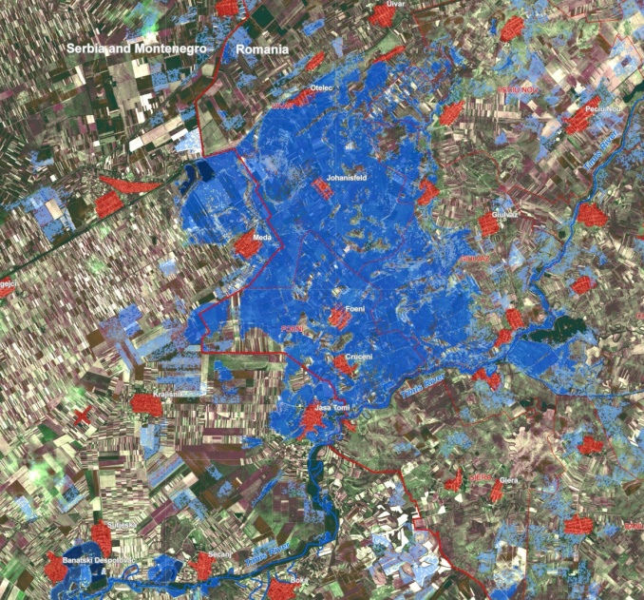
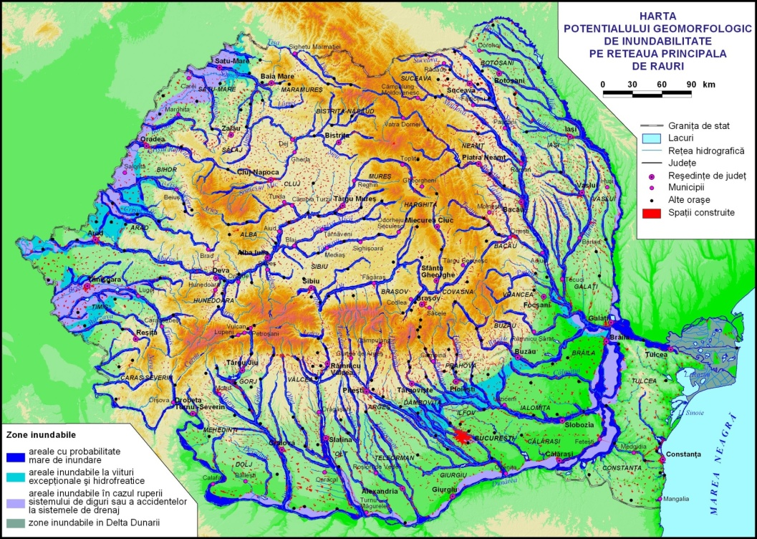
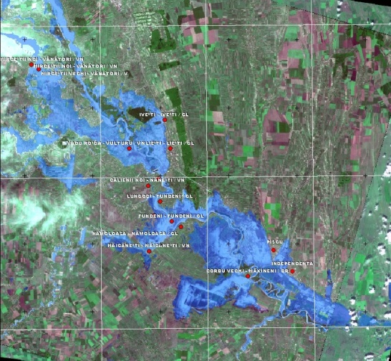
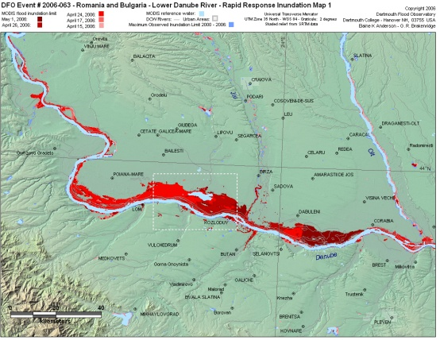
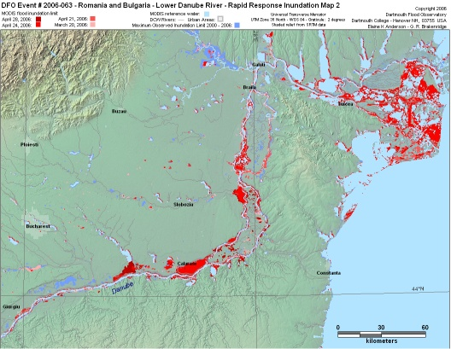
Dykes failure in the subsidence plain
(Banat, 2005)
Areas with high flood probability
Areas flooded at exceptional and groundwater floods
Areas flooded in case of dykes failures or accidents at the drainage systems
Flooded area in the Danube Delta
The flood in 2008 – Rădăuţi area
2005 floods
Danube 2006 floods
Danube 2006 floods

Slide 5
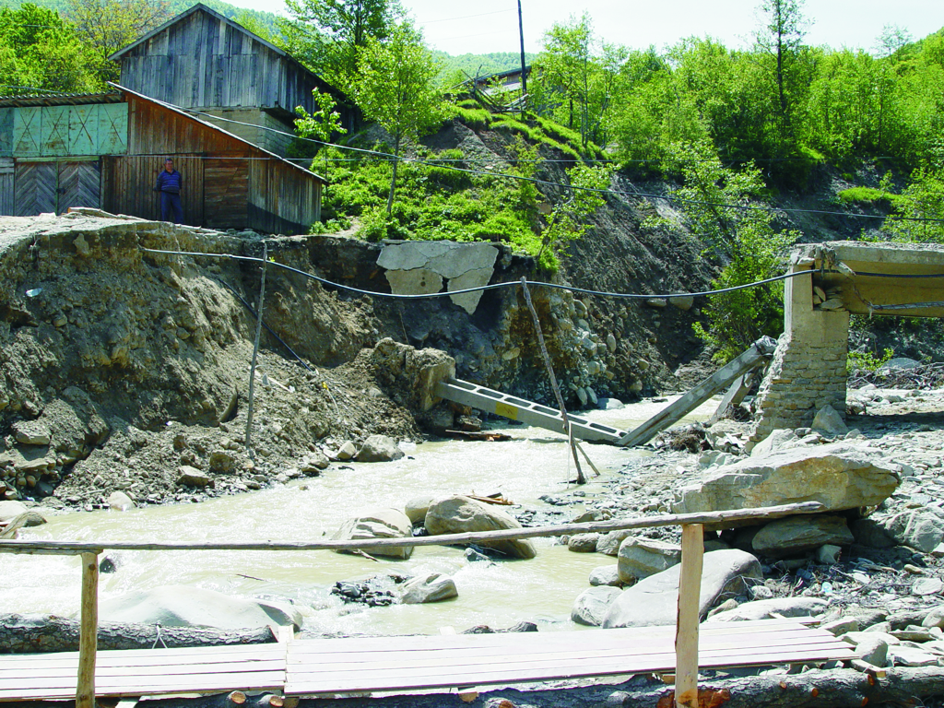
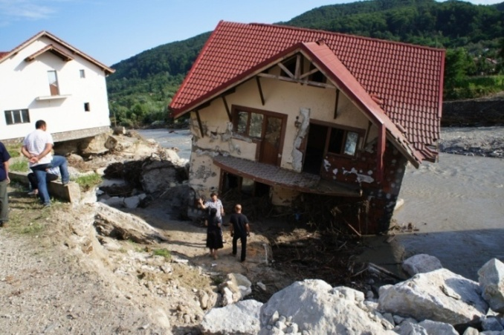
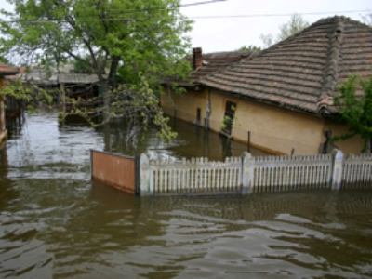
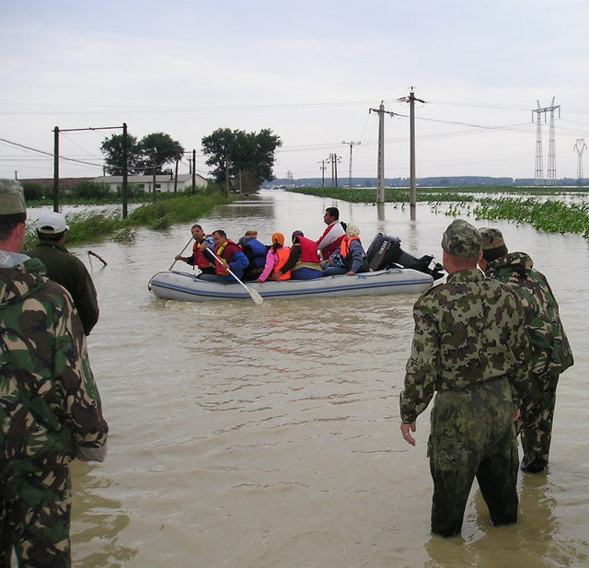
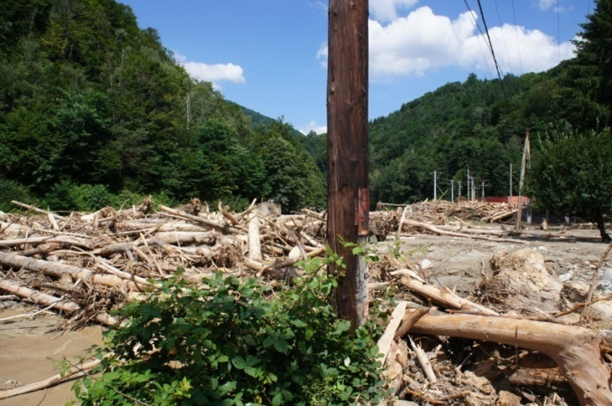
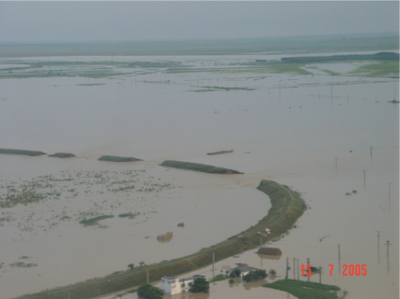
FLASH FLOODS VS. SLOW FLOODS
The potential slow-flooded areas are generally known, settlements being protected by levees, bypass channels, reservoirs, etc. Thus, it is typically a significant reduction of their vulnerability, even if the value of assets and population have a higher exposure.
Instead, flash flood affected areas are taken into account only where such phenomena have produced. The difficulty of identifying areas exposed and magnitude lies in the great variability of triggering factors, especially rain characteristics

Slide 6
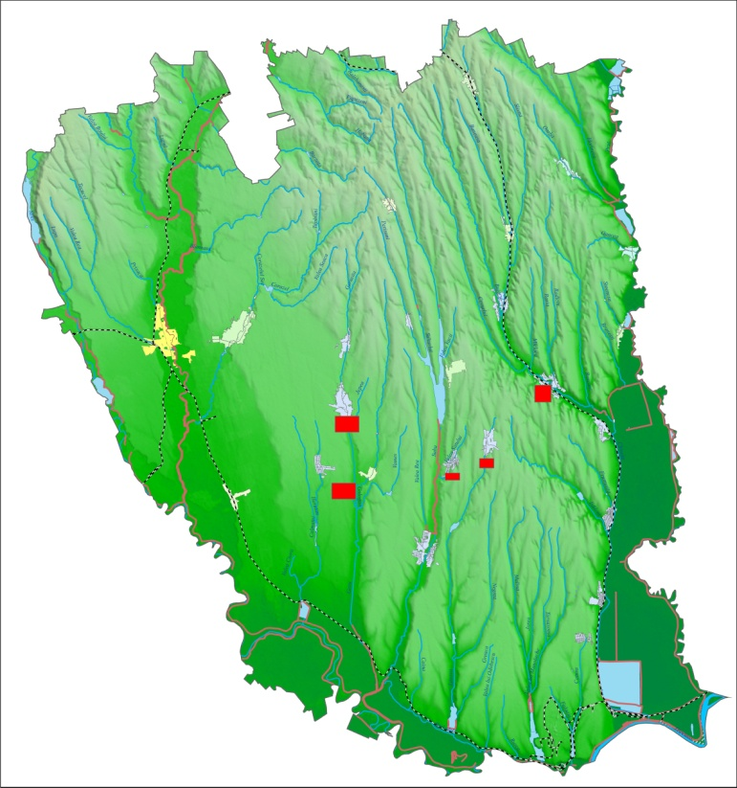
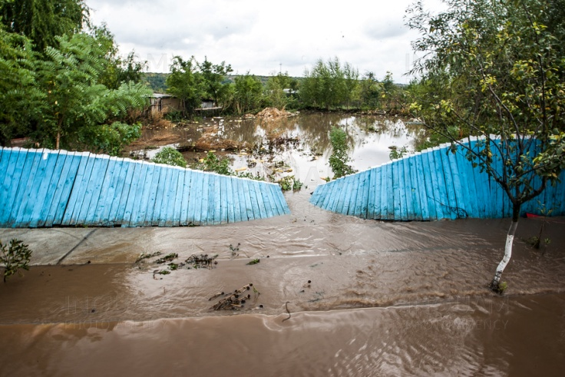
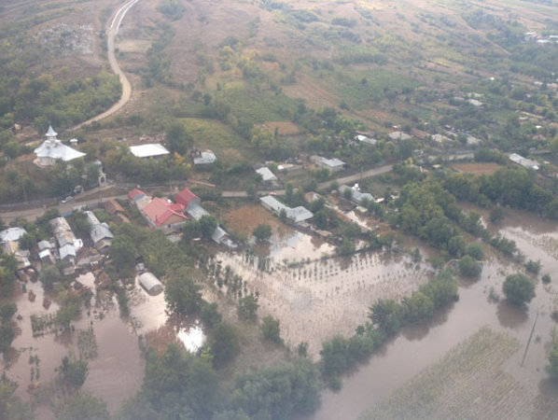
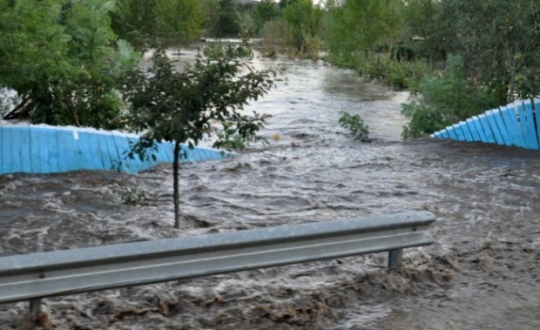
PLUVIAL FLOODS IN ROMANIA
Galati county is characterized by medium to low values of morphometric parameters (mean elevation - 100 m; mean slope -3⁰).
The rainfall amount that generated the floods in September 2013 have been close to or even exceed 1/100 years return period. Thus, in 12 hours there were registered over 100 - 145 mm.
Consequences:
  9 deaths
  1386 damaged or destroyed houses
  4 socio-economic objectives affected
  342 km affected roads and railways etc.

Slide 7
FLOOD MANAGEMENT SYSTEM IN ROMANIA
The central public authority in the field of water is the Ministry of Water and Forests (M.A.P.). It elaborates and updates the National Strategy for flood risk management, coordinates the elaboration of flood defense plans, floods hazard and risk maps, flood risk management plans, etc.
The "Romanian Waters" National Administration and its territorial units ensures the application of the national flood risk management policy, the maintenance of the hydrotechnical works, emergency situation activities, water monitoring, etc.
National Institute of Hydrology and Water Management carries out research and development activities and provides services in the field of hydrology, hydrogeology and water management at national level.
It also provides short and medium and long-term hydrological warnings and forecasts.

Slide 8
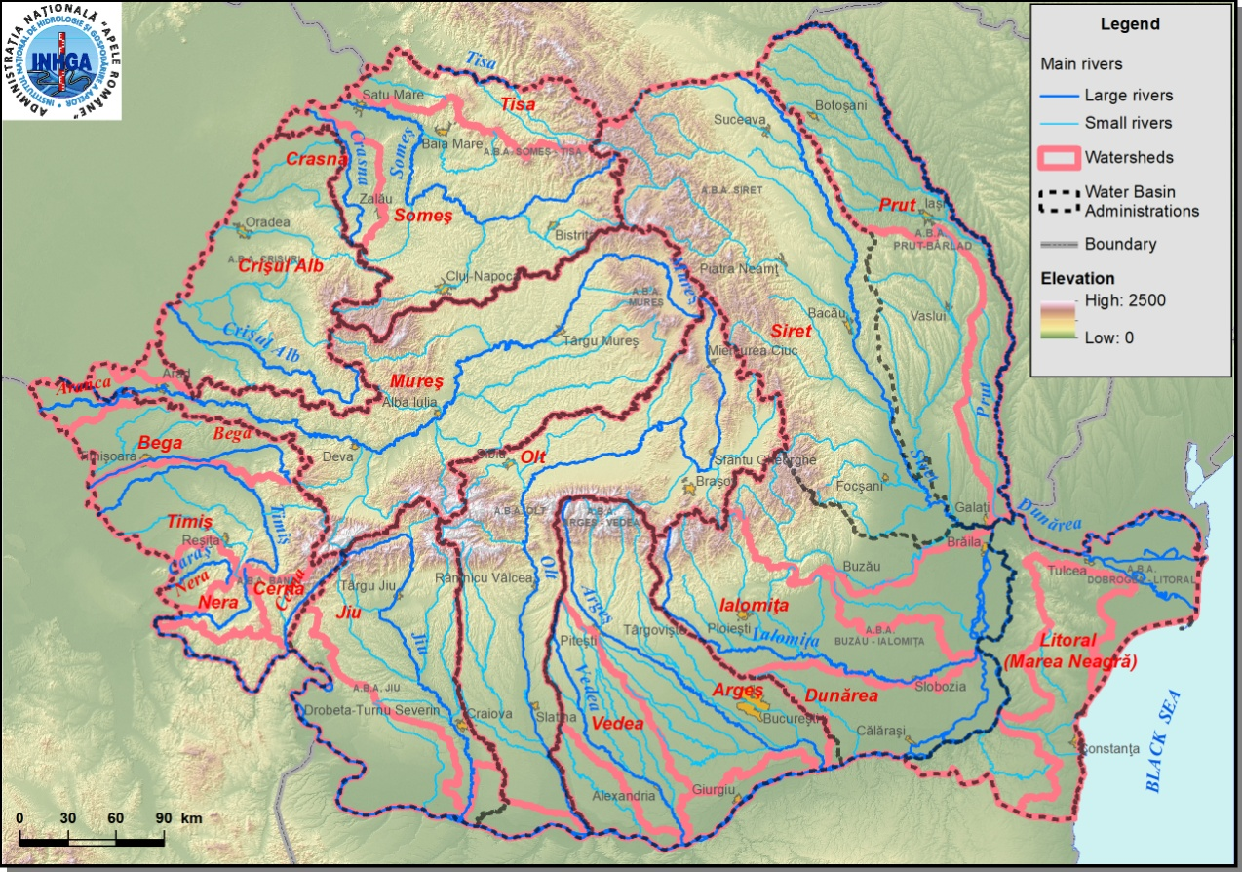
Level 1: | Ministry of Waters and Forests central authority in water field
Level 2: | National Administration of Romanian Waters the authority to implement the national water policy
Level 3: | Basin Water Administrations (11) National Institute of Hydrology and Water Management Complex exploitation Stânca – Costeşti
Level 4: | Territorial Water Management Units at County Level (42)
On the Romanian territory there are about 5,000 main water courses, with a total length of about 80,000 km.
The water management activity is organized in 11 Water Basin Administrations - hydrographic basins or areas.

Slide 9
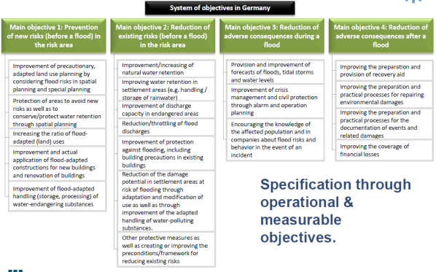
ACTIVITIES FOR FLOOD RISK MITIGATION
The decreasing of flood consequences and flood risk required various activities.
Flood risk
Flood hazard
studies
methodologies
modeling
mapping
hydraulic works maintenance
design of new measures
spatial development
planning
cost-benefit analyses
legislation and regulations etc.
Historical floods
Flood modelling
Specific measures

Slide 11
EU FLOOD DIRECTIVE
The purpose of this Directive is to establish a framework for the assessment and management of flood risks, aiming at the reduction of the adverse consequences for human health, the environment, cultural heritage and economic activity associated with floods.

Slide 12
SOURCES OF FLOODING
EU FLOOD DIRECTIVE
Different sources, mechanisms and characteristics of floods required specified methodologies at the national level.
CHARACTERISTICS OF FLOODING
Fluvial
Pluvial
Groundwater
Sea water
Artificial water – Bearing infrastructure
Flash flood
Snow melt flood
Other rapid onset
Medium onset flood
Slow onset flood
Debris flow
High velocity flow
Deep flood
MECHANISMS OF FLOODING
Natural exceedance
Defence exceedance
Defence or infrastructural failure
Blockage / Restriction
Accordingly to Flood Directive technical specifications

Slide 13
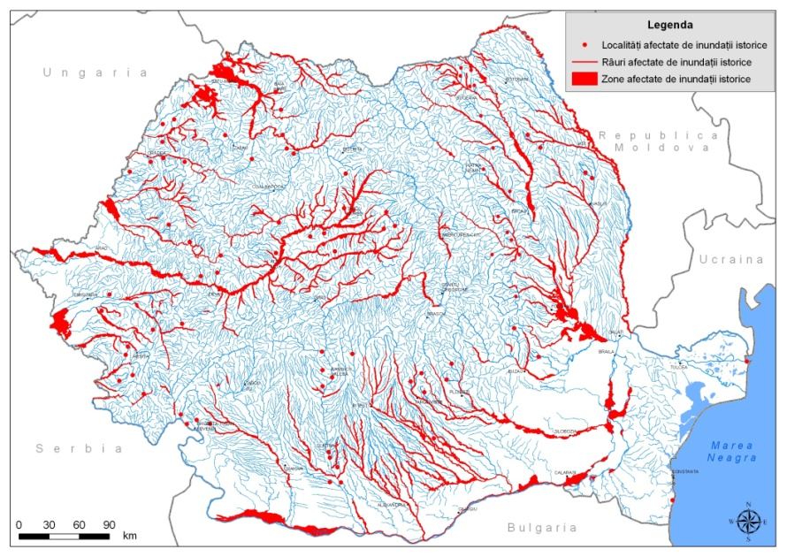
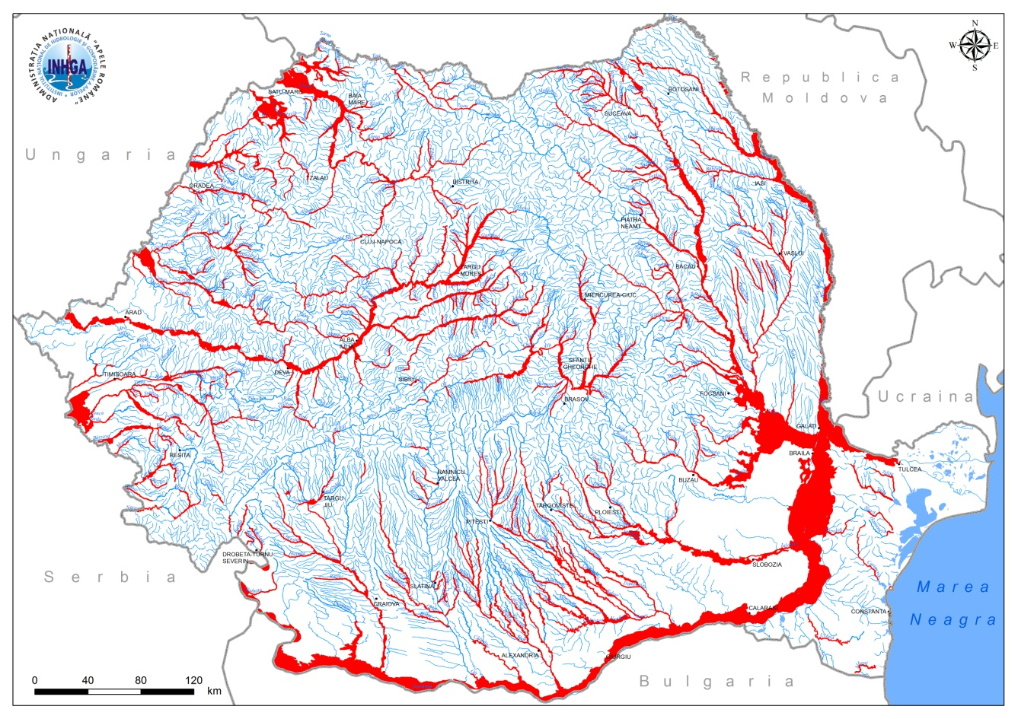
RIVERS INCLUDED IN FLOOD DIRECTIVE – CYCLE 1
Number
Lenght

Slide 14
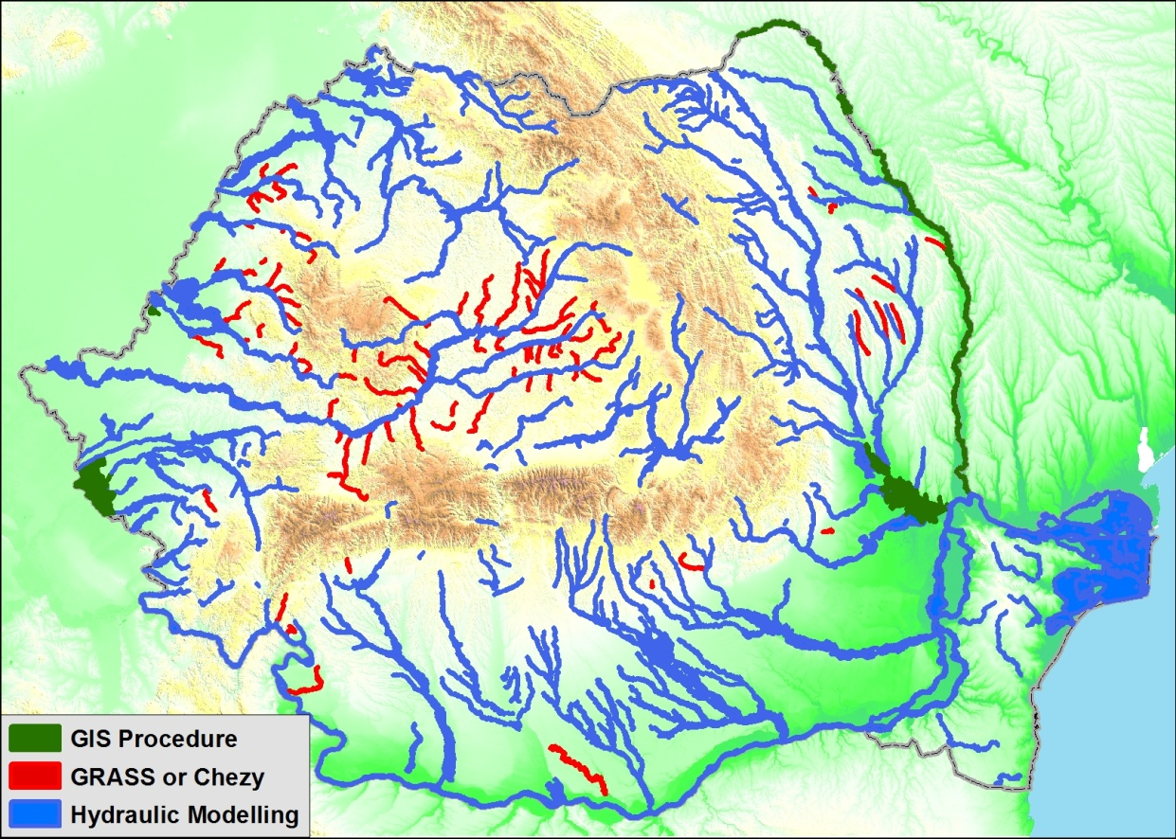
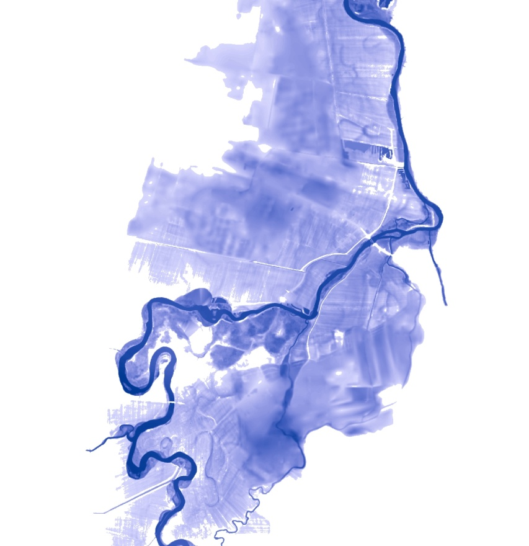
Hydraulic modelling, performed by specialized companies, consisted of 1D or 2D simulating by running MIKE 11/21, Sobek, HEC, etc.

Slide 15
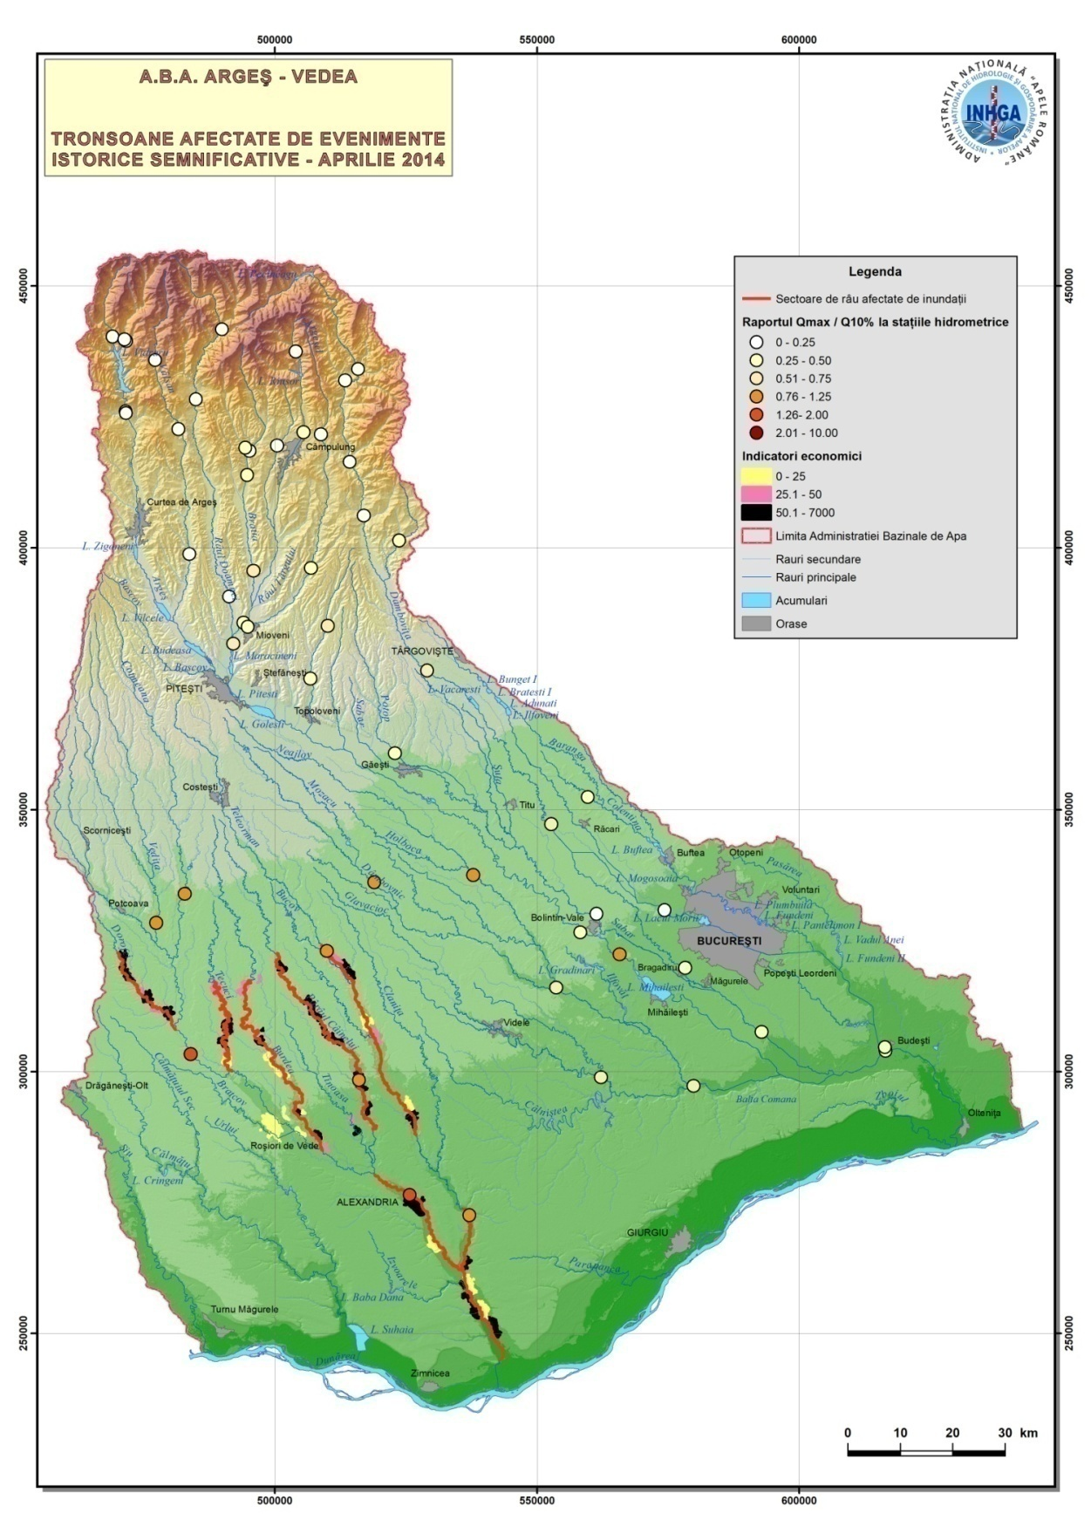
AREAS OF POTENTIAL SIGNIFICANT FLOOD RISK – CYCLE 2
The database of historical floods consequences was significantly improved. It has been converted into GIS format and spatially analyzed.
The maximum monthly flows were analyzed in more detail. These were transformed into modulus values by calculating monthly Q max / Q10% ratios.
The Q max / Q10% coefficients allow the identification of the areas affected by significant floods.
The average of these coefficients at the WBA level highlighted the years 2010 and 2016, but especially the July 2014 event produced in Olt WBA.

Slide 16
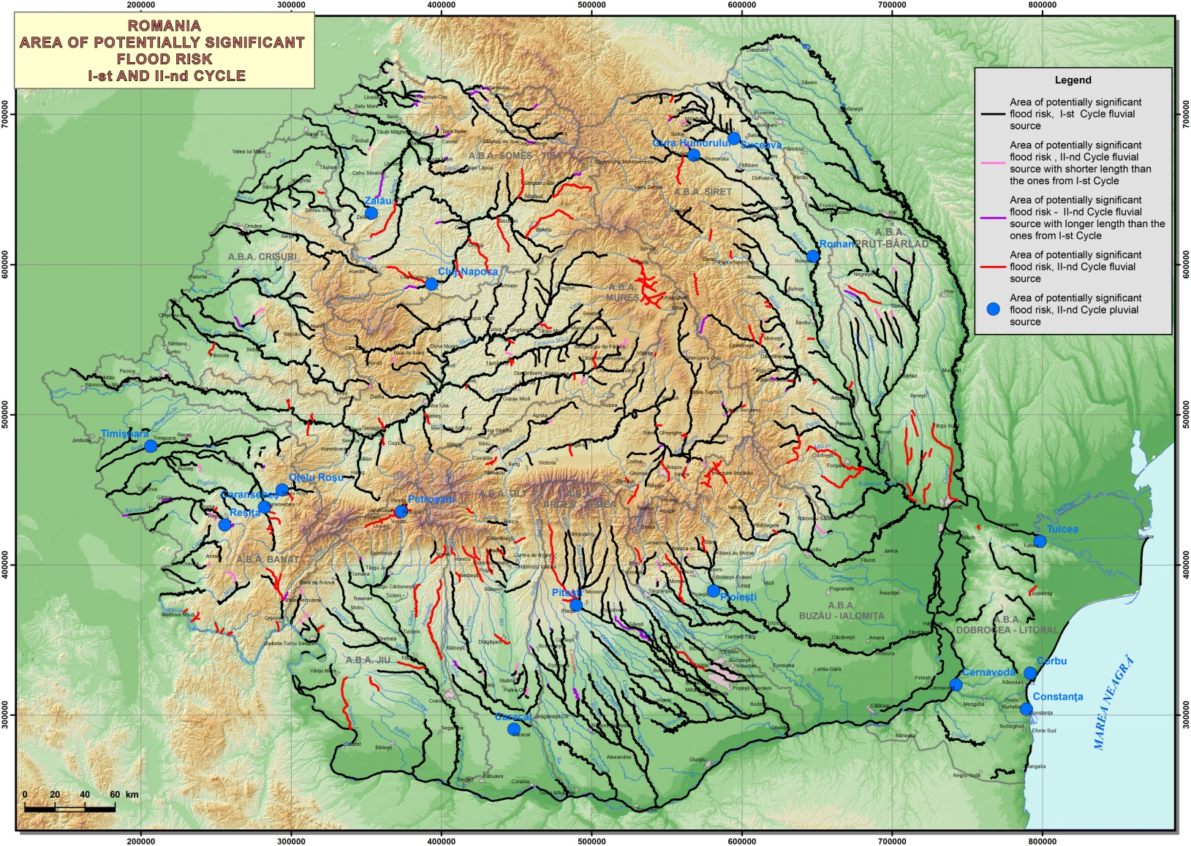
AREAS OF POTENTIAL SIGNIFICANT FLOOD RISK – CYCLE 2
The total length of areas with significant potential risk to floods in Romania is currently 19,482 km, registering a 11% increase in Cycle 2 of reporting.
17 areas were included as pluvial floods.

Slide 17
FLOOD-PRONE AREAS - GRASS PROCEDURE
This method is based on some results presented in recent years in the literature, which demonstrate the possibility to achieve flood-prone areas through Digital Elevation Model processing using GIS methods
The likely area affected by floods could be estimated with acceptable errors.
The results can be adjusted by comparing the results with flooding areas obtained by detailed hydraulic modeling in the basins where they are available.
For the modeling based on Fuzzy systems, some indicators obtained by the GIS processing were used as fuzzy variables:
  Modified Topographic Index (MTI), proposed by Manfreda in 2008;
  height above the watercourse (relative elevation);
  distance from the watercourse;
  minimum curvature of the land.

Slide 18
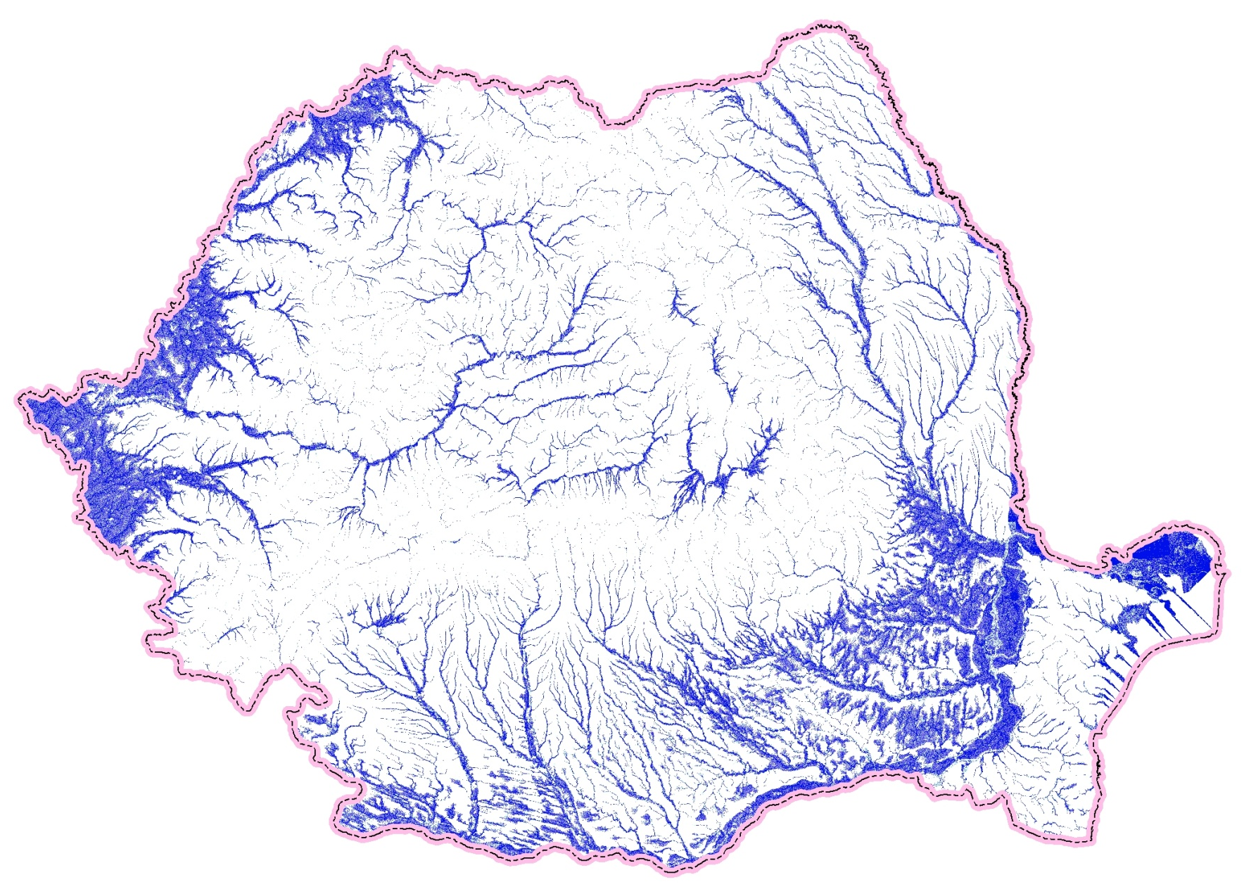
FLOOD-PRONE AREAS –
GRASS PROCEDURE
Index value |  | SRTM |  | Topo maps
 |  | kmp | % | kmp | %
20-41 | no | 184040 |  | 188914
41-51 | low | 6740 | 2.9 | 2856 | 1.2
51-55 | medium | 7677 | 3.3 | 1507 | 0.6
55-60 | high | 19876 | 8.5 | 27811 | 11.7
60-79 | very high | 16819 | 7.2 | 16340 | 6.9
 |  | 51112 | 21.7 | 48514 | 20.4

Slide 20
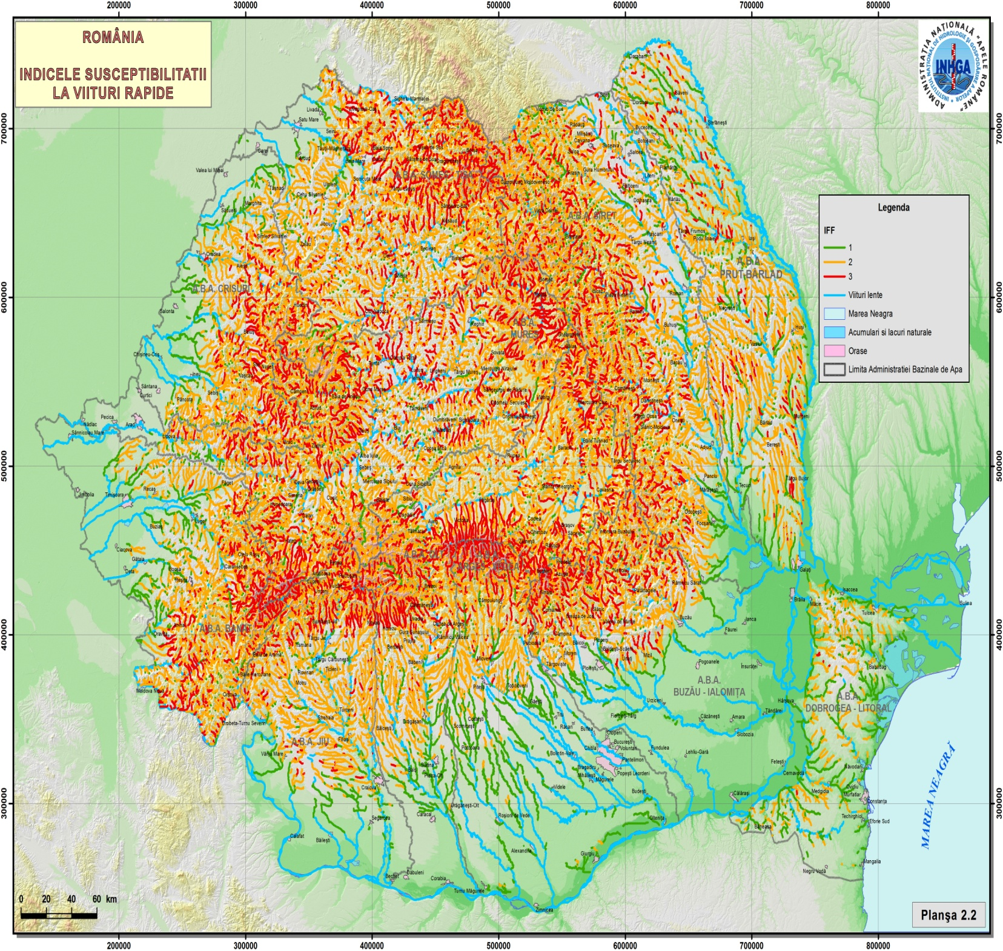
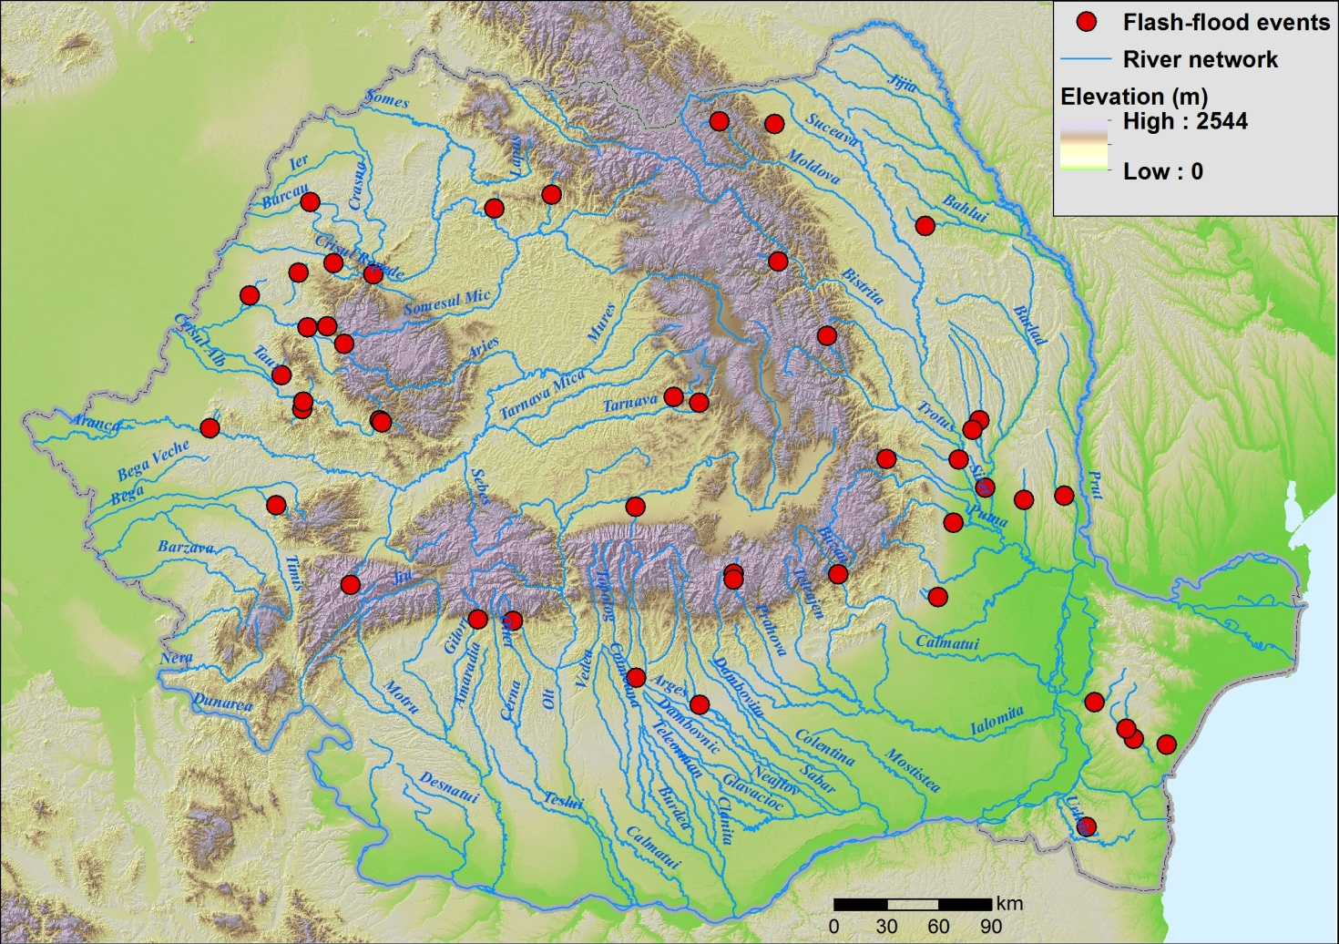
IDENTIFICATION OF RIVER SECTORS WITH POTENTIAL FLASH FLOODS
The main flash floods in Romania: selection based on geomorphic criteria, runoff more than 900 l/s/km² and peak flow over the 10-year return period flow (Qmax > Q10%).

Slide 21
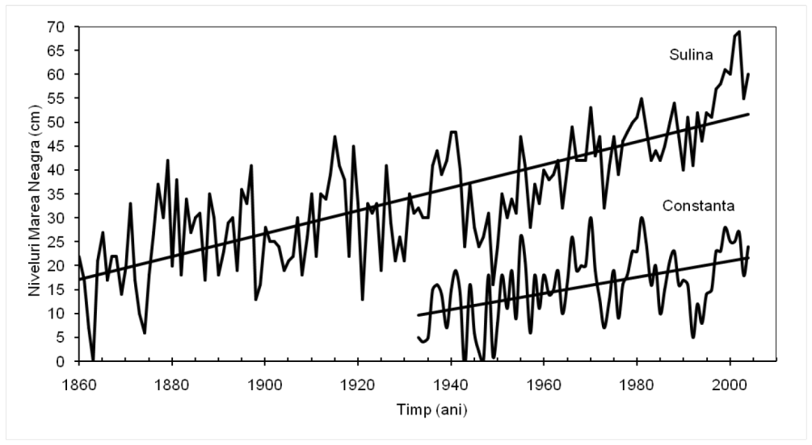
CLIMATE CHANGE IMPACT ON FLOOD RISK
In the first cycle of the Floods Directive implementation, the Romanian did not include, in flood hazard mapping nor in the design of flood protection projects, the impact of climate change.
The increase of the maximum flow of the Danube has been highlighted especially for its last stretch, due to the flood wave overlapping of Siret and Prut Rivers.
The Black Sea level increase since 1860: +33 cm in 145 years at Sulina and +13 cm in 70 years at Constanta. According to the EEA, the global sea level rise could reach 0.47 m (0.32-0.63 m) in 2100 in the case of a medium emissions scenario (RCP4.5, +2.4°C).

Slide 22
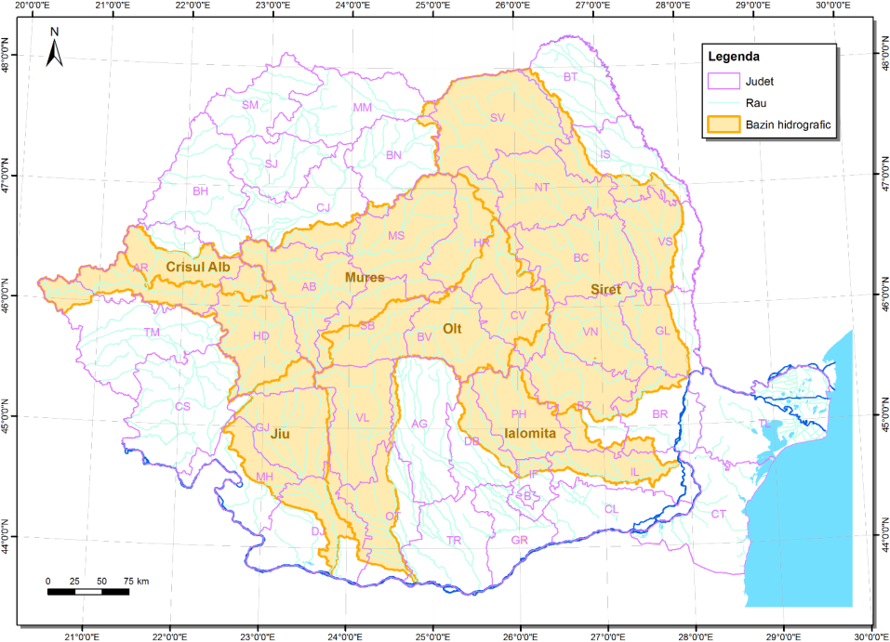
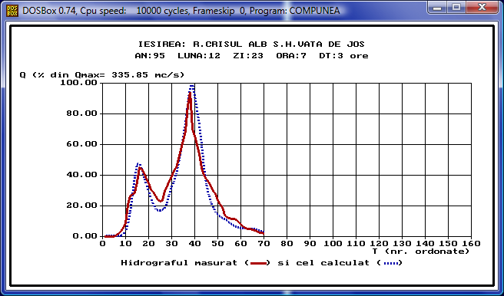
CLIMATE CHANGE IMPACT ON FLOOD RISK
The assessment of climate change impact on maximum flow is achieved by NIHWM (the team coordinated by Corbus & Mic)
The hydrological simulations were carried out for the reference and the future periods, respectively: 1971-2000 (Scenario 0) and 2021-2050 (Scenario 1), for 50 % of the country).
A deterministic hydrological model that allows the simulation of flow in small or in large and complex river basins, which are divided into homogeneous units (river sub-basins) is used.

Slide 23
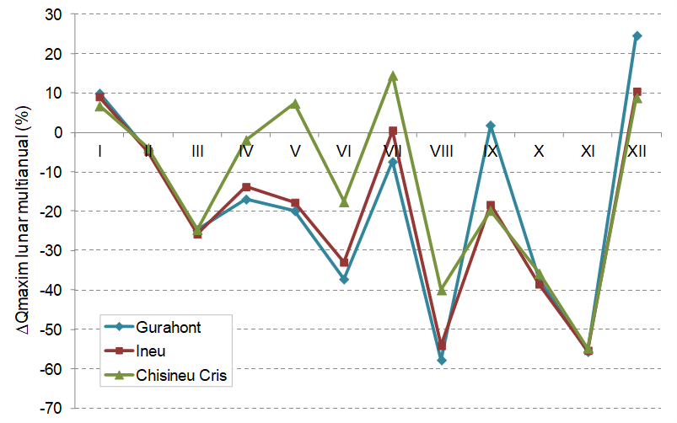
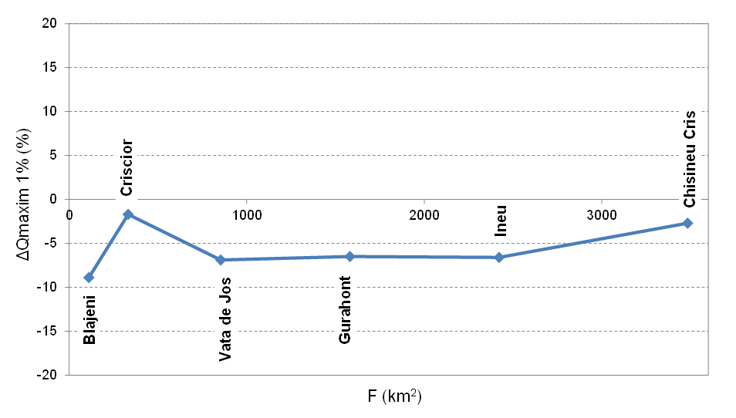
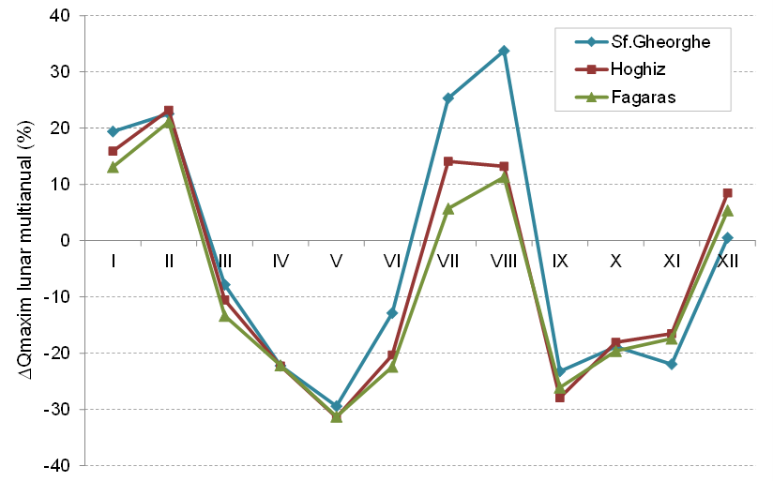
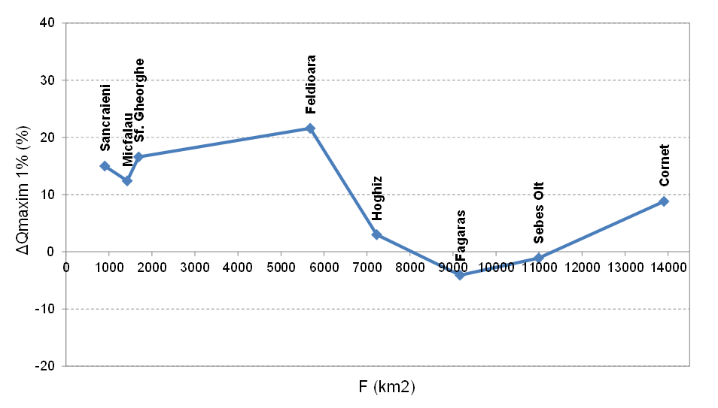
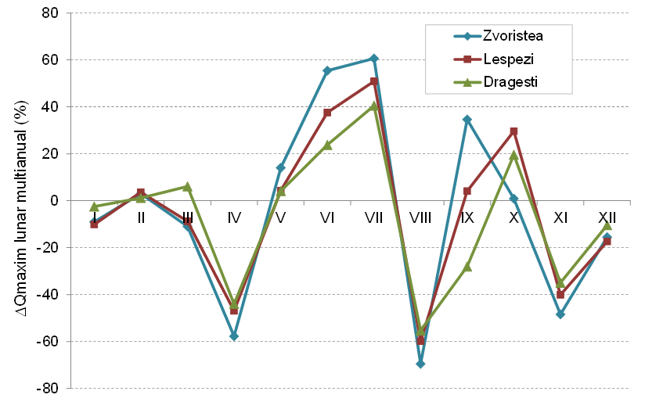
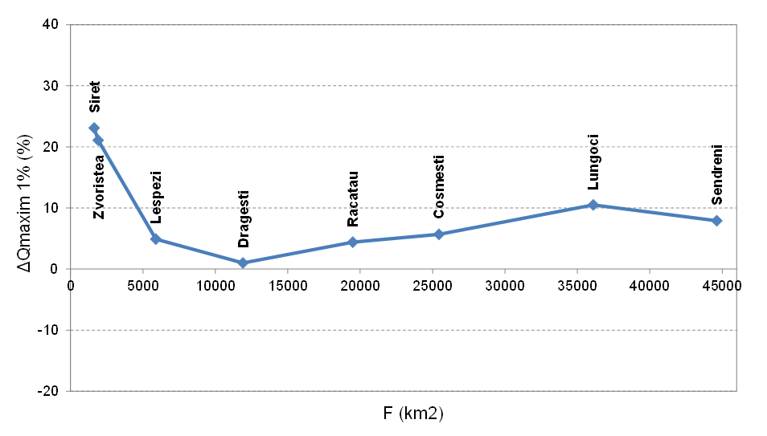
The variation of the relative deviation of the monthly peaks, multiannual averages, for 2021 ÷ 2050 compared to the reference period
Relative variation (%) for the maximum discharges with 100 years return period (1%), computed for the future period 2021-2050 comparing to the reference period
Crişul Alb
The climate change signal is different from one model to another. But generally the models estimation are in line with actual trends.
The models estimate a significant change of runoff values and annual hydrograph by shifting the maximum monthly average discharge value to the beginning of the year.
The climate change could especially impact upstream and small basins subject to flash floods and pluvial floods
Crişul Alb
Olt
Olt
Siret
Siret

Slide 24
RISK MAPS
There are several methodological approaches for flood risk, with various degrees of complexity.
Under the Floods Directive, flood risk is defined by the association between the probability of a flood and potential adverse consequences for human health, environment, cultural heritage and economic activities.
Other approaches quantify the effects using two distinct elements, namely exposure and vulnerability.
The own developed method is based on an international report, the risk assessment using a matrix as a function of the hazard level (P1, P2, P3) and exposure class (E0, E1, E2, E3).
RISK |  |  | Hazard class
 |  |  | H1 | H2 | H3
 |  |  | Low (<0.5) | Medium (0.5-1.5) | High (>1.5)
Vulnerability | V1 | Low | R0 | R0 | R1
 | V2 | Medium | R1 | R1 | R2
 | V3 | High | R1 | R2 | R3

Slide 25





FLOOD RISK RECEPTORS
Economic activity:
  Arable land
  Major industrial activity
  Small economic activity
Population:
  Number of affected inhabitants
  Number of inhabitants located in the area of maximum water depth
  Health: hospitals, water supply
  Community: kindergartens, universities, schools, town halls, police offices
Cultural heritages:
  Churches
  Monuments
  Museums
  UNESCO sites
Infrastructure:
  Railway - type: electric and nonelectric, international routes etc.
  Railway stations
  Roads – type: motorways, european, national, local etc.
Environment:
  Nature protected areas
  Drinking water prot. Areas.

Slide 26
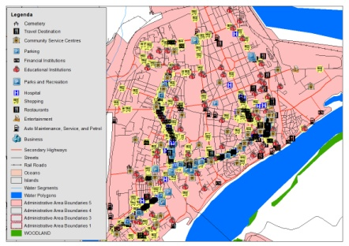
Main data used
The data sets are also used for the prioritization of measures in the Flood Risk Management Plans
NAVTEQ
Dataset /
OSM - Open Street Map
Improved CORINE Land Cover
dataset
WIMS (RWNA)
dataset
NIHWM
datasets
Basic data for EU Reporting
Improved data for National level
Localities
Roads and Railways
Railway stations
Bridges
Protected Areas etc.
Reservoirs
Dump sites
Airpors,ports
Cadastered rivers and basins
Topo maps
Statistical data (settlements population)

Slide 27
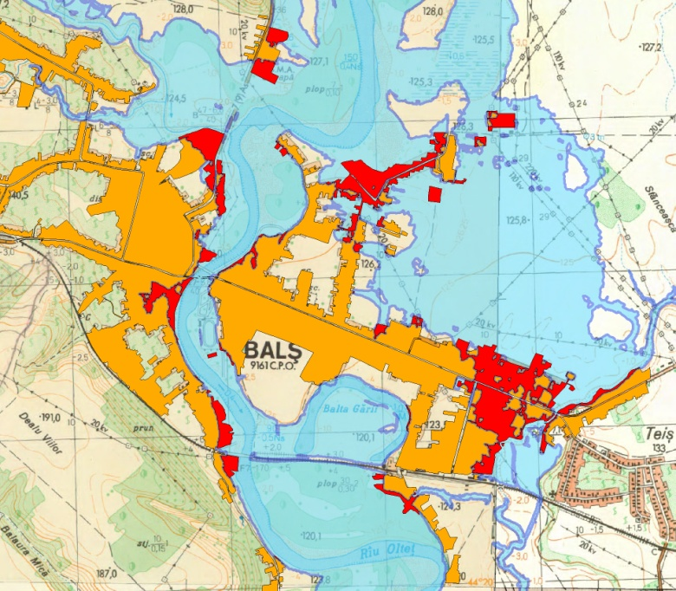
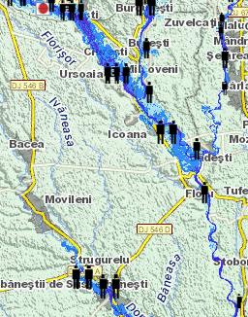
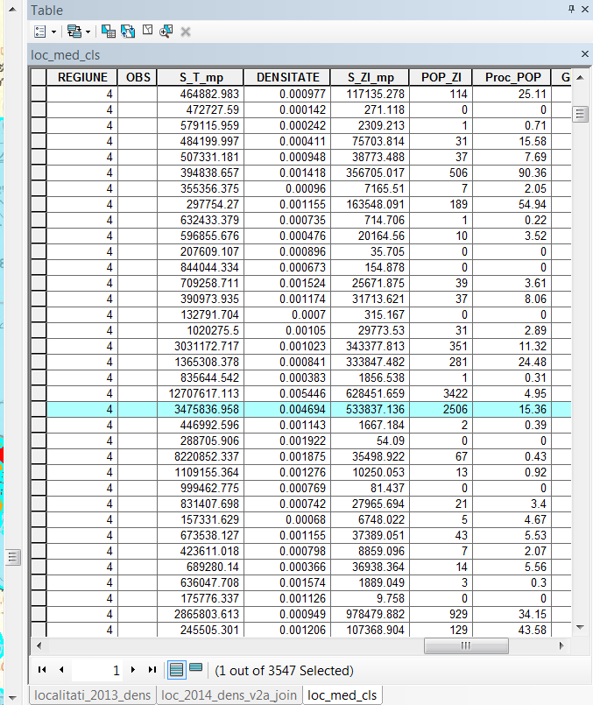
RISK MAPS - Settlements
In the absence of information on each building, this layer is very important, the population being the main receptor at risk. It is essential to be geometrically correct. Information on the types of buildings would lead to much better results.
For the "Number of Affected inhabitants" indicator, as well as for its representation on the portal, the population was statistically assessed, proportional to the flooded area.

Slide 28
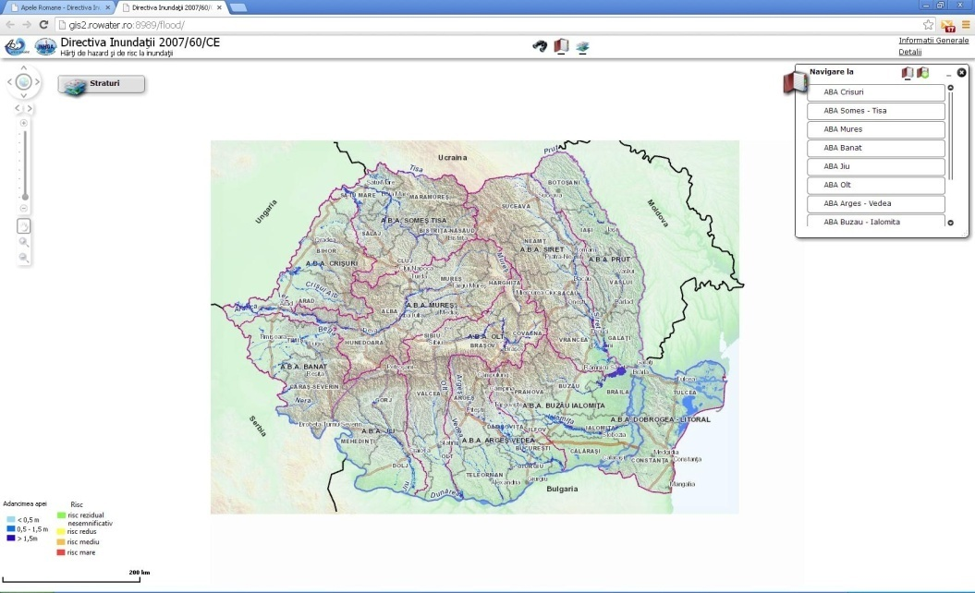
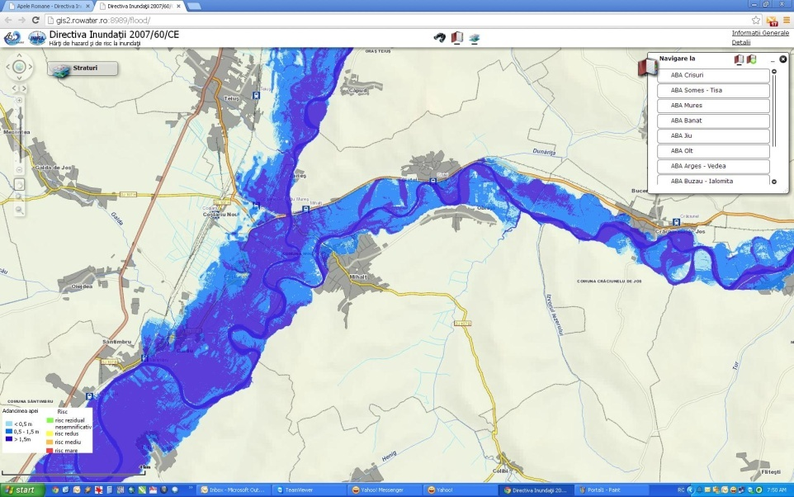
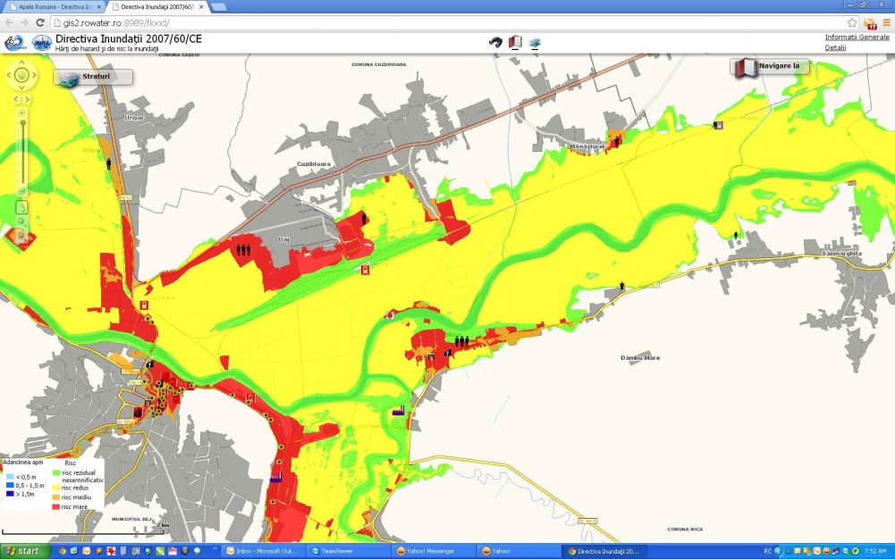
DATA PORTAL - FLOOD HAZARD AND RISK MAPS
www.rowater.ro/HHHRI/HHHRI.aspx
http://gis2.rowater.ro:8989/flood/

Slide 29
FLOOD RISK MANAGEMENT MEASURES
Structural
Measures
Nonstructural
Measures
Taking into account that :
  Floods are the most common and most costly natural disasters in Europe.
  Frequency likely to increase with climate change.
  Strategic long term and integrated flood risk management are focusing on prevention to increase resilience of society.
Non Structural measures and Green Infrastructure Solutions
becoming more important with increased recognition of its benefits

Slide 30
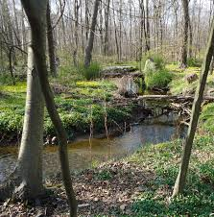






TERRITORIAL PLANNING AND FLOOD RISK MANAGEMENT
Territorial planning is part of integrated flood risk management and plays a key role in prevention.
Flood risk management plans may include the promotion of sustainable land use practices, improvement of water retention as well as the controlled flooding of certain areas in the case of a flood event.

Slide 31
CONCLUSIONS
The mitigation of flood risk involves multidisciplinary activities, including actions during floods based on knowledge. The activities must take into account that:
There is an increasing trend in the frequency of occurring severe flash-floods, characteristic for small basins, generally below 200 km2, as well as for hot season. Such phenomena have caused significant damages.
The results obtained using simplified methods for flood hazard maps are in general acceptable good results especially in the mountainous area.
The landforms in the flash-flood prone areas lead to the increasing of consequences.
…. and many others conclusion based on national and international studies.

Slide 32
CONCLUSIONS
Last 10 years concerns:
  Historical database structure and information
  Hazard modeling
  Risk maps methodologies
  Risk receptors database
  Flash floods susceptibility and hazard
  Climate change impact on maximum flow
  First Flood risk management plan and cost-benefit analysis.
Next concerns to short and medium term:
  Hazard and risk modelling for new rivers
  Switching to quantitative risk from qualitative one
  Identification of area susceptible to be affected by pluvial floods and modelling
  Increasing SMART features of measures, especially the prioritisation
  Improving the using of green measures

Slide 33

Thanks for your attention!
From the Black Forest to the Black Sea ...

