Slide 1
The DANUBE FLOODPLAIN Project
¹Bernd Cyffka & ²Danube Floodplain Project Consortium
¹Floodplain Institute, Applied Physical Geography, CU Eichstaett-Ingolstadt
²www.interreg-danube.eu/approved-projects/danube-floodplain
November 7, 2019 | Kiev, Ukraine

Slide 2
Danube Floodplain
Reducing the flood risk through floodplain restoration along the Danube River and tributaries

Slide 3
The necessity to restore the floodplains of the river Danube
Further man-made constructions and management measures lead to:
modification of hydromorphological dynamics
disconnection of river and floodplain
alteration of biotic and abiotic conditions
changes of river discharge characteristics
Today, the management of rivers and floodplains needs to be improved to enhance naturalness and to reduce flood risk and damage.

Slide 4
Basics
Runtime: 06/2018 – 12/2020
Total Costs: 3.672.655,88 m EUR
Funding ERDF: 2.899.428,55 m EUR
Funding IPA: 222.328,90 m EUR
18 Partners from 10 Countries (Austria, Bulgaria, Croatia, Czech Republic, Germany, Hungary, Romania, Serbia, Slowakia, and Slowenia)
4 Associated Partners
Lead Partner: Romanian Waters (NARW)

Slide 5
Danube Floodplain …
… is running within the South East Europe Danube Transnational Programme, Priority: Environment and culture responsible Danube region, and is designed to strengthen transnational flood risk and water management.

Slide 6
Objectives of Danube Floodplain
According to the EU Strategy for the Danube Region:
Management environmental risks
Restoration and maintenance of water quality
Maintenance of biodiversity and quality of air and soil
Specific Danube Floodplain Objectives:
Better understanding and restoration of floodplain areas
Agreement on measures for restoration, preservation, and maintenance of floodplains
Improved stakeholder cooperation in the field of floodplain management

Slide 7
Expected Chance
Better knowledge of all countries in the Danube catchment on Integrative Water Resources Management by restoration of floodplains and the combination of green infrastructure as well water retention basins with co-operation of all stakeholders.

Slide 8
The following tools will be developed
Manual for restoration and preservation of floodplains in the Danube catchment which is mainly directed to authorities and practitioners
Sustainable floodplain management in the Danube catchment
Strategic guidebook with the most important summarized results to be addressed to the broader public
Roadmap for the Danube catchment with agreed next steps to realize floodplain projects

Slide 9
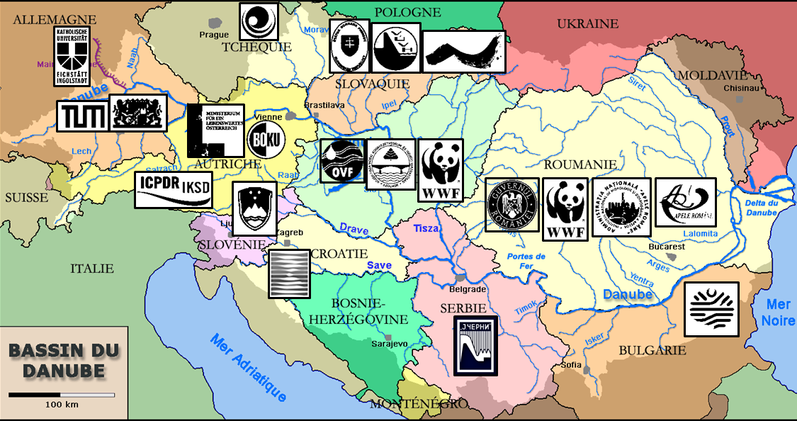
Project Partner

Slide 10
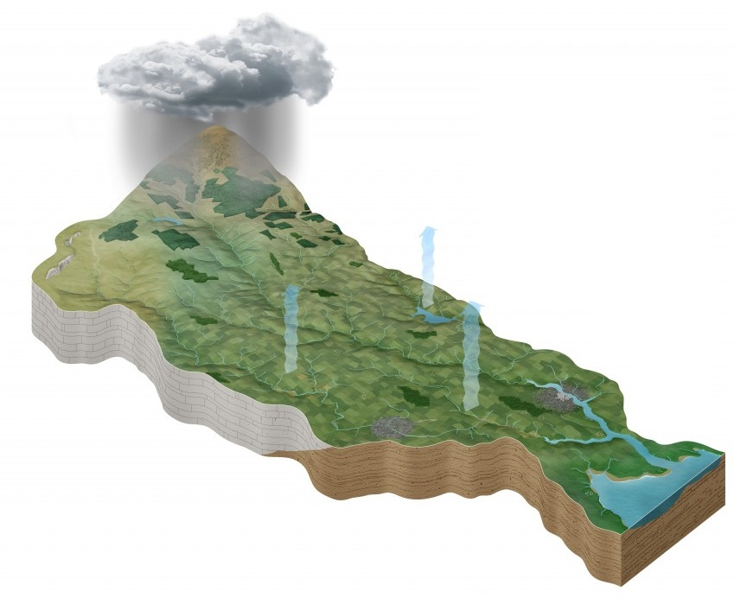
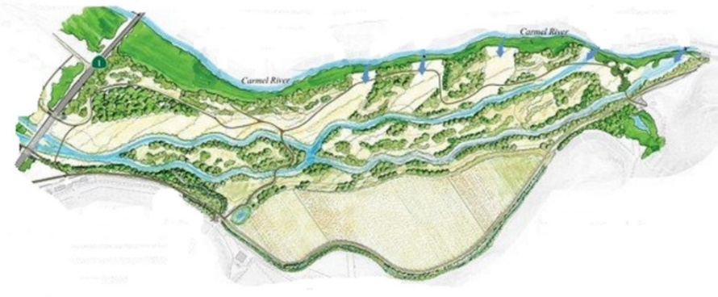
WP 1: Project Management
WP 2: Communication Activities
Danube Floodplain Roadmap
Flood Protection Potential of Local Measures
catchment scale
(Danube)
Synthesis on Project Findings
Assessment of Stakeholders, ESS and Biodiversity
Mapping of
Potential
Floodplains
WP 4
Cost-Benefit Analysis Integrating ESS
WP 3
Upscaling Study of Hydraulic Impacts
Floodplain Management Manual for improving flood risk mitigation
Catchment Potential of Flood Protection
Summary of Floodplain Restoration and Preservation Approaches
WP 5
floodplain
scale
(pilot areas)
Prioritization of Potential Measures
General Floodplain Evaluation Tool
Link to other WP

Slide 11
German contributions – mainly work package 4
Activities
4.1 TUM / NIHWM Assessment of Flood Protection Impact of Floodplain Restoration Measures
4.2 CUEI / TUM Assessment of Stakeholders, Ecosystem Services and Biodiversity on selected Pilot Sites
4.3 TUM / CUEI Cost Benefit Analyses (CBA) of Pilot Sites integrating Environmental System Services (ESS)
4.4 BOKU / TUM Development of the Danube Floodplain Evaluation Tool
Main topics
1D modelling
2D modelling
Biodiversity and ESS
Cost Benefit Analysis
Floodplain Evaluation Method (FEM) and corresponding tool

Slide 12
Main German contributions – TU Munich Hydrology
Scientific:
Connection of 1D-Models in the Danube catchment
Implementation of Ecosystem Services into an extended Cost Benefit Analysis
Transfer of local flood protection effects to a Danube wide strategy
Administrative:
Heading of WP4
Consulting for national 2D hydrodynamic models
Coordinator of activities in the pilot areas
Support of the flood risk strategy of the Danube catchment

Slide 13
Basics
R

Slide 14
Main German contributions – CU Eichstätt-Ingolstadt Floodplain restoration and ecosystem services
Scientific:
Support to prioritize floodplain restoration areas
Development of Ecosystem Services and a habitat model
Recommendation of restoration measures
Support in selecting parameters to apply the Floodplain Evaluation Method (FEM)
Administrative:
Participation in stakeholder analyses
Support in recommendation for priority lists of restoration
Coordination of possible measures to restore and preserve of floodplains in the Danube catchment

Slide 15
The role of Ecosystem Services in the project
Ecosystem services (ES) can help to obtain an overview of the uses of and pressures on an ecosystem, to capture the condition of the ecosystem and to derive recommendations and management options. The ES approach was used:
to identify the ES used in the pilot areas
to estimate the intensity of the use of ES
to mark the location of the used ES in a map
to estimate the change in the intensity of use of ES after the implementation of restoration or flood risk measures

Slide 16
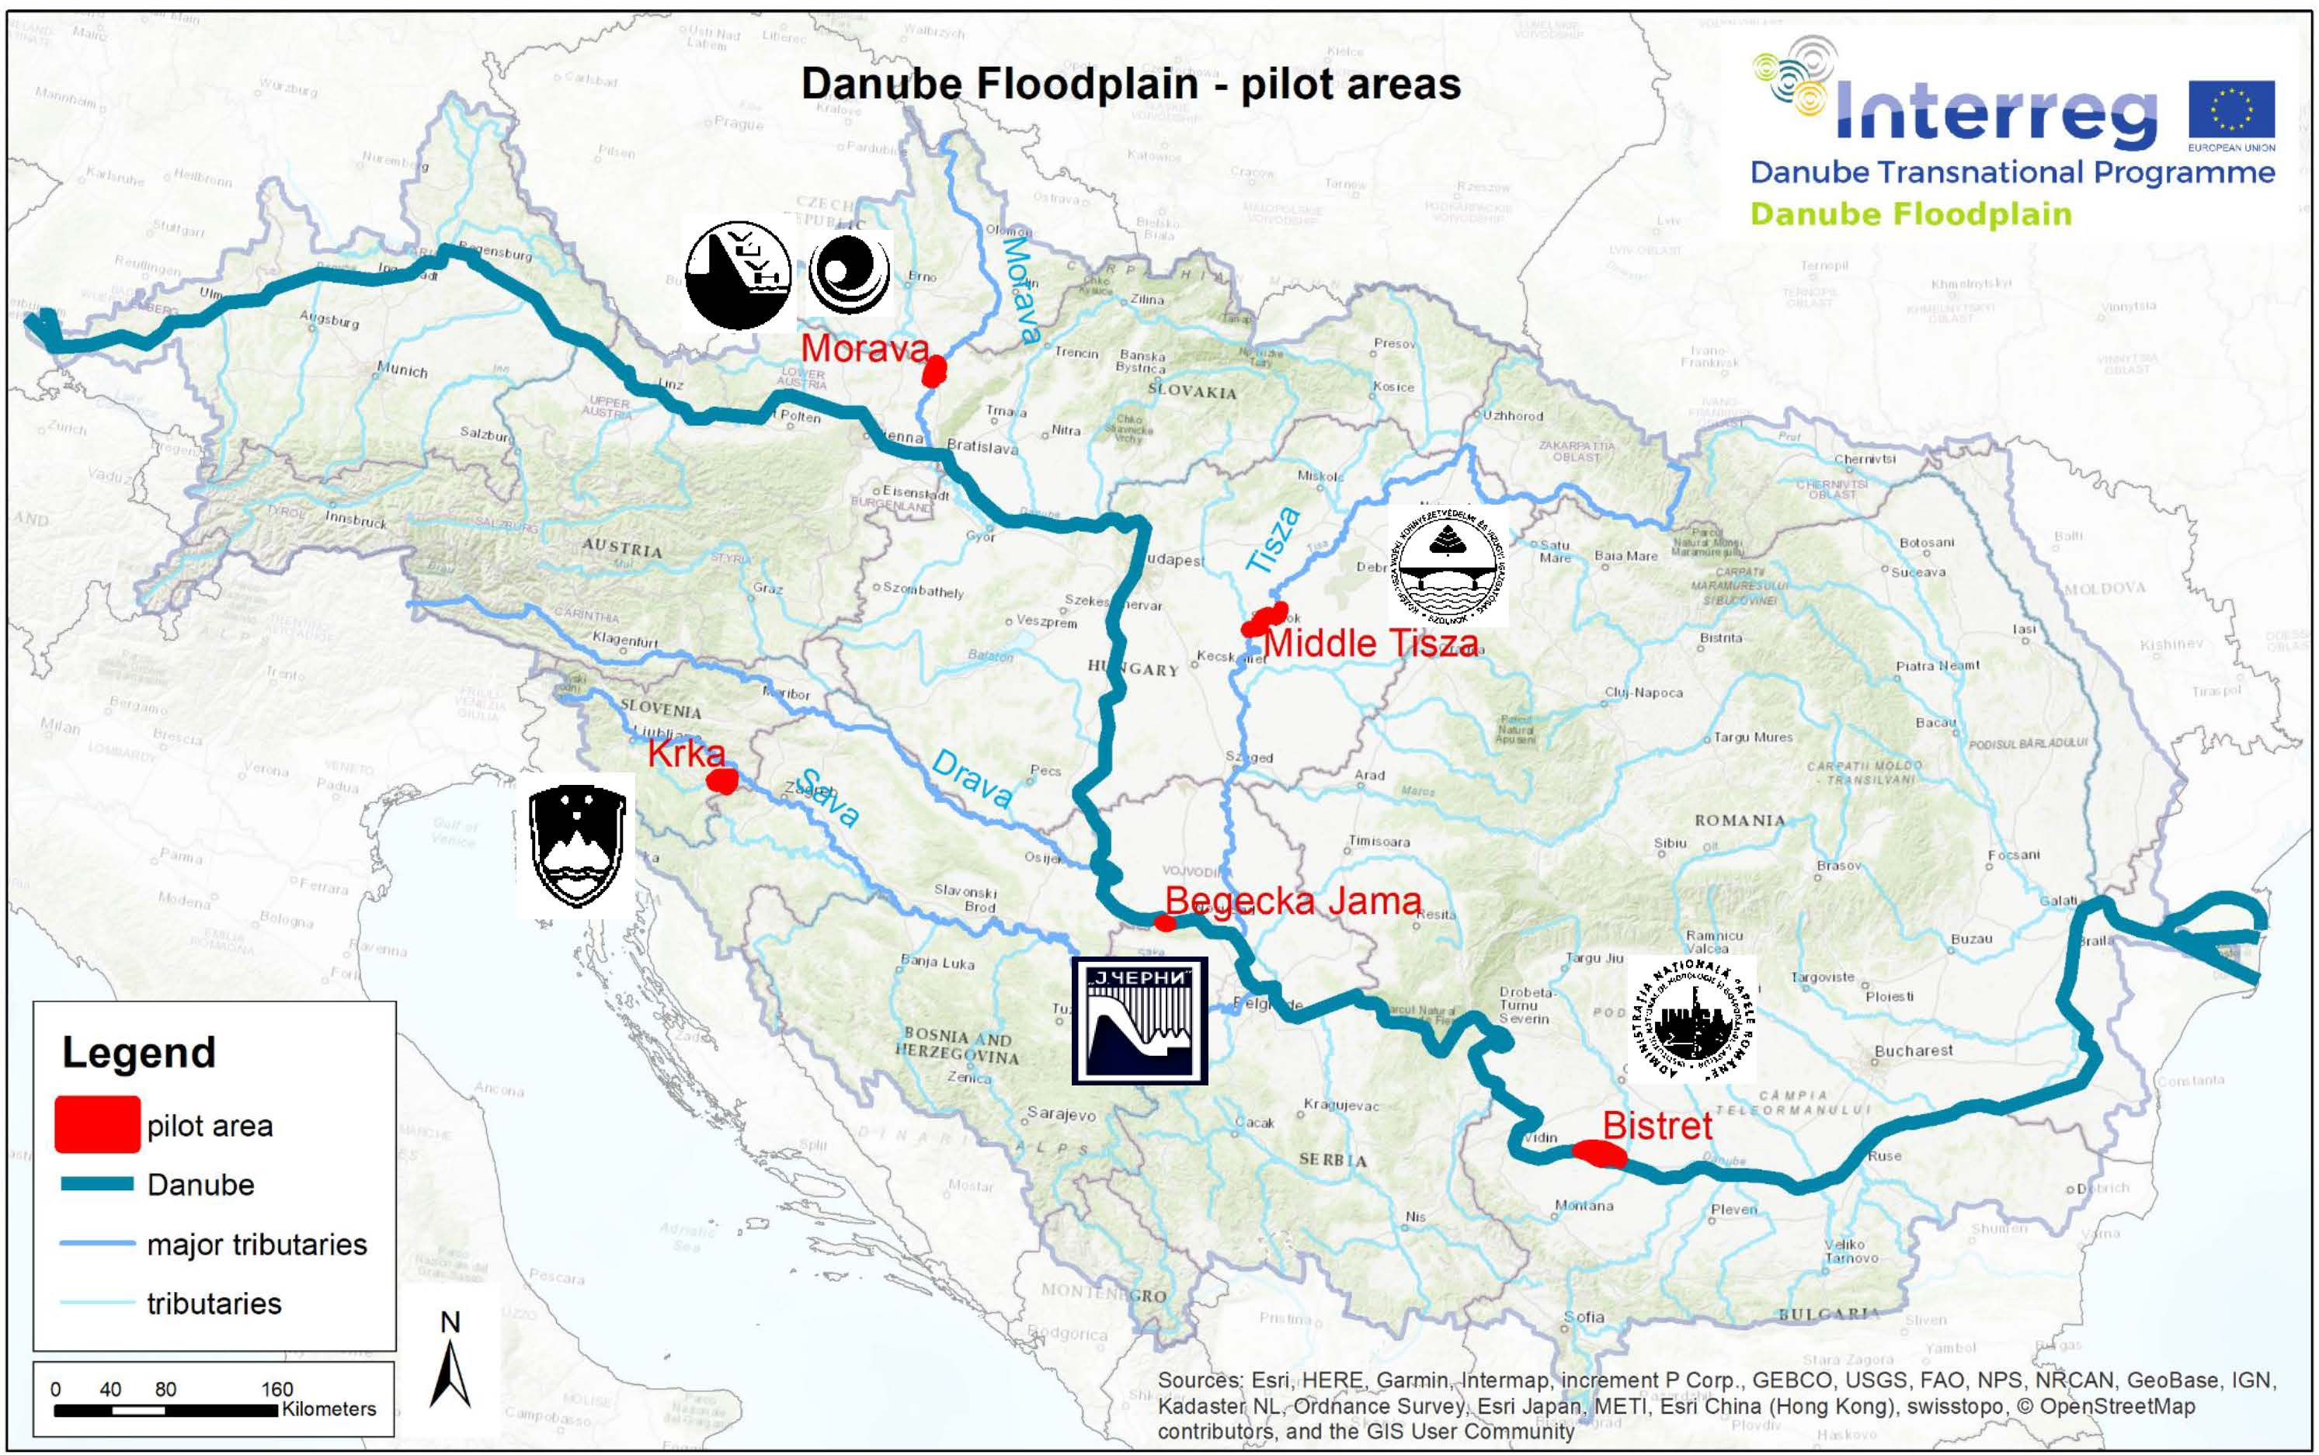
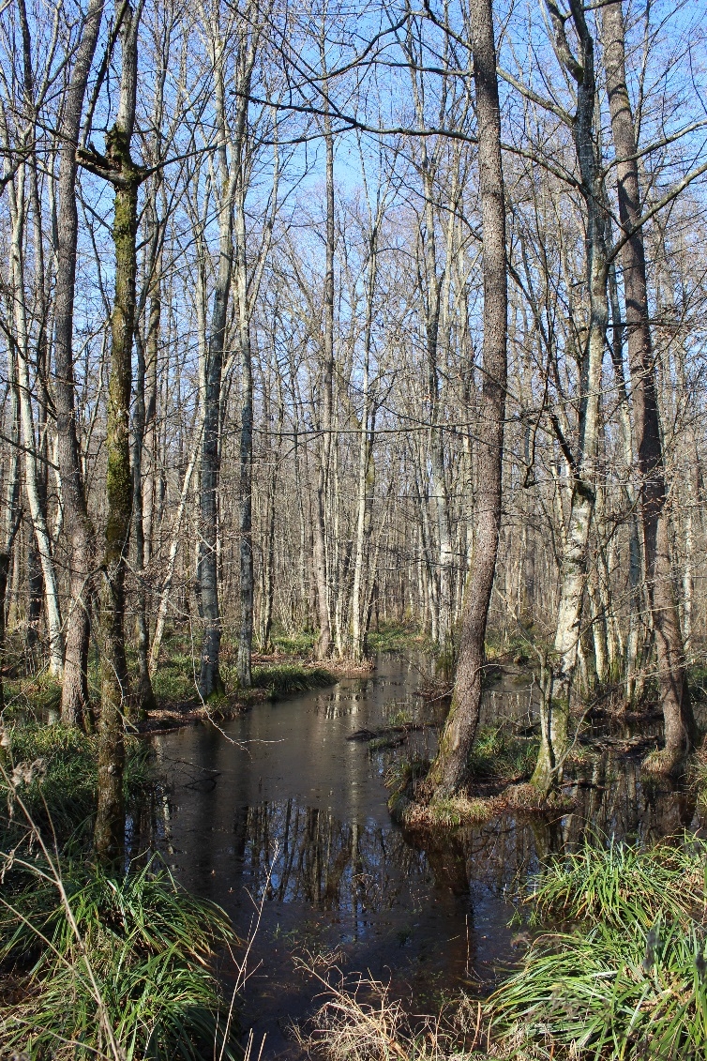
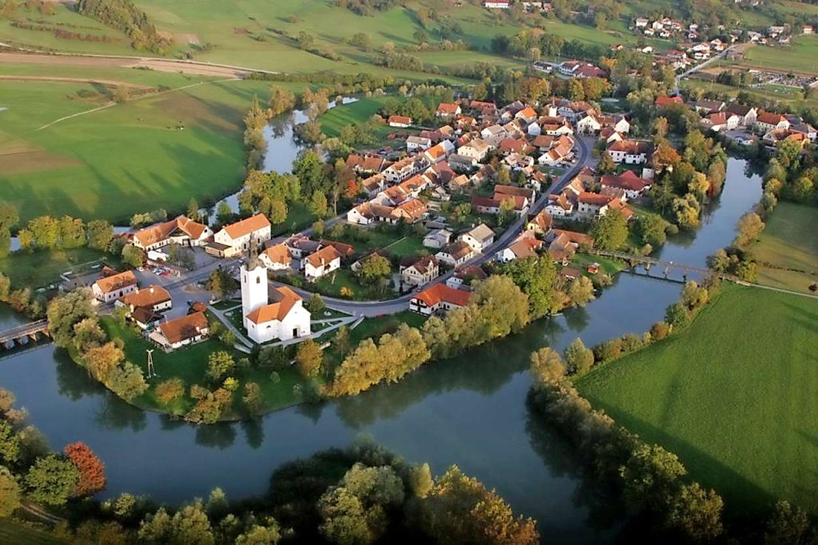
Floodplain Institute Neuburg
Land use/land cover¹ | Area in ha
Urban | 112,08
Croplands | 1150,27
Woodland and forest | 2439,19
Grassland | 347,19
Rivers and lakes | 66,08
¹Copernicus LCLU dataset (Riparian Zones)
Slovenian Water Agency

Slide 17
Ecosystem service class | Identified Ecosystem Services | Definition
Provisioning ecosystem services | agricultural product | A plant foods produced by agricultural cultivation.
 | wood | Wood for heating or creating wood products (furniture, roof trusses)
 | animal product | Products like meat, cold cuts, milk, butter, etc.
 | game meat | Wild game meat obtained by hunting and offered for sale. Wild game can be goose, duck, reer, boar, etc
 | honey | Beehive
 | water | Water for drinking or irrigation from surface water bodies or groundwater bodies
 | fish | Fish for sale, which is produced by professional fishing or aquaculture.
Regulating ecosystem services | high water regulation | The ability of rivers and floodplains to retain or flatten flood waves.
 | air purification | The ability of plants to purify air by assimilation of particulates or harmful gases
 | local climate regulation | The ability of forests and water bodies to influence local temperatures by evaporation or storing of warmness under treetops or in water bodies. In summer months is the air cooled by evaporation, in autumn and spring months the heat is stored and slowly released into the environment.
 | nutrient retention | The ability of floodplains to store nutrients (N,P, C) by uptake into stationary biomass, by deposition as sediments or to decimate by microbial degradation or respiration (in case of C)
 | provision of habitats | Availability of habitats in typical functional and structural quality, which may be used by typical biotic communities of rivers and floodplains, which may then partially be used by humans
Cultural ecosystem services | recreational activities | All activities that take place in the terrestrial and lead to recreation or are carried out as a hobby. These are hiking, cycling, jogging, photography, mushroom collecting, bird watching, hunting
 | education | All activities that lead to further education for oneself or others. These are scientific research, cultural heritage, information events
 | water related activities | All activities that are carried out in or on water bodies and are done as a hobby or to recreate. These are swimming, canoeing, stand up paddling or sport fishing
 | tourism | These can be special places that are visited by tourists or activities that are done by tourists. These can be hotels, thermal baths or sport hunting or fishing.

Slide 18
Thank you for your attention!

