Slide 1
STEPS TO IMPLEMENT OF DIRECTIVE 2007/60/EC IN UKRAINE
AND
PRELIMINARY FLOOD RISK ASSESSMENT
Authors
Kostiantyn Danko, Yurii Nabyvanets, Yuliia Filippova, Viktoriia Korniienko, Oleksandr Lobodzinskyi, Kateryna Surai, Andrii Malyshev, Kostiantyn Sokolchuk
Kyiv, 05-08 November 2019

Slide 2
Implement of Directive 2007/60/EC (Flood Directive) in Ukraine is part of a global reform of the implementation of integrated water resource management based on the basin principle.
This reform has been introduced in Ukraine after Association Agreement between the European Union and the European Atomic Energy Community and their member states, of the one part, and Ukraine, of the other part"
Flood Directive implement steps;
2. Ukrainian experience of preliminary flood risk assessment.
Only from 2000 year more than 280 emergency flood events were in Ukraine:
Losses from floods – 6 203 750 ₴ or 228 079 €;
Expenses for liquidation flood events with adverse consequences – 65 419 925 ₴ or 2 405 144 €;
People died – 91 people;
Children died – 11 people;
Rescued people – 4266 people;

Slide 3
Flood Directive implement steps:
IMPLEMENTED
- changes Ukrainian Legislations (changes of Water Code of Ukraine);
- identification of the appropriate competent authority (Ministry of Interior of Ukraine, The State Emergency Service of Ukraine)
- development normative acts (Methods of preliminary flood risks assessment (PFRA); Methods of development flood risk maps and flood hazard maps; Template of flood risk management plan (FRMP);
preliminary flood risks assessment (for 9 River basin districts of Ukraine (RBD)).
IN DEVELOPMENT NOW
flood risk maps and flood hazard maps (for 9 RBD);
flood risk management plans (for 9 RBD in 2022).

Slide 4
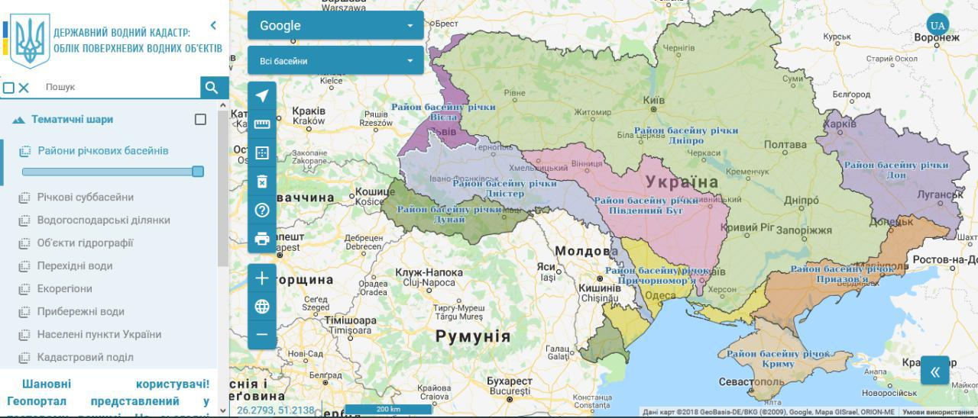
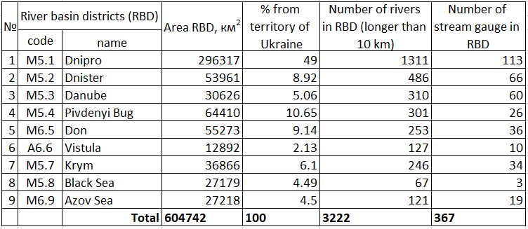
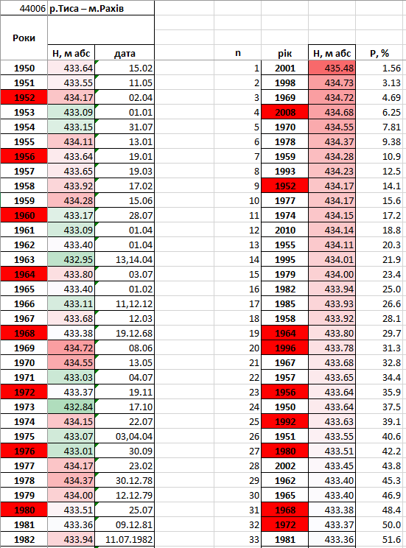
2. Ukrainian experience of preliminary flood risk assessment
Preliminary flood risks assessment consist from analise:
Database of flood emergency of The State Emergency Service of Ukraine (SESU) - from 2000 year more than 280 emergency flood events;
Database of monitoring of hydrological phenomena of Ukrainian Hydrometeorological Center (UHMC) – 1698 flood events from the beginning of hydrological monitoring$
Database of rivers high water levels of Central Geophysical Observatory named after Boris Sreznevsky (CGO) – data of 367 stream gauge.

Slide 5
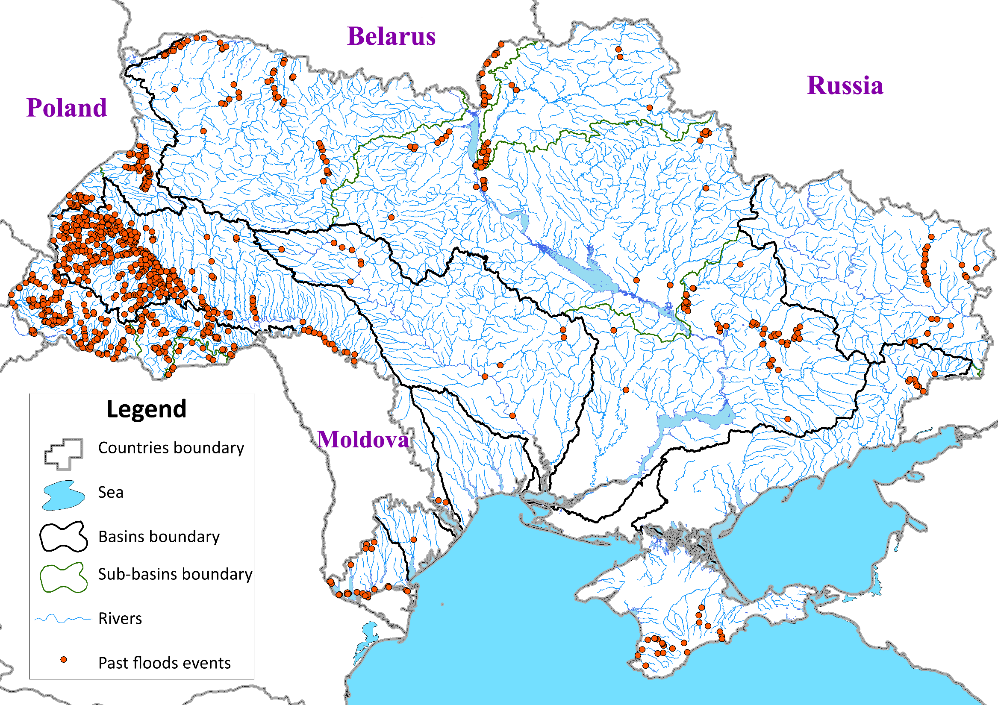
Past significant floods
Analysis of the database determinate 899 of flood events with sings of an emergency.
In Danube RBD were 247.

Slide 6
The value of potential flood risk included combination of the level of flood emergency situation and the probability of flood event. We use risk matrix for this calculations.
Consequences (C) | Probability (P)
 | Low (0,2%) floods which can occur once per 500 years | Medium (1%) floods which can occur once per 100 years | High (10%) floods which can occur once per 10 years or more often
Severe effects | Medium risk (3) | High risk (4) | Very high risk (5)
Moderate effects | Low risk (2) | Medium risk (3) | High risk (4)
Minor effects | Insignificant risk (1) | Low risk (2) | Medium risk (3)
Consequences of flood event | Description
Minor effects | flood event which could be classified at least as object level of emergency situation connected with flooding
Moderate effects | flood event which could be classified at least as local level of emergency situation connected with flooding
Sever effects | flood event which could be classified at least as regional or state level of emergency situation connected with flooding

Slide 7
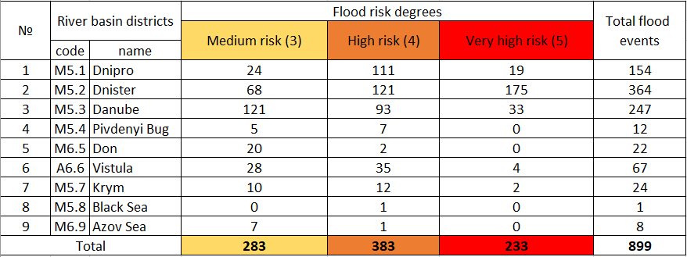
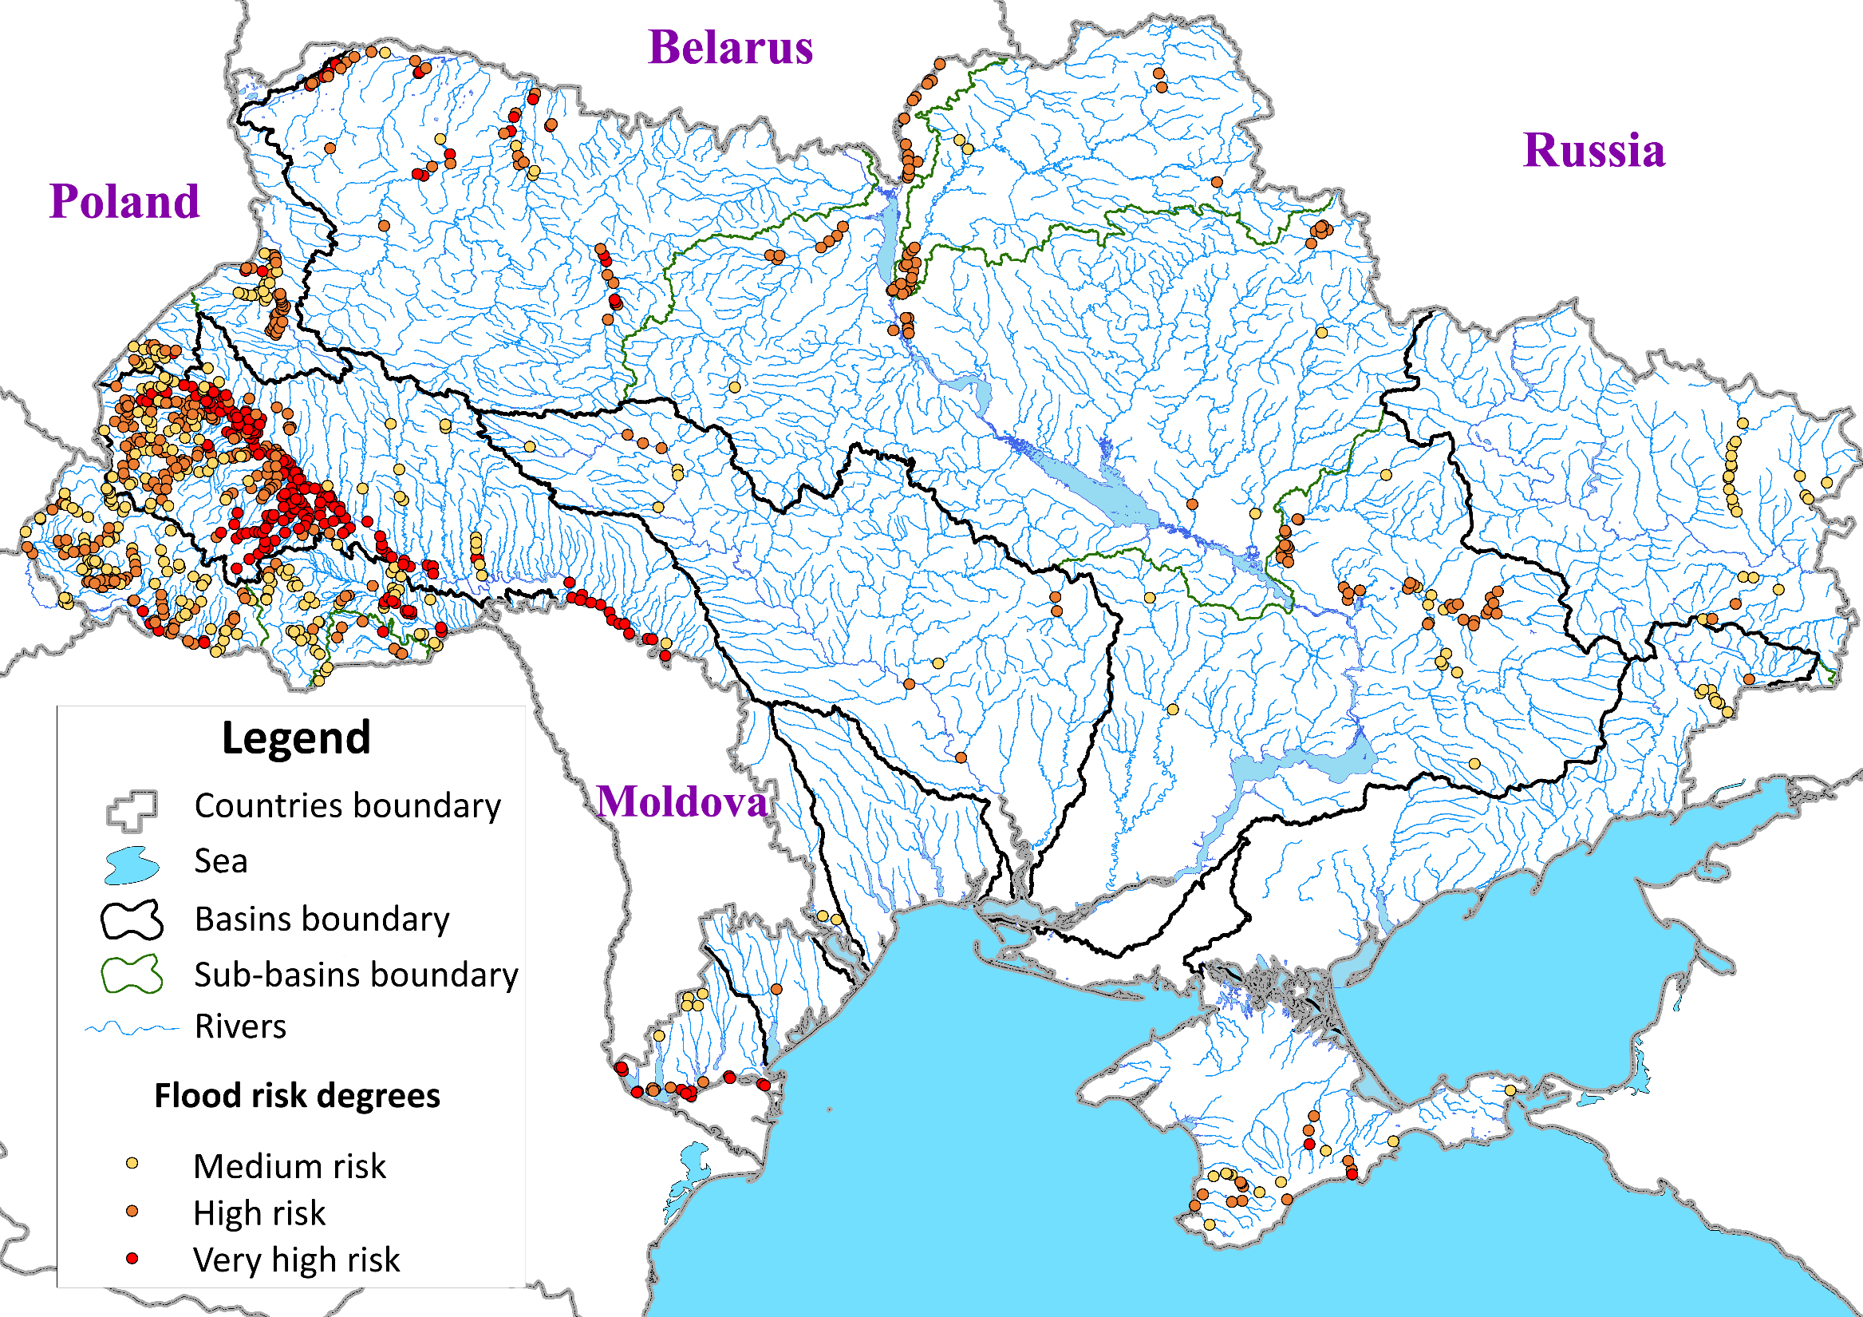
Potential flood risk
Of the 899 of flood in Ukraine were determinate 233 potential flood with very high flood risk degree.
In Danube RBD 33 very high flood risk degree.
Of all the flood events with high flood risk degree most of all determinated in Dnister RBD – it is 175 potential flood risk

Slide 8
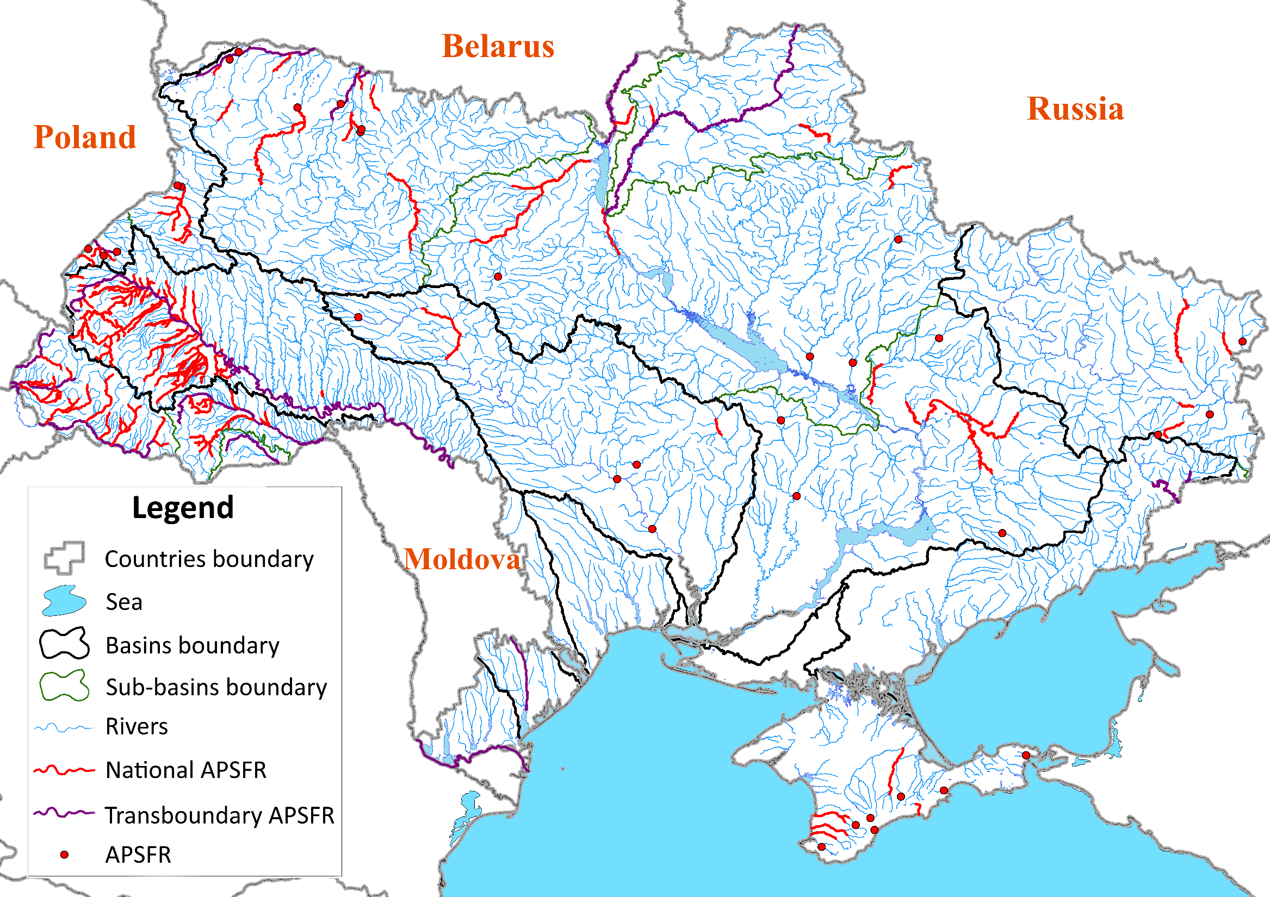
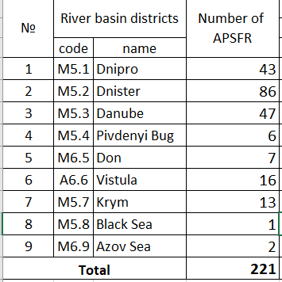
Identification of APSFR
On the basis of analysis of significant past floods and significant potential floods 221 APSFRs were identified in Ukraine (one river - one APSFR or one settlement - one APSFR)
Linear APSFR - 188 (with total length 8748 km)
Point APSFR - 33

Slide 9
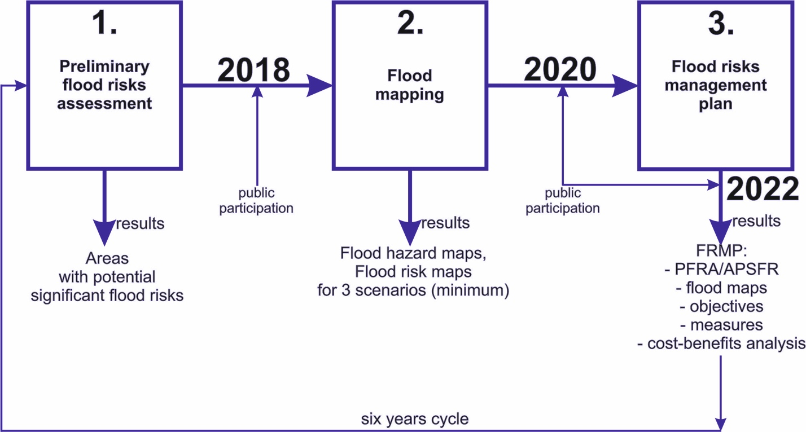
Flood mapping and flood risk management plans
Now we are developing flood risk maps and flood hazard maps;
We are beginning to develop flood maps for Dnister RBD, because there are the most of APSFRs and the most of potential flood risks in Ukraine.

Slide 10
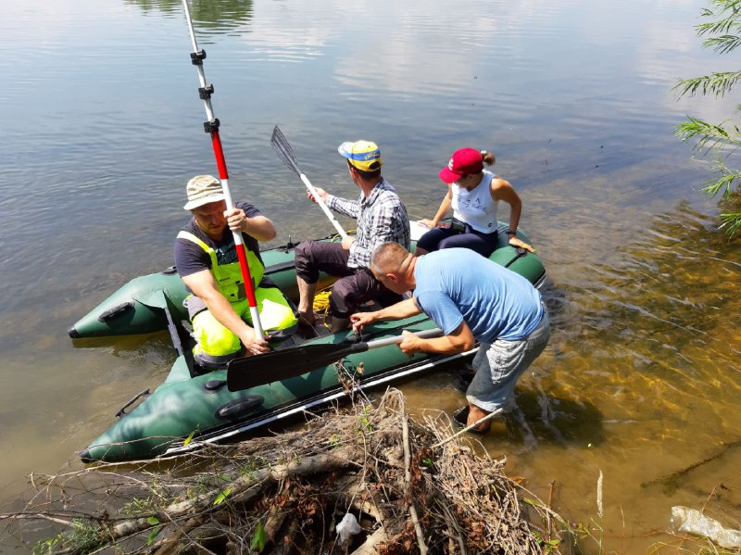
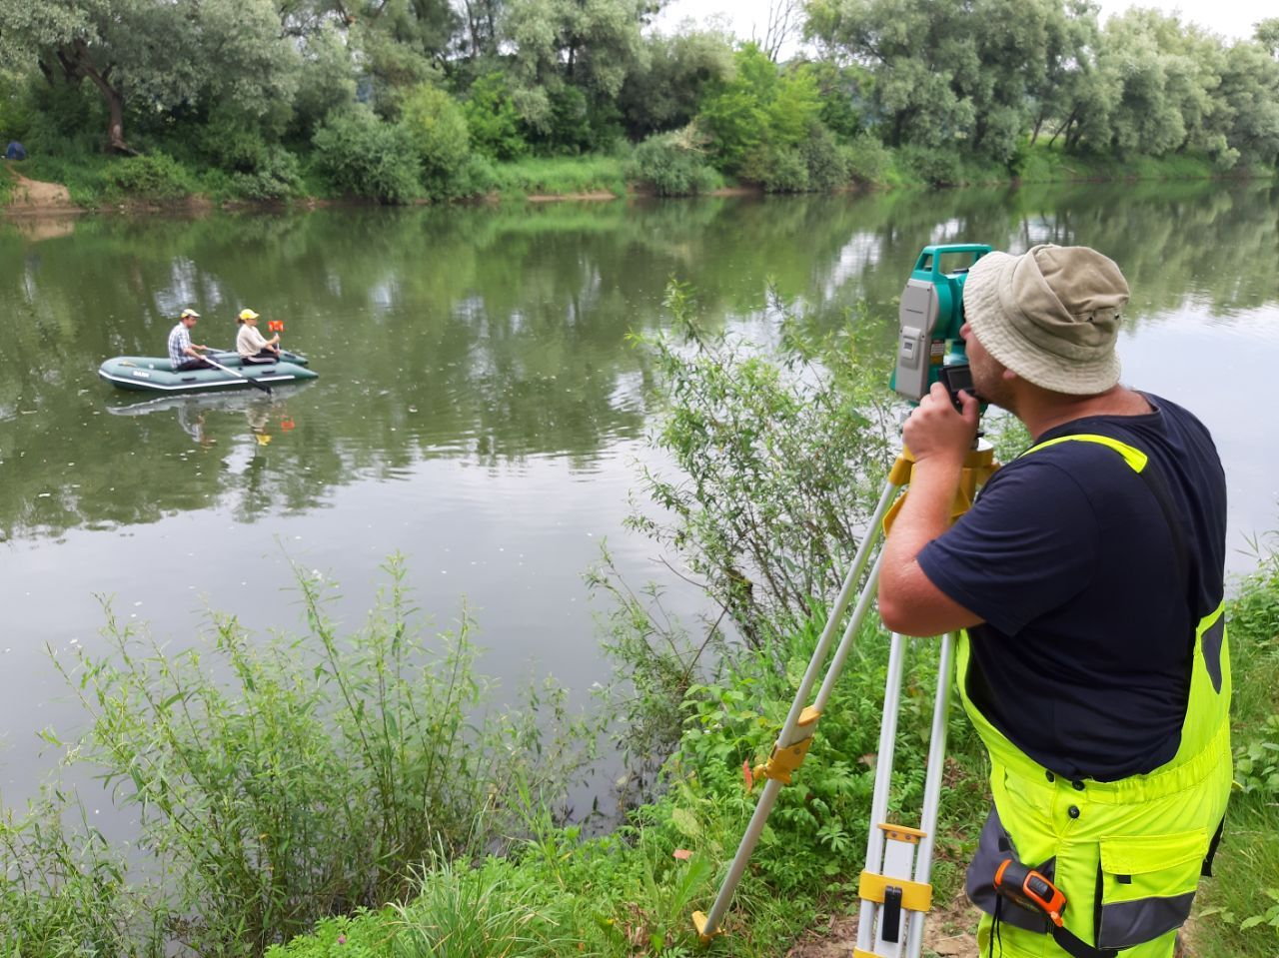
Thank you for attention!!!

