Slide 1
MODELLING WATER QUALITY UNDER CHANGING CONDITIONS
IN A NORDIC CATCHMENT
Csilla Farkas, Marianne Bechmann, Eva Skarbøvik
NIBIO, Norwegian Institute of Bioeconomy Research
Danube Conference 2019, Kyiv, Ukraine
6 November 2019.

Slide 2
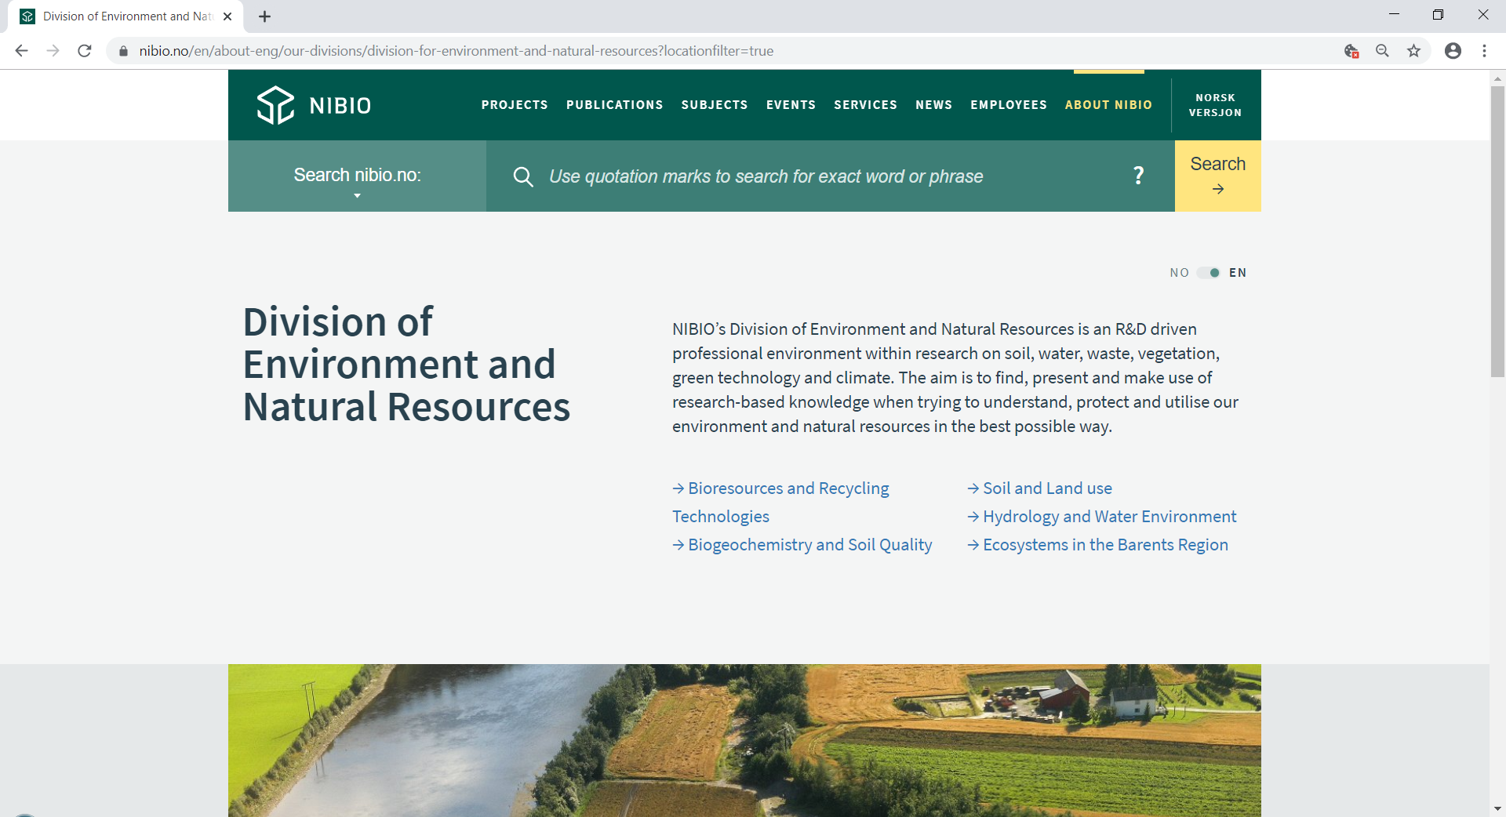
Norwegian Institute of Bioeconomy Research

Slide 3
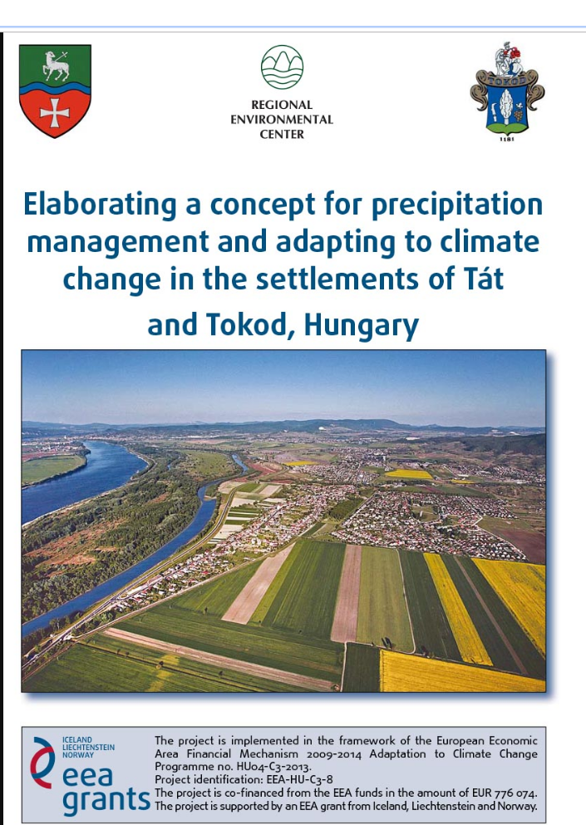

Slide 4
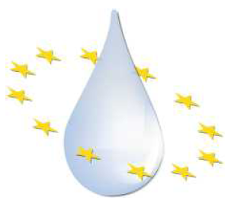
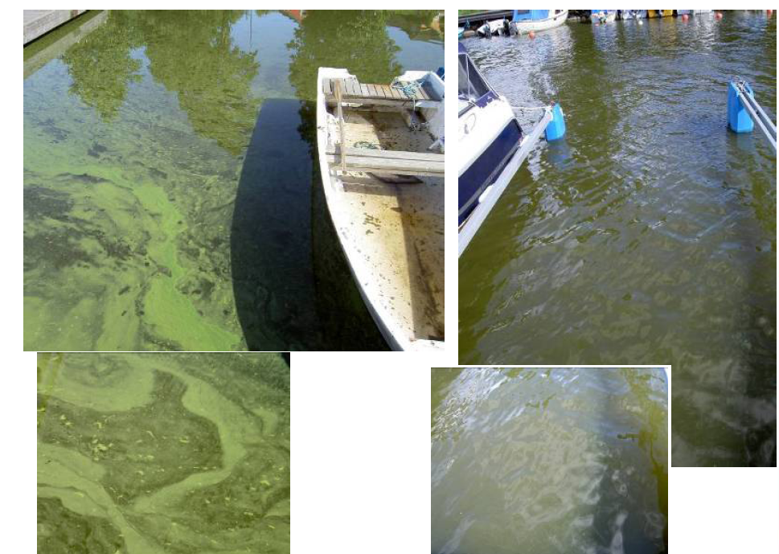
Challenges in implementing WFD in Norway
Eutrofication is usually the main cause
for not fullfilling the requirements for good
water quality in agricultural areas
WFD
  In South-Eastern Norway
  > 30% of the water bodies are characterized as being at risk or possibly at risk
  45% of the anthropogenic P input to Norwegian surface water originates
  from agricultural areas
  The natural background flux of P is estimated to be around 20-25% in the form of dissolved natural organic matter

Slide 5
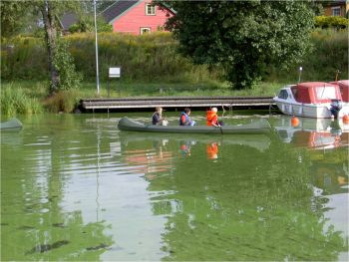
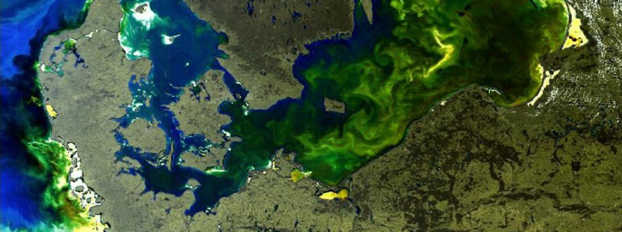
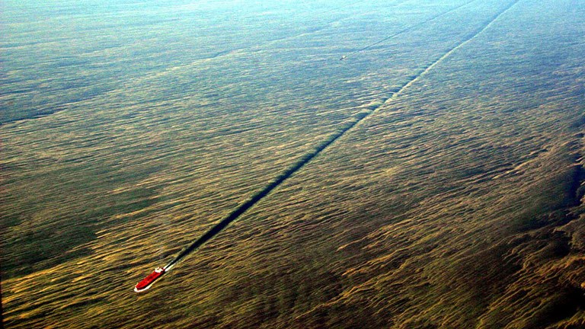
Water quality problems in the Nordic countries
marine ecosystems
freshwater ecosystems
Photo: E. Skarbøvik, NIBIO
An algal bloom in the Baltic Sea. satellite image: HZG
Baltic algae blooms in 2005. Photo: Kustbevakningen

Slide 6
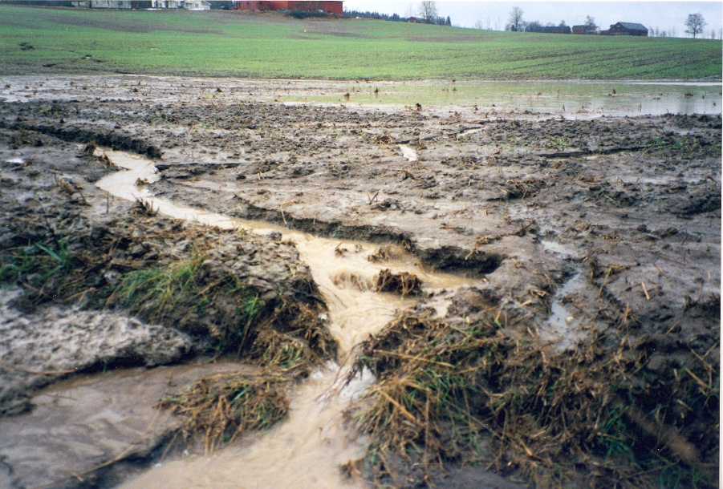
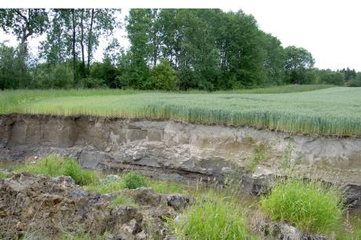
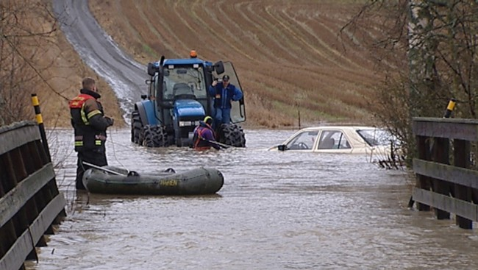
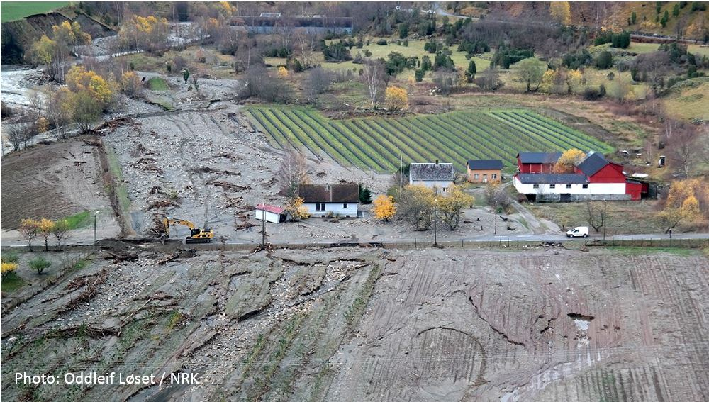
Extreme hydrological situations and soil loss
Photo: E. Skarbøvik, NIBIO
Photo: NIBIO

Slide 7
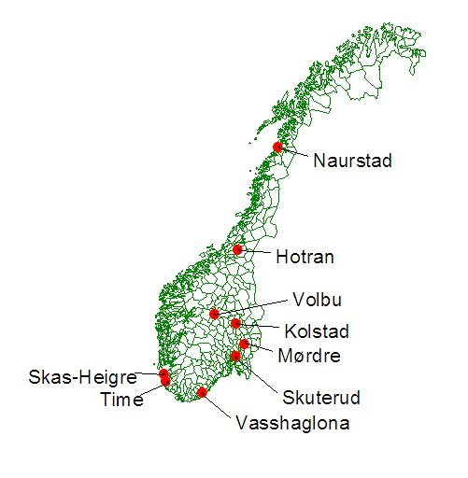
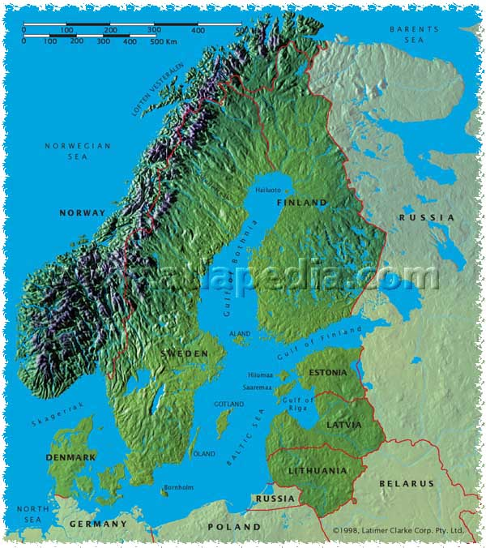
Environmental monitoring program in Norway (JOVA)
JOVA: measurements runoff, nutrient and soil loss
from agricultural dominated catchments under
various cropping systems, climatic conditions,
soil types and hydro-geological conditions
Discharge measurement (hourly)
Water sampling and analysis
(SS, N_{tot}, P_{tot}, others )
Composite sampling approx.
every 14 days
JOVA started at the initiative of MOE, MOA and EPA-Norway in beginning of 90’s

Slide 8
Our main goals are:
To quantify the sources of soil particle and phosphorus losses
Identify possible cost-effective measures to reduce loadings of
soil particles and nutrients under changing conditions

Slide 9
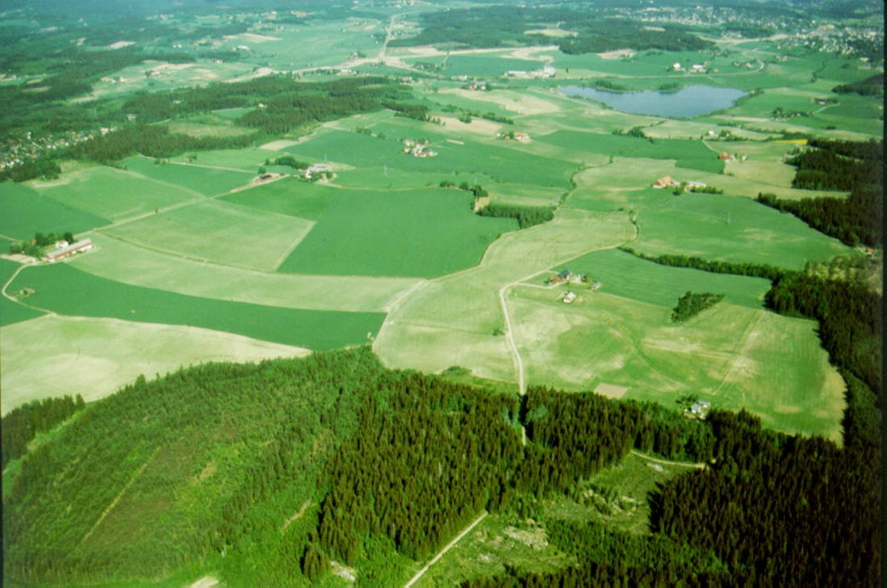
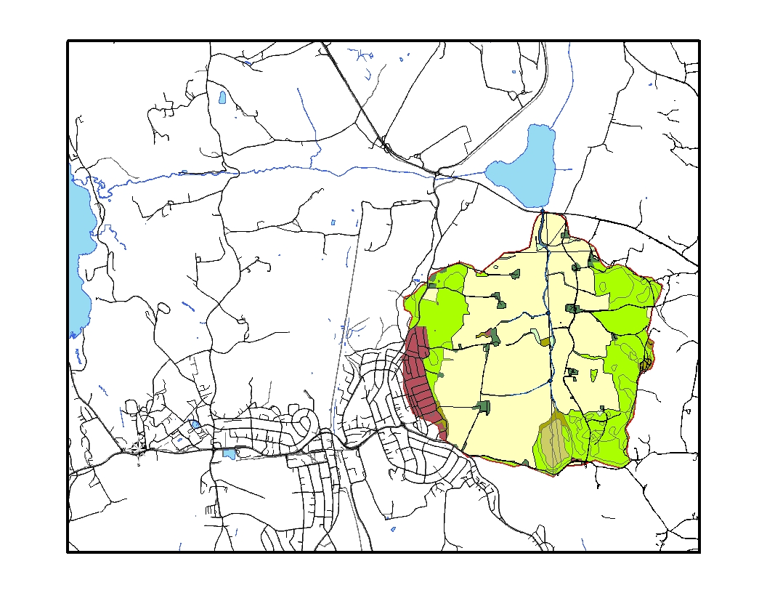
Skuterud catchment
Total area: 4,5 km²
Arable land: 2,7 km² (60 % of total area)
Forest: 1.3 km² (31% of the total area)
Grain crops dominating (80-90 %)
Subsurface drainage system
  Spacing, L= 8 – 10 m
  Depth, d = 0.80 – 1.00 m
Data since 1993
  Detailed data available on farm management practices
  Runoff, nutrient and soil loss
  Climatological data IMT, LMT
  Soil data available (S&L)
Østensjøvannet
Monitoring station
Årungen
Skuterud

Slide 10
The INCA-P model
INCA-P model:
    process-based
    semi-distributed model of the sediment and P transport in the
    dynamic catchment and river system
Catchment hydrology:
    direct runoff
    soil zone
    groundwater zone
INCA-P simulates at a daily time-step
    water flow and storage
    sediment and P loads from different land-use types
    in-stream SS, total, particulate and dissolved P concentrations

Slide 11
Application of the INCA-P model in the
Skuterud catchment
  Parameterisation
    Available data from the Skuterud catchment and reach
    Literature review
    Expert assumptions
    Calibration procedure
    Stepwise calibration approach (flow; SS&TP)
    flow flow&SS&TP
    Validation procedure
    Scenario analyses

Slide 12
Application of the INCA-P model in the
Skuterud catchment
  Warming up period: 1 September, 1993 – 31 December, 1993
  Calibration period: 1 January, 1994 – 31 December, 1999
  to set up the parameters for all the land use types
  Validation period: 1 January, 2000 – 31 December, 2007
  Land use types:
    Forest (31%)
    Grass (2%)
    Arable, No Autumn Tillage (18%)
    Arable, Autumn Tillage (41%)
    Urban (8%)

Slide 13
Reference data for land-use specific sediment loss from

Slide 14
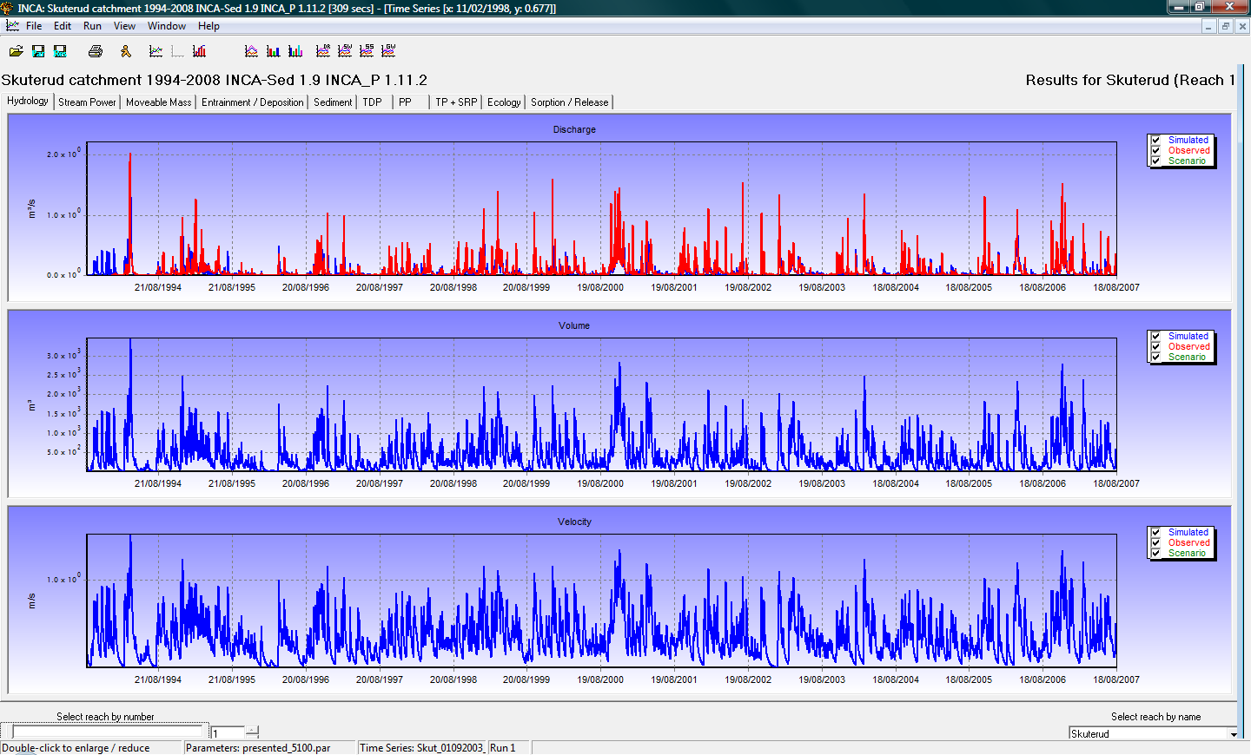
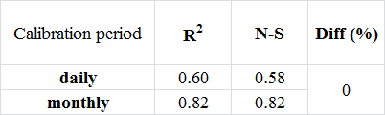
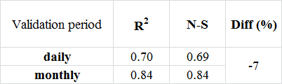
INCA-P model calibration results - hydrology
Calibration period
Validation period

Slide 15
INCA-P model calibration results – sediment and TP

Slide 16
Site-specific climate scenarios - selection
KNMI
DMI
ICCP Project
Ensemble Project
Mean annual temperature (Cº)
SMHI
present
Yearly precipitation sum (mm)
Reference period: 1930 - 1960
Study period: 2030 - 2050

Slide 17
Simulated impact of the projected climate change
in case of no change in present land use
flow
suspended sediment
TP
Present climate
C1 –C6: selected climate scenarios

Slide 18
Implementing land use scenarios in the INCA-P model
Fertilisation ( 50 % increase/decrease)
Land use (crop field changed to a) grassland b) vegetables, c) forrest)
Soil management (different areal proportion of autumn and spring tillage;
sawing and harvesting dates)

Slide 19
INCA-P model: results for changes in
land use / soil management

Slide 20
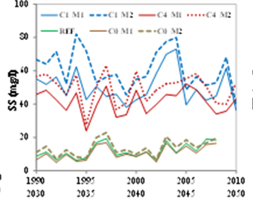
Simulated impact of the projected climate change for present land use (REF) and two management scenarios (M1, M2)
suspended sediment
C0: present climate
C1, C4: selected climate scenarios

Slide 21
Conclusions
The INCA-P model was capable to simulate the flow, sediment and P transport in the pilot catchment
It is important to use all the available expert-based information while calibrating simulation models (reference data for sediment losses from diff. land use areas in this case)
The land use / soil management scenarios, considered in this study can not mitigate the effects of future climate changes
Further efforts are needed to ensure good water quality in the future: Innovative measures for increasing water/soil retention in the landscape

Slide 22
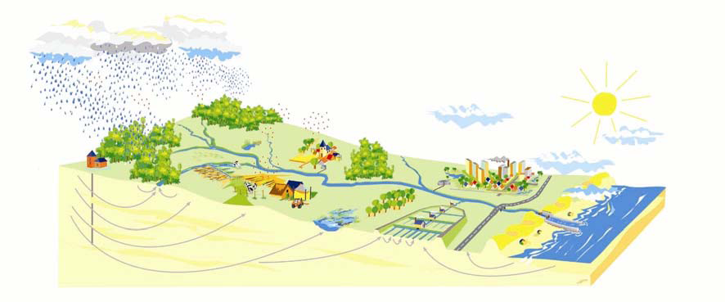
Where can we apply measures?
Extreme event
Forest
Urban solutions
Rural areas
Stream

Slide 23
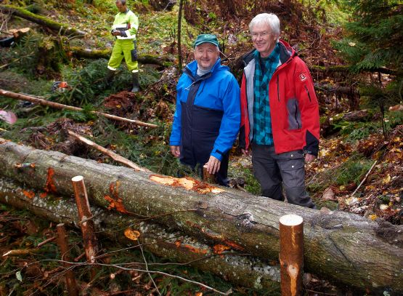
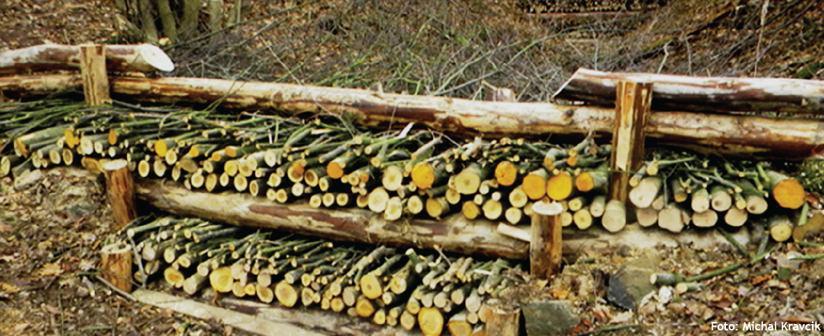
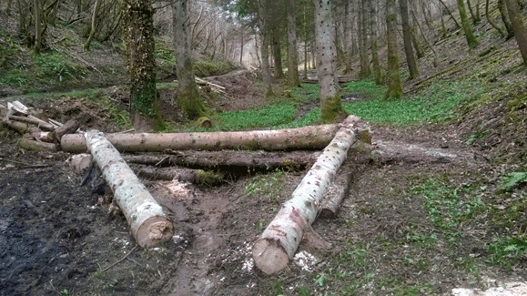
Measures in the forest

Slide 24
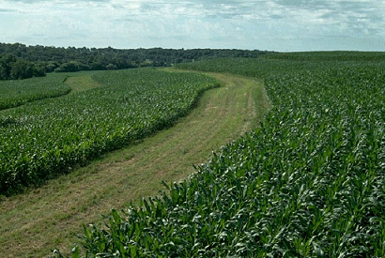
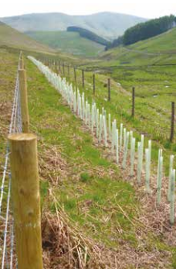
Measures in rural areas

Slide 25
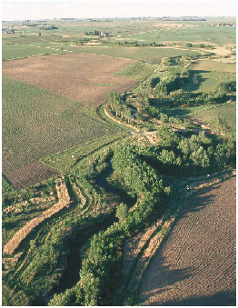
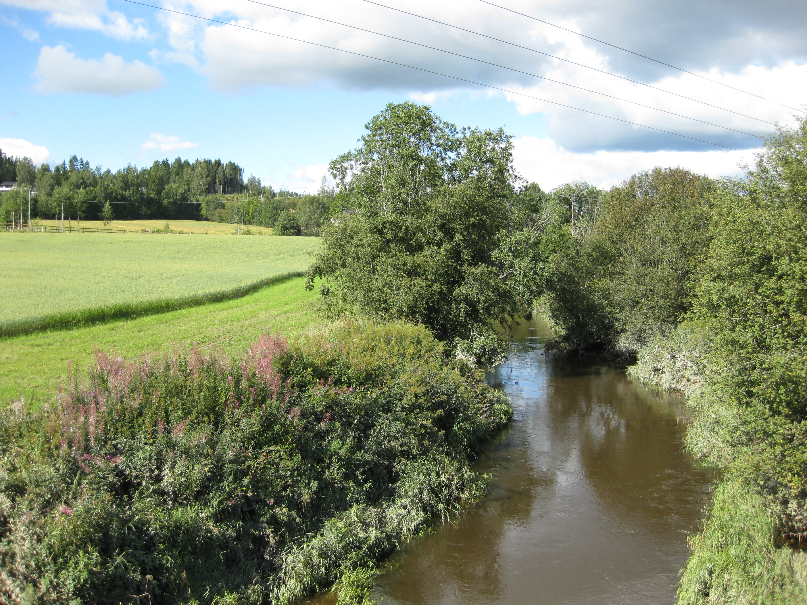
Measures in the stream
Photo: E. Skarbøvik, NIBIO

Slide 26
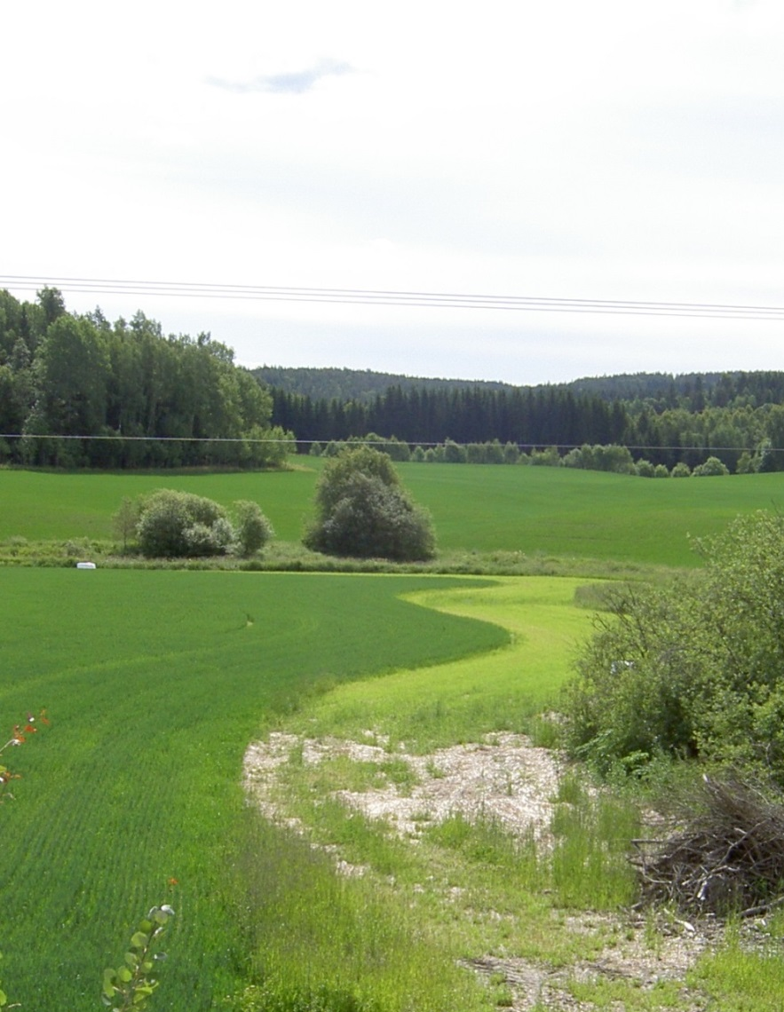
Measures to reduce peak flow and nutrient runoff
Water retention in the forest
Water retention ponds
Fertilization planning
Reduced tilling
Buffer strips
Grass covered waterways
Sedimentation ponds
Restauration of streams
Tile drainage maintenance
Measures for point sources
Land set aside as flooding area
Improved soil infiltration capacity
Photo: E. Skarbøvik, NIBIO

Slide 27

Thank you for the attention!

