Slide 1
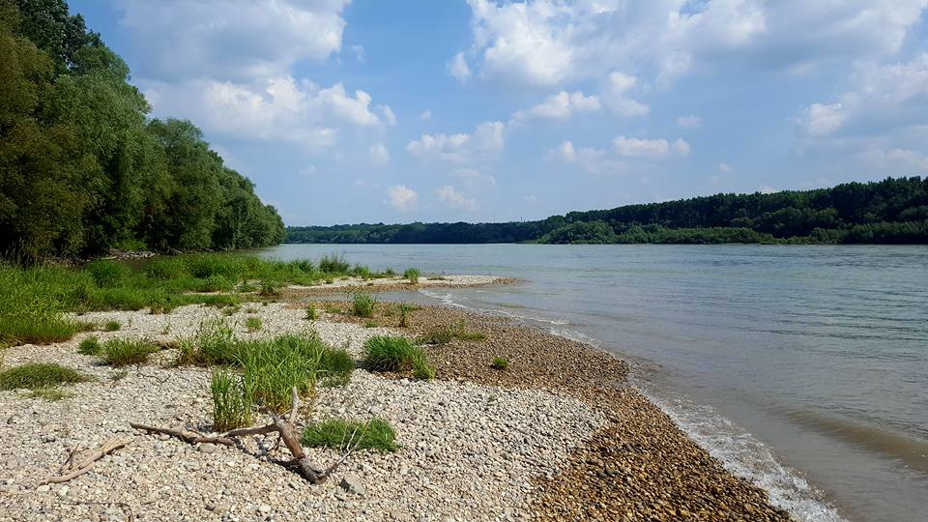

DanubeSediment
Danube Sediment Management – Restoration of the Sediment Balance in the Danube River
• SEDIMENT ALTERATION – A SIGNIFICANT WATER MANAGEMENT ISSUE IN THE DANUBE RIVER BASIN
Helmut Habersack, Marlene Haimann, Philipp Gmeiner, Sandor Baranya, Katarína Holubová,
Florin Vartolomei

Slide 2
Main objectives of DanubeSediment
To propose a transnational sediment monitoring network
To establish for the first time the sediment budget for the Danube River considering the input of the most important tributaries as well,
To identify reaches with surplus and deficit, river bed aggradation and degradation, sediment-related problems in flood risk management, hydropower generation, navigation, ecology
To gain knowledge and better understanding of sediment transport and morphodynamic processes
To develop a Danube Sediment Management Guidance (DSMG) and a related Sediment Manual for Stakeholders (SMS)

Slide 3
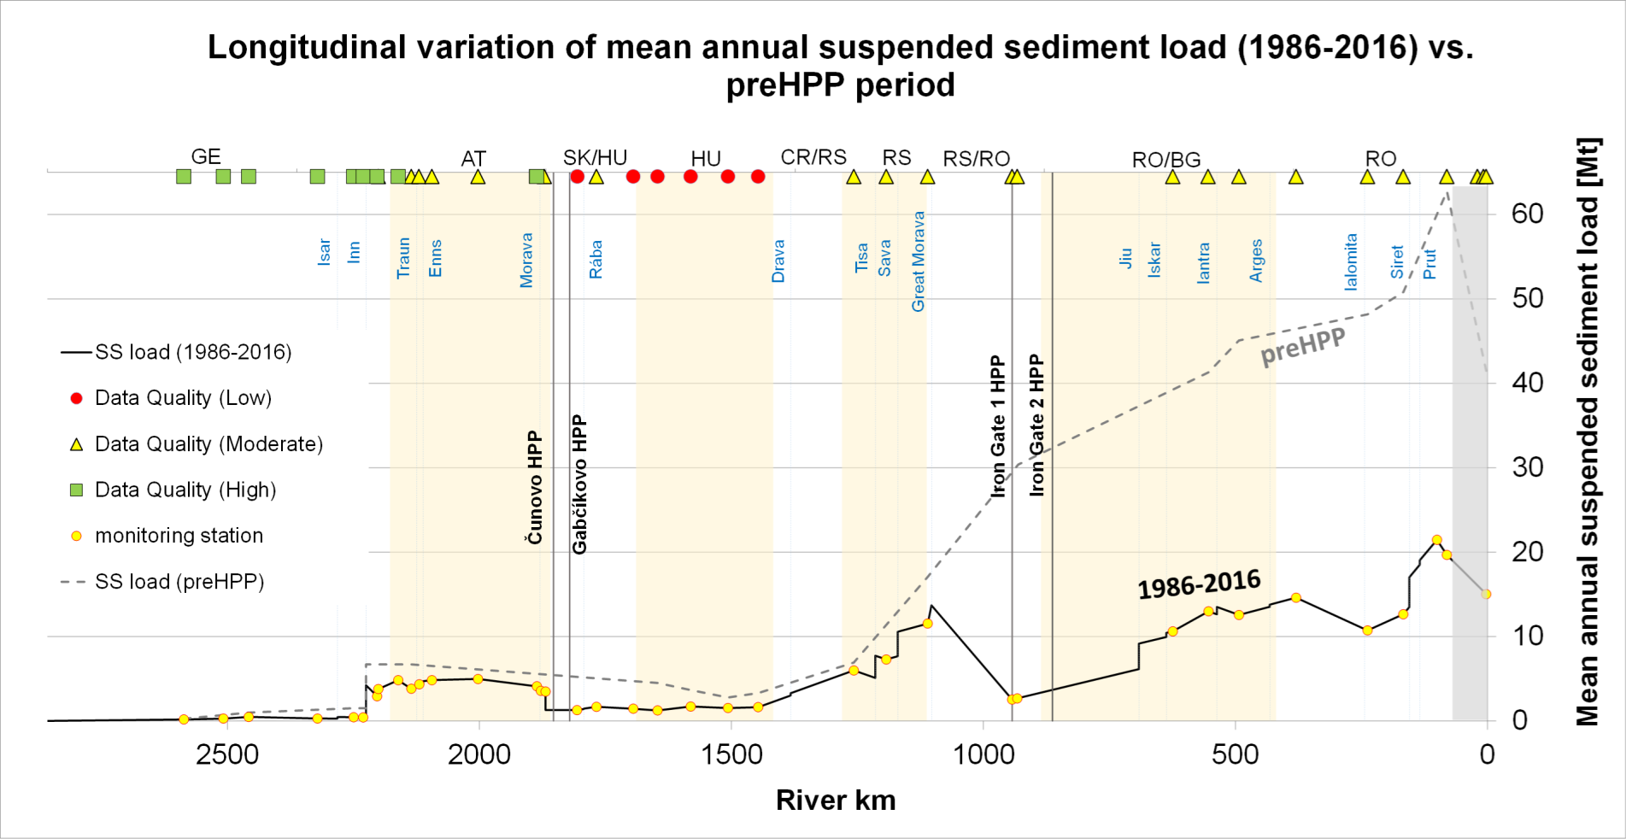
Sediment deficit
(DanubeSediments, 2019)
→ Reduction of sediment input to Black Sea by about 60 %

Slide 4
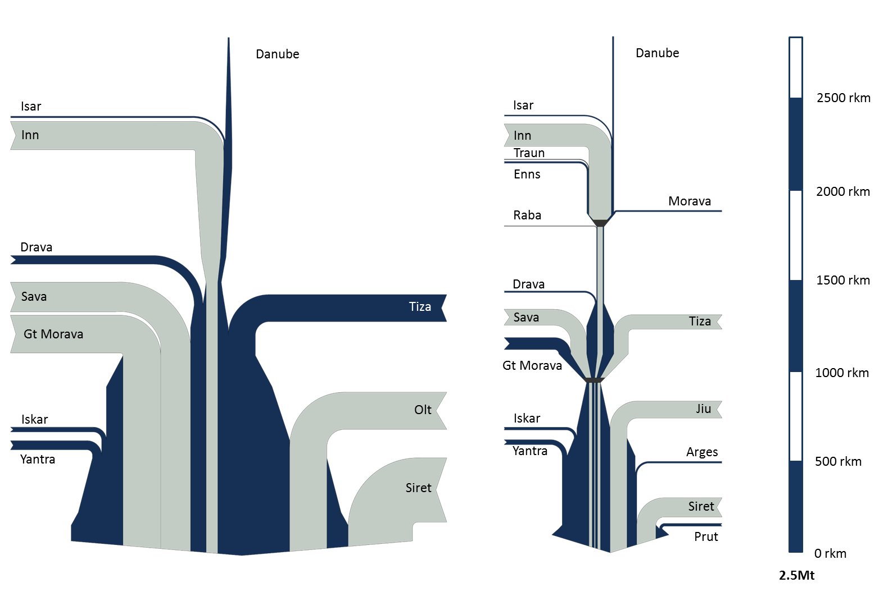
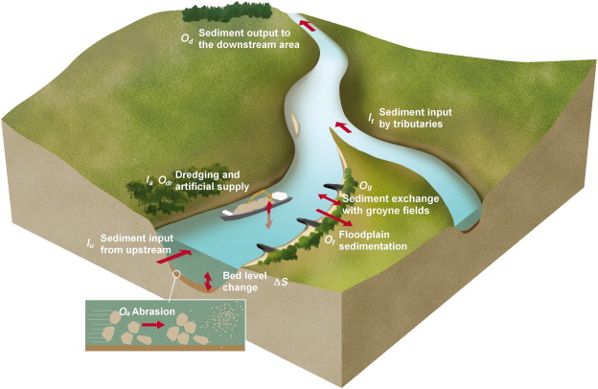
Sediment (Dis)balance
Historic situation
Existing situation
Sediment budget:
(based on Frings et al., 2014b)
(DanubeSediments, 2019)

Slide 5
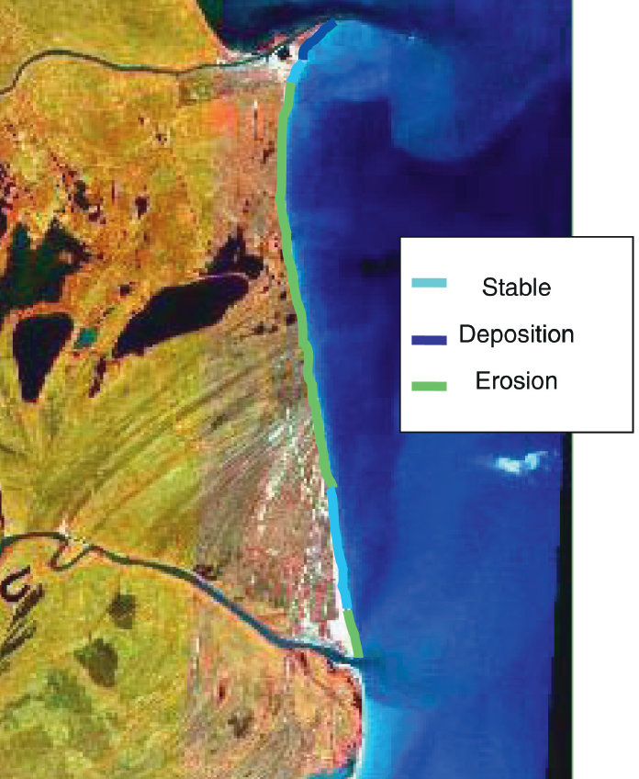
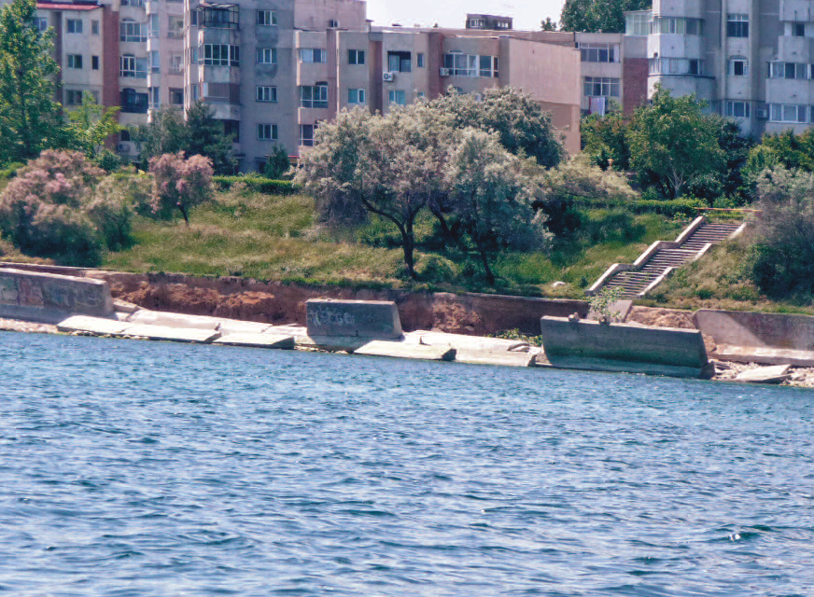
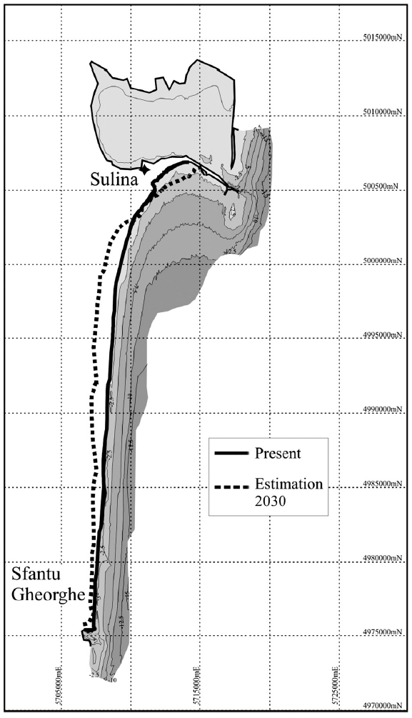
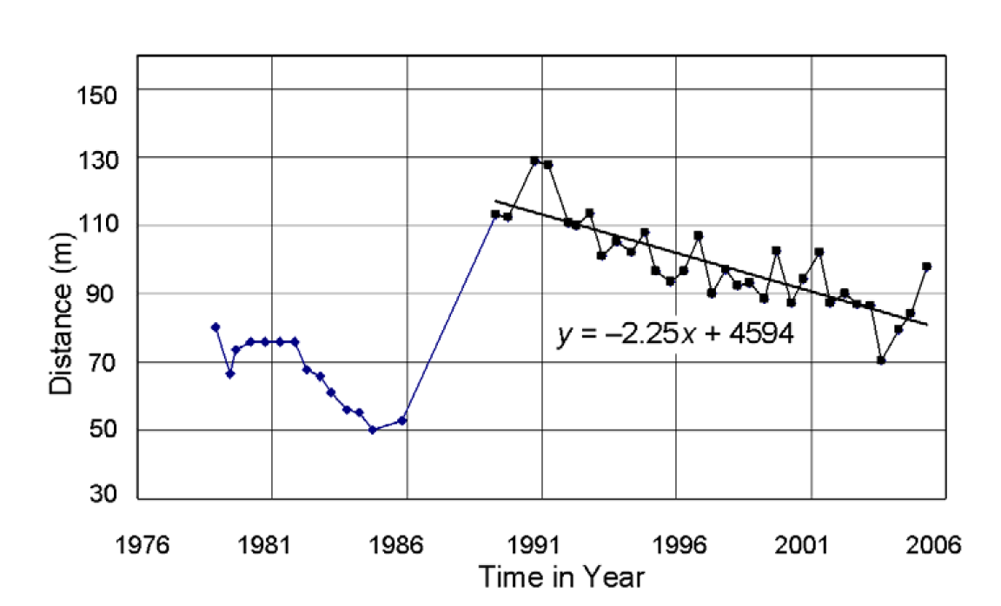
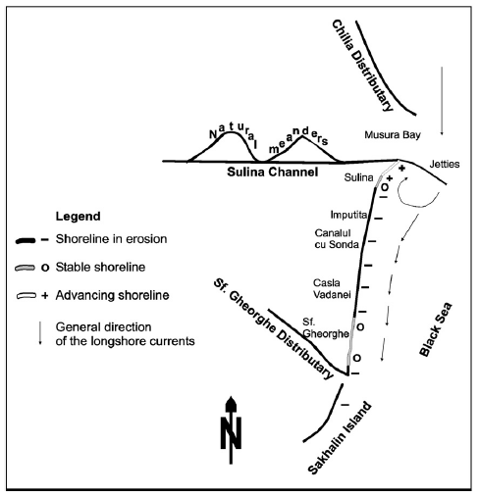
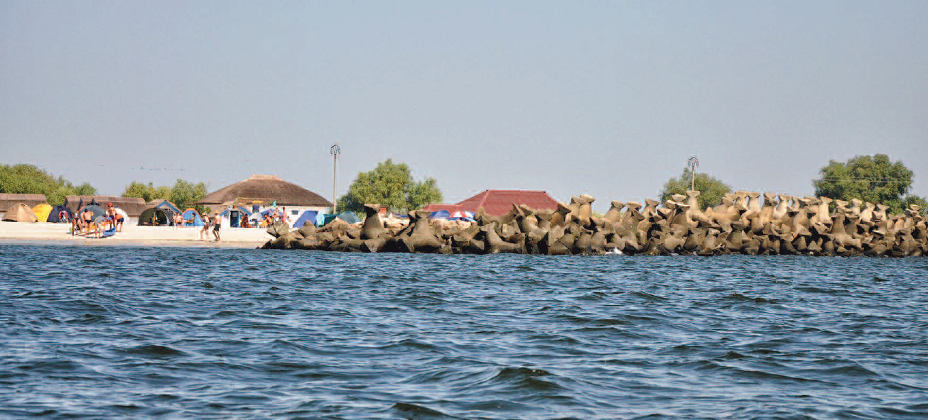
Coastal Erosion
Coastal erosion
Kuroki et al., 2006
Tescari et al., 2006
Stanica & Panin, 2009
Coastal erosion up to 24 m / year

Slide 6
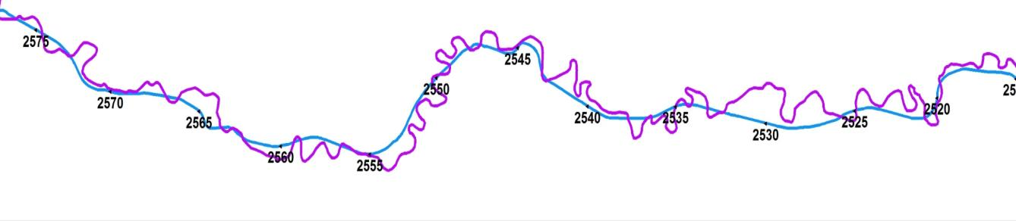
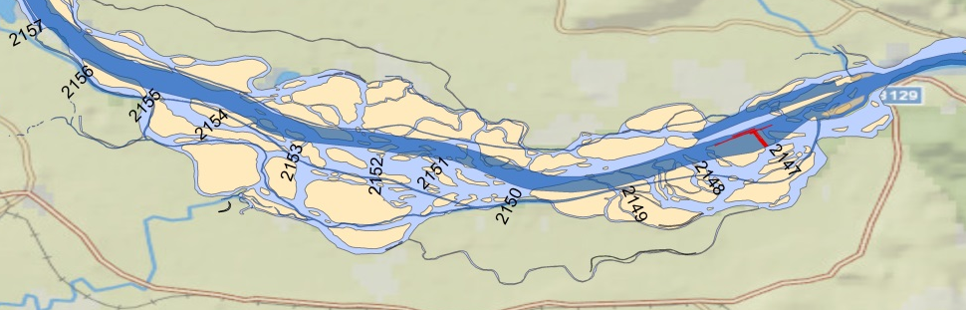
Length and width change
Channel length change
reference state
Danube in Germany
present state
Upper Danube: -38 %, Middle Danube: - 6 %, Lower Danube: -5 %
Channel width change
Upper Danube: -39 %, Middle Danube: - 12 %, Lower Danube: - 0,4 %

Slide 7
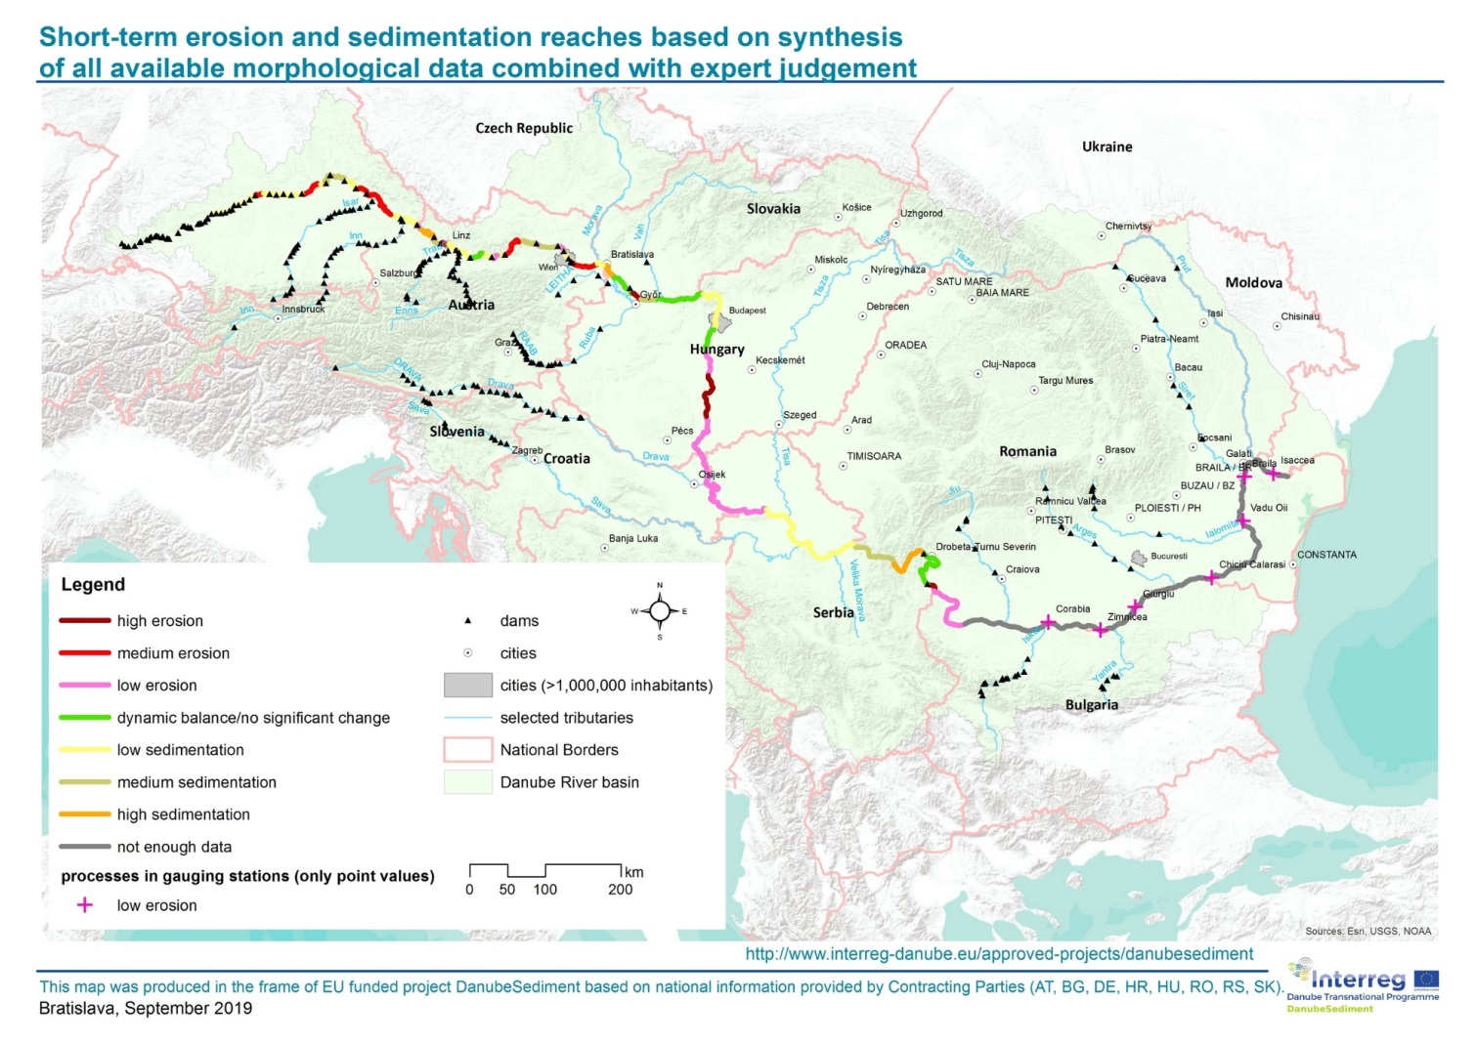
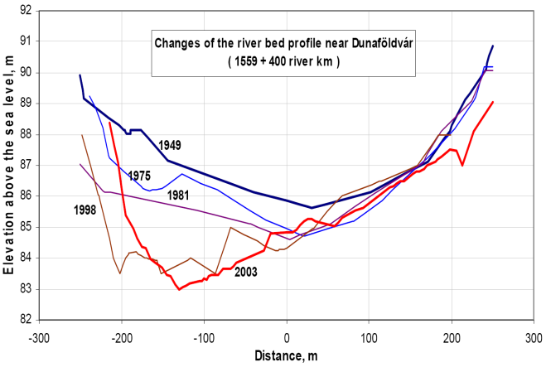
Morphological Change
Sediment alteration –
river bed change
Goda et al., 2007
Erosion: 55 % (29 %)
Sedimentation: 36 %
Equilibrium: 9 %
modified after Batuca et al., 2002

Slide 8
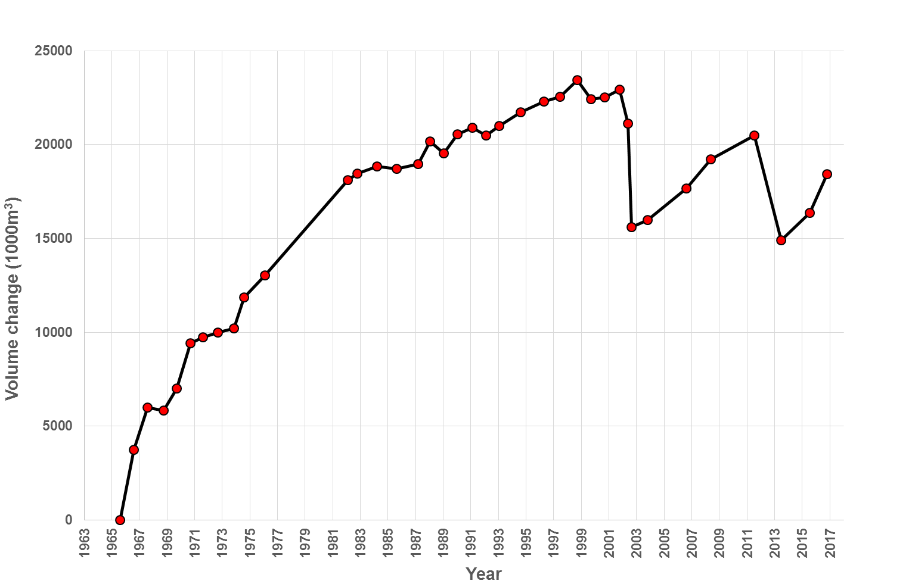
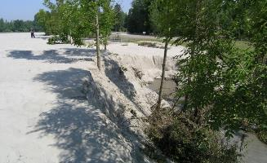
Remobilisation in a reservoir during 2002 and 2013 floods
Question of sediment release
Release: 5,5 Mio. m³
Sedimentation in impoundments
Source: viadonau, Verbund

Slide 9
→ ICPDR 3rd Danube River Basin Management Plan
Significant Water Management Issue
Alteration of sediment balance
Based on key findings of the DanubeSediment project the alteration of the sediment balance is now identified as new sub-item of the Significant Water Management Issue “Hydromorphological alterations”. The aim is to fully integrate this issue into the development of the 3rd DRBMP Update 2021.

Slide 10
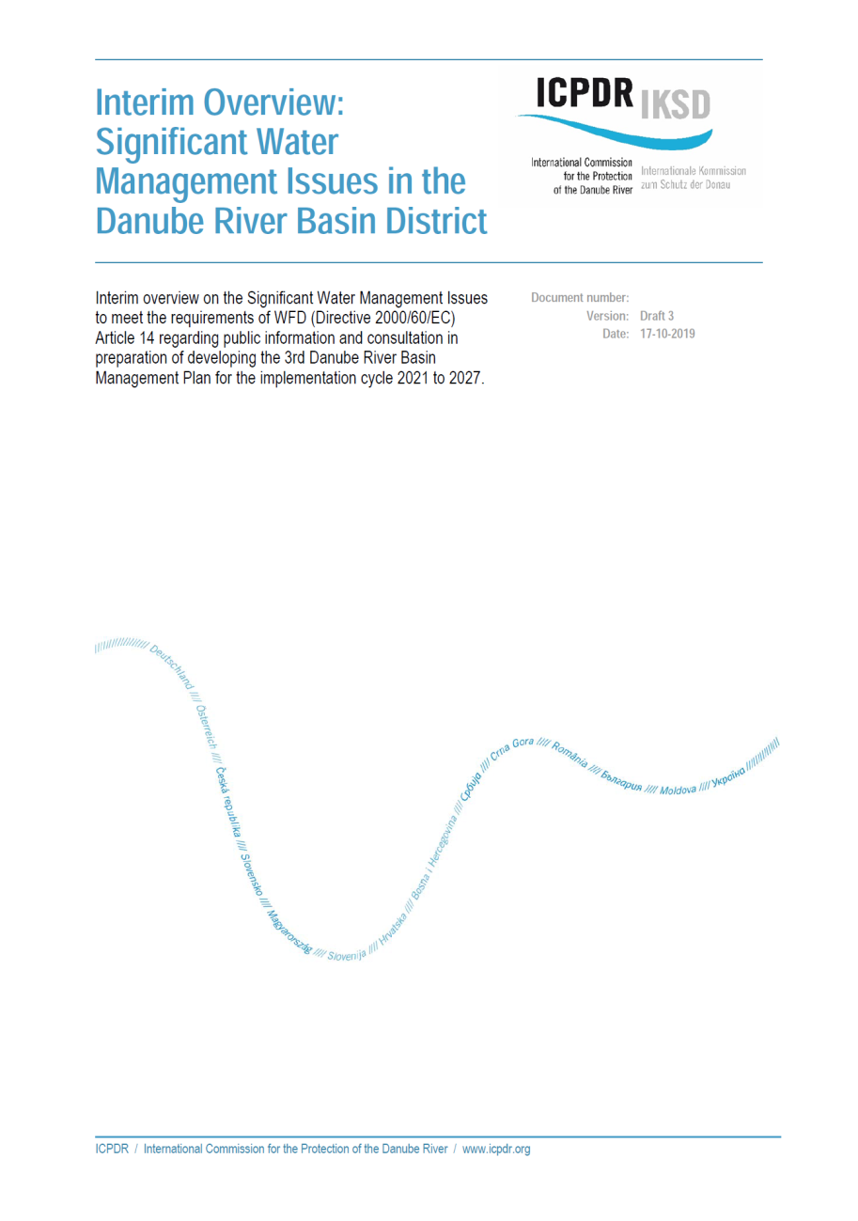
Significant Water Management Issue (SWMI) report
Significant Water Management Issue
Vision
The ICPDR’s basin-wide vision is a balanced sediment regime and an undisturbed sediment continuity. Type-specific natural bed forms and bed material as well as a dynamic equilibrium between sedimentation and erosion is provided. The balanced sediment regime enables the long term provision of appropriate habitats for the type-specific aquatic communities and water dependent terrestrial ecosystems.

Slide 11
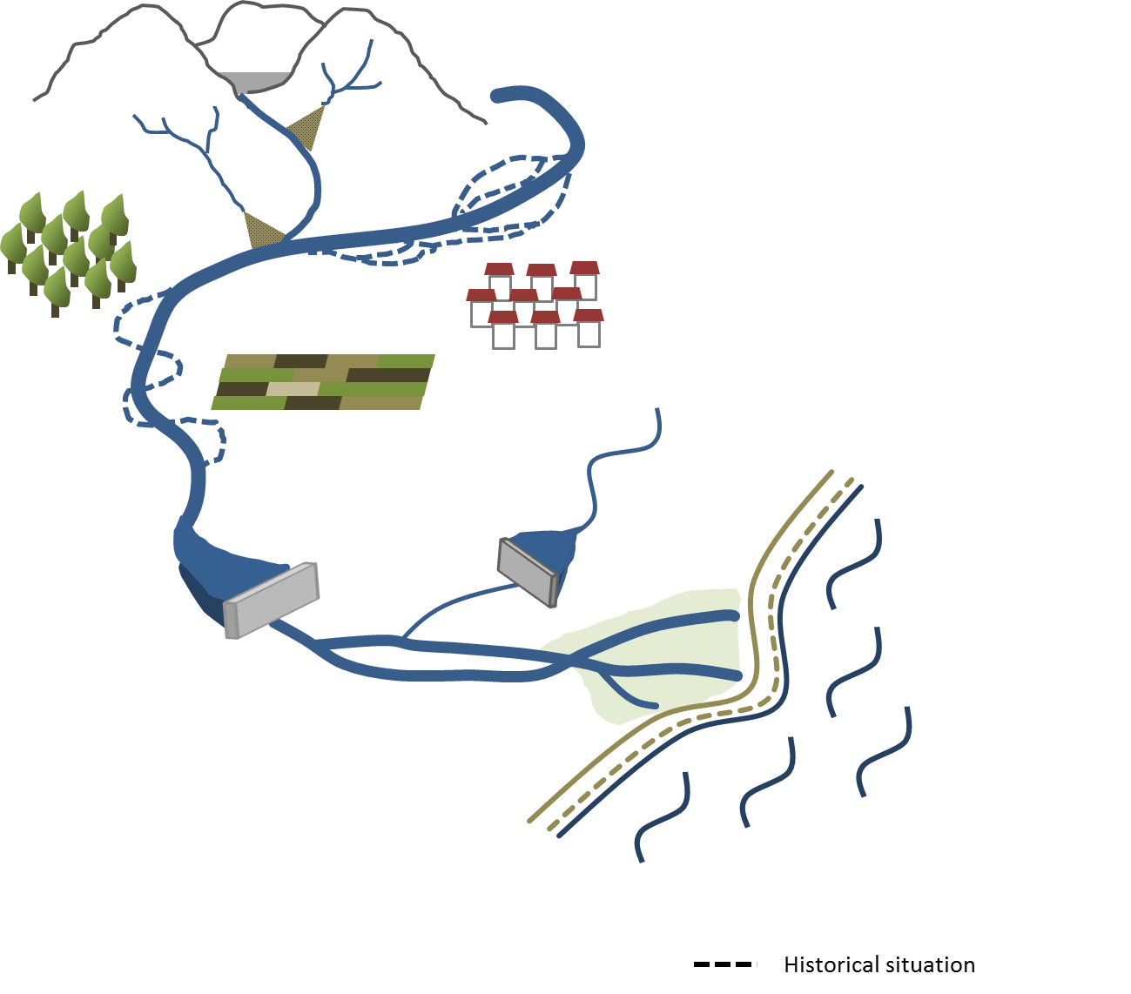

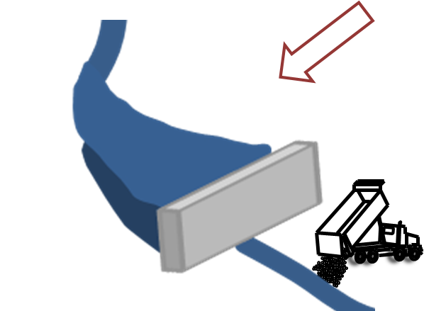
Danube Sediment Management Guidance (DSMG)
Location of selected measures
within the basin
3
Catchment scale
land use - optimized cultivation
land use - afforestation
improved sediment continuum
1
2
3
5
1
Reach / sectional scale
reservoir – flushing, bypass, turbidity current
free flowing section – widening, side channel reconnection
5
4
Local / point scale
at the dam – weir height, sediment turbine, elevation of outlet and intake structures
free flowing section – feeding
5
6
2
6
4
7
7

Slide 12
Danube Sediment Management Guidance (DSMG)
  General Recommendations
  Development of a basin-wide sediment management concept
  Improvement of legal regulations and governance
  Preservation of the sediment continuity and the morphology
  Restoration / Improvement of the sediment continuity
  Reduction of surplus and deficit reaches
  Development and implementation of sediment related measures addressing navigation, hydropower and flood risk management
  Defined refeeding of the dredged material
  Adapted land use, reduced sediment outputs from agriculture
  Establishment of harmonized sed. monitoring network and data management
  Sediment quality needs to be included
  Sediment related risk analysis
  Stakeholder involvement and interdisciplinary planning
  Adaptive implementation of measures and accompanying monitoring

Slide 13
Conclusions
The Danube River features a totally disturbed system (sediment continuum interruption, sediment disbalance).
Sediments are essential for hydromorphology, thus for ecology, but also an essential aspect for hydropower, navigation, flood risk management etc.
Cumulative effects on sediments arise not only from upstream to downstream but also backwards.
It has to be considered that sediment processes differ between each river section
(Upper Middle Lower Danube Danube Delta).
The alteration of sediment balance becomes a Significant Water Management Issue in the DRBMP.

Slide 14
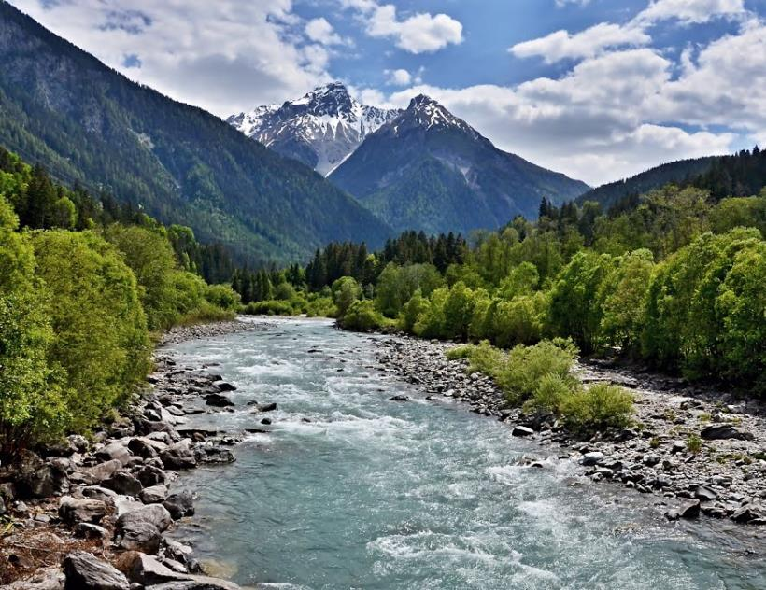
Many thanks for your attention!
Univ. Prof. DI Dr. Helmut Habersack
Chair on Hydraulic Engineering and River Research
UNESCO Chair on Integrated River Research and Management
Christian Doppler Laboratory for Sediment Research and Management
Institute of Hydraulic Engineering and River Research
Department of Water, Atmosphere and Environment
BOKU – University of Natural Resources and Life Sciences, Vienna
Muthgasse 107, 1190 Wien
Tel.: +43 1 47654 0
Fax: +43 1 47654 149
helmut.habersack@boku.ac.at
http://www.wau.boku.ac.at

Slide 15
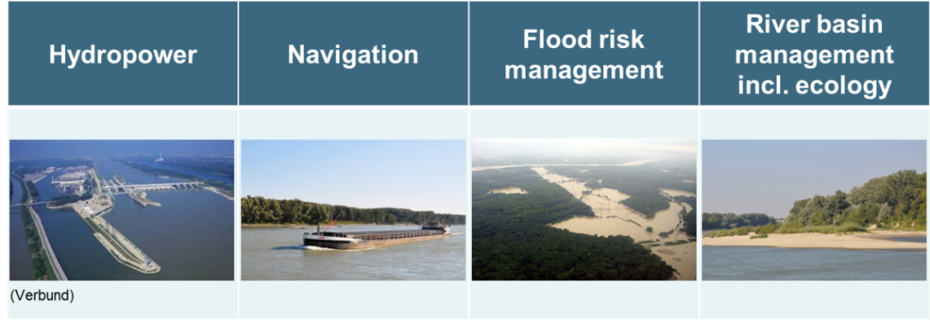
Part C: Good practice examples for sediment management measures
DanubeSediment
Sediment Manual for Stakeholder (SMS)
Different categories of measures:
1) State of the art
2) Tested (implemented at least once)
3) State of science
Subdivided in 4 chapters:

Slide 16
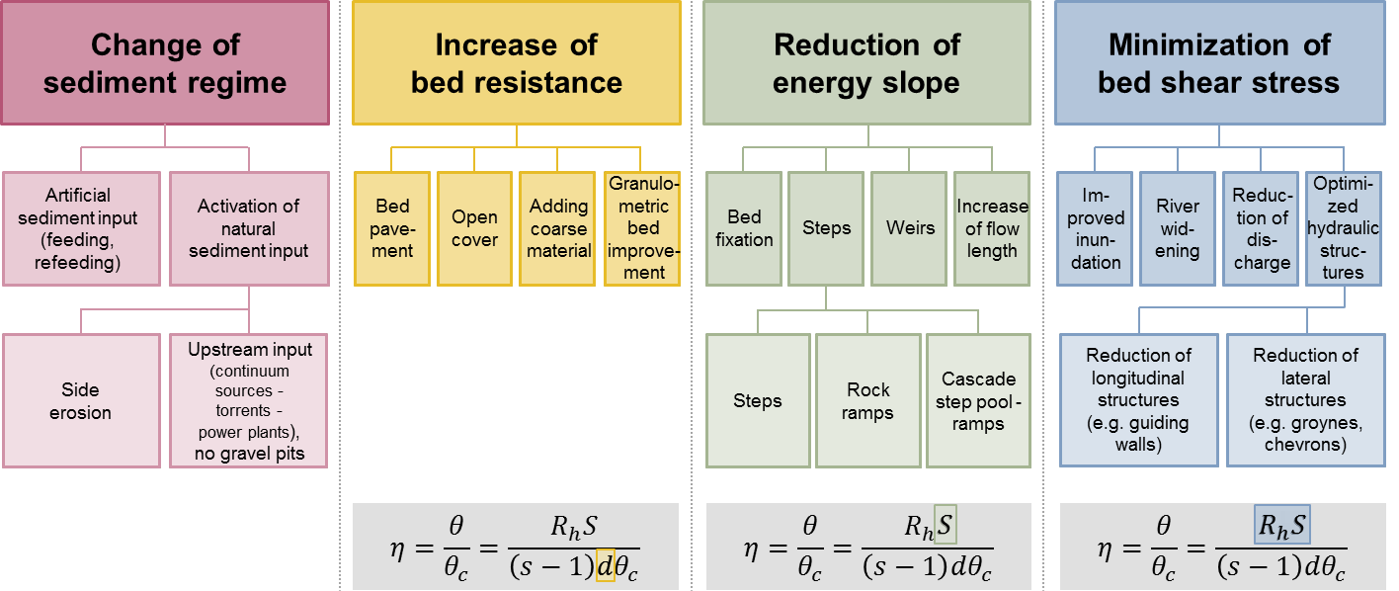
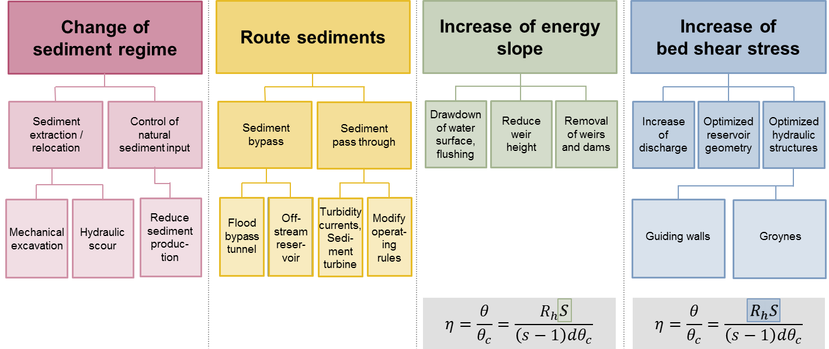
Sediment management measures
DanubeSediment
against erosion in free flowing sections
(modified after Habersack et al., 2013)
against sedimentation in reservoirs

Slide 17
Part C: Good practice examples for sediment management measures
DanubeSediment
Sediment Manual for Stakeholder (SMS)
Good practice examples:
- Measures for improving the continuity of sediment transport
- described in a standardized way incl. figures, tables, photos and a summary of practical experiences, qualitative cost estimation
Recommendations for Stakeholders

Slide 18
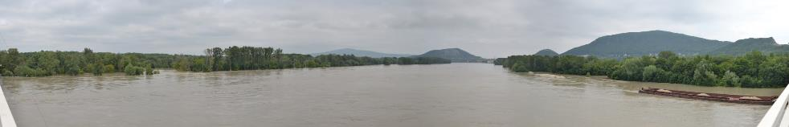
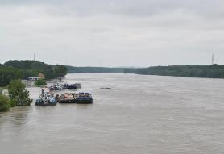
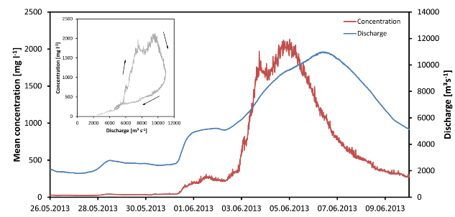
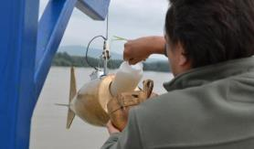
Sediments – Floods – Hydropower
Bedload and suspended sediment measurement
Habersack et al., 2017

Slide 19
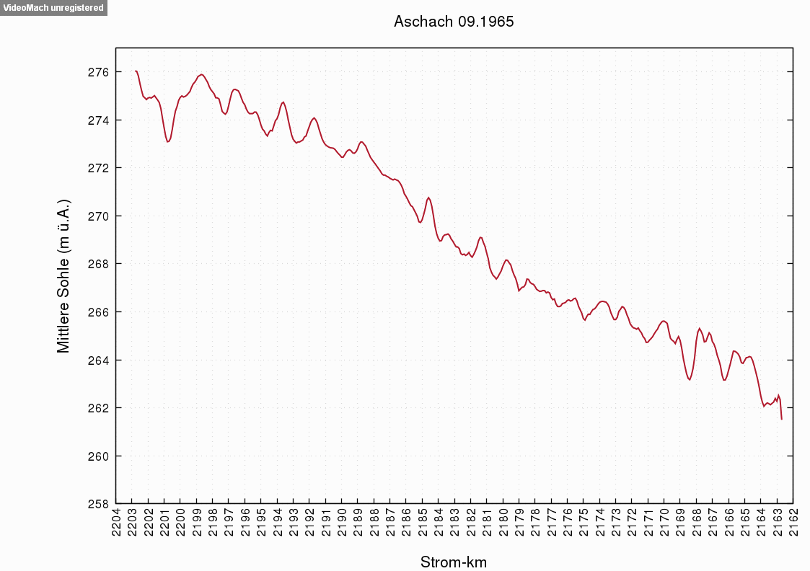

Reservoir sedimentation and remobilisation
DanubeSediment
source: Verbund/viadonau

Slide 20
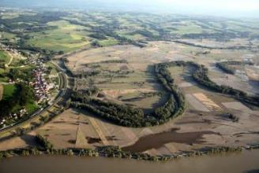
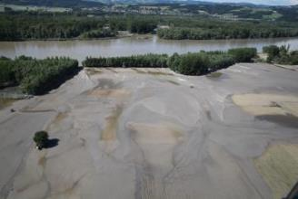
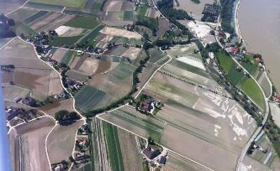
Sedimentation during flood 2013
Sediments: Deposition in floodplains
Machland
(Gmde Ardagger Markt, Pressl, 2013)
Eferdinger Becken
Verbund, Schmallfuss, 2013)
Habersack et al., 2015

