Slide 1
The potential for predicting low flows for the Central European rivers with a special focus on summer 2018
M. Ionita¹ and V. Nagavciuc²
¹Alfred Wegener Institute for Polar and Marine Research, Bremerhaven, Germany
²Stefan cel Mare University, Suceva, Romania

Slide 2
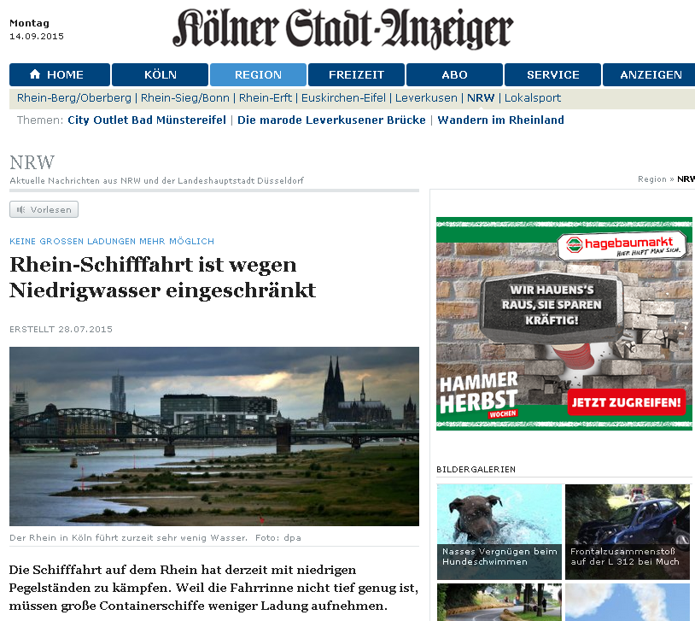
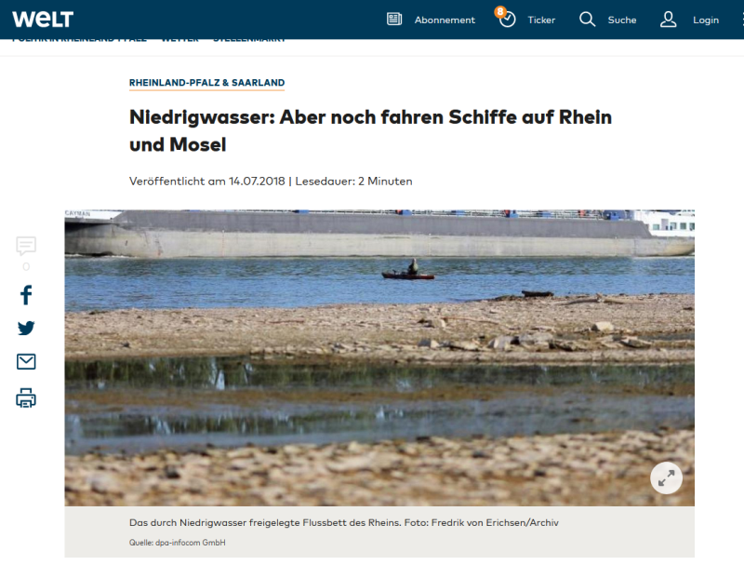
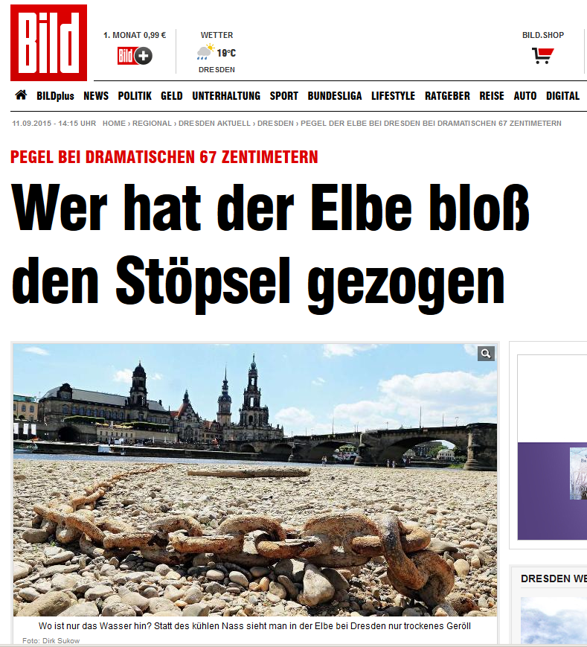
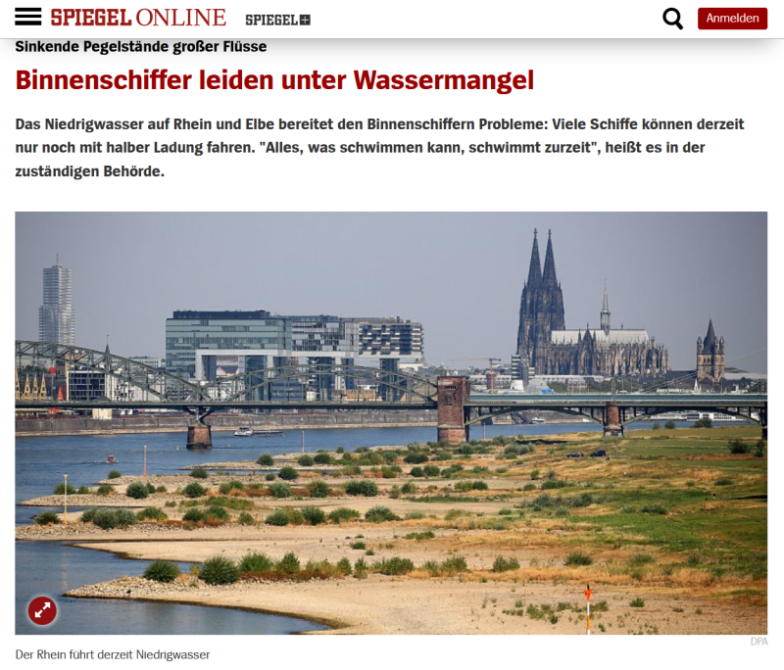
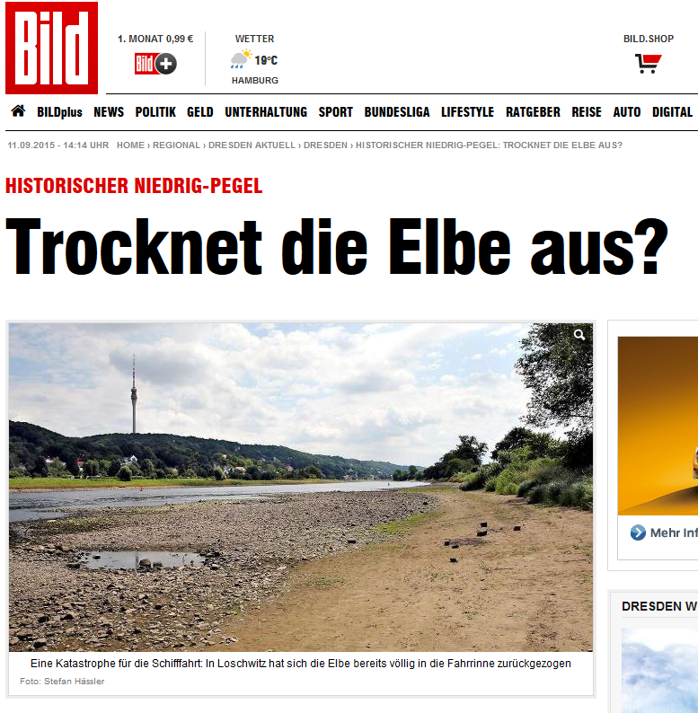
Motivation
2015
2018
Notes:
2

Slide 3
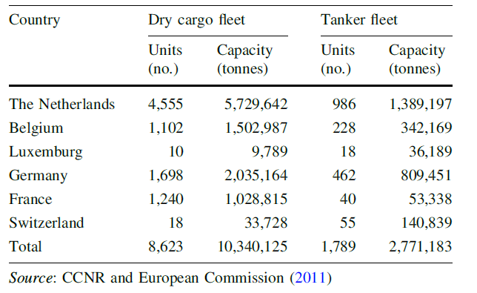
Motivation
Low water levels affect:
Transport
Energy (Hydropower, Cooling water, Energy transport)
Sedimentation
Ecology
Water resources management
70 % of the German waterways are of international relevance
River Rhine is one of the most frequented inland waterways in the world
Strengthening of the inland waterway transport is necessary to handle the continuing transport growth economically and ecological sustainably
Notes:
3

Slide 4
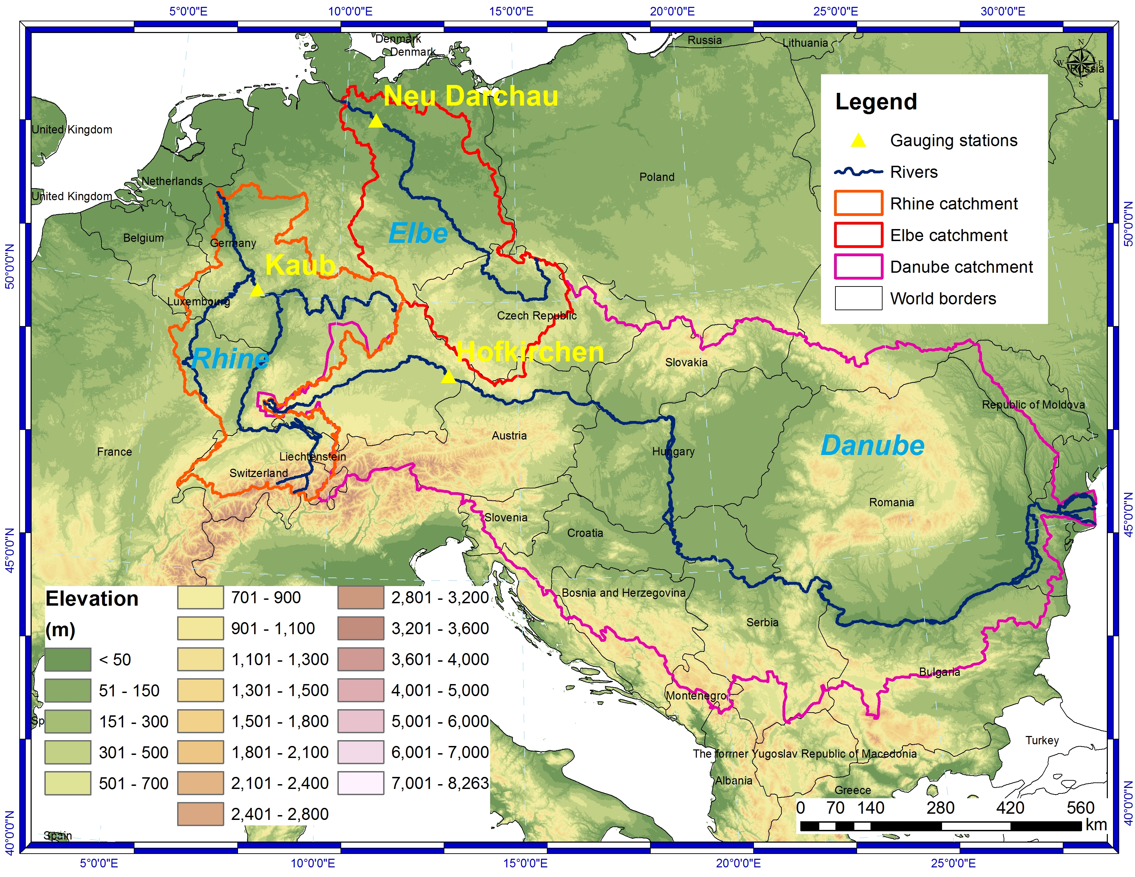
Study area

Slide 5
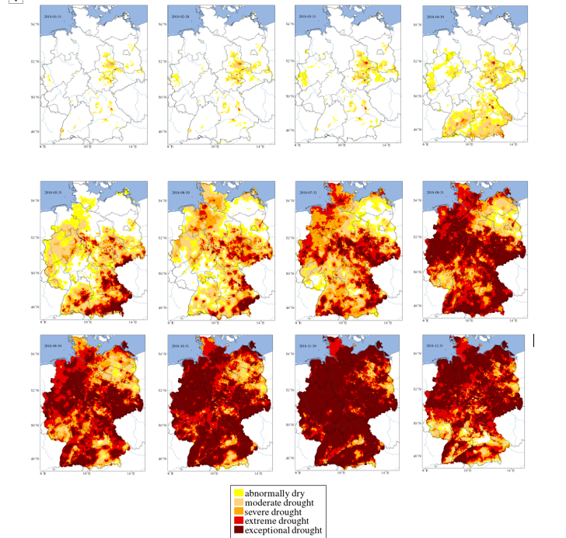
2018 – Soil moisture drought
Jan-Apr
May-Aug
Sep-Dec
Soil Moisture Index, Total Soil Column (~1.8m) at the end of each month in 2018, data from UFZ Drought Monitor (https://www.ufz.de/index.php?en=37937, retrieved 12.06.2019).

Slide 6
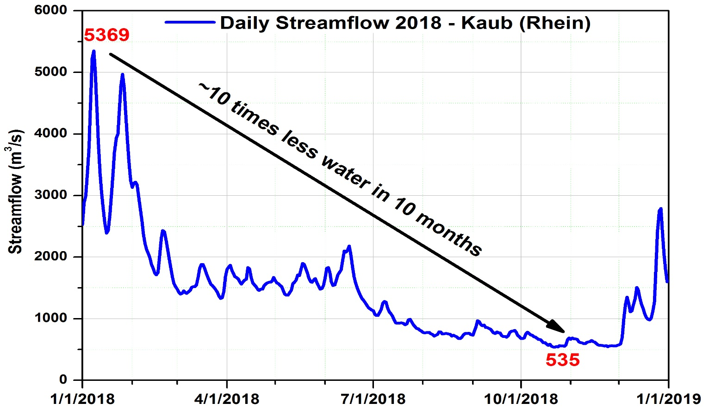
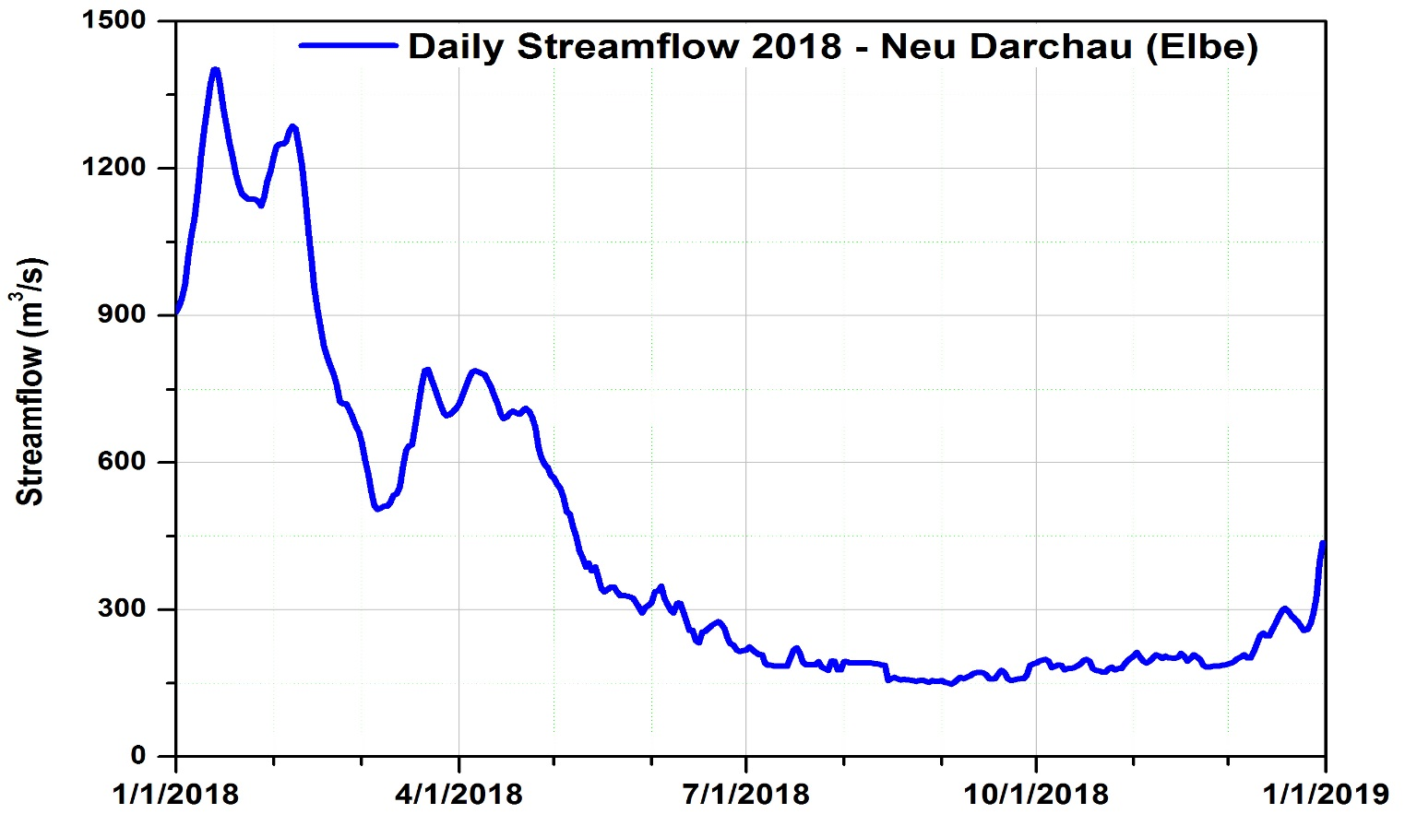
2018 – Hydrological situation

Slide 7
Objectives
Hydrological/Hydraulical models have a forecast horizon depending on weather forecast and water runoff duration, ~2-4 weeks (large catchments)
Can the forecast horizon be lengthened?
Can statistical models based on climatological parameters be used?
Identification of large scale predictors for monthly and seasonal discharge (mean flow) and water levels for the Rhine, Elbe and Danube rivers
Development of a statistical algorithm for the monthly and seasonal prediction
Test if the proposed methodology can be used as an operational system for monthly and seasonal outlook

Slide 8
Data
Local data (Germany)
Monthly/daily discharge data (NM7Q, MQ and HQ) measured at Neu Darchau (Elbe) and Kaub (Rhine), provided by BfG.
Precipitation (PP) and temperature (TT) data from DWD (5km x 5km, 1948-2018).
Global data
Extended Reconstructed Sea Surface Temperature (SST) v4b (2°x 2°) (1948-2018) from NOAA
Sea level pressure (SLP), Geopotential Height, Relative Humidity, Soil Moisture, Ground Temperature data, U, V (at 700 mbar) (2.5 º x 2.5 º) covering the period 1948-2018 from NCEP/NCAR data base
All data should be available at the beginning of the month for a „real time“ forecast.

Slide 9
Methodology
Detection of stable teleconnections:
31 – years moving average correlations between:
monthly/seasonal discharge and spatial regional parameters:
Precipitation (PP)
Temperature (TT)
As well as spatial large global parameters:
Sea Surface Temperature (SST)
Soil Temperature (ST10)
Soil Moisture (SM10)
Sea Level Pressure (SLP)
Precipitable water content (PWC)
Zonal and Meridional Wind (U700, V700)
→ Stability Maps

Slide 10
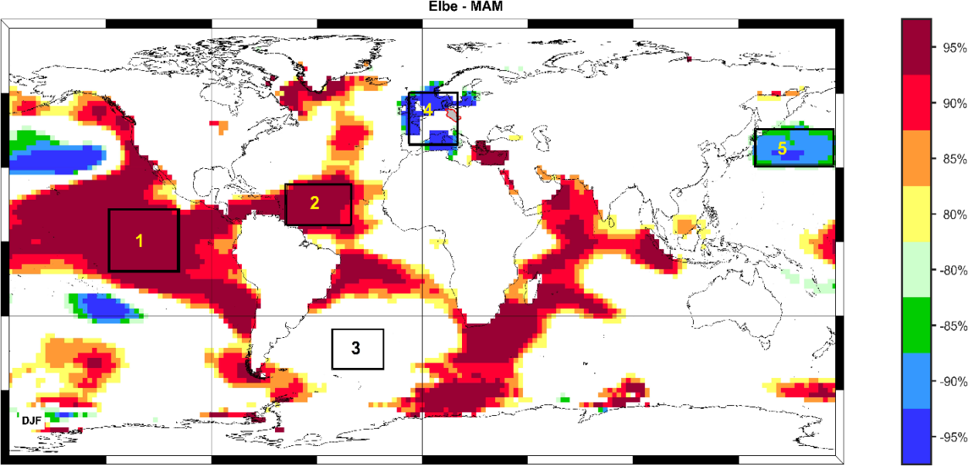
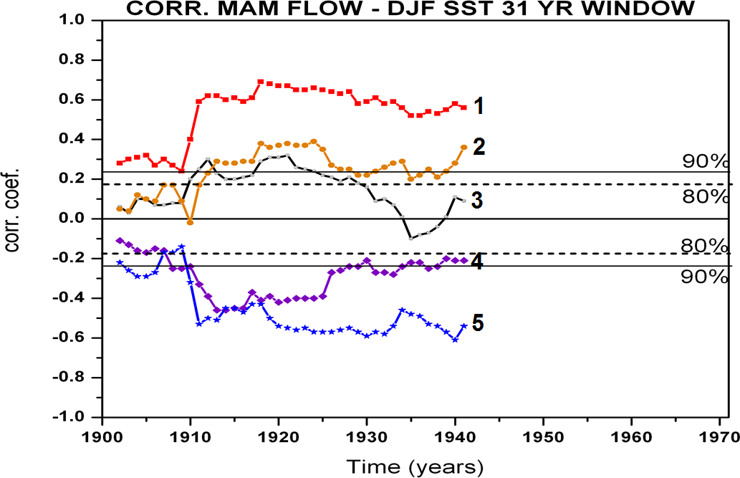
Methodology
Stability Map
Stability Criteria
more than 80% of the 31-yr windows are above 90% level: STABLE
more than 80% of the 31-yr windows are above 80% level: STABLE
more than 80% of the 31-yr windows are above 80% level: STABLE
more than 80% of the 31-yr windows are above 90% level: STABLE
less than 80% of the 31-yr windows are correlated: UNSTABLE

Slide 11
Methodology
Definition of indices for PP, TT, SST, SLP, PWC, etc based on stability maps.
Choice of the optimal predictors based on the stability maps and on:
Climatological expertise (“does it make sense?”)
Stepwise and backward regression
→ Reduced number of predictors

Slide 12
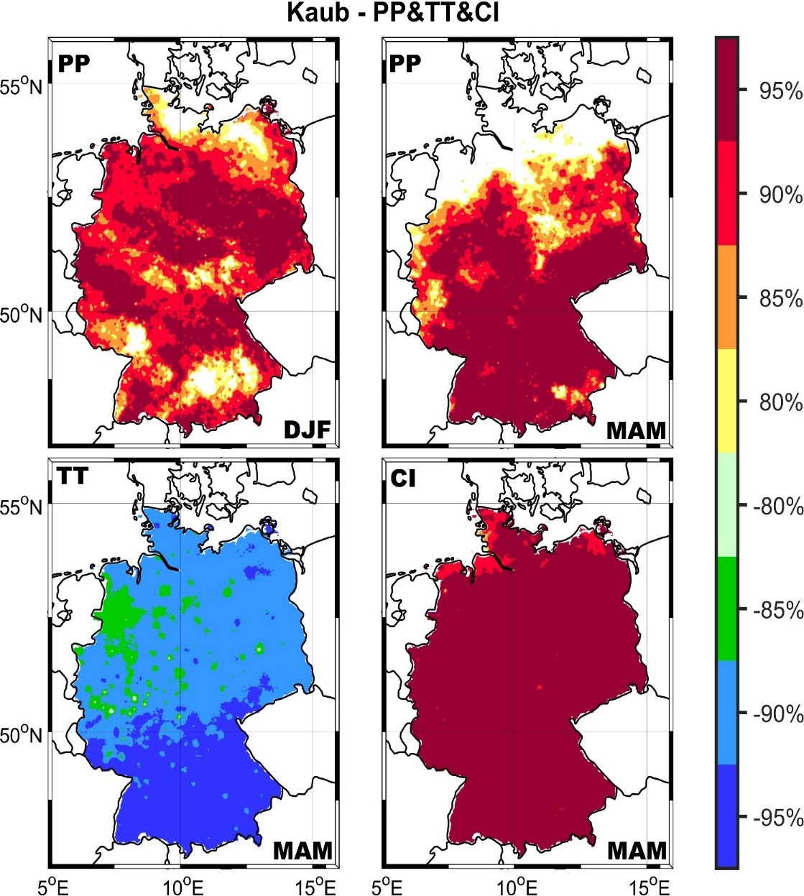
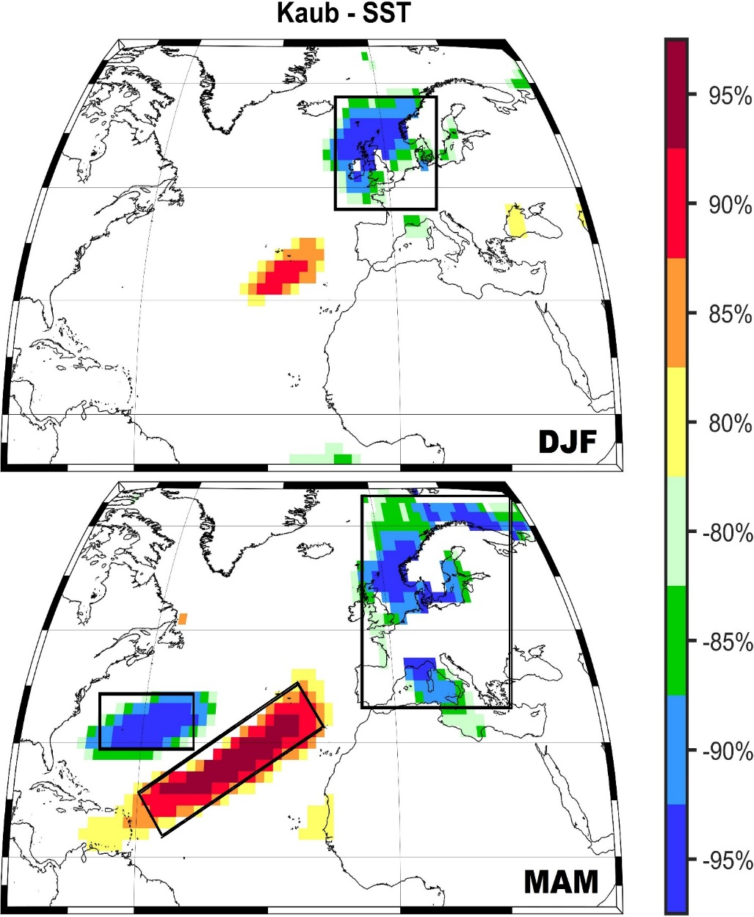
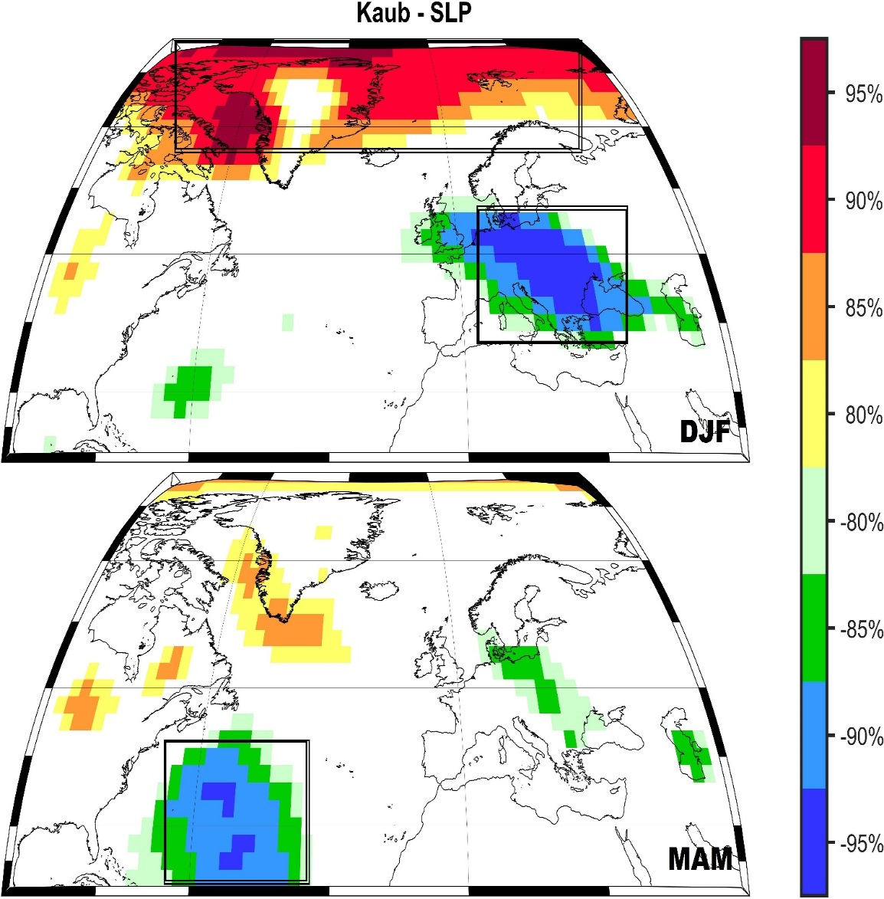
Predictors Kaub MQ JJA

Slide 13
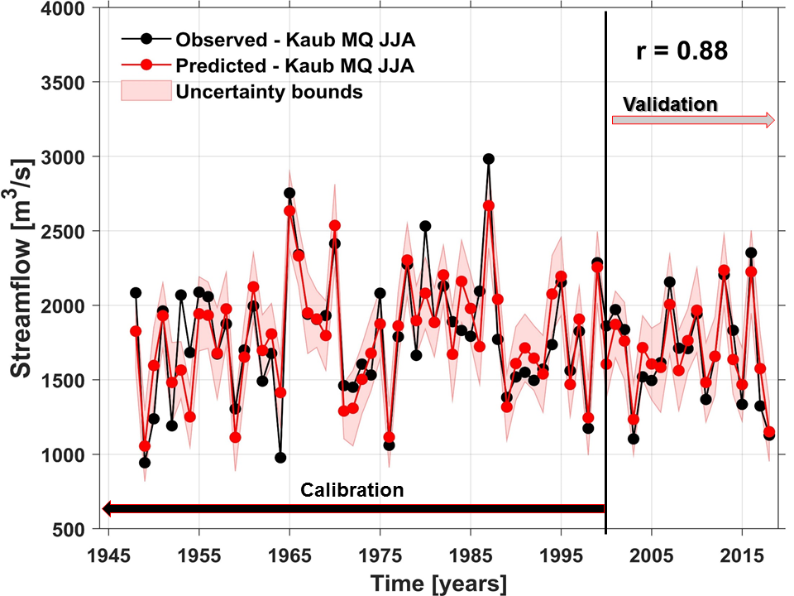
MQ – Kaub JJA (Rhine)
2018

Slide 14
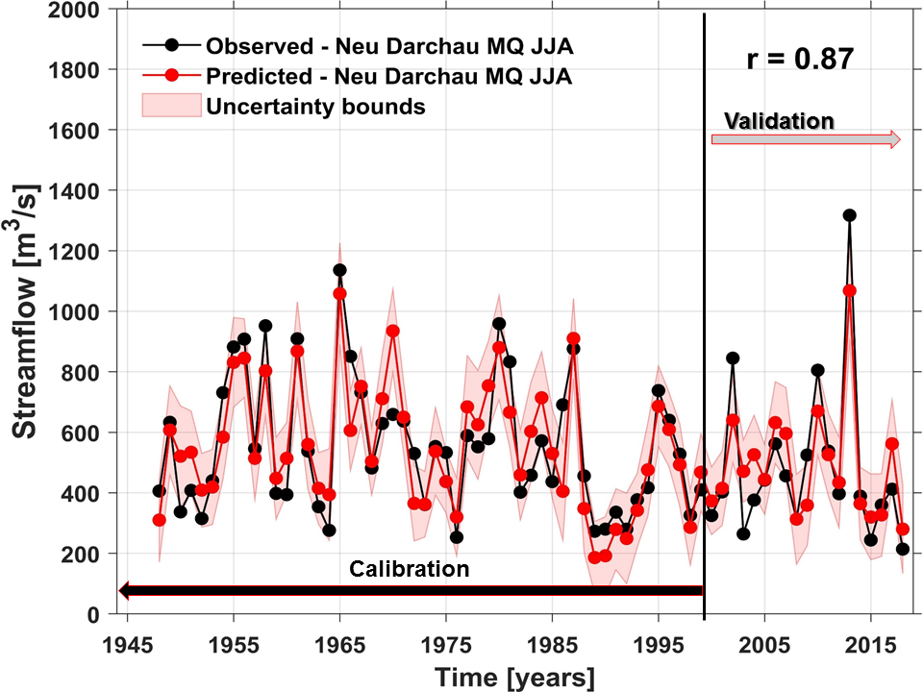
MQ - Neu Darchau JJA (Elbe)
2018
2018

Slide 15
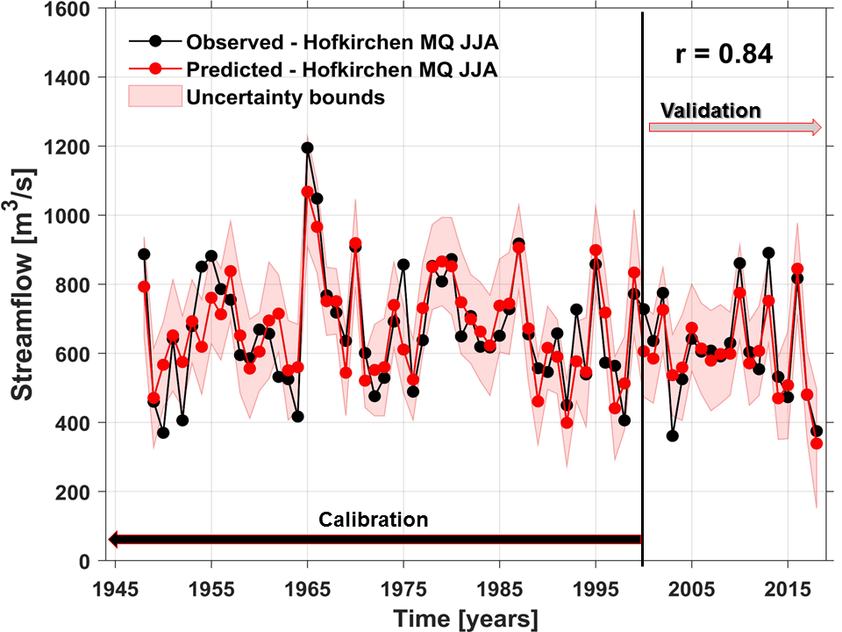
MQ – Hofkirchen JJA (Danube)
2018

Slide 16
Conclusions
The role of global climatic and oceanic factors in forecasting monthly/seasonal discharge in large German catchments is very significant.
The climatic/oceanic predictors differ from one month to another and from one station to another.
The lagged relationship between the monthly/seasonal discharge and the climatic/oceanic variables vary from 6 months (SST, Air temperature) up to 1 month (local precipitation and temperature, soil moisture).
The most reliable predictors are: sea surface temperature, sea level pressure, geopotential height at 700-mb, air temperature, precipitation, soil moisture, zonal and meridional wind at 700-mb.

Slide 17
Thank you
Dr. Monica Ioniţa
Monica.Ionita@awi.de
Dr. Viorica Nagavciuc
Viorica. nagavciuc@gmail.de
www.awi.de

