Slide 1


Stephan Dietrich¹⁾, Ulrich Looser²⁾, Philipp Saile¹⁾, Dmytro Lisniak¹⁾, Claudia Färber¹⁾, Irina Dornblut²⁾, Markus Ziese³, Elke Rustemeier³, Sven-Henrik Kleber², Andreas Becker³,
Harald Köthe¹⁾
¹⁾ International Centre Water Resources and Global Change (ICWRGC)
²⁾ Bundesanstalt für Gewässerkunde (BfG) ³⁾ Deutscher Wetterdienst contact: dietrich@bafg.de
State of the art of global hydrological data assessment with a focus on the Danube basin

Slide 2

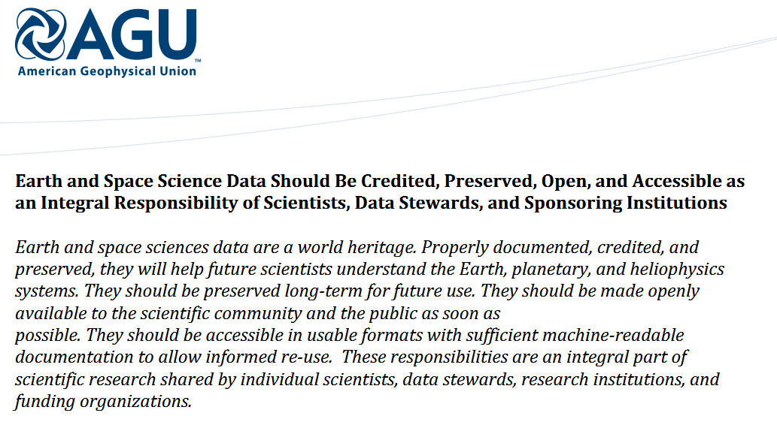

Motivation

Slide 3
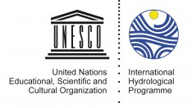
IHP-IX is recommending different actions
Demonstrate to all stakeholders the results to disseminate information, to increase public awareness of the risks facing society in relation to water.
6
Assist in disseminating and developing new interpretation methods of scientific information into a format usable for policy making.
5
Enabling the accessibility, visibility and open-access of scientific information for the world to learn from each other.
4
Our focus
3
Enhance development and use of scientific research methods to correctly analyze and interpret the data, resulting in better scientific information.
2
1
Enabling data accessibility and visibility, comparable and usable data series, and open-access data.
Improving the quality and quantity of water data by enabling an increase in the density of collection stations and better validation of such data.

Slide 4
Outline
Discoverability and interoperability of global water data: Status quo and the Global Terrestrial Network – Hydrology (GTN-H)
The Global Runoff Data Centre (GRDC)
  covers monthly discharge data globally
  development and implementation of OGC WaterML 2.0 and OGC Sensor Observation Service (SOS) 2.0 hydrology profile
GEMS/Water Data Centre (GWDC)
  Global freshwater quality data for rivers, lakes, reservoirs, wetlands and groundwater systems
  ISO 19115-compliant metadata catalogue
Global Precipitation and Climatology Centre (GPCC)
  Covers daily precipitation data

Slide 5
Outline
Discoverability and interoperability of global water data: Status quo
The Global Runoff Data Centre (GRDC)
  covers monthly discharge data globally
  development and implementation of OGC WaterML 2.0 and OGC Sensor Observation Servic (SOS) 2.0 hydrology profile
GEMS/Water Data Centre (GWDC)
  Global freshwater quality data for rivers, lakes, reservoirs, wetlands and groundwater systems ; database GEMStat
  ISO 19115-compliant metadata catalogue
Global Precipitation Climatology Centre (GPCC)
  Covers daily precipitation data

Slide 6
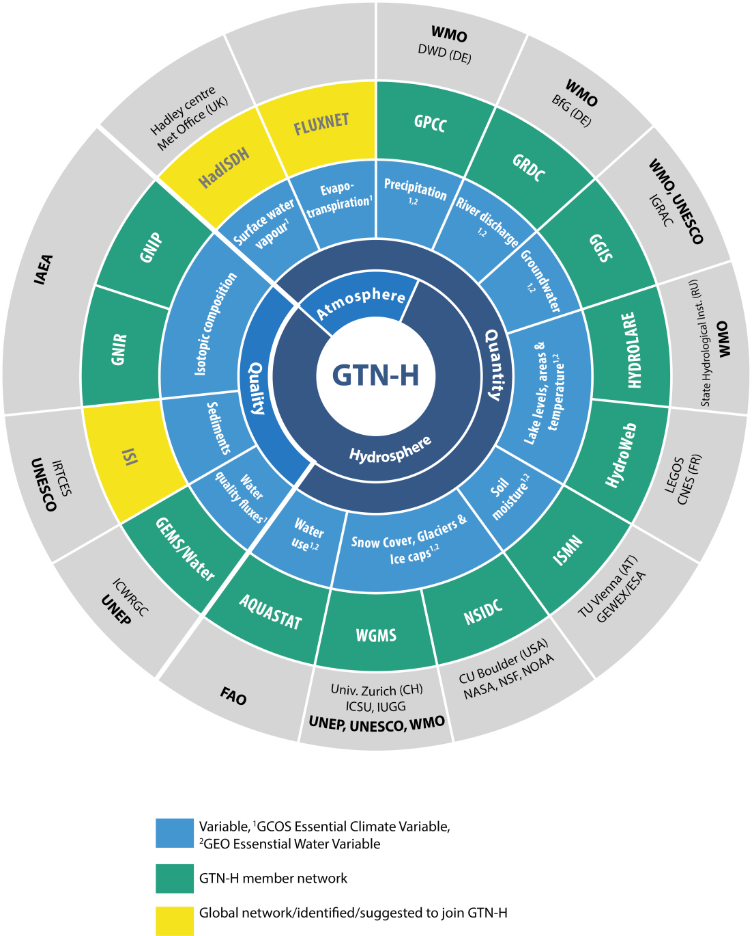
The existing
operational
global
water
data
centers
6
Notes:
6

Slide 7


The existing operational
global water data centers
GTN-H: Network of the global water data centres
Joint project of the World Meteorological Organization (WMO) and the Global Climate Observing System (GCOS);
Implemented in 2001
7
Notes:
7

Slide 8
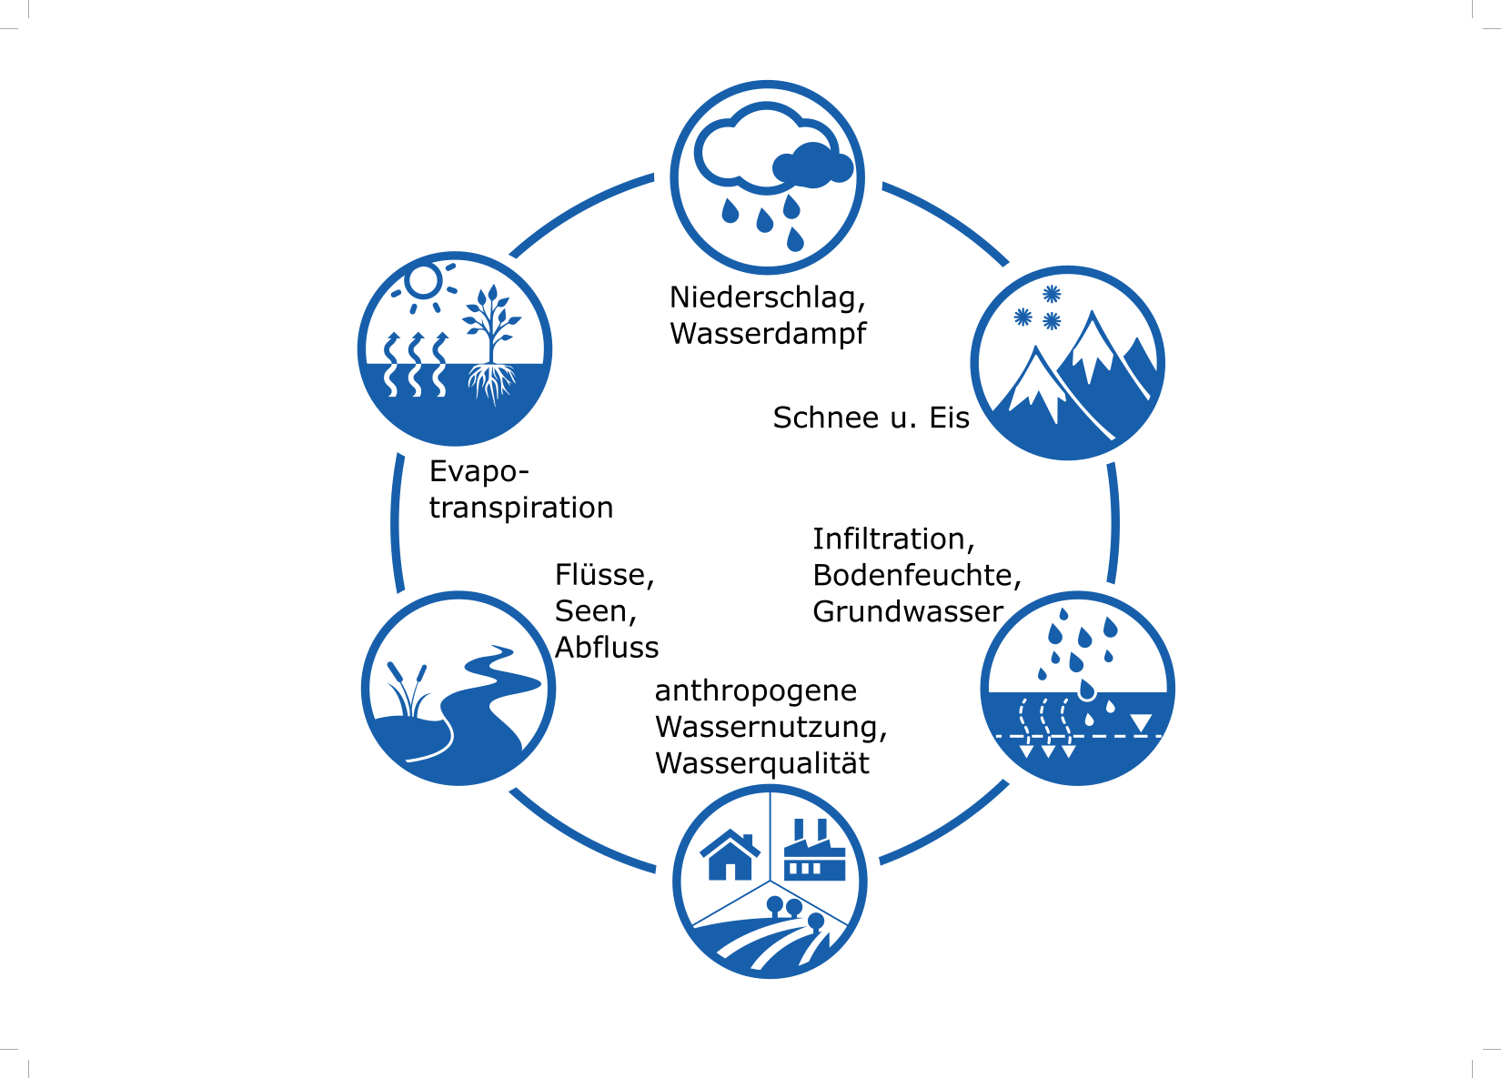
Global Terrestial Network – Hydrology (GTN-H)
Mission
Co-ordination mechanism to support scientific advance and operational applications for climate variability/change, water resources assessment and management.
Objectives
Support current and emerging technologies and available infrastructure. Sharing standards
and best practices (Knowledge transport)
Development of integrative data products.

Slide 9
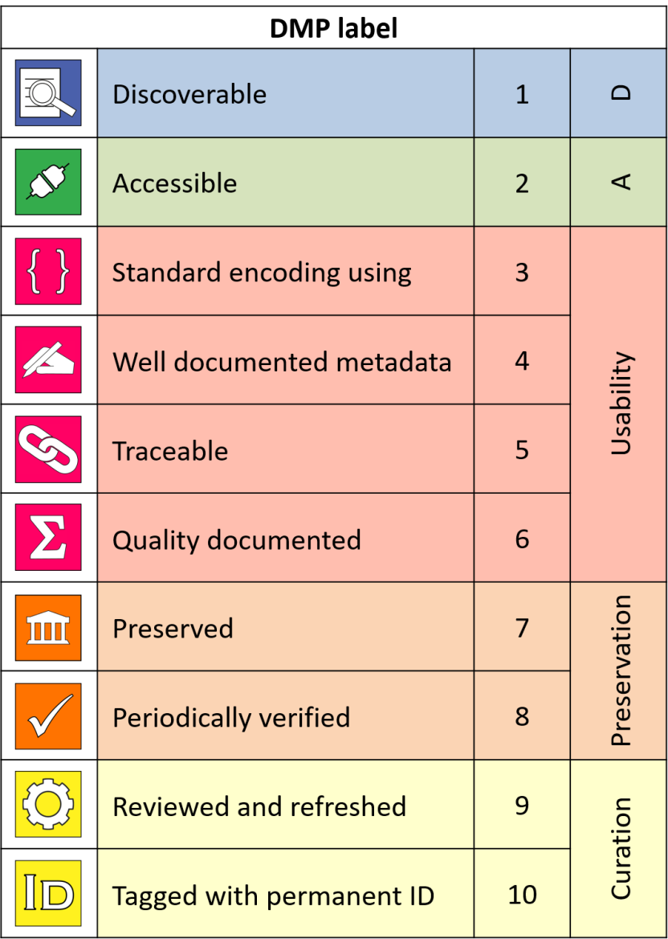
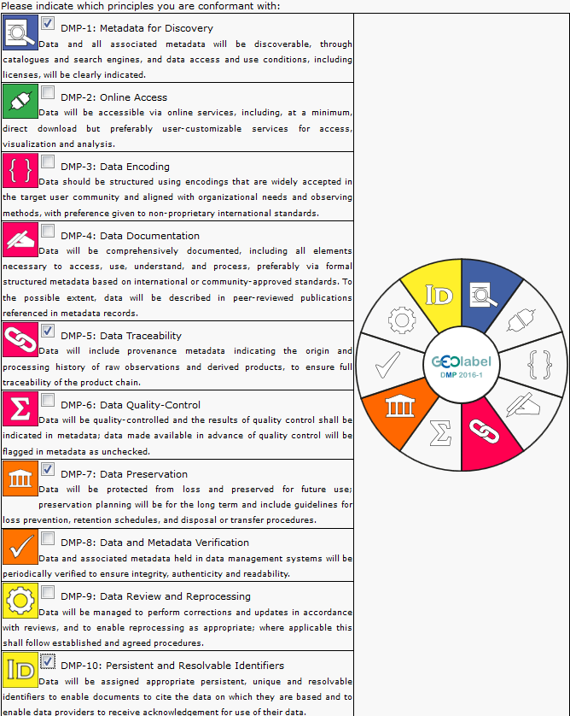

GTN-H aims for curated water data
http://geolabel.info/
DMP_generation.htm
GEO data management principles

Slide 10
Metadata (discoverability of data)
Aim: how-to-understand-the-data
Need: ability to share metadata
  Discoverbility services
Use generic profiles for tempo-spatial coverage:
  E.g. ISO19115/19156
Domain specific extension of generic profiles
  Generic profiles for data sets (e.g. time series), group/collections (of data sets), services
  Hydrological community: No convention about parameter names etc (like CF convention für netCDF)
  E.g. marine community profile (AODC) (https://mcp-profile-docs.readthedocs.io/en/stable/preface.html)

Slide 11
Interoperability: bring the data together
The reality
Notes:
Ähnlich für Transferformate

Slide 12
Transfer formats
netCDF-CF and/or WaterML-2
  As a common basis
lack of sampling data for exchange standards
  E.g. for water quality
  to be eveloped in the OGC/WMO HDWG
Requirements unified Ontology:
  Methods
  Parameters (observed property)
  Sample media
  Sampling feature
Code lists exists in different communities
  Find together the relevant one(s)
  Use them

Slide 13

Outline
Discoverability and Interoperability of global water data: Status quo
The Global Runoff Data Centre (GRDC)
  covers monthly discharge data globally
  development and implementation of OGC WaterML 2.0
  and OGC Sensor Observation Servic (SOS) 2.0 hydrology profile
GEMS/Water Data Centre (GWDC)
  Global freshwater quality data for rivers, lakes, reservoirs, wetlands and groundwater systems; database GEMStat
  ISO 19115-compliant metadata catalogue
Global Precipitation Climatology Centre (GPCC)
  Covers daily precipitation data

Slide 14



More than 30 Years
Global Runoff Data Centre (GRDC)
Operating:
under the auspices of World Meteorological Organisation (WMO)
within the Federal Institute of Hydrology, Koblenz
Main Functions:
Acquisition, harmonisation and storage of global historical river discharge data and associated metadata
Dissemination of historical discharge data and derived data products of more than 9500 stations in 161 countries to science and research (“One-stop shop”)
Support to:
climate-related programmes and projects of the United Nations and their special organisations and the international scientific community
http://grdc.bafg.de

Slide 15
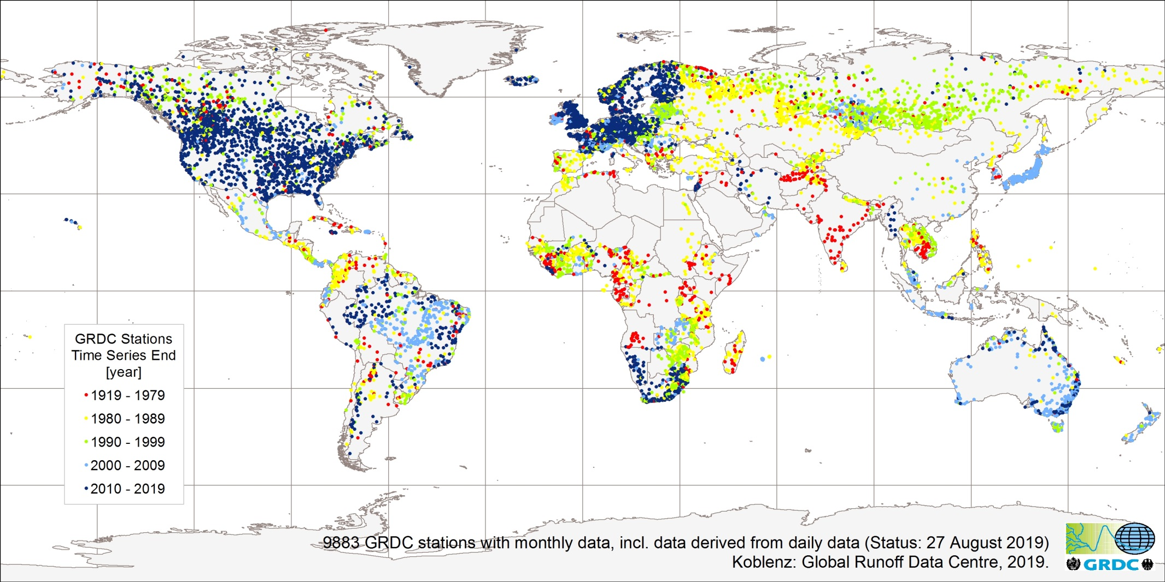
Global Coverage of GRDC Stations indicated by time series end
Data available on request and free of charge when complying with data user policy
Status of the Global Runoff Database
Potential aim: data harvesting of long-term research data
GRDC.bafg.de

Slide 16
Status of the Global Runoff Database
for the Danube River and its tributaries
Country | Number of Stations | Time series Start | Time series End
Austria | 67 | 1930 | 2012
Bulgaria | 7 | 1931 | 1999
Croatia | 2 | 1921 | 1990
Czech Republic | 12 | 1911 | 2016
Germany | 81 | 1826 | 2016
Hungary | 19 | 1891 | 1999
Romania | 19 | 1840 | 2010
Serbia | 9 | 1926 | 2010
Slovakia | 22 | 1900 | 2017
Slovenia | 19 | 1909 | 2016
Switzerland | 7 | 1904 | 2016
Ukraine | 5 | 1931 | 1995

Slide 17
Need for standardization of data exchange
WMO‘s data exchange policy expresses the need
to exchange operational data, information and related forecasts on the state of watercourses, particularly of trans-boundary rivers on a regular basis
for exchange of scientific data (access to systematic observation)
for exchange of data in support international conventions (like IPCC or UNFCCC)
for co-operation between nations to control data quality, data formats and metadata standards, to facilitate common procedures for the exchange of data and information
WMO CHy requested GRDC to co-chair the WMO/OGC Hydrology Domain working Group to guide the development of internationally accepted standards for the exchange of hydrological data and information

Slide 18

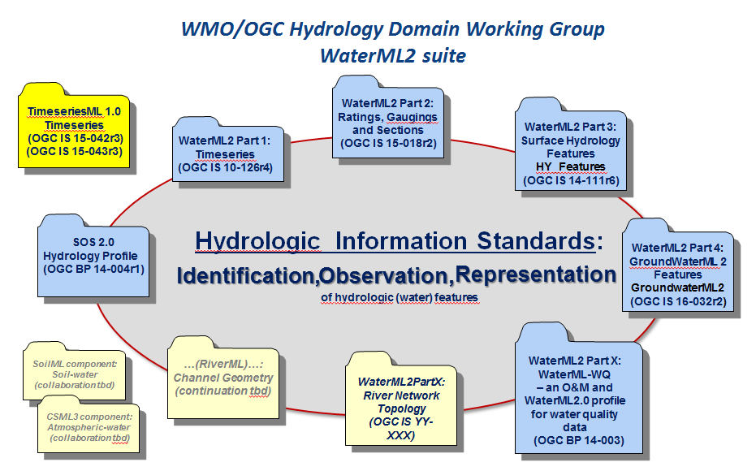

GRDC and Standardisation
WaterML2.0
is built on widely used OGC and ISO standards,
it represents a break-through for linking local to global water information sources into large water information networks
enables efficient analysis and modelling of water data across information sources.

Slide 19
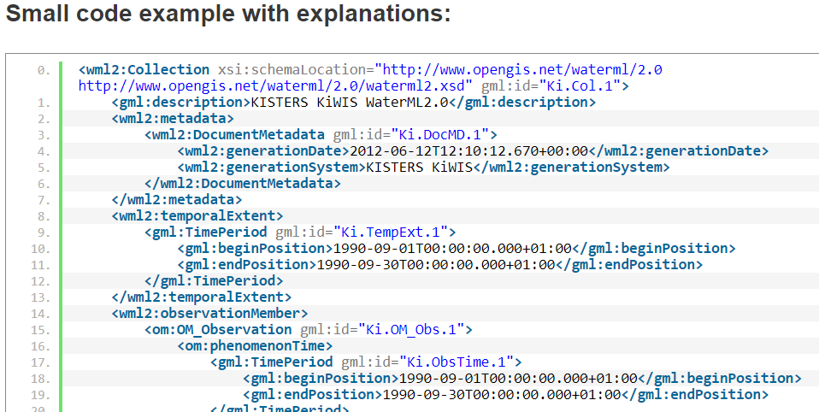
WATERML 2.0 PART 1: TIME SERIES
the first international standard for encoding water observation time series
waterml2.org
2012: OGC adopted ”WaterML2.0 Part 1: Time series” as an OGC Standard
2017 : adopted by the WMO Executive Council
Support for WaterML2.0.Part.1 is growing and endorsed amongst others as a standard by
  EU Commission Regulation No 1253/2013
  US Federal Geographic Data Committee (FGDC)
  US Federal Government, as an official component of the civil Earth observation strategy.

Slide 20
Outline
Discoverability of global water data: Status quo
The Global Runoff Data Centre (GRDC)
  covers monthly discharge data globally
  development and implementation of WaterML 2.0 and the SOS 2.0 hydrology profile
GEMS/Water Data Centre (GWDC)
  Global freshwater quality data for rivers, lakes, reservoirs,
  wetlands and groundwater systems; database GEMStat
  ISO 19115-compliant metadata catalogue
Global Precipitation Climatology Centre (GPCC)
  Covers daily precipitation data

Slide 21
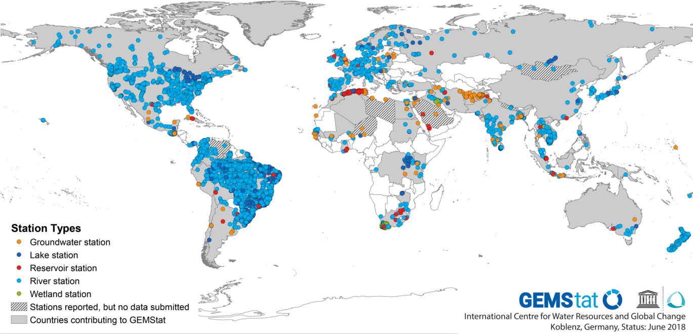


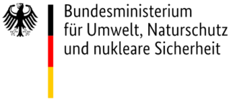
The GEMS/Water Data Centre (GWDC)
Collection of freshwater quality data from the GEMS/Water Network (UN Environment) in database GEMStat
in 76 countries, since 1965, ~350 parameters
> 4000 stations
> 4 million measurements in rivers, lakes, wetlands and groundwater
gemstat.org
Notes:
Momentan sind in der Datenbank mehr als 4000 Stationen vorhanden, mit mehr als 4 Millionen Messungen in Flüssen, Seen, Feuchtgebieten und Grundwasser.
Daten sind für 76 Länder und 345 Parameter vorhanden.
Aktuell 4155696 Messwerte in Datenbank
Costa Rica neu dazugekommen in 2018, mit 192 Stationen.
Und die längste Zeitreihe beginnt 1965.
Wie Sie auf der Karte sehen können, ist die geographische Verteilung der Messungen sehr heterogen. Und das ist auch der Fall für die zeitliche Auflösung der Daten.

Slide 22
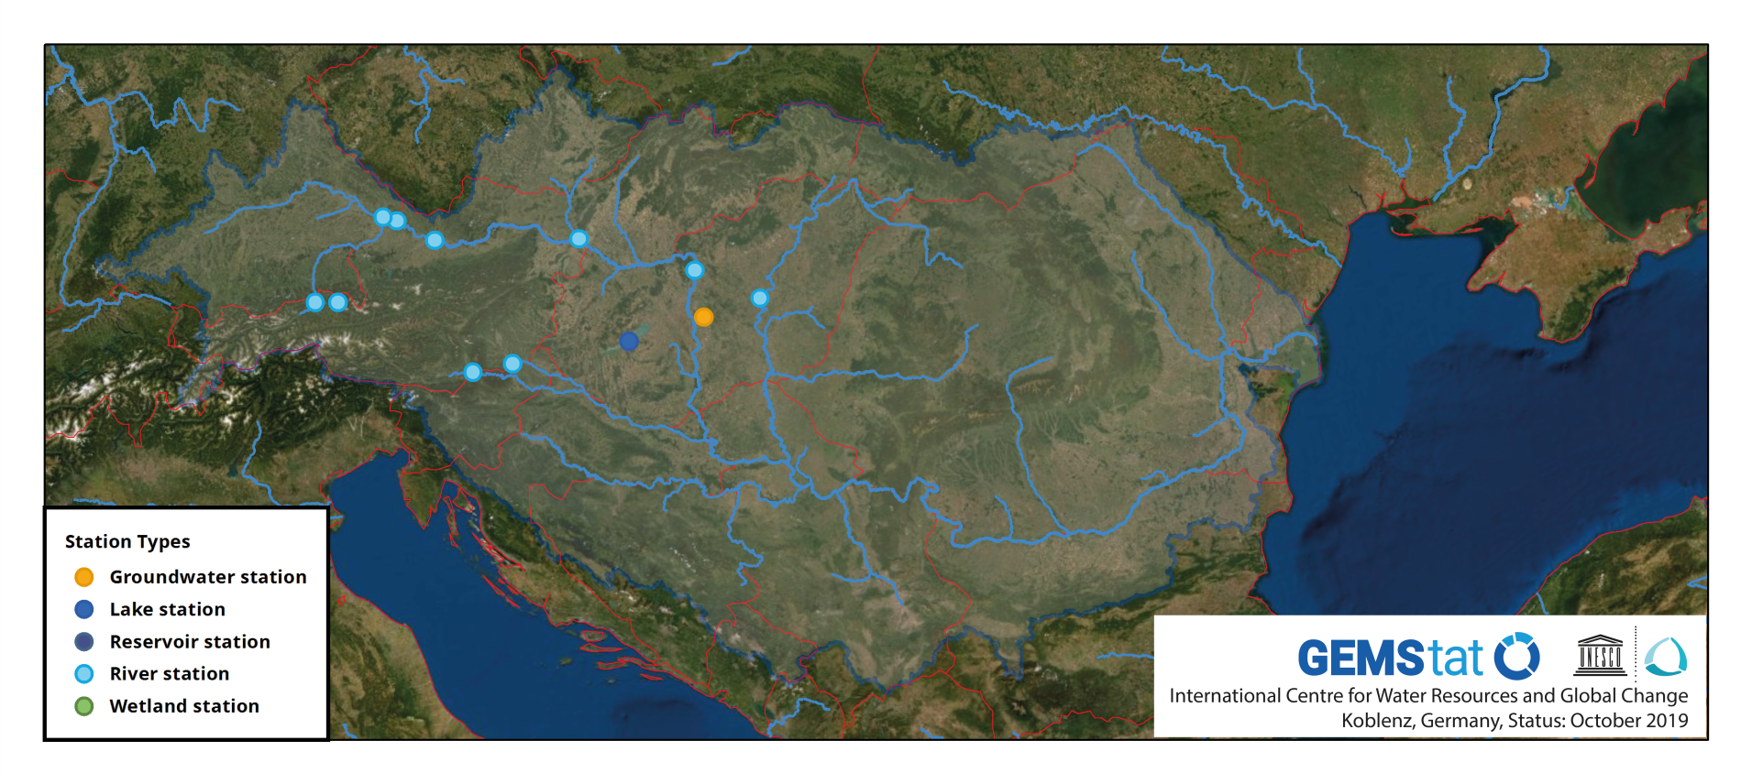
Freshwater Quality reported from the Danube Catchment
 | overall stations | Year start | Year End
Austria | 6 | 1995 | 1996
Hungary | 4 | 1979 | 1996
Germany | 2 | 1979 | 1995

Slide 23
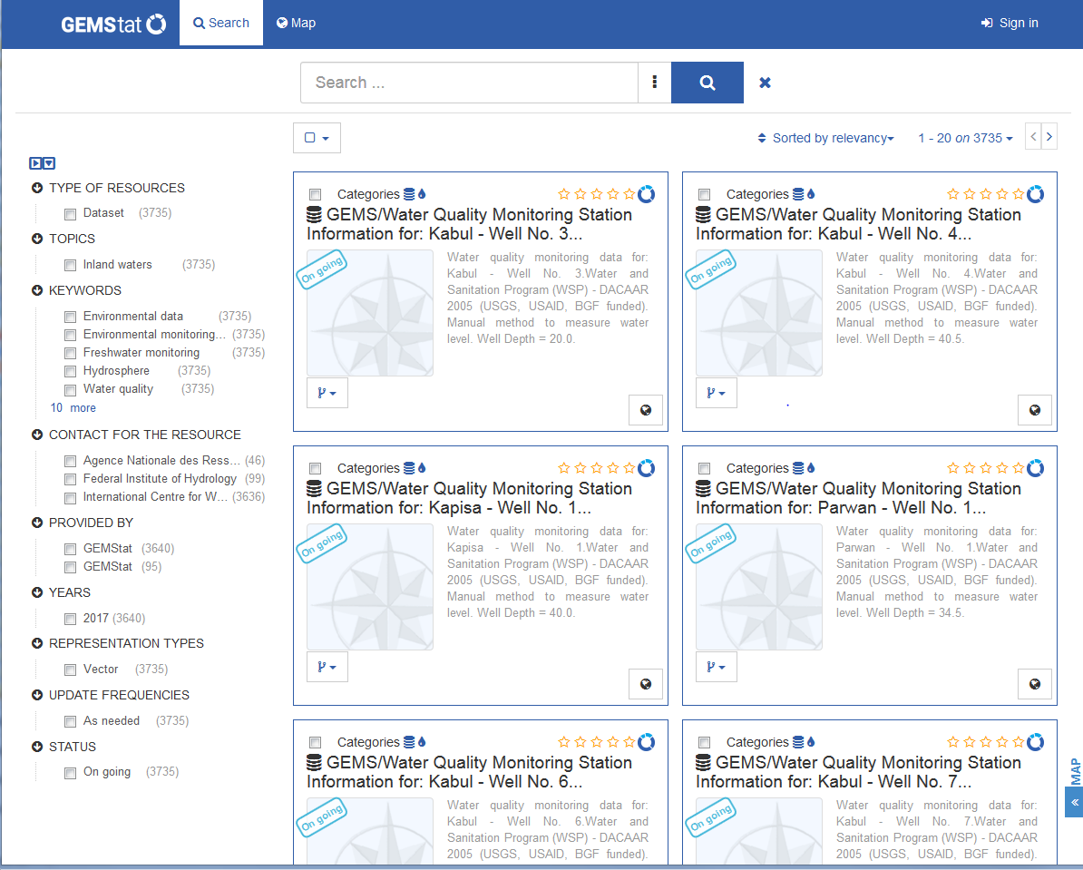

Findable – Standard-compliant metadata to enhance monitoring data discoverability
Geonetwork metadata catalogue
provide ISO 19115-compliant metadata
for each monitoring station referencing access to
  data download services (where data policy allows)
  related maps and data products
GEOSS
WIS
UNEP
Live
Catalog
Metadata
Data
Notes:
For the support of interoperability the GEMStat provides ISO 19115-compliant metadata both through
a catalogue user interface
as well as several open web services including an OGC CSW service.

Slide 24
Outline
Discoverability of global water data: Status quo
The Global Runoff Data Centre (GRDC)
  covers monthly discharge data globally
  development and implementation of WaterML 2.0 and the SOS 2.0 hydrology profile
GEMS/Water Data Centre (GWDC)
  Global freshwater quality data for rivers, lakes, reservoirs, wetlands and groundwater systems; database GEMStat
  ISO 19115-compliant metadata catalogue
Global Precipitation Climatology Centre (GPCC)
  Covers daily precipitation data

Slide 25
GPCC background and data base
  GPCC was established at the beginning of 1989 at Deutscher
  Wetterdienst (DWD) on invitation by WMO; now in operation for
  more than 30 years
GPCC’s main task is the analysis of precipitation on the basis of
in-situ data for the land-surface
  GPCC is contributing to GEWEX (GHP and GDAP) and to GCOS
  Within GDAP it is the component for the analysis of the in-situ
  measurements for the GPCP (Global Precipitation Climatology
  Project)

Slide 26
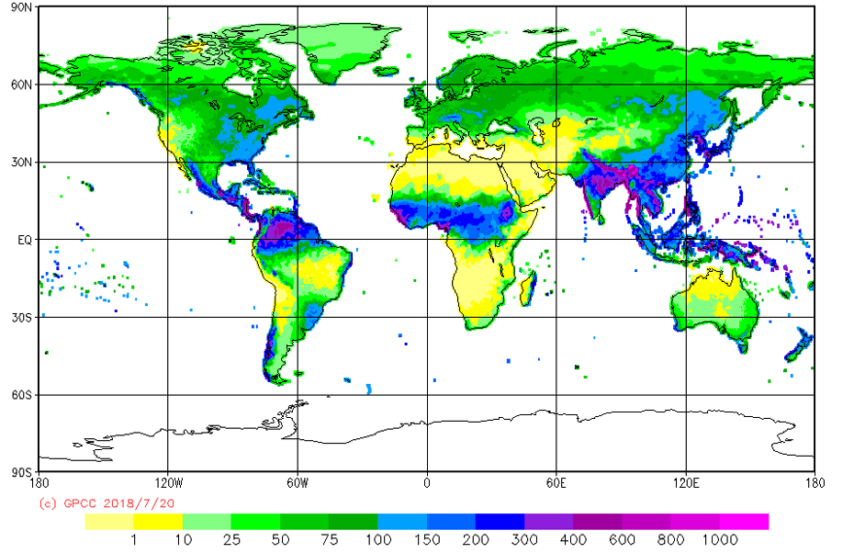
Example of Monthly data in GPCC data base
GPCC Normals Version 2018 for July
Data referenced by DOIs (Digital Object Identifiers) in fully interoperable machine readable format (netCDF)

Slide 27
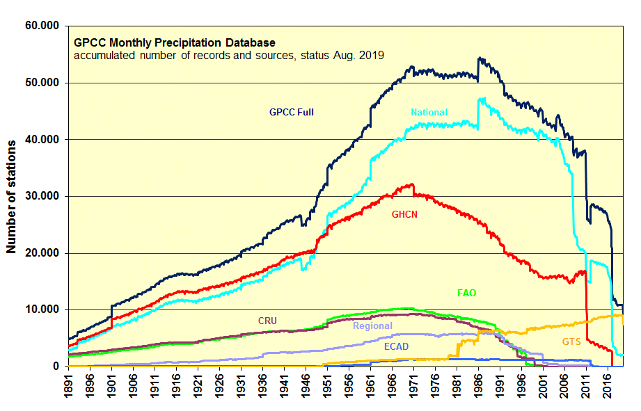
Monthly data in GPCC data base
(GHCN V.2 +
suppl. from
GHCN daily)
GTS includes
SYNOP-based GPCC and CPC
data and CLIMAT

Slide 28
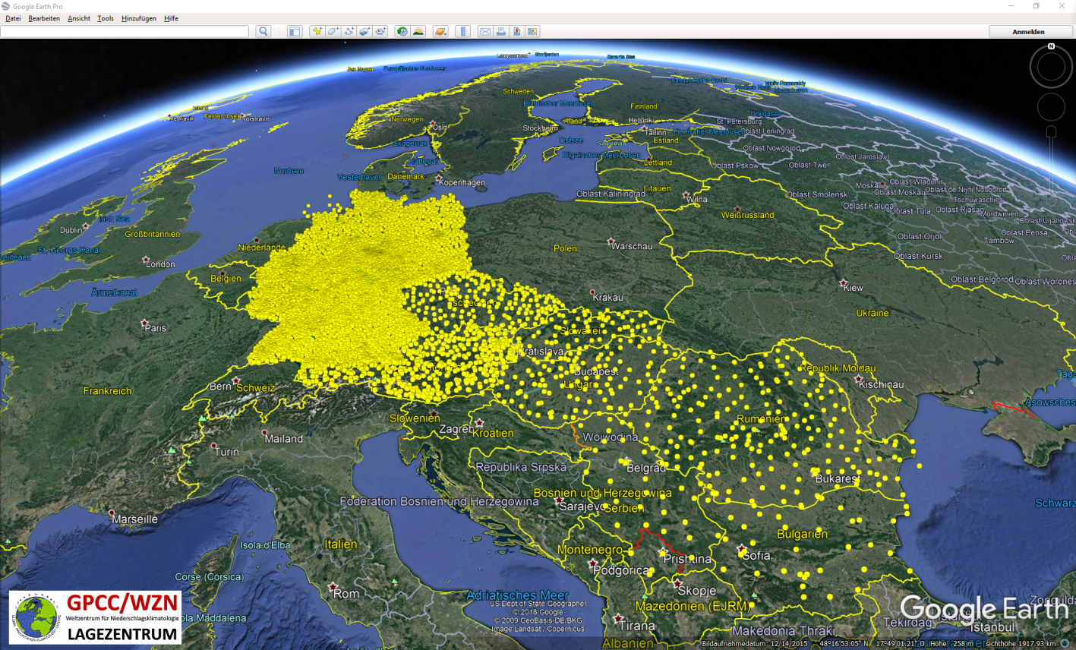
GPCC coverage
 | # total station | Timeseries 1951-2019* | Timeseries 1901-1951*
Austria | 688 | 64 | 19
Czech Rep. | 875 | 75 | 2
Germany | 15638 | 1324 | 596
Bulgaria | 54 | 21 | 3
Slovakia | 82 | 46 | 31
Hungary | 130 | 21 | 2
Serbia | 45 | 5 | 1
Romania | 222 | 13 | 10
*with coverage ≥ 90%

Slide 29
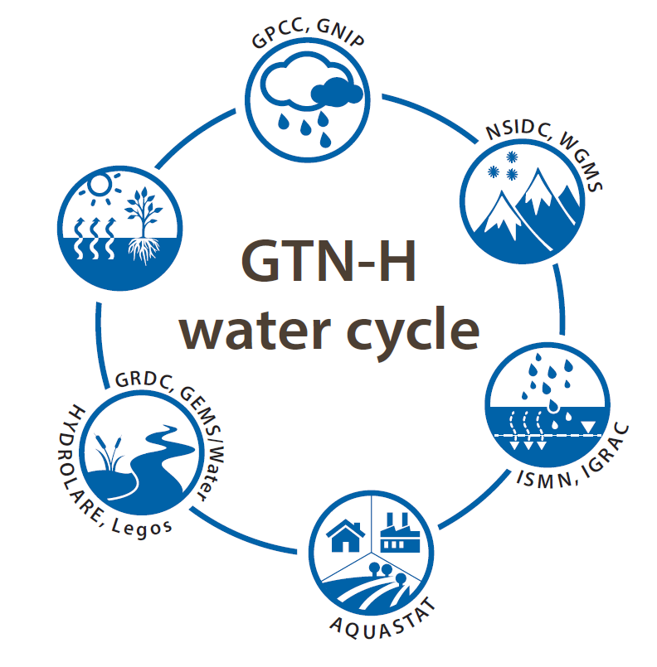

Global Terrestial Network – Hydrology (GTN-H)
Network of the global water data centres
Joint project of the World Meteorological Organization (WMO) and the Global Climate Observing System (GCOS); implementation 2001
In September 2017 ICWRGC took the coordination of GTN-H

Slide 30
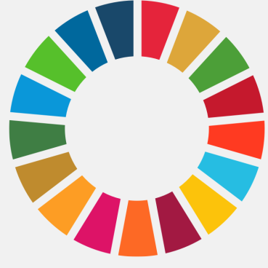
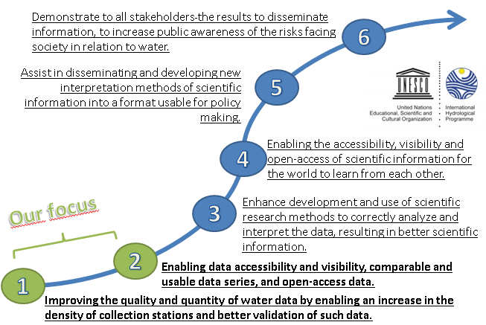
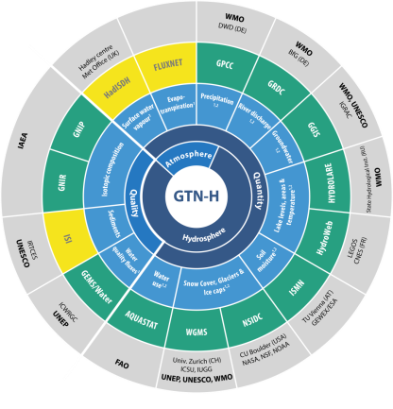
Outlook
IPH IX:
  IHP will support SDG process (need for data)
Operational Global Data Centres
  Exists oftenly since decades and already contribute to IHP agenda and support SDG6 monitoring and indicators by hosting curated water data sets
  Will continously enhance their data products and informations
  However, data acquisition should be support by all member countries
  Improved data exchange between opertional and scientifical networks
ICT* Tools
Water Education
A: Addressing the gap between data and information in support of water resources management
B: Supporting science-based decisions for adaptation and mitigation (to face the negative consequences of past adopted decisions).
C: Achieving sustainable water management (SWM)
Water Governance as a foundation

Slide 31

Outlook
GTN-H
  will continuely work on enhanced interoperability of GTN-H data centres
  is fostering linkage between in-situ and satellite observations
  will develop integrative data products
ICT* Tools
Water Education
A: Addressing the gap between data and information in support of water resources management
B: Supporting science-based decisions for adaptation and mitigation (to face the negative consequences of past adopted decisions).
C: Achieving sustainable water management (SWM)
Water Governance as a foundation

Slide 32
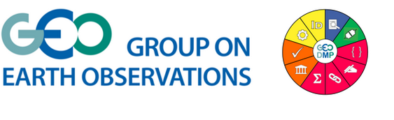
Take home messages
Making your data Findable, Accessable, Interoperabale, Reuseable
Feasable and sustainable
  federated where possible,
  but centralized where necessary
Standards based
  reuse existing community standards,
  adapt, (invent only if really necessary)
  Ecourage and support communities to participate
  Stakeholders included in decision making process: UNESCO, WMO, UNEP, …

Slide 33
Take home messages
Include following mandatory
metadata elements
  Citation information
  (title, author/org, date, DOI)
  Users should cite the original scientists/database who
  contributed to the downloaded
  dataset to ensure that the hard work performed by members of our community is acknowledged properly

Slide 34
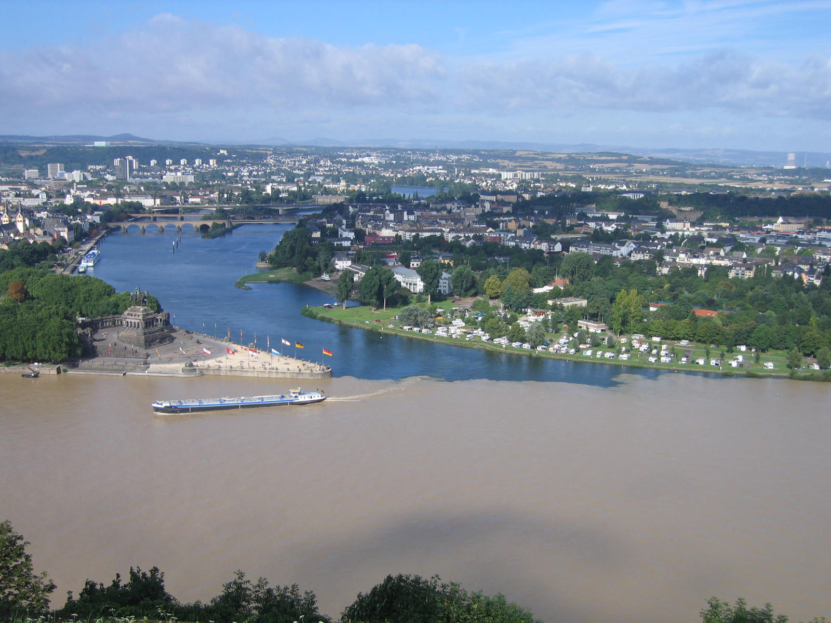
Thank you for your attention
www.waterandchange.org
gtn-h.info | dietrich@bafg.de

Slide 35
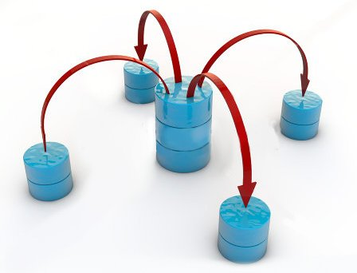
„Interoperability seems to be about the integration of information. What it‘s really about is the coordination of organizational behavior.“
David Schelle, Founder and Chairman of the OGC

Slide 36
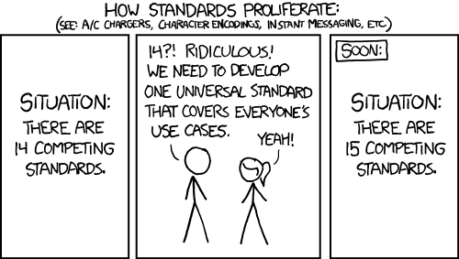
issues
https://xkcd.com/927/

Slide 37
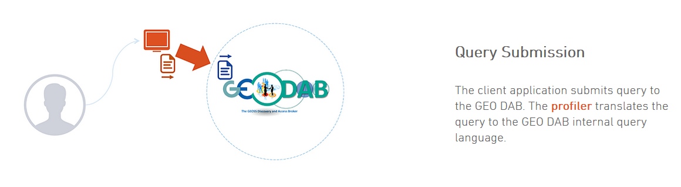
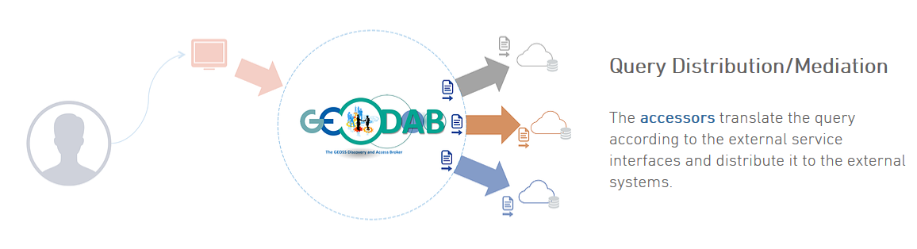
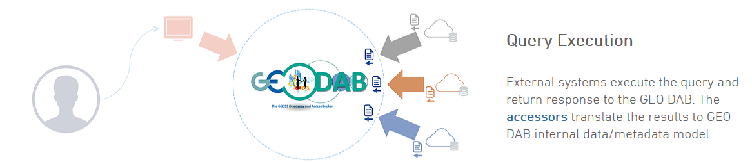
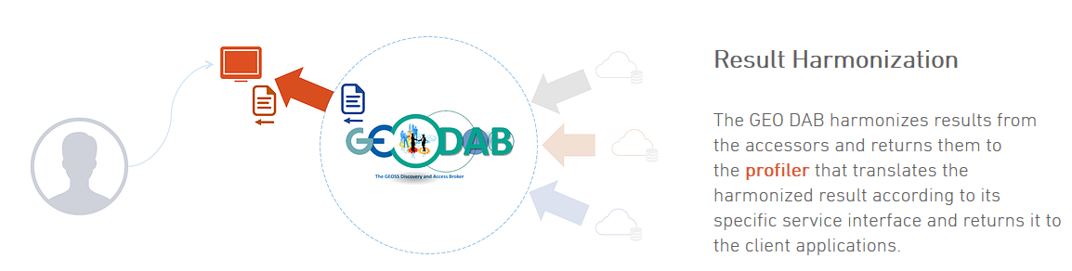
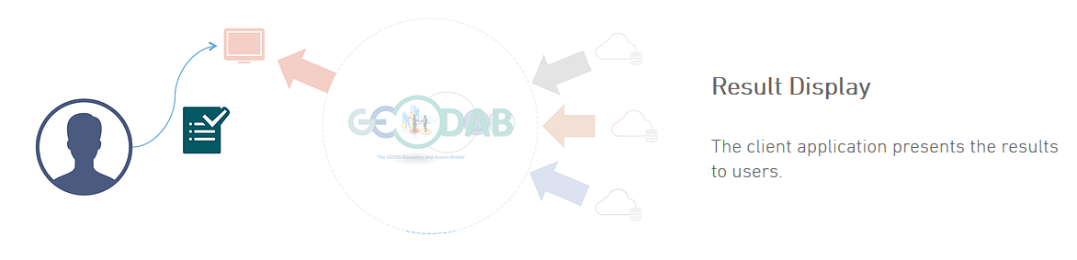
Data Access Brokering

Slide 38
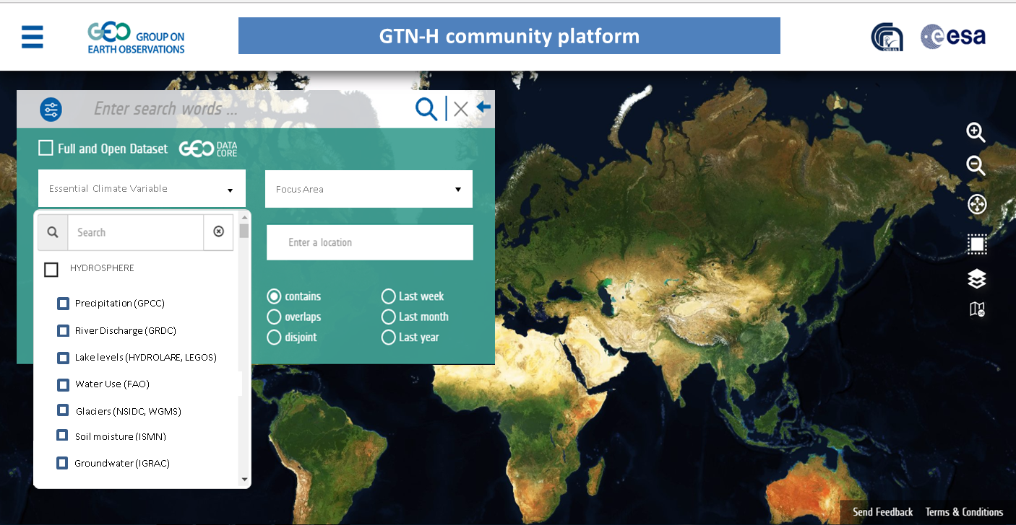
bringing our data together
We construct a GTN-H community portal: using the GEOSS portal functionalities

Slide 39
GEO data management principles
http://geolabel.info/
DMP_generation.htm

Slide 40
Transfer formats
netCDF-CF and/or WaterML-2
  As a common basis
lack of sampling data exchange standards
  E.g. for water quality
  to be developed in the OGC/WMO HDWG
Requirements unified Ontology:
  Methods
  Parameters (observed property)
  Sample media
  Sampling feature
Code lists exists in different communities
  Find together the relevant one(s)
  Use them

Slide 41
Ontologies
An Ontology is a formal naming and definition of the types, properties, and interrelationships of entities that really or fundamentally exist in the domain of hydrology.
In particular, it compartmentalizes the variables needed in hydrology and establishes the relationships between them.
Examples:
  WMO Hydrological Observing System (WHOS)
    http://hydrolite.ddns.net/whos/index.php/ontology
  CSIRO linked data registry
    http://registry.it.csiro.au/

Slide 42
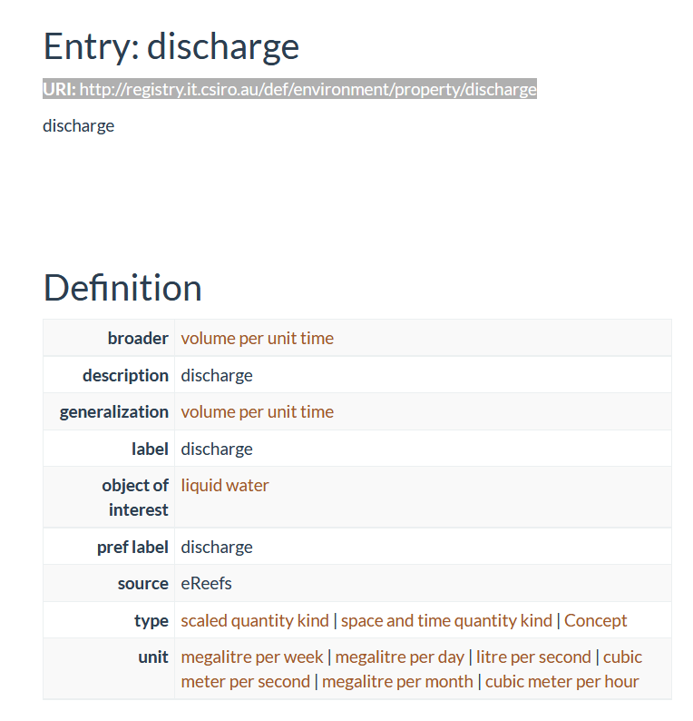
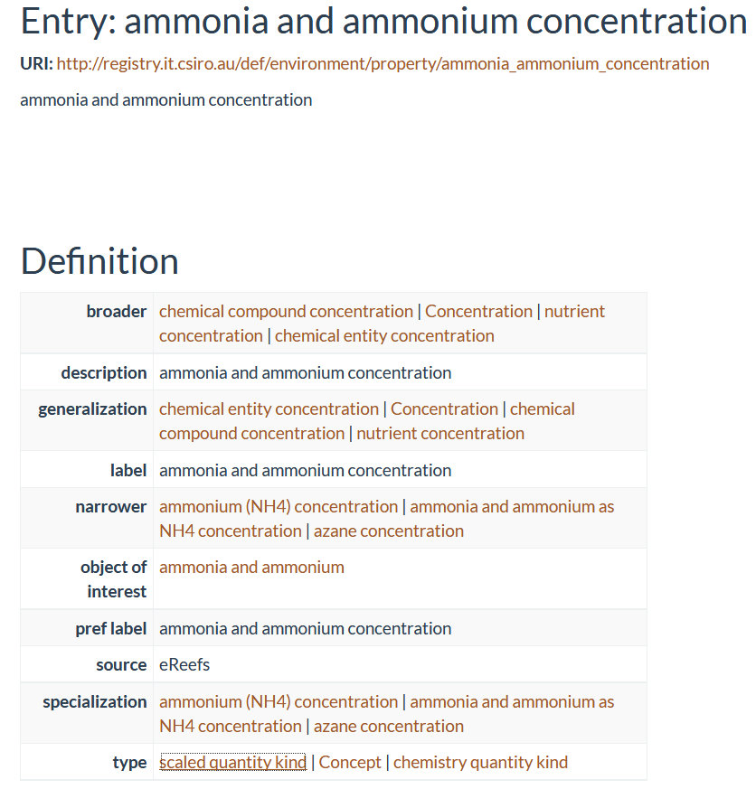
Examples

