Slide 1
ASSESSMENT HARMONIZATION PROBLEMS
OF THE LONG RETURN PERIOD FLOODS
ON THE DANUBE RIVER
Pavla Pekárová, Pavol Miklánek, Veronika Bačová Mitková, Marcel Garaj, Ján Pekár
Slovak Academy of Sciences, Institute of Hydrology, Bratislava;
Comenius University in Bratislava, Faculty of Mathematics, Physics, and Informatics
Notes:
One of the basic problems of the flood hydrology was (and still is) the solution of the relationship between peak discharges of the flood waves and probability of their return period. The assessment of the design values along the Danube channel is more complicated due to application of different estimation methods of design values in particular countries downstream the Danube. Therefore it is necessary to commence the harmonization of the flood design values assessment methods. All methods of estimating floods with a very long return period are associated with great uncertainties. Determining of the specific value of the 500- or 1000-year floods for engineering practice is extremely complex. Nowadays hydrologists are required to determine not only the specific design value of the flood, but it is also necessary to specify confidence intervals in which the flow of a given 100-, 500-, or 1000-year flood may occur with probability, for example, 90%.

Slide 2
Motivation
to propose unified methodology to estimate the design values of flood discharges in stations along the Danube River
to present the results of the estimation of the Q_{max} discharge series distribution function using log Pearson Type III distribution (LP3) with inclusion of the historical floods into data series
estimation of the relationship between the skew coefficient of the LP3 III distribution function and runoff depth in 20 gauges along the Danube River.
Notes:
The assessment of the design values Qmax can be done by several methods. In this study we have applied the statistical methods based on the assessment of the distribution function of measured time series of the maximum annual discharge. In order to apply regionalization methods for the estimation of the distribution function in this study we used only one distribution - the Pearson Type III distribution with logarithmic transformation of the data (LP3 distribution).

Slide 3
Data
Notes:
To estimate regional skew coefficient for the Danube River we used 20 Qmax measured time series from water gauges along the Danube River from Germany to Ukraine. We firstly analyzed the occurrence of historic floods in several stations along the Danube River. Then we search relationship between the parameter of skewness of LP3 distribution function and runoff depth, altitude, or basin area in all 20 water gauge. Skewness coefficients of the LP3 distribution in the stations along the Danube River vary between –0.4 and 0.86.

Slide 4
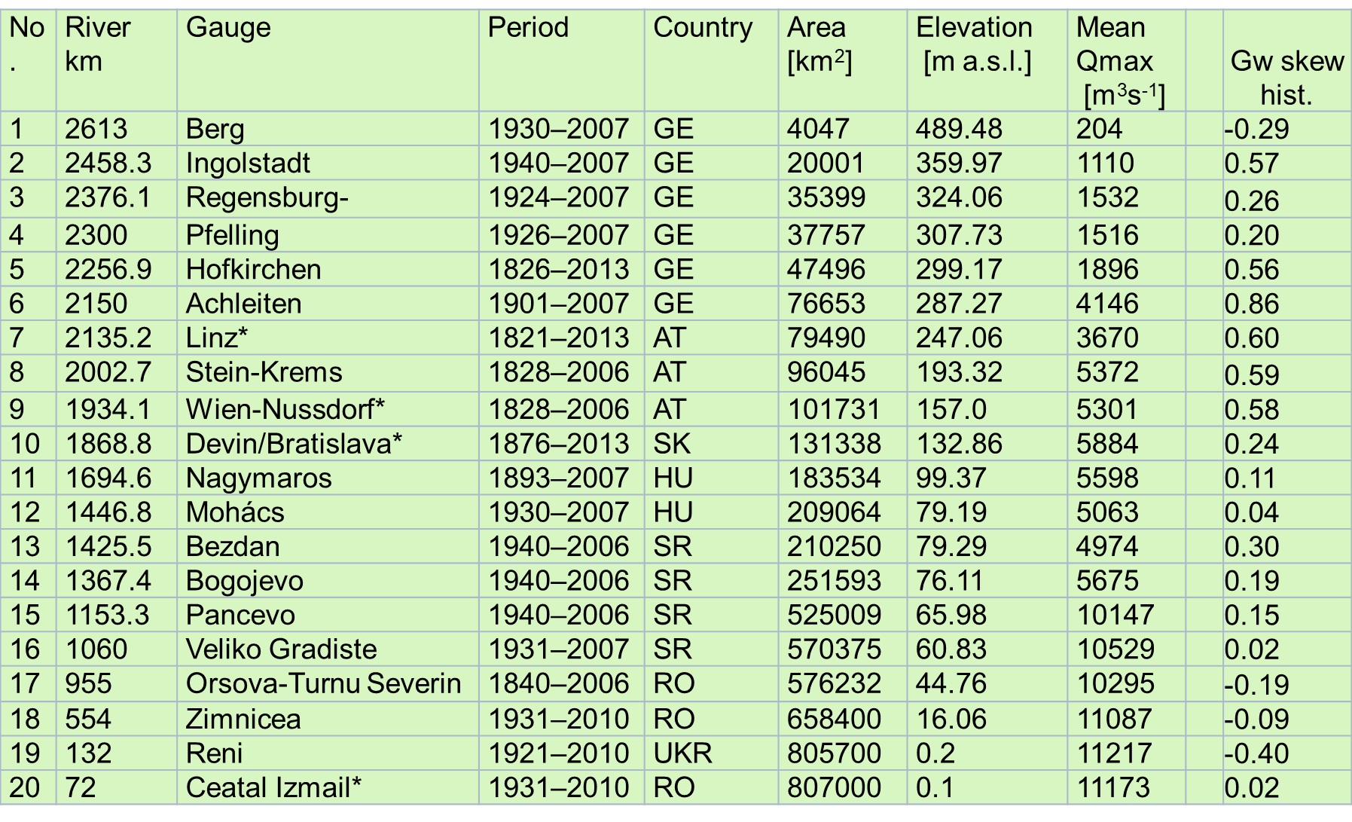
Data

Slide 5
Historical Danube River floods in river section Devín–Bratislava since 1500 up to 1876
(red columns - summer floods, blue columns - winter floods);
since 1876- the observed annual peaks Qmax at Bratislava gauge

Slide 6
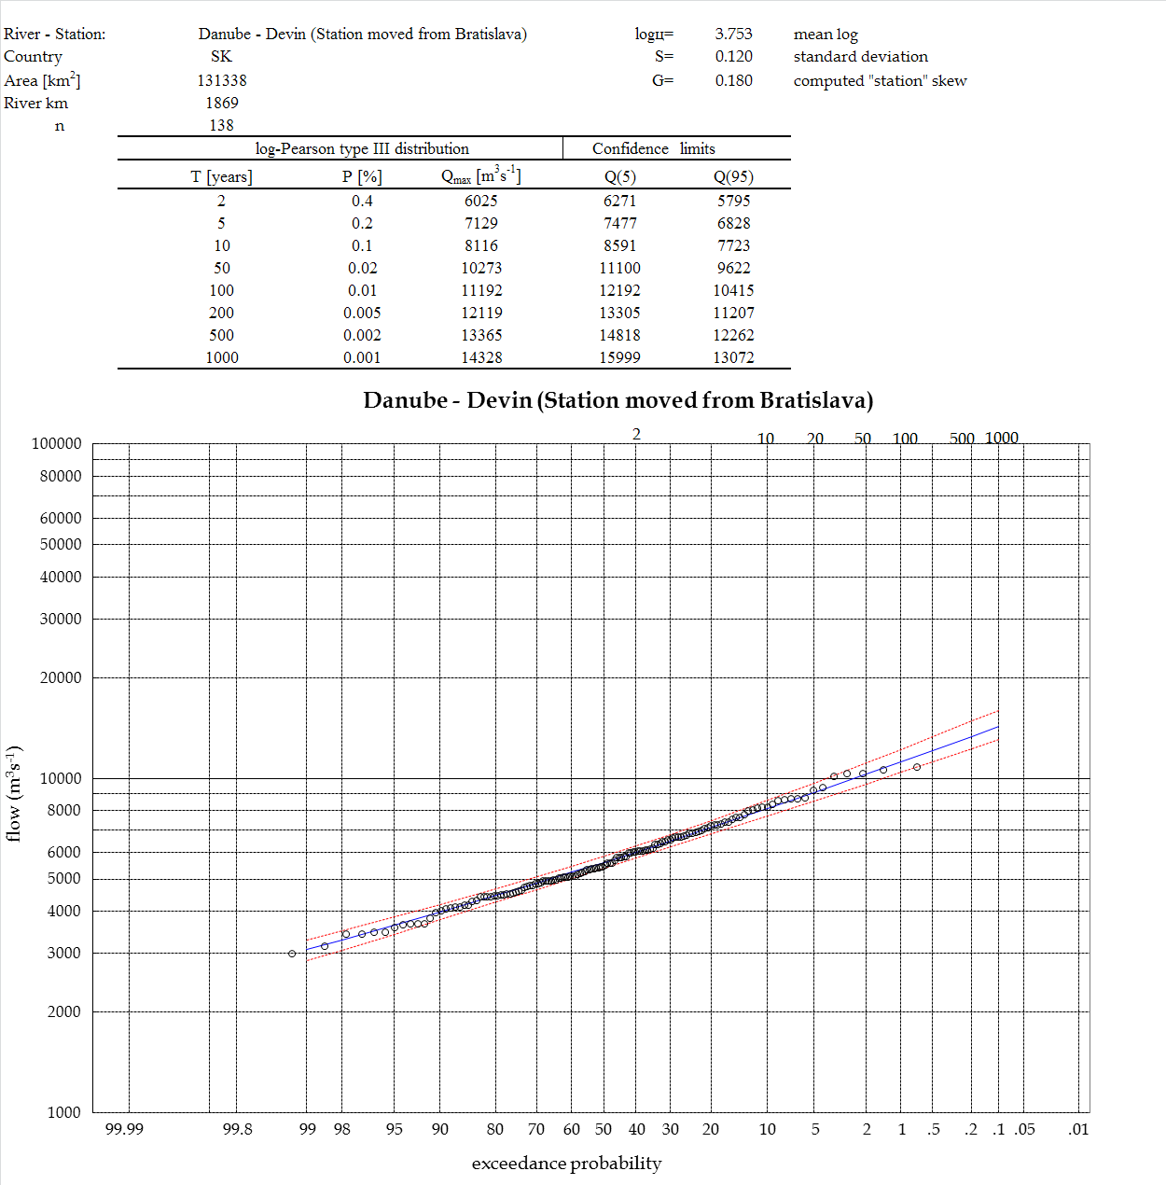
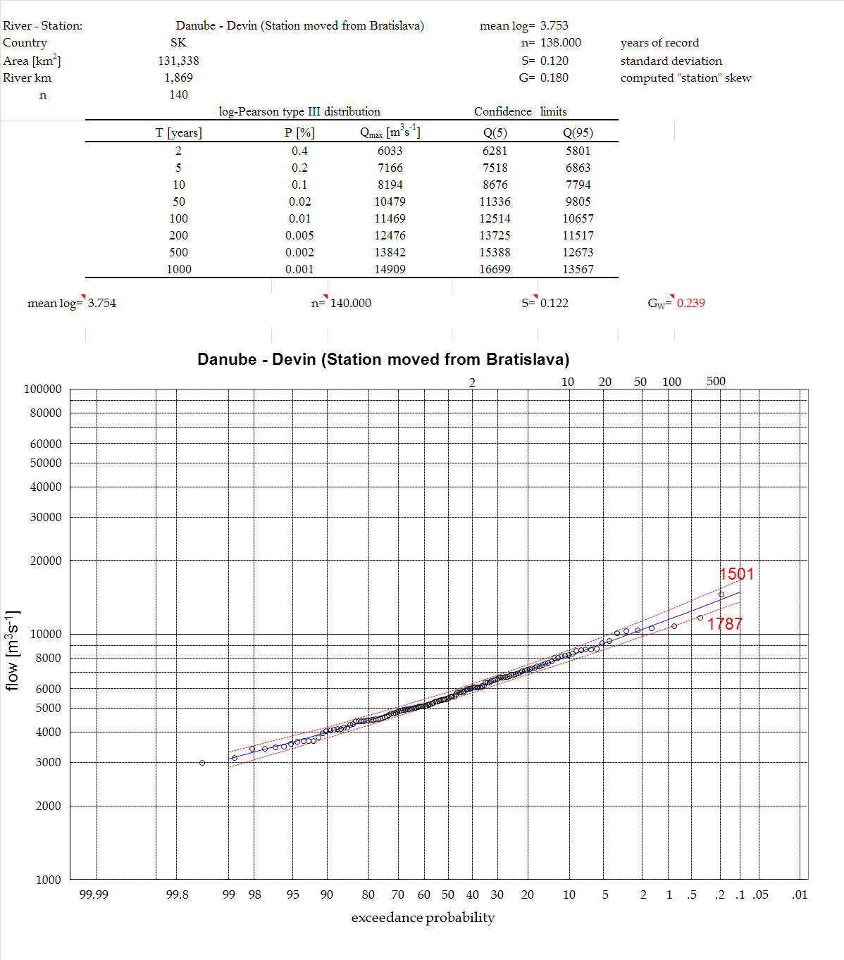
Empirical and theoretical exceedance probability curves of the Danube yearly maximum discharges at Bratislava. q(5) and q(95) are the probability confidence limits, the log- Pearson type III. probability distribution
Notes:
6
6
The inclusion of the historical floods to calculation procedure has increased the skew coefficient G to Gh by 0.2 in average. Historic coefficients of skewness (Gh) of the LP3 distribution curves are in a range from –0.404 to 0.861 along the Danube River.

Slide 7
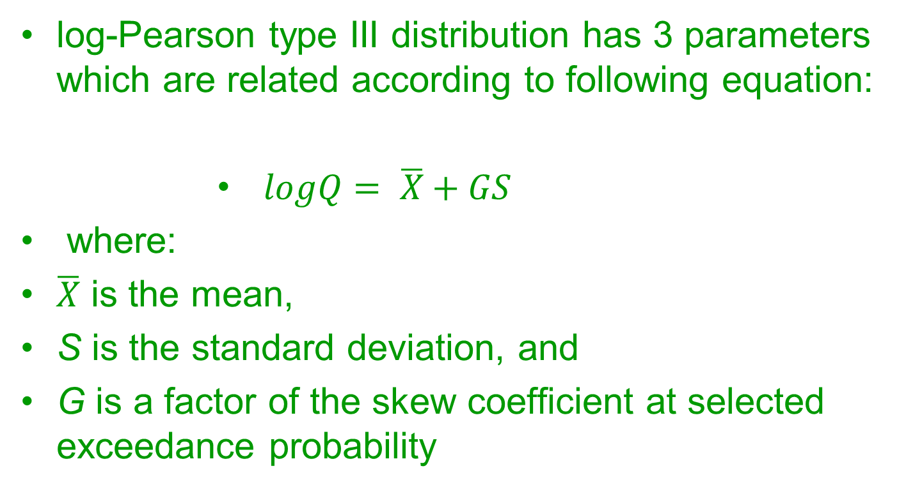
log-Pearson type III distribution has 3 parameters which are related according to following equation:
$logQ= \overline{X}+GS$
where:
$\overline{X}$ is the mean,
S is the standard deviation, and
G is a factor of the skew coefficient at selected exceedance probability
Notes:
In the first step, we estimated the LP3 distribution function parameters (mean Q, standard deviation S, and station skewness coefficient G), for each of the stations separately and computed Qmax design values In the case of gauges with historic floods, we added historic floods into the measured Qmax series, and recalculated the parameters of the LP3 distribution curves for individual stations having included the historic floods.

Slide 8
T-year design discharges (left); coefficient k (right)
at stations along the Danube River
Notes:
Several hydrological characteristics were analysed along the Danube River. Fig. 4a shows how QT design values change along the Danube. The coefficients k=QT/Qa, (Qa is long term mean discharge) are presented in Fig. 4b. The 1000-year discharge is 16-times higher than the mean annual discharge at station Berg, while its is only 7-times higher at station Bratislava, and only 3-times higher at station Reni

Slide 9
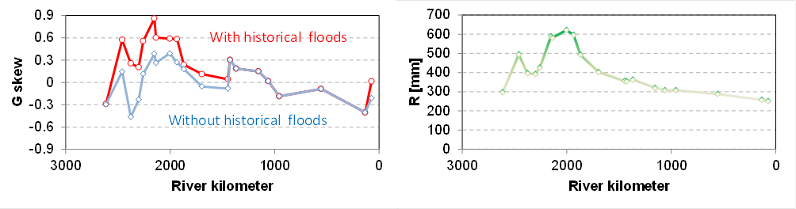
Both skew coefficients G and Gh , and long term runoff depth at the analysed stations have the similar course along the Danube
Notes:
Both, the skew coefficients G and Gh , and long term runoff depth at the analysed stations have the similar course along the Danube.

Slide 10
Gh = 0.977*ln(R) – 5.595 r² = 0.786;
Gh = 0.00234*R – 0.719 r² = 0.779;
where: R – long-term average annual runoff depth in mm (from 240 mm to 640 mm).
Notes:
The following two best fitted relationships between the historical skew coefficient Gh and the runoff depth at the station were estimated (Fig. 5):
We propose to use the regional skew G_{r} coefficient calculated according to the simple linear relationship for estimations of the T-year discharges at gauges on the Danube River.

Slide 11
Dependence of regional skew coefficient Gr
on the runoff depth R, Danube River
Notes:
The estimation of T-year discharges is never-ending process. Urbanization, channel regulation, flood protection construction and many other interventions, can change maximum discharges and negatively influence the application of frequency analysis. The future prediction of peak annual discharges is based on historical records. Land use changes and massive regulations of river beds can interrupt a stationarity of hydrological time series. Selected statistical variables (mean, median, skew, variation) have to be estimated appropriately from all the observing data. If anything will be changed in a catchment, it is necessary to recalculate distribution curves and define new T-year discharges in particular stations.

Slide 12
FLOOD REGIME OF RIVERS
IN THE DANUBE RIVER BASIN
Pavol Miklánek, Pavla Pekárová, Ján Pekár
Notes:
L
adies and gentleman
As you can see, the title of my presentation is: Comparison of the 1895 and 2006 Danube floods.
The authors are:
Dr. Melo and Dr. Pekar from: Comenius University
Dr. Miklanek and me from: IH SAS
Dr. Melova from SHMI
This lecture follows the lectures of my colleagues
Dr. Miklanek and Dr. Halmová.

Slide 13
1 AVERAGE DAILY DISCHARGE AND ANNUAL PEAK DISCHARGE SERIES COLLECTION
2 HISTORY AND DOWNSTREAM PROPAGATION OF THE DANUBE FLOODS
3 ANALYSIS OF HOMOGENEITY OF ANNUAL TIME SERIES
4 ANALYSIS OF CYCLICITY AND LONG-TERM TRENDS OF ANNUAL SERIES, AND QMAX SERIES

Slide 14
5 ANALYSIS OF THE INTRA-ANNUAL REGIME OF FLOOD FLOW AND ITS CHANGES IN THE DANUBE BASIN
6 STATISTICAL ANALYSIS OF EXTREME DISCHARGES
7 COINCIDENCE OF THE FLOOD FLOW OF THE DANUBE RIVER AND ITS MAIN TRIBUTARIES

Slide 15
8 THEORETICAL DESIGN HYDROGRAPHS AT THE HYDROLOGICAL GAUGING STATIONS ALONG THE DANUBE RIVER
9 REGIONALIZATION OF FLOOD REGIMES ACCORDING TO FLOOD MAGNITUDES AND OTHER HYDROLOGICAL CHARACTERISTICS THROUGH APPLICATION OF THE MULTIVARIATE COPULA FUNCTIONS

Slide 16
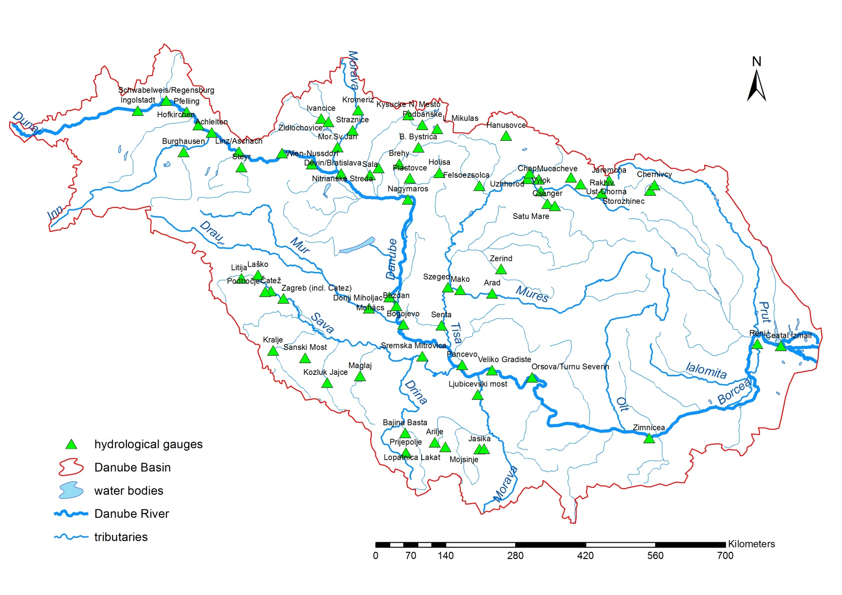
Danube Tributaries Data
60 stations
XXVII. DANUBE CONFERENCE 2017, Golden Sands, Bulgaria, 26-28 September 2017
Notes:
16

Slide 17
O1: Average daily discharge and annual peak discharge series collection
XXVII. DANUBE CONFERENCE 2017, Golden Sands, Bulgaria, 26-28 September 2017
Notes:
17

Slide 18
O1: Average daily discharge and annual peak discharge series collection
XXVII. DANUBE CONFERENCE 2017, Golden Sands, Bulgaria, 26-28 September 2017
Notes:
18

