Slide 1
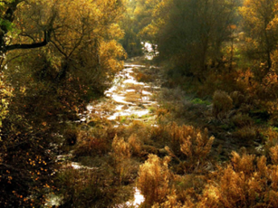
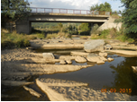
MONITORING AND INVESTIGATION OF INTERMITTENT RIVERS IN BULGARIA
National Institute of Meteorology and Hydrology, BULGARIA

Slide 2
INTERMITTENT RIVERS
River flows could be defined according to their surface hydrologic stream duration as either perennial or temporary.
Normally perennial streams flow throughout the year, while temporary streams lack surface flow for some periods of the year. Temporary streams are classified as intermittent or ephemeral.
Intermittent streams flow in some periods as result of snowmelt and eventually elevated groundwater tables during the periods of increased precipitations.
National Institute of Meteorology and Hydrology

Slide 3
As tributaries to larger rivers they play a significant role in the dynamics of materials and energy at the watersheds. Intermittent streams are poorly represented in existing river monitoring programs in Bulgaria and very seldom are objects of regular monitoring.
Covering the whole territory of Bulgaria the authors identify four main types of intermittent streams as: 1) intermittent flows as result of Mediterranean climatic impact located in the southern part of the country; 2) sinking intermittent flows as result of specific geological and soil characteristics, 3) intermittent flows in large karst and loess areas and finally 4) the sinking flows in alluvium depositions mainly along the large mainstreams.

Slide 4
Intermittent streams have a hydrologic flow regime with very specific characteristics that place them as interact between land and water.
Understanding the drying river is a basis for further understanding of the ecohydrological processes of the river basins and is a strong indicator of climate changes in the regions.
National Institute of Meteorology and Hydrology

Slide 5
The intermittent rivers have always been underestimated, including in Bulgaria. Currently the increased European interest is expressed in a special European project called COST Action Ca 15113 - Science and Management of Intermittent Rivers & Ephemeral Streams (SMIRES) with the participation of National Institute of Meteorology and Hydrology, Bulgaria seeking to summarize our knowledge of these rivers including from hydrological point of view.
National Institute of Meteorology and Hydrology

Slide 6
INTERMITTENT RIVERS IN BULGARIA
The river runoff on the territory of Bulgaria is formed under the influence of three climatic zones - temperate continental; transitional-continental; continental-Mediterranean; as well orohydrographic, geological and hydrogeological characteristics of the catchments.
The investigation has three objectives: 1) characterizing the spatial distribution of the drying rivers on the territory of Bulgaria; 2) study of the genesis of drying up of the main types of the intermittent rivers; 3) frequency of occurrence and duration of the phenomenon over the years.

Slide 7
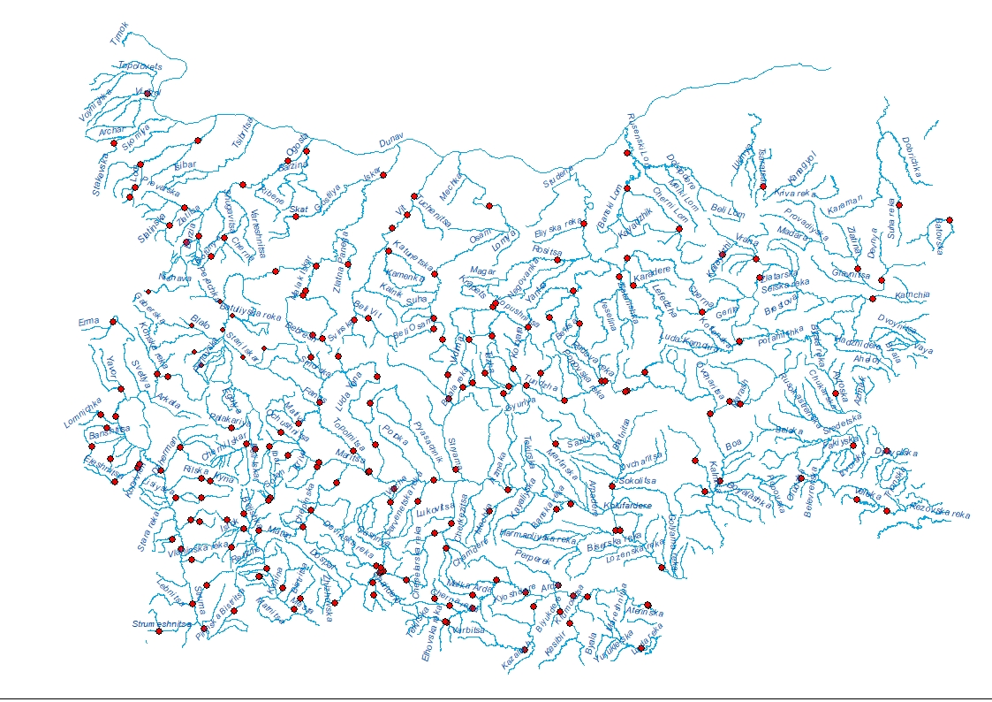
Hydrological network and database
The survey is based on historical time series of the daily flows from the State hydrometric network on the territory of the country - 216 gauging stations (200 among them active at present and 16 temporally closed the last years)

Slide 8
STATISTICAL PROCESSING
The referent period of investigation covers 37 years from 1981 to 2017. The accepted period includes a low-water phase registered on the territory of the country - 1981-2000 and a phase with a trend of increasing flows 2001-2017.
The criteria for the selection of drying rivers were adopted by the Working Group 1 (Hydrology) of project “Science and Management of Intermittent Rivers & Ephemeral Streams” (SMIRES) in 2017.
Statistical processing of hydrological daily time series for all gauging stations with registered zero-flow has been carried out for the whole period of investigation.

Slide 9
CRITERIA FOR INTERMITTENT RIVERS
a) at least one event with discharge lower or equal to one liter per second for daily data;
b) for weekly data seven consecutive days (i.e. one record) with this discharge value;
c) for monthly – one month; the minimum time series length is 10 years, with less than 5% of missing days.
RESULTS - The total number of gauging stations with registered zero-flow days is 42 (among them: 38 stations with numerous registered zero-flow days in the studied period and 4 with accidently registered zero-flow days) – Table 1

Slide 10
Statistical characteristics
Where:
n₀ is the total number of days with zero-flow, ƒ is the fraction of zero-flow years which is the number of years with zero-flow divided by the total number of years, ma is the mean annual number of zero-flow days which is the total number of zero-flow days divided by the number of years, max d - maximum number days zero-flows in the one year for the period, min d - minimum number days zero-flows in the one year for the period, mean d - mean number days zero-flows in the one year for the period, Cv -coefficient of variation of the days with zero-flow.

Slide 11
As a result of both field surveys and statistical processing of the hydrological historical time series at the monitoring stations, four major regions presented on the country map below, were identified with drying rivers meeting the aforementioned criteria:
      Dobrudja region – region 1;
      The Eastern Rhodopi and Sakar Mountain – region 2;
      The Southern Black Sea area – region 3;
      The southern parts of the catchment area of the Struma River – region 4

Slide 12
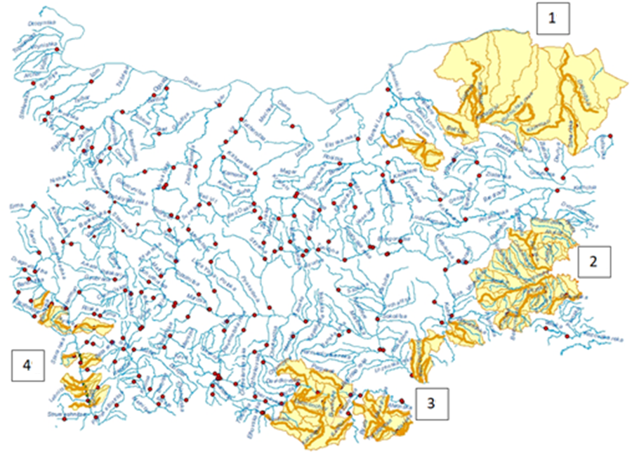
Regions with intermittent rivers in Bulgaria

Slide 13
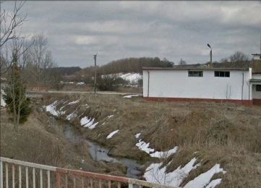
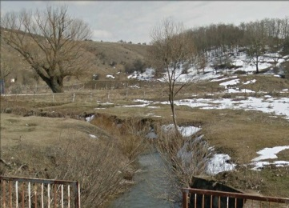
Dobrudja sinking rivers region [1]
The Dobrudja rivers flow into the Dobrudja Plateau and parts of the Ludogorie area in wide or canyon-shaped river valleys. This area is characterized by a small outflow coefficient of rainfall, one of the lowest determined on the territory of Bulgaria – only 2%.
Dobrudja area is characterized by negligible surface runoff and very large karst groundwater resources. The low rainfall and karst character of the area limits the surface runoff after prolonged heavy rainfall.
Characteristic of the Dobrudja rivers is the absence of a true estuary, submersion and groundwater feeding; truncated or unformed shallow river beds. The rivers are dry, with mainly ground feeding and most often large catchments with an altitude of less than 300 m.

Slide 14
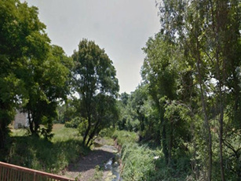
Southern Black Sea region [2]
The rivers in the Southern Black Sea region form their runoff under the influence of the Mediterranean climate but with specific features of the Black Sea area.
The specific Black Sea climatic influence and the lack of significant ground feeding are the main factors for the seasonal drying up of the rivers in the region. The Southern Black Sea region is characterized by low water content with low runoff (11%).
Typical for the region is the great diversity in the annual runoff distribution, which is strongly influenced by the nature of rainfall and their distribution over the years.

Slide 15
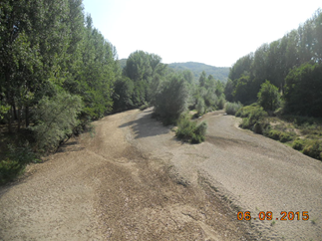
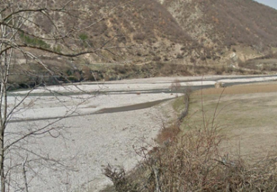
Eastern Rodopi and Sakar Mountains region [3]
A specific river type for this region are the sub-Mediterranean small and medium-sized rivers, characteristic of all tributaries of the Arda River flowing into the section from the Kardzhali Reservoir to the Greek border.
The right tributaries of the Arda - Varbitsa and Krumovitsa Rivers are the special and very typical case of the sub-Mediterranean mountain rivers, characterized by rapid outflow concentration, formation of extreme high waves and severe shallow water afterward - Figure -1 .
The Mediterranean climate, the lack of significant aquifers and the natural drainage of the terrain are the main factors for the observed seasonal dryness of these rivers and their torrential character.

Slide 16
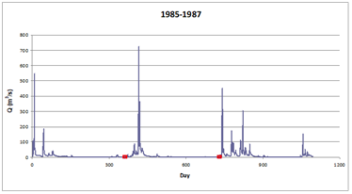
Hydrograph of Varbitza river - Mediterranean impact on the mountain areas Eastern Rodopi and Sakar - Region 3

Slide 17
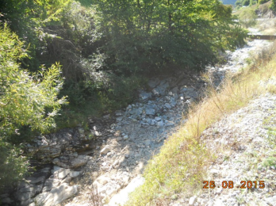
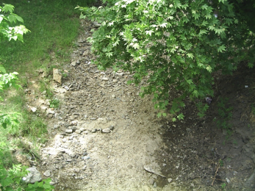
Struma watershed region [4]
Mediterranean influence on runoff formation (Continental-Mediterranean climatic region) covers the middle reaches of the Struma River where drying, mostly small left and right tributaries have been observed.
The catchment areas are composed mainly of silicate (magma and metamorphic) rocks: southern Bulgarian granites, gneisses, shales, rhyolites, etc. In the mentioned rock formations, there are no conditions for the formation of significant resources from groundwater type in the cracks. Generally areas with the distribution of these rock formations are estimated to be poorly waterlogged.
The Mediterranean climate, the lack of significant aquifers and the natural drainage of the terrain are the main factors for the observed seasonal drying up of these rivers and the torrential nature of some of them, such as the Potoka River and others.

Slide 18
results and discussion
The reasons for the drying up of the rivers in the four identified regions have different genesis:
The regions located in the eastern part of the Rhodopi Mountains and the catchment area of the Struma river are exposed to the Mediterranean climate, which is reflected in hot and dry summers with little rainfall and prolonged drought.
In the southern Black Sea region and the Strandja Mountain, there is a mixed influence of the Mediterranean climate and the specific influence of the Black Sea, characterized by wet winters and autumns and drier spring and summer.
The genesis of the drying up of the rivers in Dobrogea is quite different. The main reason is the geological structure of the area and the sinking of the rivers in quaternary alluvial and diluvial deposits in the karst region. An acute continental climate with prolonged summer droughts is another important factor.

Slide 19
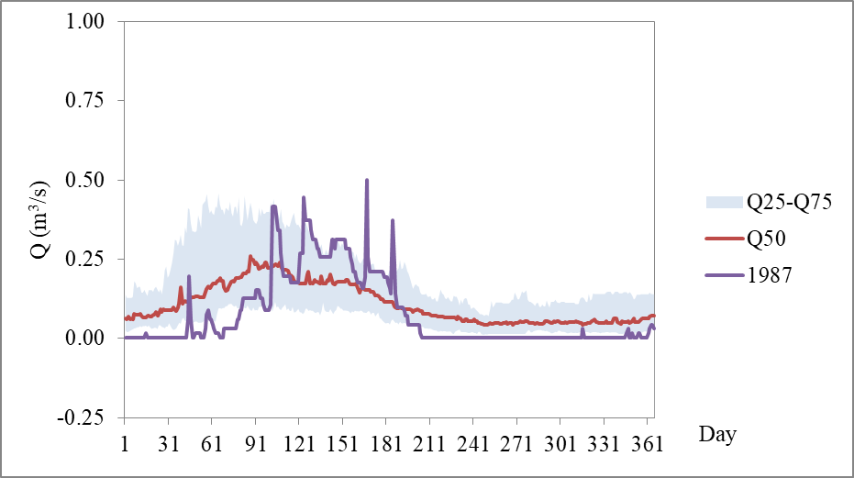
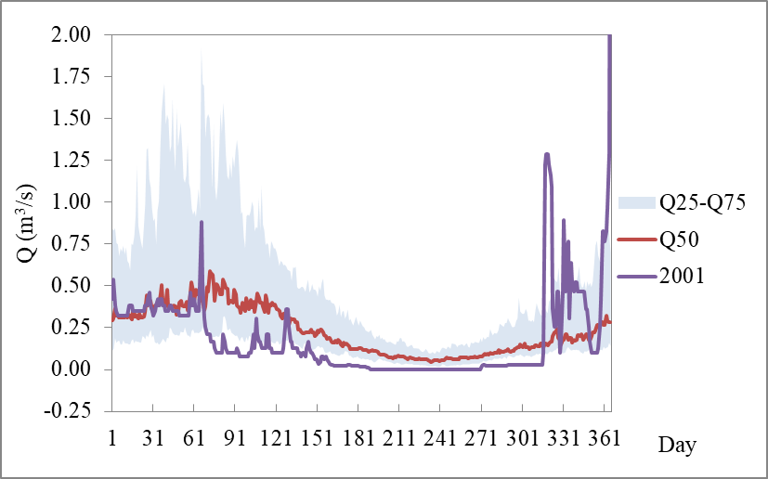
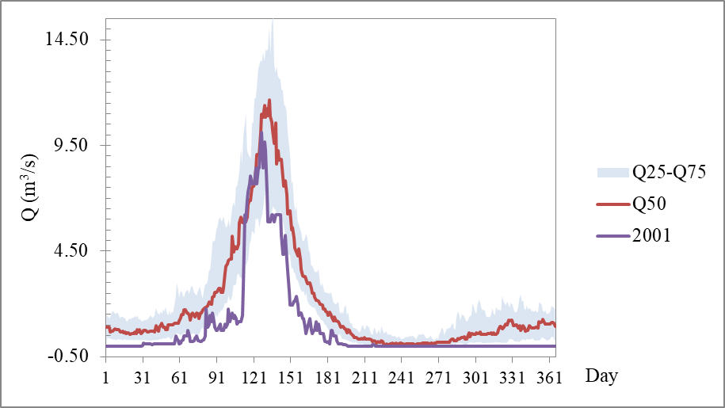
HYDROGRAPHS - COMPARISON
The hydrographs and flow duration curves demonstrate the very different flow regime and interannual distribution in the different geographical region.
Hydrographs of the Sencovez River– (1981-2017) Dobrudja sinking rivers region - 1
Hydrographs of the Fakiiska River at Fakia –(1981-2017) Southern Black sea region -2
Hydrographs of the Bl. Bistriza River–(1981-2017)
Struma watershed region - 4
- annual hydrographs - year with highest proportion of zero flows - in violet
- median in interquartile ranges between Q25 and Q75 - in blue shaded areas
- median flow - in red

Slide 20
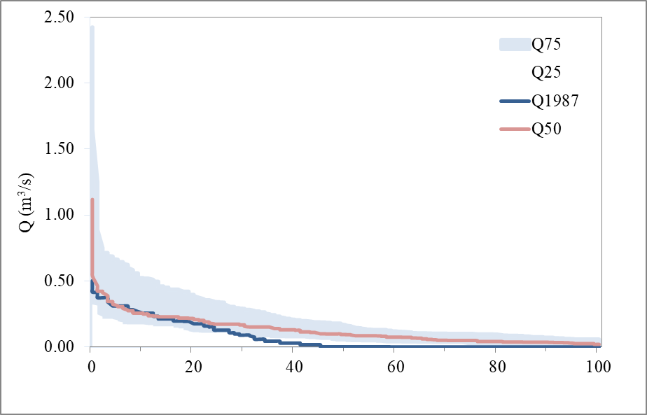
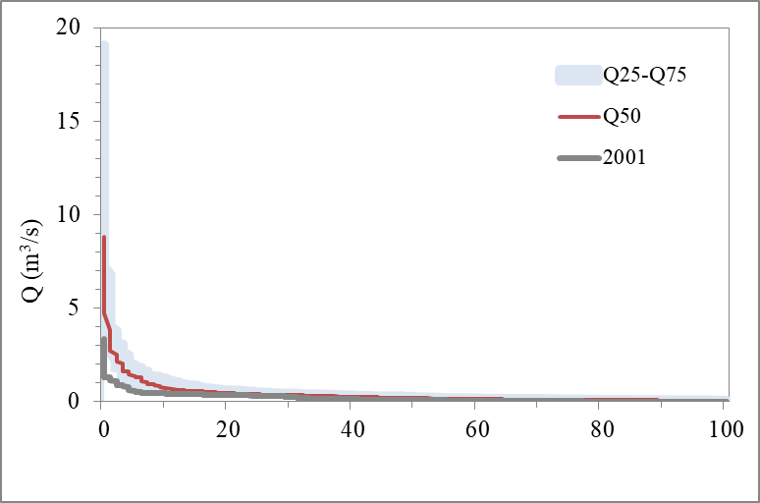
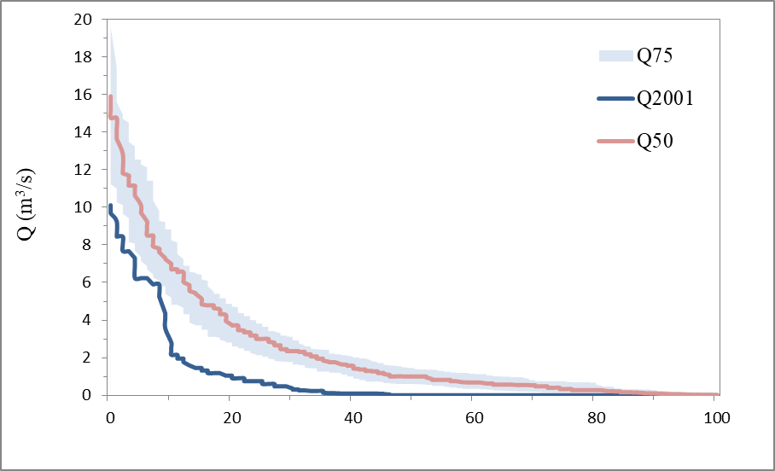
FLOW DURATION CURVES - COMPARISON
The hydrographs and flow duration curves demonstrate the very different flow regime and interannual distribution in the different geographical region.
Flow duration curves of the Sencovez River– (1981-2017) Dobrudja sinking rivers region - 1
Flow duration curves of the Fakiiska River at Fakia –(1981-2017) Southern Black sea region -2
Flow duration curves of the Bl. Bistriza River–(1981-2017)
Struma watershed region - 4
- annual flow duration curves - year with highest proportion of zero flows - in violet
- median in interquartile ranges between Q25 and Q75 - in blue shaded areas
- median flow - in red

Slide 21
conclusions
The present study reflects some of the results of the investigation on the spatial distribution, the genesis of drying up and the regime of the rivers with zero-flow days in Bulgaria.
For the first time, regions with dried beds are identified and mapped on the territory of the Bulgaria.
The current pioneering investigation for the country may be a good basis for future exploration of drying rivers.

Slide 22

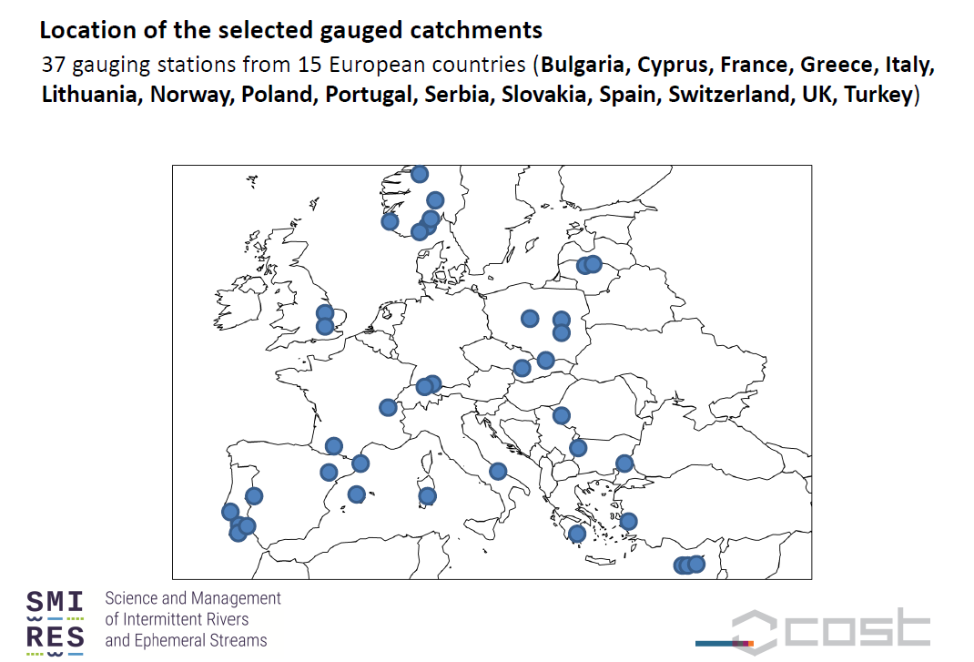

Slide 24
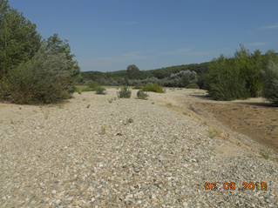
Thank you

