Slide 1
TIME SERIES ANALYSIS AND FORECAST ESTIMATES OF THE MEAN ANNUAL WATER RUNOFF OF RIVERS IN OF THE PRUT AND SIRET BASINS (WITHIN UKRAINE)
Lukianets O., Obodovskyi O. Grebin V. Pochaievets O.
Taras Shevchenko National University of Kyiv, Ukraine

Slide 2
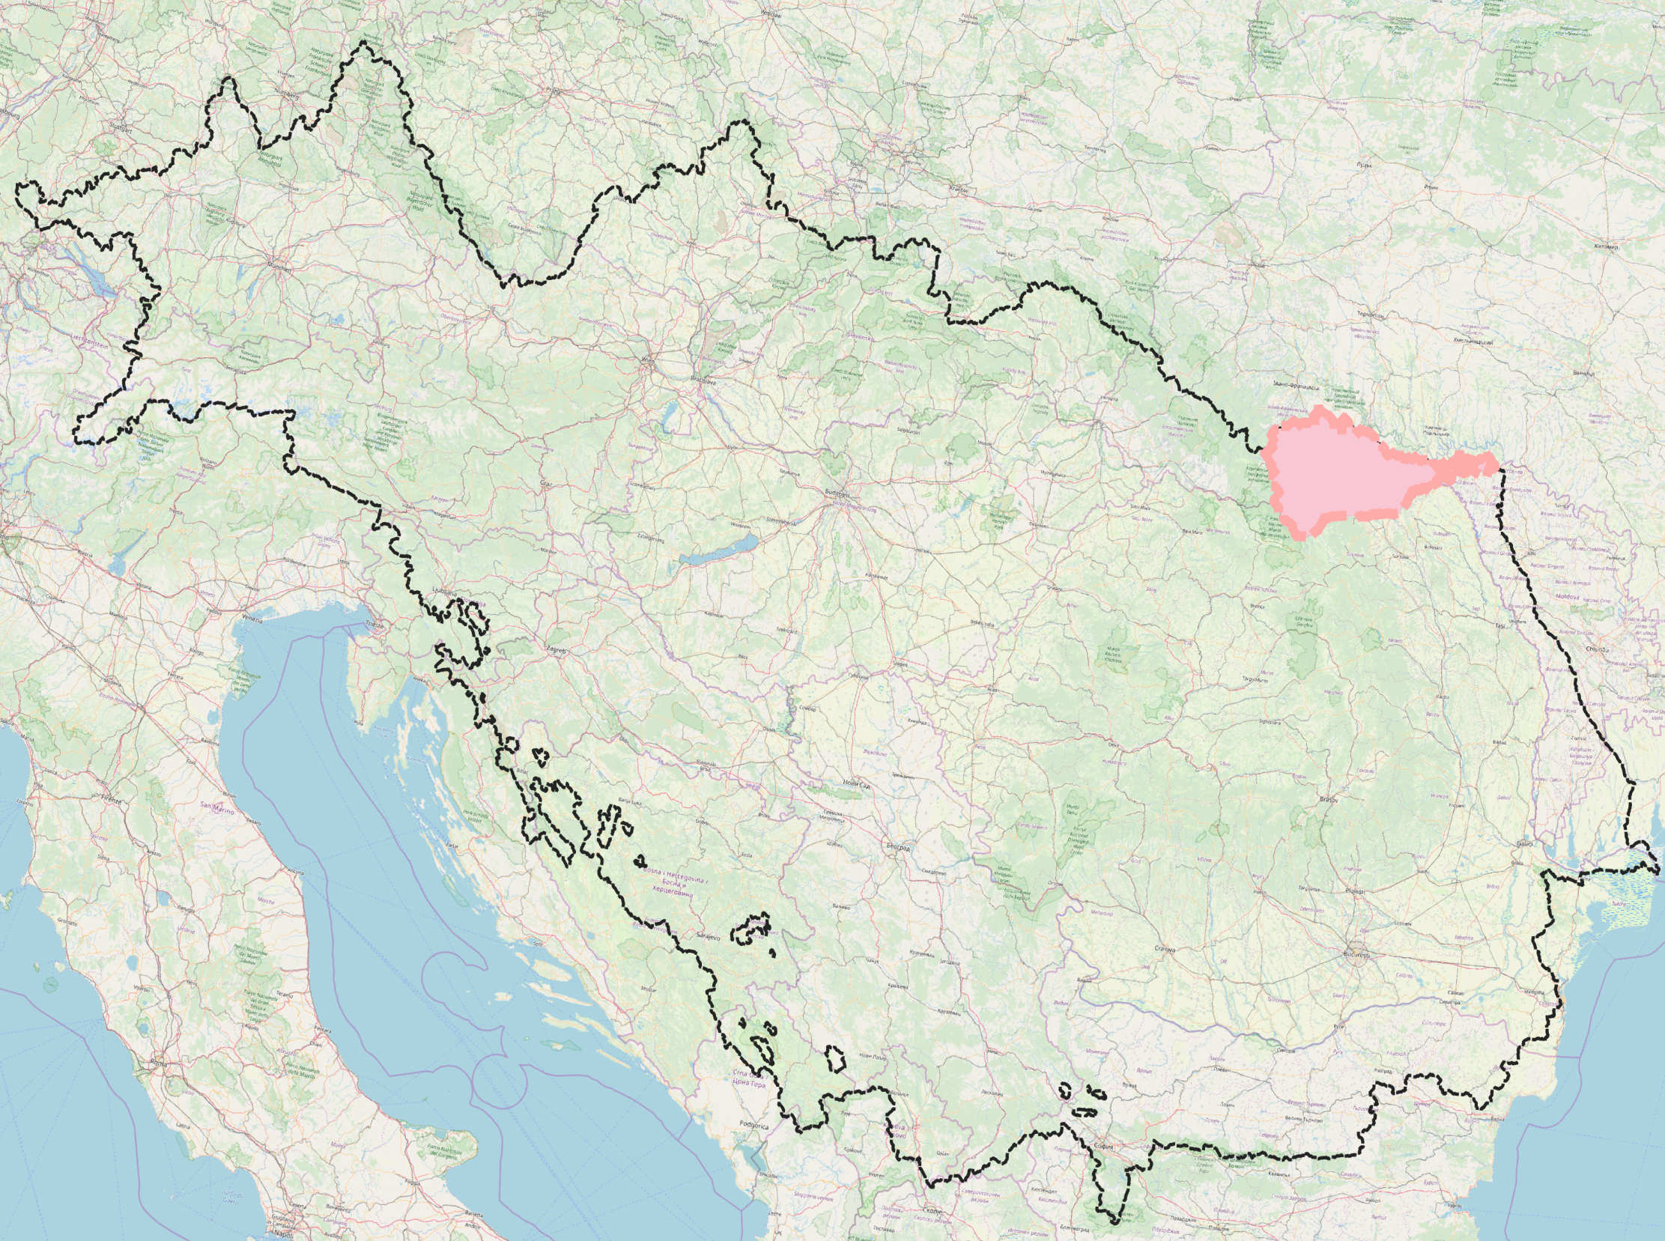
Research area
Catchment areas
within Ukraine
Prut 9400 km²
Siret 2029 km²
One of the most flood hazard regions
of Europe
12 hydrological stations
At 83% ≥ 50 years of observations to 2015
Prut – Chernivtsy
Catchment area 6890 km²
121 years of observations

Slide 3
River | hydrometric station | Catchment area km² | Mean elevation of catchment area, m a.s.l. | Multi-annual mean |  | Vаriation coefficient | Number of years under observation | Relative value of mean standard deviation , %
 |  |  |  | Discharge, m³ˑs⁻¹ | Specific discharge, dm³· s⁻¹· km⁻²
The Prut and Siret basins
Prut | Vorokhta | 48,3 | 1500 | 1,99 | 41,1 | 0,27 | 38 | 4,6
 | Tatariv | 366 | 1200 | 7,76 | 21,2 | 0,26 | 56 | 3,6
 | Yaremche | 597 | 960 | 12,4 | 20,8 | 0,28 | 66 | 3,5
 | Chernivtsi | 6890 | 450 | 73,0 | 10,6 | 0,29 | 121 | 3,5
Kamyanka | Dora | 18,1 |  | 0,37 | 19,5 | 0,38 | 67 | 4,7
Chornyava | Lyubkivtsi | 333 |  | 1,60 | 4,80 | 0,42 | 31 | 7,9
Bilyi Cheremosh | Yablunytsia | 552 | 1200 | 9,77 | 17,1 | 0,38 | 58 | 5,1
Chornyi Cheremosh | Verkhovyna | 657 | 1200 | 14,1 | 21,5 | 0,37 | 58 | 5,0
Cheremosh | Usteriky | 1500 | 1100 | 27,9 | 18,6 | 0,25 | 58 | 3,4
Iltsya | Iltsi | 86,1 |  | 1,67 | 19,4 | 0,29 | 57 | 4,0
Putyla | Putyla | 181 | 960 | 2,57 | 14,2 | 0,34 | 51 | 4,9
Siret | Storozhynets | 672 | 590 | 6,65 | 9,90 | 0,39 | 63 | 5,0

Slide 4
Data and methods
function of mathematical expected value
function of dispersion values or standard deviation
probability distribution function
autocorrelation function
criteria homogeneity
criteria of the series and of the longest series
integral curves of the differences

Slide 5
Results and discussion
Long-term fluctuations in average annual water runoff of river Prut – a city of Chernivtsy
Homogeneity criteria | Statistics value |  | Results of hypothesis test
 | empirical | theoretical
Student’s, statistics t | 1,95 | [-1,98,+1,98] | homogenous
Fisher’s, statistics F | 2,33 | [+1,+1,61] | heterogeneous
Wilcoxon-Mann-Whitney U | 2434 | [1719, 2571] | homogenous

Slide 6
Analysis of long-term fluctuations
Correlogram of time sequences of average annual water discharges for river Prut – city of Chernivtsy
Confidence limits 95% of probability of exceedance of the autocorrelation functions of average annual water runoff
Integral curves of the differences of multi-annual mean annual water discharges of the rivers in Prut and Siret basins.
_{95%}
Lower limit | Upper limit
0,14 | 0,16

Slide 7
Fluctuations and forecast of water runoff of the Prut river basin
Average water discharges for a period of water content phases and forecast estimates of the runoff for the period until 2050
Period (years) | phase water content |  | Number of years in phase | Period average water content discharges (m³ ·s⁻¹) river Prut – city of Chernivtsy, F=6890 km ²,
 | ↑ - wet, ↓ - dry
1883-1898 | ↑ |  | 15
1899-1911 | ↓ |  | 13
1912-1927 | ↑ |  | 16 | 93
1928-1939 | ↓ |  | 12 | 56
1940-1955 | ↑ |  | 16 | 73
1956-1964 | ↓ |  | 9 | 54
1965-1981 | ↑ |  | 17 | 83
1982-1992 | ↓ |  | 11 | 62
1993-2009 | ↑ |  | 16 | 69
The forecast values with standard deviations in phase water content (m³ ·s⁻¹)
2010-2020÷21 | ↓ | 11÷12 |  |  | 57±4
2021-2037÷38 | ↑ | 16÷17 |  |  | 80±9
2038-2048÷49 | ↓ | 11÷12 |  |  | 57±4

Slide 8
Ratio between multi-annual mean discharges water and multi-annual mean discharges water of dry and wet phases of the rivers Prut and Siret
Probable deviation of calculated values of average water runoff, %
wet phase | dry phase
±11 | ±7

Slide 9
The generalized ratio of average water discharges of the rivers of basins Prut and Siret in periods of dry and wet phases
longstanding average water discharges, m³ ·s⁻¹ | water content |  | difference in the phases of water content, m³ ·s⁻¹ |  | longstanding average water discharges, m³ ·s⁻¹ | water content |  | difference in the phases of water content, m³ ·s⁻¹
 | wet phase, m³ ·s⁻¹ | dry phase, m³ ·s⁻¹ |  |  |  | wet phase, m³ ·s⁻¹ | dry phase, m³ ·s⁻¹
0,5 | 0,72 | 0,16 | 0,56 |  | 22,0 | 24,04 | 18,57 | 5,47
1,0 | 1,26 | 0,59 | 0,67 |  | 24,0 | 26,21 | 20,28 | 5,93
2,0 | 2,34 | 1,44 | 0,90 |  | 26,0 | 28,38 | 21,99 | 6,39
3,0 | 3,43 | 2,30 | 1,13 |  | 28,0 | 30,55 | 23,70 | 6,85
4,0 | 4,51 | 3,16 | 1,36 |  | 30,0 | 32,72 | 25,42 | 7,30
5,0 | 5,60 | 4,01 | 1,59 |  | 32,0 | 34,89 | 27,13 | 7,76
6,0 | 6,68 | 4,87 | 1,81 |  | 34,0 | 37,06 | 28,84 | 8,22
7,0 | 7,77 | 5,72 | 2,04 |  | 36,0 | 39,23 | 30,55 | 8,68
8,0 | 8,85 | 6,58 | 2,27 |  | 38,0 | 41,40 | 32,27 | 9,13
9,0 | 9,94 | 7,44 | 2,50 |  | 40,0 | 43,57 | 33,98 | 9,59
10,0 | 11,02 | 8,29 | 2,73 |  | 42,0 | 45,74 | 35,69 | 10,05
12,0 | 13,19 | 10,01 | 3,19 |  | 44,0 | 47,91 | 37,40 | 10,51
14,0 | 15,36 | 11,72 | 3,64 |  | 46,0 | 50,08 | 39,12 | 10,96
16,0 | 17,53 | 13,43 | 4,10 |  | 48,0 | 52,25 | 40,83 | 11,42
18,0 | 19,70 | 15,14 | 4,56 |  | 50,0 | 54,42 | 42,54 | 11,88
20,0 | 21,87 | 16,86 | 5,02

Slide 10
Сonclusions
High reliability of the cycles with periods of 29 ± 2 years demonstrates a stable frequency of wet phases (17 ± 2 years) and dry phases (10 ± 2 years).
Until 2020-21, the dry phase will continue, and then the wet phase with the duration of 16-17 years can be expected and from 2037-38 the dry phase will again continue until 2048-49.

Slide 11
Thanks for your attention

