Slide 1


ANALYSIS OF LOW-FLOW CONDITIONS IN A HETEROGENEOUS KARST CATCHMENT AS A BASIS FOR FUTURE PLANNING OF WATER RESOURCE MANAGEMENT
Klaudija Sapač, Simon Rusjan, Nejc Bezak, Mojca Šraj
University of Ljubljana, Faculty of Civil and Geodetic Engineering, Department of Environmental Civil Engineering, Ljubljana, Slovenia
Kyiv, Ukraine, November 6-8, 2019

Slide 2
Introduction
Understanding and prediction of low-flows is needed for:
    efficient water resources management,
    identification of water-related environmental problems.
In the literature, there are many different methods and indices, by which low-flows can be characterized (e.g., seasonal indices, flow duration curves, baseflow index, etc.).
In our study the following indices were used:
    baseflow index (BFI),
    Q₅₀, Q₉₀, Q₉₀/Q₅₀, and
    recession constants.

Slide 3
Objectives
Calculation and analysis of low-flow indices.
Detailed analysis of recession constant results and how calculation criteria influence the value of recession constant.

Slide 4
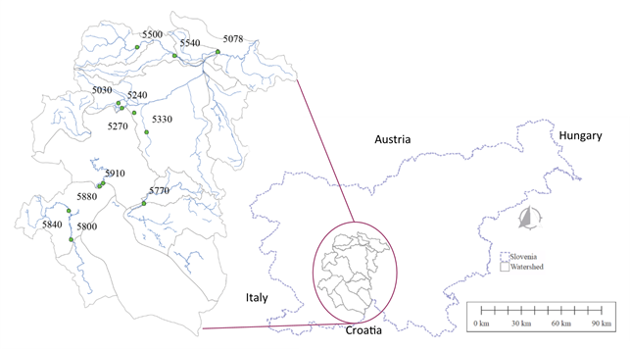
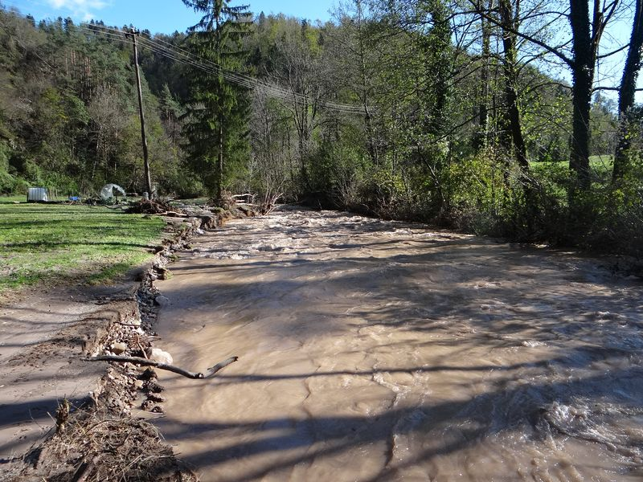
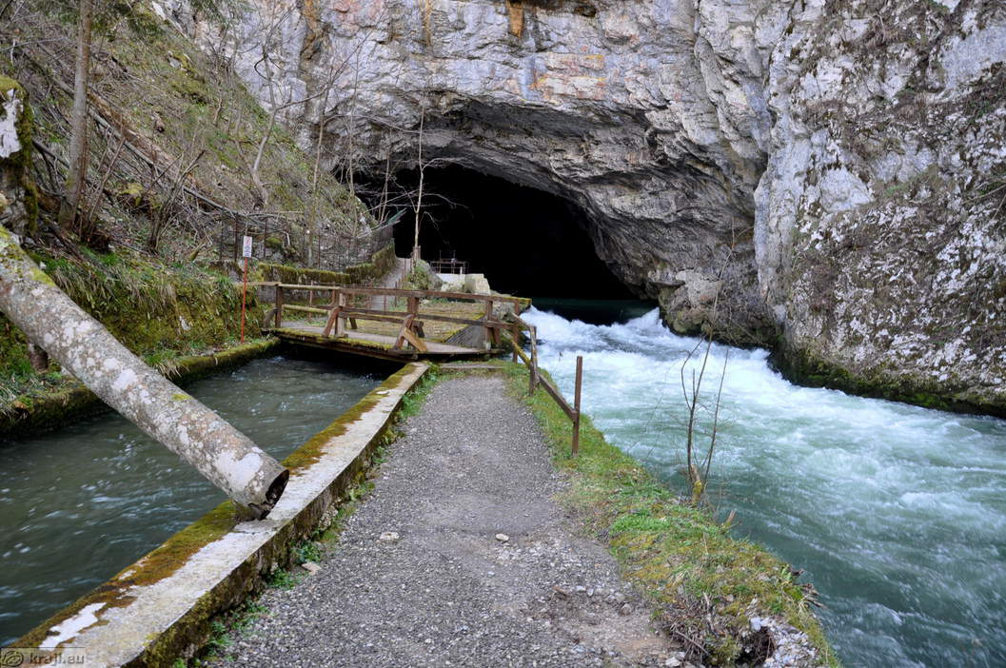
Study area and data
Daily discharge data at 11 water stations in the non-homogenous Ljubljanica river catchment (Slovenia).
The criteria for inclusion of water station into analysis: at least 25 years of data, gaps in data shorter than 5 years, and station was operating in the year 2016 (the last available data).
Catchment characteristics:
    90% karst: underground conduits,
    karst caves
    10%: mainly streams with torrential characteristics
    altitude: 300-1800 m a.s.l.
    precipitation: 1400-2000 mm

Slide 5
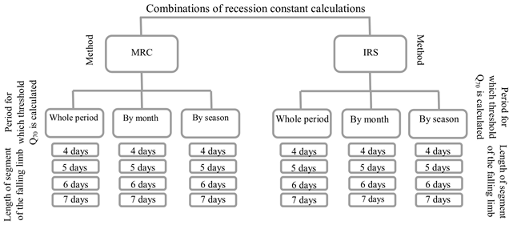
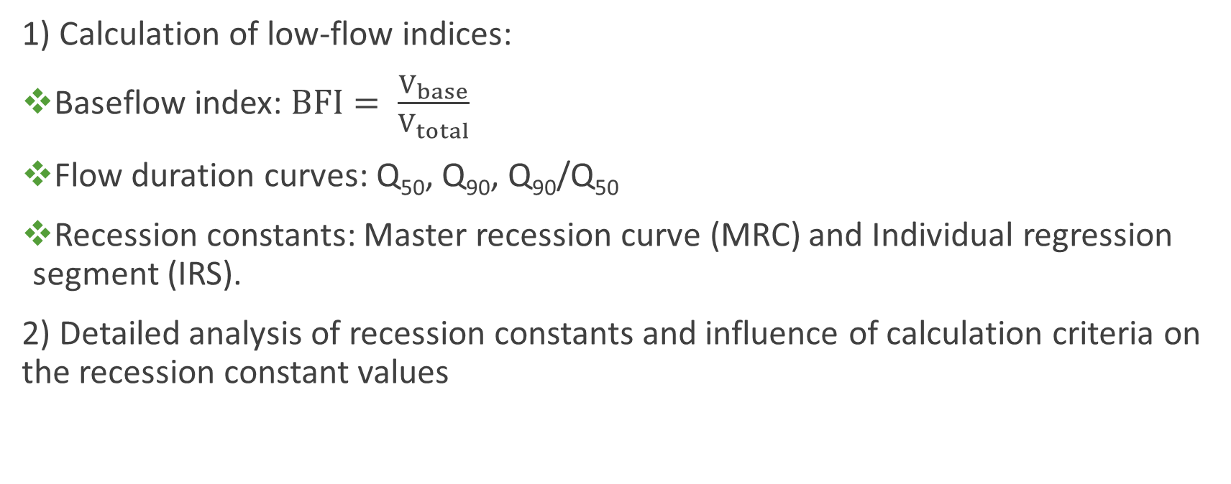
Methods
1) Calculation of low-flow indices:
Baseflow index: $BFI= \frac{V_{base}}{V_{total}}$
Flow duration curves: Q₅₀, Q₉₀, Q₉₀/Q₅₀
Recession constants: Master recession curve (MRC) and Individual regression segment (IRS).
2) Detailed analysis of recession constants and influence of calculation criteria on the recession constant values

Slide 6
Results
BFI, Q₉₀/Q₅₀, recession constant → highest contribution of delayed sources: Malni and Bistra
→ lowest contribution: Mali Otok and Cerknica
Q₉₀/Q₅₀ shows on a relatively large contribution also at Dvor and Razori (torrential streams)
Recession constant is calculated as average of 24 values (all combination of criteria)

Slide 7
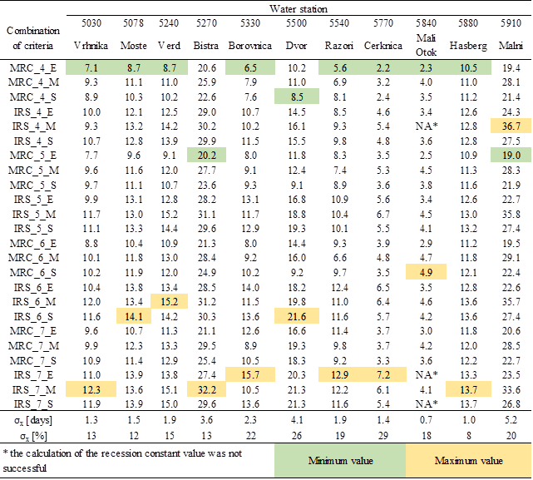
Results
Paired, two-sided t-test with significance level α = 0.05
Influence of:
    Method (MRC or IRS): 1 test
    Period for calculation the Q₇₀ as threshold: 3 tests
    Length of the segment: 6 tests
Method: MRC or IRS; Calclulation of threshold for analysis: entire period (E), monthly (M) or seasonal (S); Segment length: 4, 5, 6 or 7 days.

Slide 8
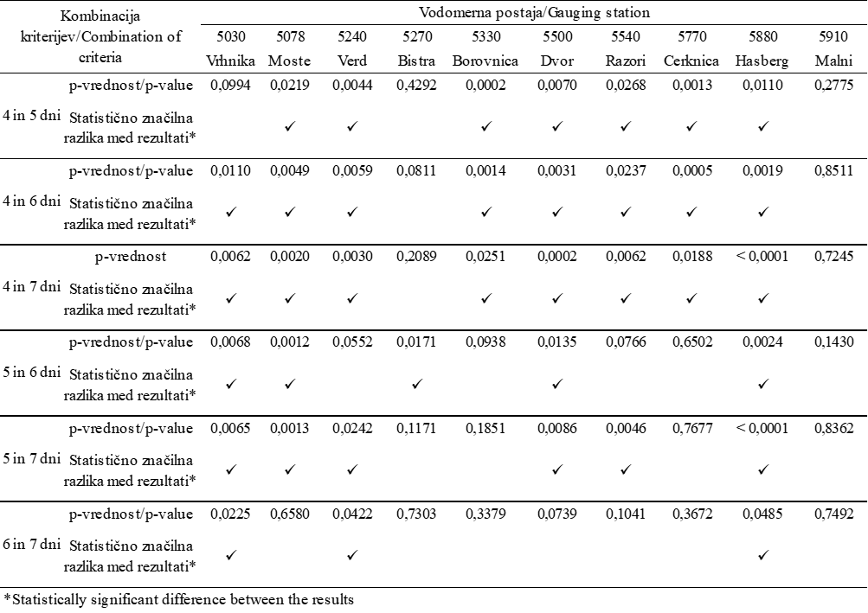
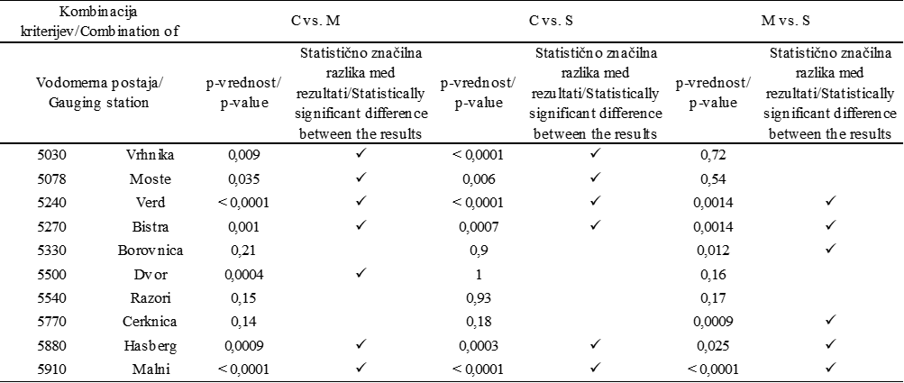
Results

Slide 9
Conclusions
Evaluation of several low-flow characteristics is needed for a comprehensive and holistic overview.
When investigating influence of calculation criteria, we found that at some stations the change of criterion can significantly influence the value. In case of changing the method, at all stations statistically significant differences were found.
Although some methods for the recession analysis were considered subjective in the past, Lamb and Beven (1997) think that subjectivity is not necessarily a weakness. Experts who know a catchment very well are able to judge the quality and relevance of the data, which are later used for the recession analysis (Sapač et al. 2019, Acta hydrotechnica).

Slide 10
Thank you for your attention.
More about the research can be found in:
Sapač, K., Rusjan, S., Šraj, M., 2019. Influence of calculation criteria on the values of low-flow recession constants in a non-homogenous catchment in Slovenia. Acta Hydrotechnica 32, 1–19.
Sapač, K., Medved, A., Rusjan, S., Bezak, N., 2019. Investigation of Low- and High-Flow Characteristics of Karst Catchments under Climate Change. Water 11, 925.
Sapač, K., Rusjan, S., Šraj, M. Assessment of consistency of low-flow indices of hydrogeologically non-homogeneous catchment. Journal of hydrology (under review, correction phase).

