Slide 1

Assessment of Statistical Significance of Historic Danube Floods
Dr. Stevan Prohaska, Aleksandra Ilić, Dr. Pavla Pekarova

Slide 2
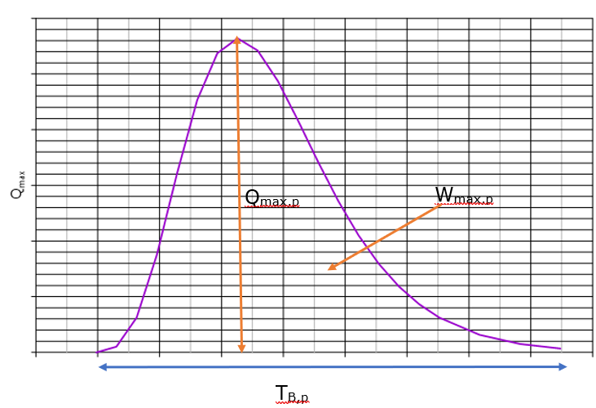
Theoretical basis for the statistical significance of historical floods assessing
Theoretical flood hydrographs of different probabilities of occurrence whose parameters are: maximum ordinate (peak) and maximum flood wave volume.
Q_{max,p} – maximum hydrograph ordinate;
W_{max,p} – maximum hydrograph volume;
T_{B,p} - total time of flood hydrograph (hydrograph base time).
Danube Conference 2019

Slide 3
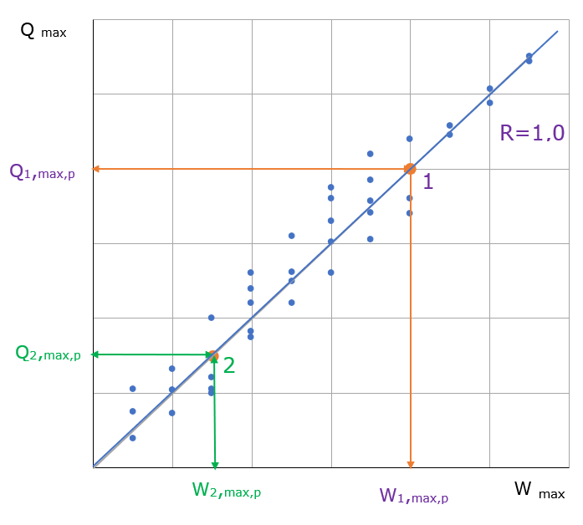
For theoretical floods of probability of occurence: p(Qmax ) = p(Wmax)= p(%) →R(Qmax:Wmax)=1.0
Theoretical basis for the statistical significance of historical floods assessing
In practice 0 < R < 1.0
Danube Conference 2019

Slide 4
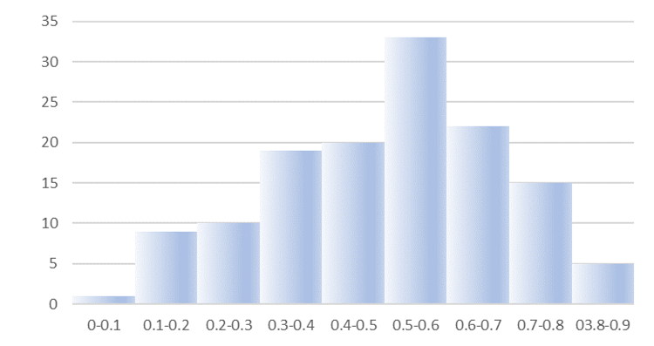
Serbian experience
In practice 0 < R < 1.0
At 132 hydrological stations of the the Republic Hydrometeorological Service of Serbia (RHMSS)→
from R(Q;W) = 0,013 (h.s Bistrica, r. Bistrica)
to R(Q;W) = 0,895 (h.s Ćemanov most, r. Tamnava).
 | R(Q_{max} : W_{max})
Range | 0.000-0.100 | 0.101-0200 | 0.201-0.300 | 0.301-0.400 | 0.401-0.500 | 0.501-0.600 | 0.601-0.700 | 0.701-0.800 | 0.801-0.900
Frequency (h. s.) | 1 | 9 | 10 | 19 | 20 | 33 | 22 | 15 | 5
Danube Conference 2019

Slide 5
In case when R(Qmax : Wmax) < 1.0 we have to define the joint-probability function of the two hydrograph parameters:
- peak discharge (Q_{max}) and
- maximum volume of floods (W_{max})
Serbian experience
Danube Conference 2019

Slide 6
Bivariate probability of occurrence of flood parameters
PROIL model:
Density functions – the lines of same bivariate probabilities of occurrence:
F(Q_{max};W_{max}) = p, for p = 0.1, 1.0, 2.0 and 5.0%, and
Bivariate exceedance probabilities function:
P {(Q_{max}≥ q_{max,P})∩(W_{max} ≥w_{max,P}) } = P, for P = 0.1, 1.0, 2.0 and 5.0 %.
Danube Conference 2019

Slide 7
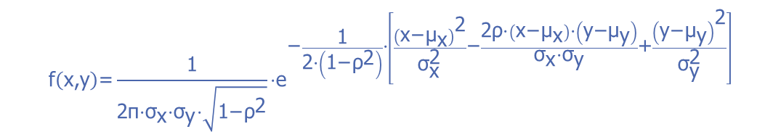
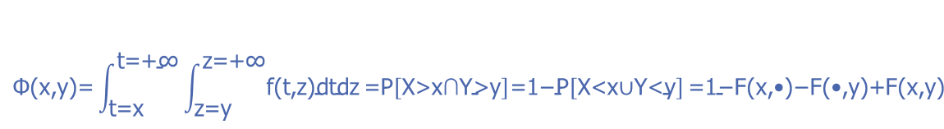
MODEL PROIL
Bivariate probability if x=Q_{max} and y= W_{max}
Density function
$$\text{f}\left(\text{x}\text{,}\text{y}\right)\text{=}\frac{\text{1}}{\text{2}\text{π}\text{⋅}{\text{σ}}_{\text{x}}\text{⋅}{\text{σ}}_{\text{y}}\text{⋅}\sqrt{\text{1−}{\text{ρ}}^{\text{2}}}}\text{⋅}{\text{e}}^{\text{−}\frac{\text{1}}{\text{2⋅}\left(\text{1−}{\text{ρ}}^{\text{2}}\right)}\text{⋅}\left[\frac{{\left(\text{x}\text{−}{\text{μ}}_{\text{x}}\right)}^{\text{2}}}{{\text{σ}}_{\text{x}}^{\text{2}}}\text{−}\frac{\text{2}\text{ρ}\text{⋅}\left(\text{x}\text{−}{\text{μ}}_{\text{x}}\right)\text{⋅}\left(\text{y}\text{−}{\text{μ}}_{\text{y}}\right)}{{\text{σ}}_{\text{x}}\text{⋅}{\text{σ}}_{\text{y}}}\text{+}\frac{{\left(\text{y}\text{−}{\text{μ}}_{\text{y}}\right)}^{\text{2}}}{{\text{σ}}_{\text{y}}^{\text{2}}}\right]}$$
Bivariate exceedance probability function:
$$\text{Φ}\text{(}\text{x}\text{,}\text{y}\text{)=}\int_{\text{t}\text{=}\text{x}}^{\text{t}\text{=+∞}}{\int_{\text{z}\text{=}\text{y}}^{\text{z}\text{=+∞}}{\text{f}\text{(}\text{t}\text{,}\text{z}\text{)}\text{dtdz}}\text{=}\text{P}\left[\text{X}\text{>}\text{x}\text{∩}\text{Y}\text{>}\text{y}\right]\text{=1−}\text{P}\left[\text{X}\text{<}\text{x}\text{∪}\text{Y}\text{<}\text{y}\right]}\text{=1−}\text{F}\text{(}\text{x}\text{,•)−}\text{F}\text{(•,}\text{y}\text{)+}\text{F}\text{(}\text{x}\text{,}\text{y}\text{)}$$
Danube Conference 2019

Slide 8
In the final version of the Chapter 10 of project No9 FRDRB these GS are included:
GS Ingolstadt,
GS Regebsburg,
GS Hofkirchen,
GS Achleiten,
GS Bezdan,
GS Bogojevo,
GS Smederevo,
GS Orsova.
As examples in this presentation the results only for two gauging profiles at the Danube will be presented: Achleiten and Bezdan
Danube Conference 2019

Slide 9
Bivariate probability of occurrence of flood parameters
Correlation between the considered flood hydrograph parameters of the Danube River were:
GS Achleiten
Coefficient of linear correlation R = 0. 472;
Standard error of correlation coefficient σ_{R} = 0.077,
and GS Bezdan
Coefficient of linear correlation R = 0. 405;
Standard error of correlation coefficient σ_{R} = 0.091.
Danube Conference 2019

Slide 10
Bivariate probability of occurrence of flood parameters
The Danube R.
H. S. Achleiten
The Danube R.
H. S. Bezdan
Danube Conference 2019

Slide 11
Return periods of historic floods along the Danube from GS Berg to GS Orsova
 | Gauging profile | Number of flood waves at GP | P{(Q_{max}≥ q_{max,P})∩(W_{max}≥w_{max, P})} = P<p=1% |  | T (years) | Analyzed period
 |  |  | Historic flood
 |  |  | Year | p
1 | Berg | 1 | 1988 | 0.33 | 300 | 1930-2007
2 | Ingolstadt | 1 | 1965 | 0.20 | 500 | 1924-2013
 |  | 2 | 1999 | 0.20 | 500
3 | Regensburg | 1 | 1988 | 0.25 | 400 | 1924-2013
 |  | 2 | 2013 | 1.00 | 100
 | Hofkirchen | 1 | 2013 | 0.65 | 150 | 1901-2013
5 | Achleiten | 1 | 2013 | 0.10 | 1000 | 1901-2013
 |  | 2 | 1965 | 0.20 | 500
 |  | 3 | 1954 | 0.20 | 500
6 | Vienna | 1 | 1965 | 0.20 | 500 | 1828-2006
 |  | 2 | 1975 | 0.25 | 400
 |  | 3 | 1954 | 0.33 | 300
7 | Bratislava | 1 | 1965 | 0.20 | 500 | 1876-2015
 |  | 2 | 1899 | 0.33 | 300
 |  | 3 | 2013 | 0.40 | 250
 |  | 4 | 1876 | 0.90 | 110
8 | Bezdan | 1 | 1965 | 0.25 | 750 | 1931-2016
9 | Bogojevo | 1 | 1965 | 0.80 | 125 | 1931-2016
10 | Pančevo | 1 | 2006 | 1.00 | 100 | 1931-2016
11 | Orsova | 1 | 2006 | 1.00 | 100 | 1840-2016

Slide 12
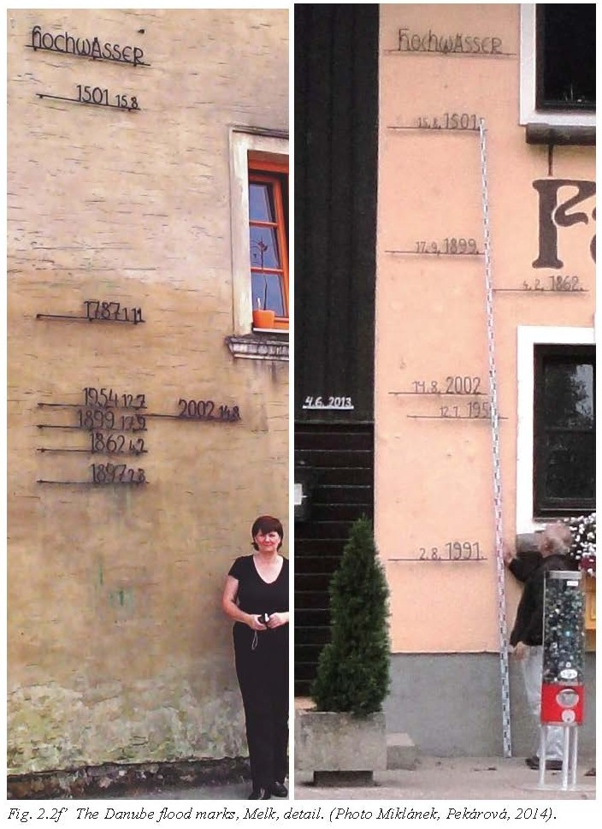
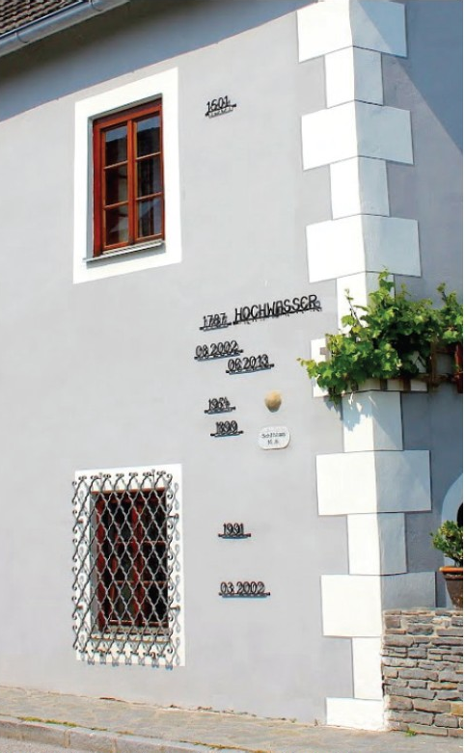
PHOTOS OF REGISTERED FLOODS IN THE DANUBE RIVER
Floods markers in Melk
Floods markers in Emmersdorf

Slide 13
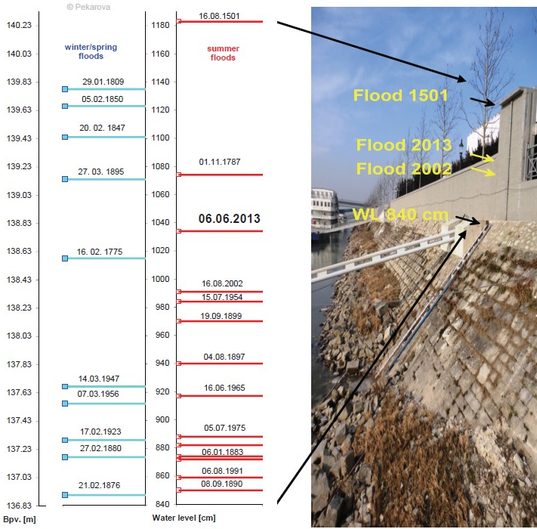
PHOTOS OF REGISTERED FLOODS IN THE DANUBE RIVER
Observed an reconstructed historical floods in Bratislava

Slide 14
Thank you!

