Slide 1
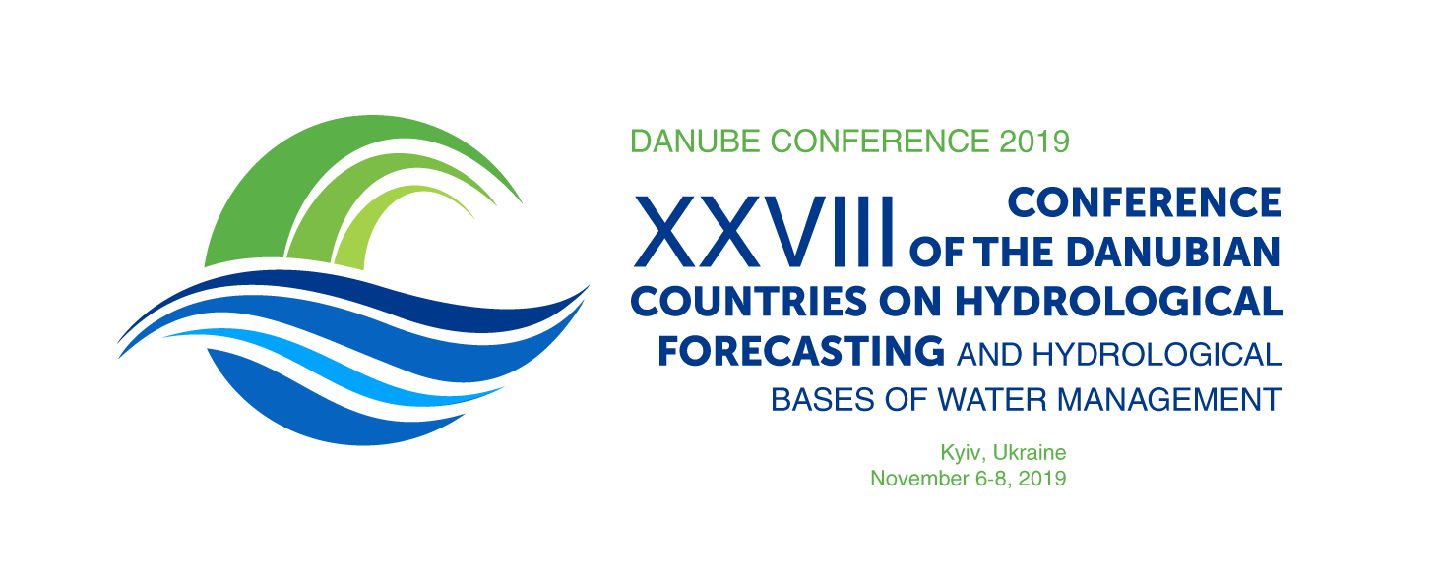
Chemical composition and water quality of the Danube and Dnipro river basins under climate changes and man-made load
Volodymyr Osadchyi, Nataliia Osadcha,
Olha Ukhan, Yurii Nabyvanets, Denis Klebanov
Ukrainian Hydrometeorogical Institute (UHMI),
The State Service on Emergency of Ukraine and
National Academy of Science of Ukraine,
37, Prospekt Nauki, Kiev, Ukraine, 03028

Slide 2
Objectives
2
To assess changes in the chemical composition and water quality in the Dnipro and Danube basin during 1989-2016.
To assess the possibility of a relationship between the economic dropdown in Ukraine and changes in the levels and rates of water pollution by various chemical substances.
Assessment of the impact of climate change on the chemical composition and surface water quality.
Identification of priority pollutants in the modern period and development of recommendations for improving the quality of surface water.

Slide 3
3
The findings are based on:
1. Generalized observation data on chemical composition of Ukrainian river basins during 1989-2016 (the State Hydrometeorological Service of Ukraine).
2.Generalized data of chemical substances in content precipitation and emission of pollutants into the atmosphere during 1989-2016 (the State Hydrometeorological Service of Ukraine ).
3. Data observations on chemical composition of Ukrainian surface water (the State Agency of Water Resources of Ukraine).
4.Field study data on water bodies of Ukraine.

Slide 4
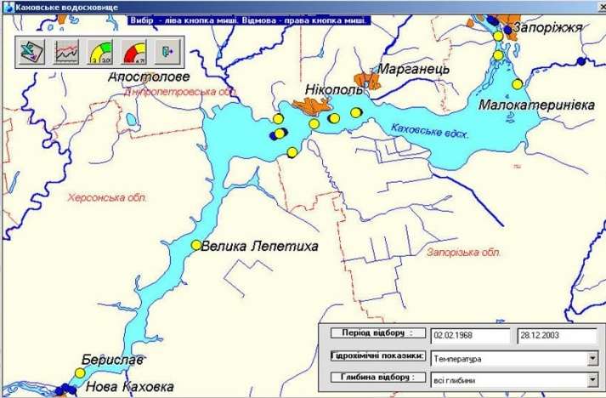
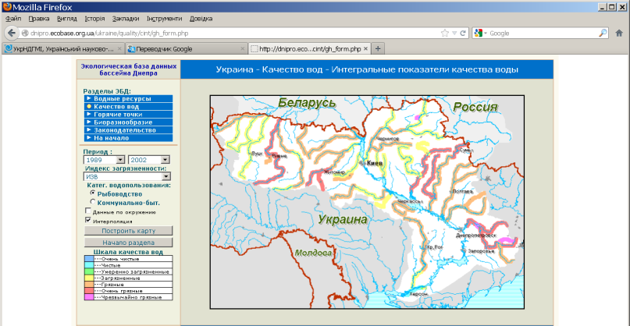
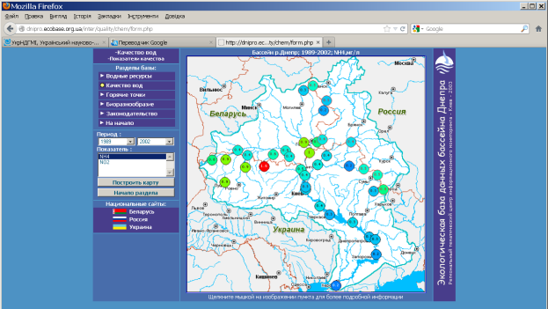
Informational-analytical system AquaGuard
(UHMI Desktop system)
The findings are based on:
GeoPortal
The State Agency of Water Resources of Ukraine
https://www.davr.gov.ua/
4
Dnipro Basin Ecological Database (http://dnipro.ecobase.org.ua)

Slide 5
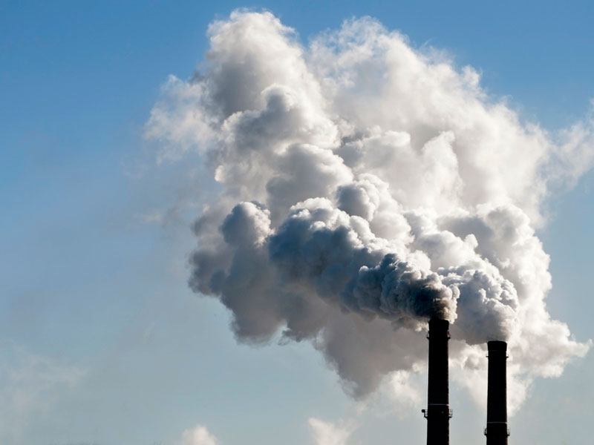
Greenhouse gases emission into the atmosphere (1990-2015 )
5
Among the total emissions -

Slide 6
6
Ammonium nitrogen (NH₄⁺) and sulfate ions (SO₄²⁻) concentration
in atmospheric precipitation (Ukraine)

Slide 7
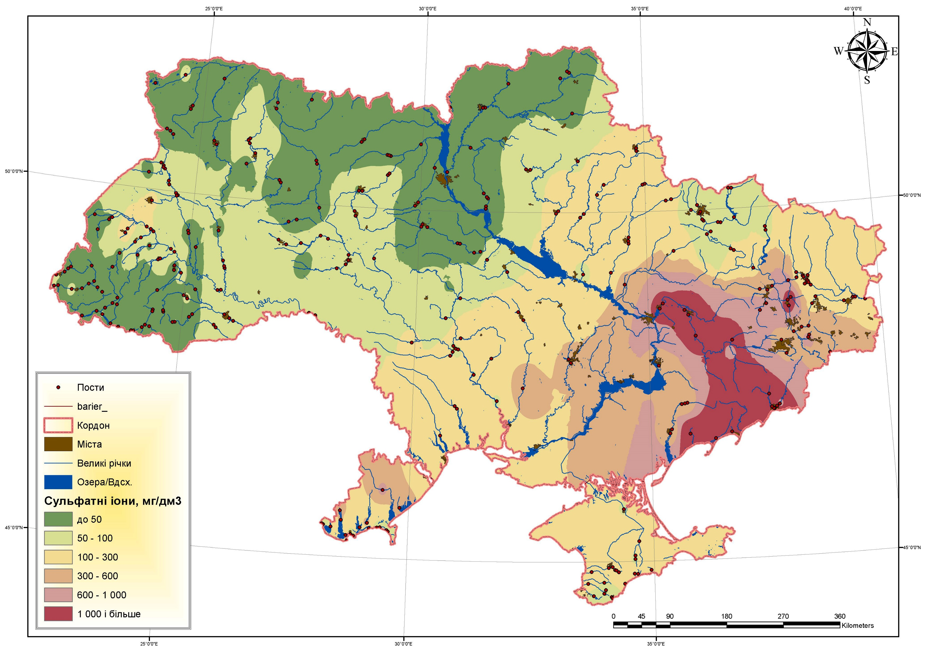
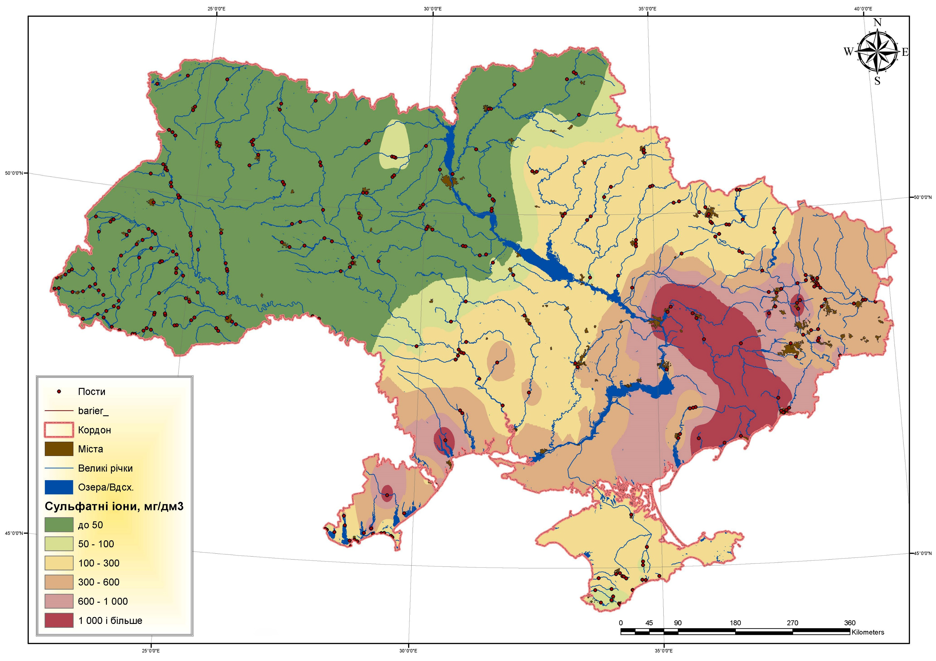
7
The concentration of sulfate ions in the surface water of Ukraine
1990-1995 yy
2011-2016 yy

Slide 8
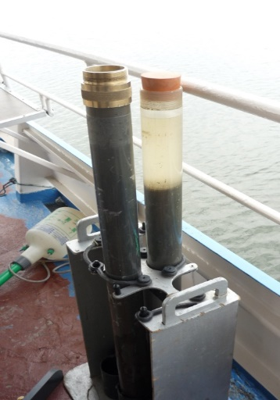
8
Vertical distribution of copper in the column of bottom sediments of the Dnipro Reservoir

Slide 9
Long-term dynamics of average annual air temperature in Ukraine (1881-2016)
9

Slide 10
10
Intra-annual distribution of water flow (the Desna river)
Residual mass curve of Water Flow in the Desna river

Slide 11
11
Dissolved oxygen content in the Kyiv reservoir water

Slide 12
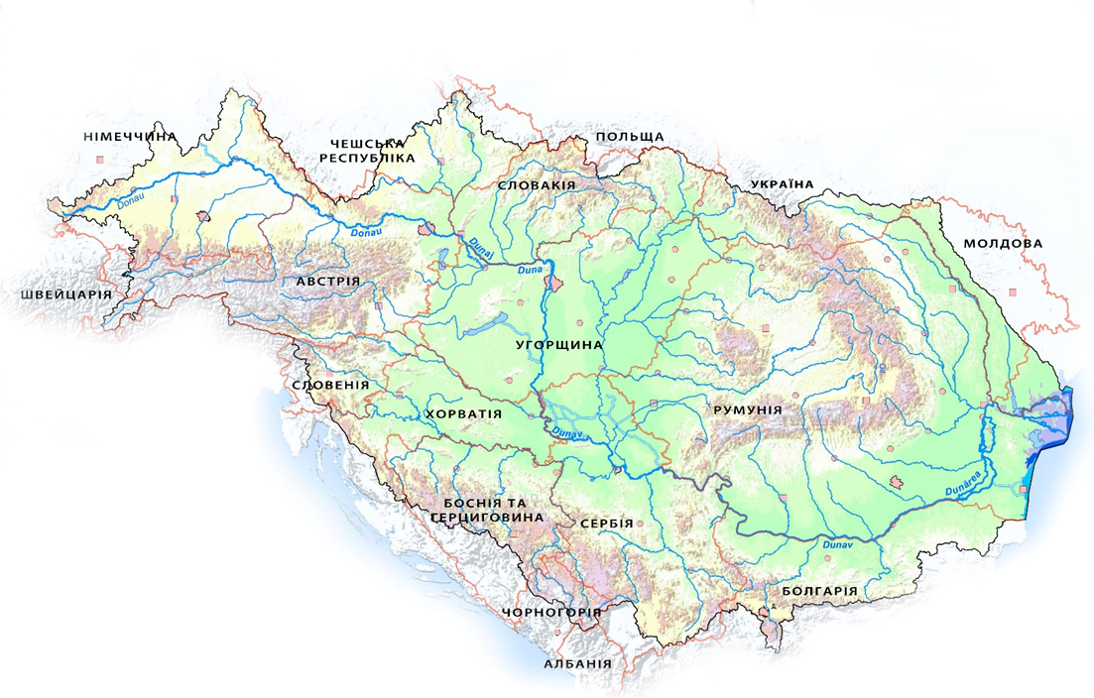
12
The Danube Basin
Residual mass curve of Water Flow and
Nitrogen & Phosphorus Loads in the Lower Danube
Ukrainian contamination to the Danube Nutrient Load

Slide 13
13
Share of the waste water in the Danube Basin
Urban waste water
Industry
Agriculture
Others

Slide 14
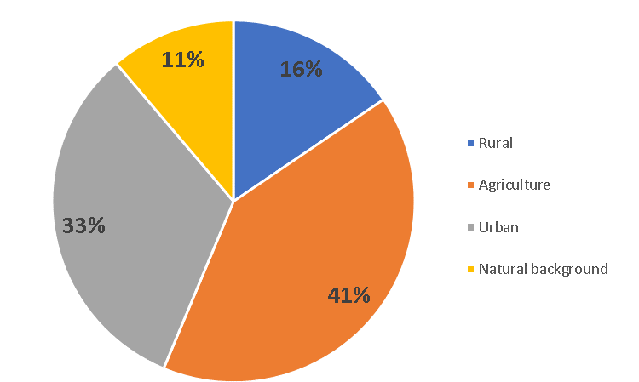
14
Share of discharge sources in the nitrogen emission
in the Danube basin
Prut
Tisza
Lower Danube
Total emission
Natural background
Urban
Agricultural territories
Rural

Slide 15
15
Phosphate ions runoff for the Danube river decreased on 70%,
for the Dnpro river – increased into 60%
Total nitrogen runoff for the Danube river
decreased on 30%,
for the Dnipro river – increased into 21%

Slide 16
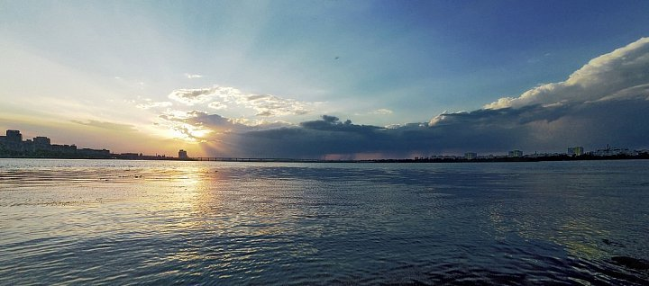
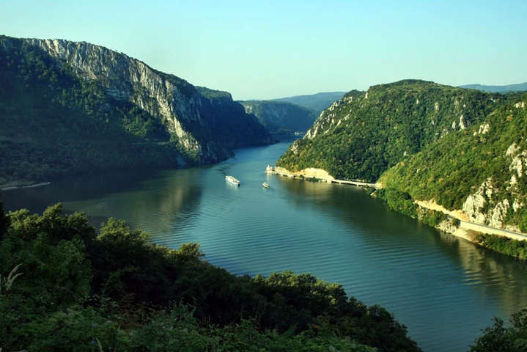
Thank you for attention!

