Slide 1



Calibration of hydrological models by PEST
Andrej Vidmar, Mitja Brilly
University of Ljubljana, Faculty of Civil and Geodetic Engineering, Department of Environmental Civil Engineering, Ljubljana, Slovenia
Kyiv, Ukraine, November 6-8, 2019

Slide 2
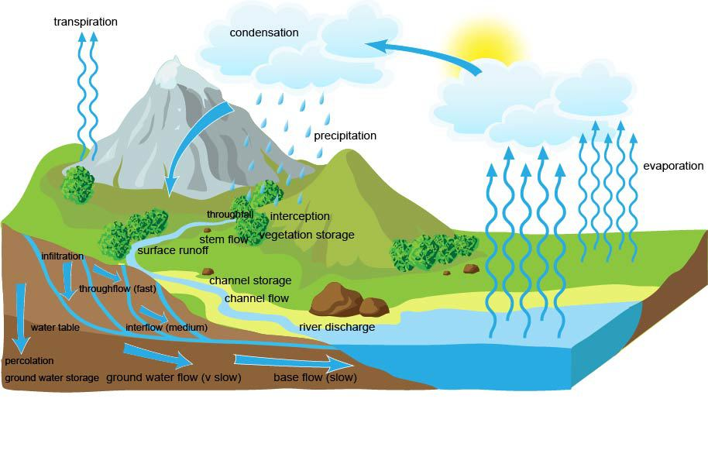
The drainage basin hydrological cycle (4D space)
Water does not come into or leave planet earth. Water is continuously transferred between the atmosphere and the oceans. This is known as the global hydrological cycle.
Complex proceses:
governed by nature
essentially stochastic
unique
non-recurring
changeable across space and time
non-linear
Source: http://www.alevelgeography.com/drainage-basin-hydrological-system
(Mikhail Lomonosov law of mass conservation in 1756)
XXVIII Danube Conference, Kyiv, Ukraine, November 6-8, 2019

Slide 3
1st _ Why use a P-R modeling?
for education
for decision support
for data quality control
for water balance studies
for drought runoff forecasting (irrigation)
for fire risk warning
for runoff forecasting/prediction (flood warning and reservoir operation)
for what happens if’ questions in watershed level
XXVIII Danube Conference, Kyiv, Ukraine, November 6-8, 2019

Slide 4
2nd _ Why use a P-R modeling?
to compute design floods for flood risk detection
to extend runoff data series (or filling gaps)
to compute design floods for dam safety
to investigate the effects of land-use changes within the catchment
to simulate discharge from ungauged catchments
to simulate climate change effects
inflow forecast the most important input data in hydropower
to compute energy production
XXVIII Danube Conference, Kyiv, Ukraine, November 6-8, 2019

Slide 5
The basic principle
XXVIII Danube Conference, Kyiv, Ukraine, November 6-8, 2019

Slide 6
Modeling noise
Structural noise
  Conceptual noise (semi-distributed,…)
  Design noise
  Calibration noise (parameter estimation noise)
Measurements noise (P [rr], T, E, Evap)
Computer noise (discrete numbers, double precisions,…)
XXVIII Danube Conference, Kyiv, Ukraine, November 6-8, 2019

Slide 7
HBV - Hydrologiska Byråns Vattenbalansavdelning
(Hydrological Agency Water Balance Department)
The HBV model (Bergström, 1976, 1992) is a rainfall-runoff model, which includes conceptual numerical descriptions of hydrological processes at the catchment scale. The general water balance can be described as
Where
P = precipitation
E = evapotranspiration
Q = runoff
SP = snow pack
SM = soil moisture
TZ = storage in soil top zone (introduced in HBV-light)
UZ = upper groundwater zone storage
LZ = lower groundwater zone storage
lakes = lake volume
XXVIII Danube Conference, Kyiv, Ukraine, November 6-8, 2019

Slide 8
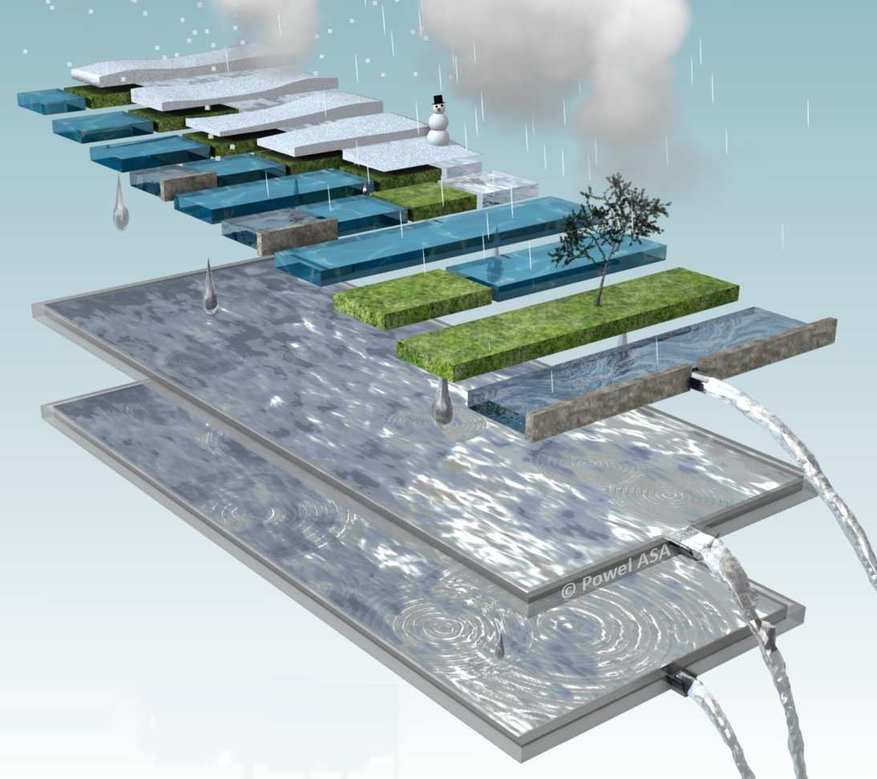
Semi-distribution
Subdivides a large problem into smaller, simpler parts with unique characteristic
Elevation zones
Vegetation zones
Conceptual noise
XXVIII Danube Conference, Kyiv, Ukraine, November 6-8, 2019

Slide 9
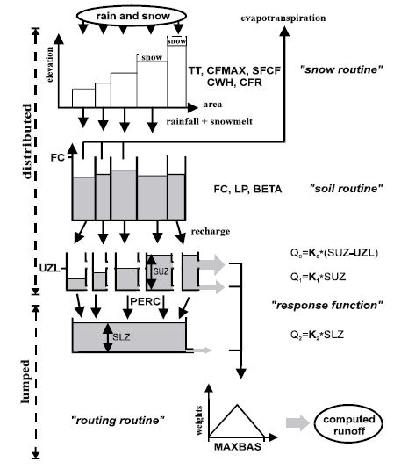
HBV overview
The HBV model is a simple multi-tank-type model for simulating runoff.
Conceptual noise
XXVIII Danube Conference, Kyiv, Ukraine, November 6-8, 2019

Slide 10
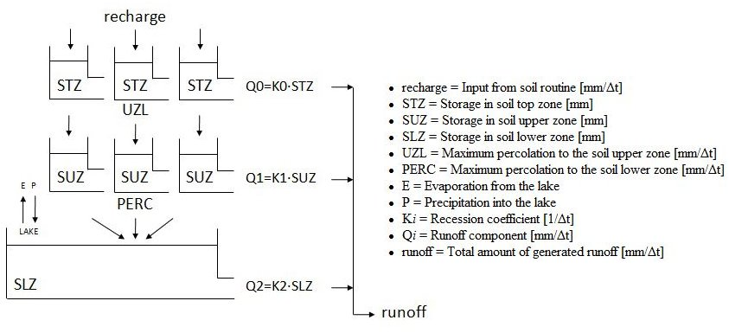
Model of Computed Runoff
Design noise
Source: Help HBV-light – Three GW Box (Distributed STZ and SUZ) Model

Slide 11
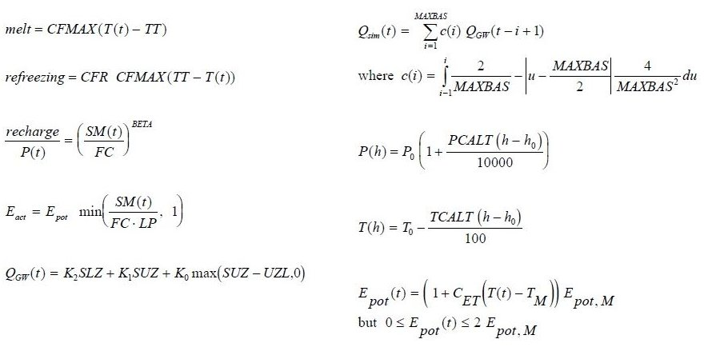
Equations Overview
Conceptual noise
Source: Help HBV-light – An Overview of the HBV Model

Slide 12
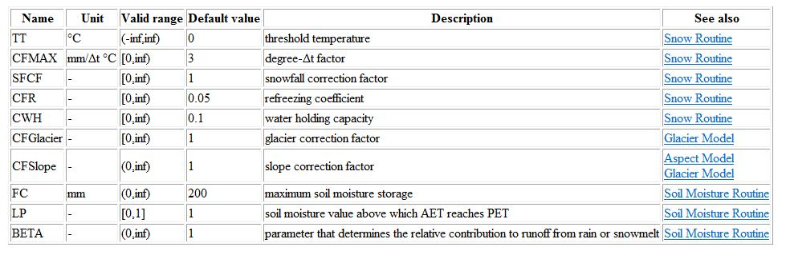
Vegetation Zone Parameters
XXVIII Danube Conference, Kyiv, Ukraine, November 6-8, 2019

Slide 13
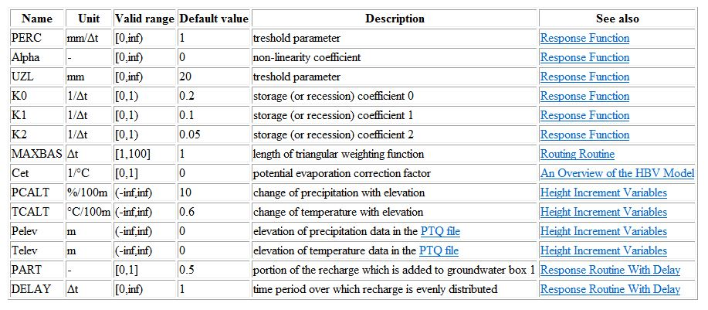
Catchment Parameters
XXVIII Danube Conference, Kyiv, Ukraine, November 6-8, 2019

Slide 14
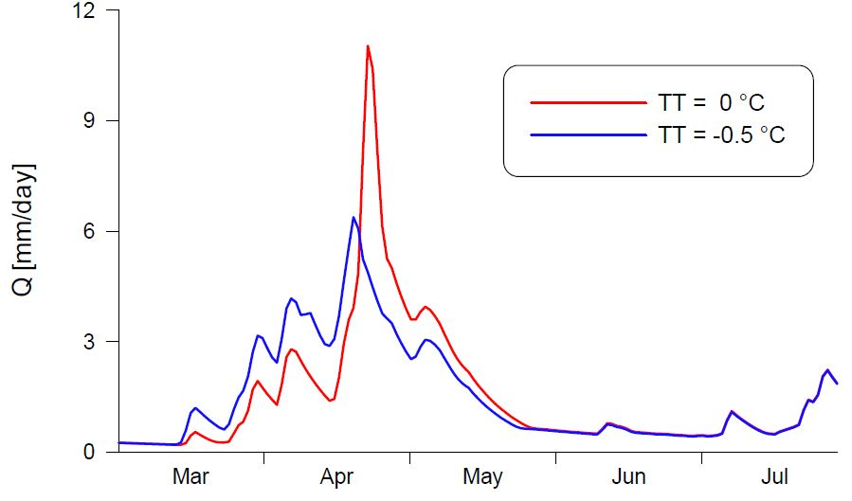
Effect of T_{T}
XXVIII Danube Conference, Kyiv, Ukraine, November 6-8, 2019

Slide 15
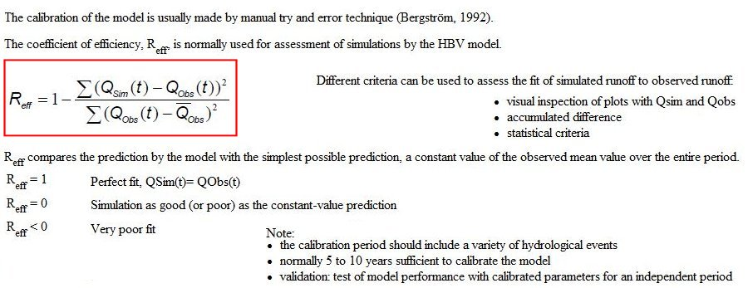
Model Calibration
XXVIII Danube Conference, Kyiv, Ukraine, November 6-8, 2019

Slide 16
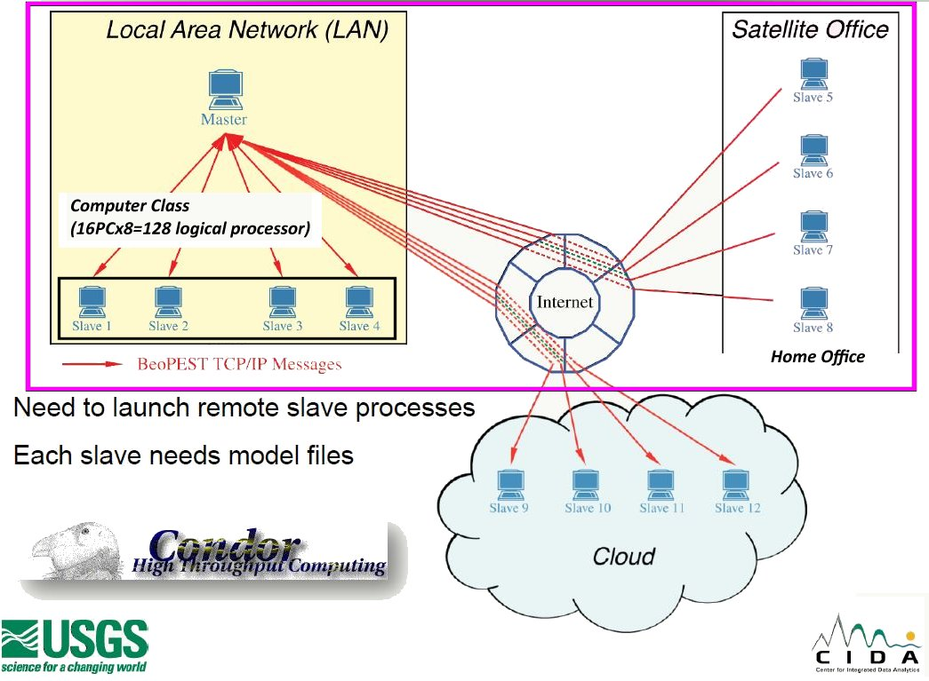
BeoPEST is an tool for model calibration
Calibration and Uncertainty Analysis for Complex Environmental Models
7. hrvatska konferencija o vodama, Opatija, 31.5.2019
XXVIII Danube Conference, Kyiv, Ukraine, November 6-8, 2019

Slide 17
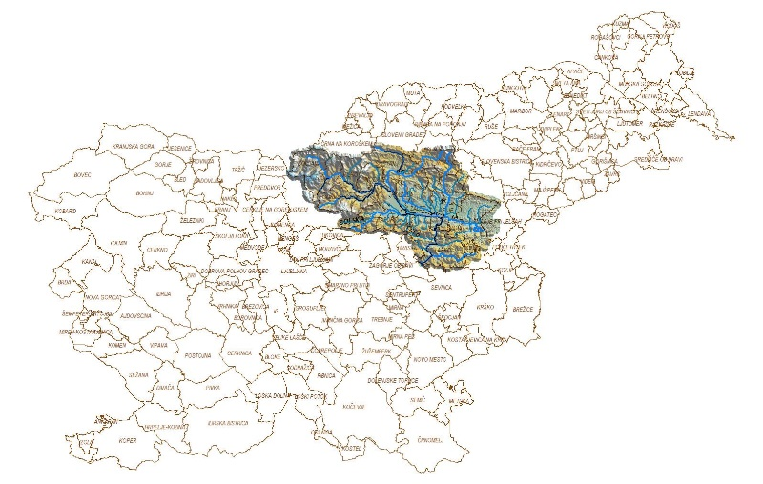
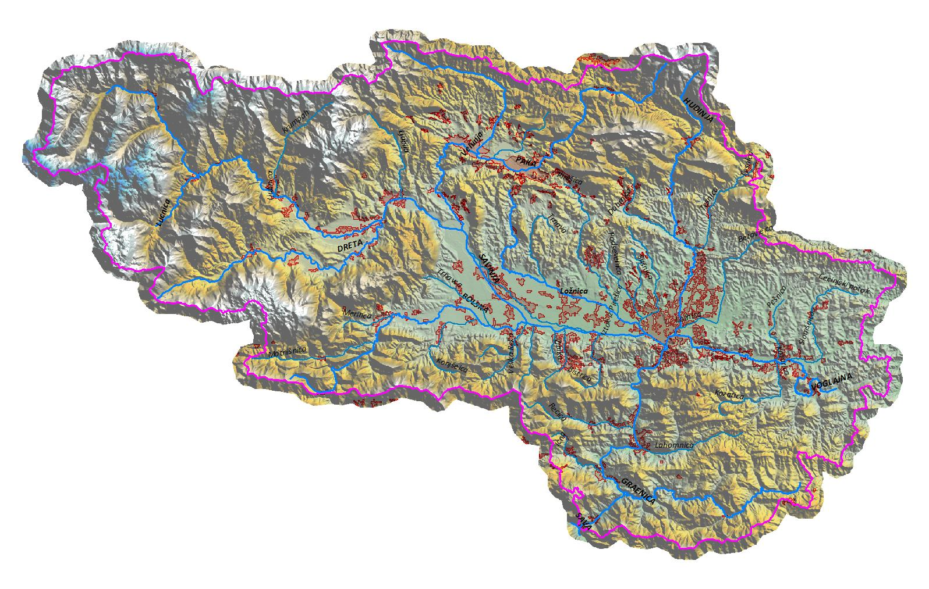
Savinja Catchment Case
Enclosed Area of 1852.3 sq km
min_Elev_m=190.1 m
max_Elev_m=2429.0 m
avg_Elev_m=604.5 m
avg_Aspect=SE (127°)
Older_Celje_elev=~238.0 m
7. hrvatska konferencija o vodama, Opatija, 31.5.2019
XXVIII Danube Conference, Kyiv, Ukraine, November 6-8, 2019

Slide 18
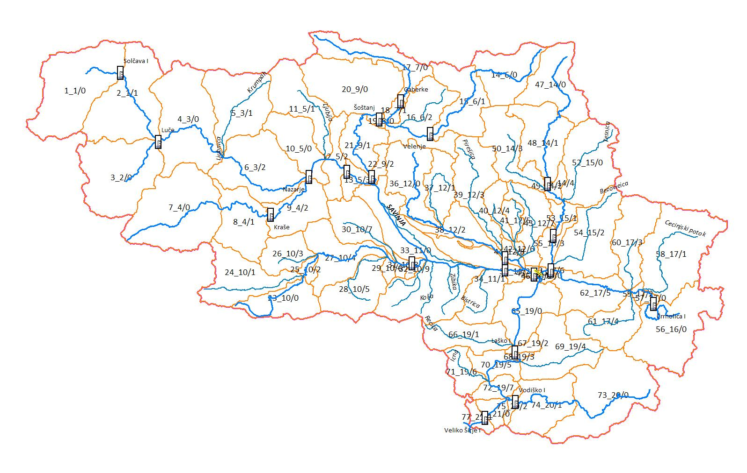
Savinja 77 sub-catchments; II. model
XXVIII Danube Conference, Kyiv, Ukraine, November 6-8, 2019

Slide 19
Goodnes of Fit for calibration period - year 2007
Average model efficiency of Savinja River to Sava outflow for whole calibration period 2007 | 0.952
Average model efficiency for 5-days flood waves 18.-22.09.2007 | 0.988
XXVIII Danube Conference, Kyiv, Ukraine, November 6-8, 2019

Slide 20
Savinja - vp Nazarje
XXVIII Danube Conference, Kyiv, Ukraine, November 6-8, 2019

Slide 21
Savinja - vp Letuš 1
XXVIII Danube Conference, Kyiv, Ukraine, November 6-8, 2019

Slide 22
Savinja – vp Medlog
XXVIII Danube Conference, Kyiv, Ukraine, November 6-8, 2019

Slide 23
Dreta – vp Kraše
XXVIII Danube Conference, Kyiv, Ukraine, November 6-8, 2019

Slide 24
Goodnes of Fit for validation period - year 1990
WS2 | WS2_Name | NS (1.10-14.11.1990)
1 | Savinja do VP Solčava I | 0.85
8 | Dreta do VP Kraše | 0.90
38 | Ložnica do VP Levec I | 0.94
45 | Savinja do VP Celje II - brv | 0.97
53 | Hudinja do VP Škofja Vas | 0.8
62 | Voglajna do VP Celje II | 0.8
67 | Savinja do VP Laško | 0.97
76 | Savinja do VP Veliko Širje I | 0.84
XXVIII Danube Conference, Kyiv, Ukraine, November 6-8, 2019

Slide 25
Savinja – vp Laško
XXVIII Danube Conference, Kyiv, Ukraine, November 6-8, 2019

Slide 26
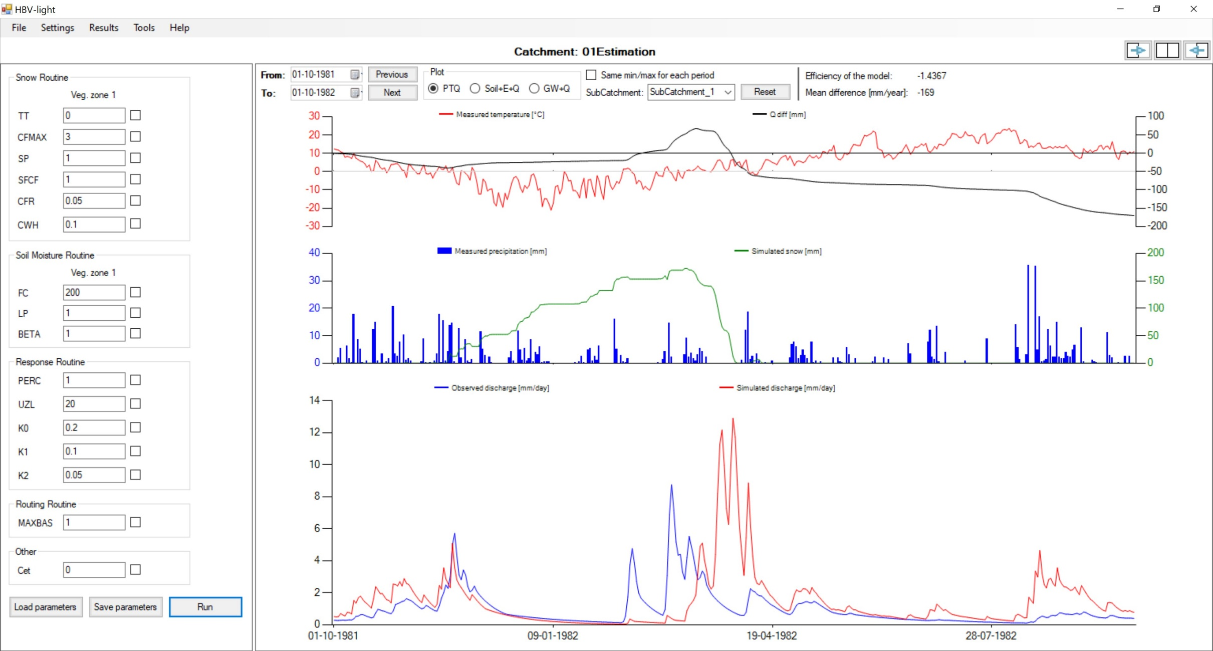
Uncalibrated – eliminated measurements noise example
XXVIII Danube Conference, Kyiv, Ukraine, November 6-8, 2019

Slide 27
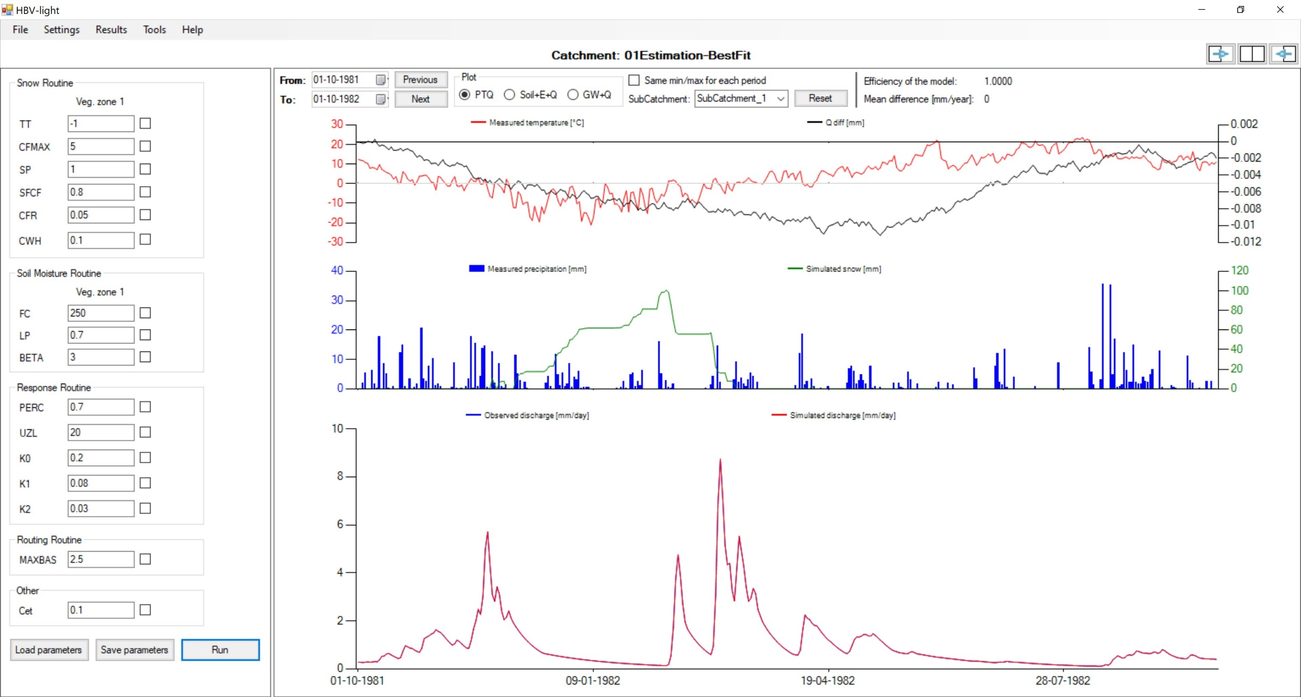
Calibrated
XXVIII Danube Conference, Kyiv, Ukraine, November 6-8, 2019

Slide 28
Efficiency
ESTIMATION | 1.10.1981- 31.12.1991 | 10 years period
PEST_type | Uncalib | Perfect fit | BEOPEST | GAP
Coeff. of determination | 0.20221114 | 0.99999986 | 0.99999985 | 0.98427475
Model efficiency | -1.43670698 | 0.99999986 | 0.99999985 | 0.98003139
Kling-Gupta efficiency | 0.01548047 | 0.99999026 | 0.99998011 | 0.93638967
Efficiency for log(Q) | -0.40112962 | 0.99999888 | 0.99999887 | 0.94828924
Flow weighted efficiency | -0.26136485 | 0.99999997 | 0.99999996 | 0.98843674
Mean difference | -168.90532793 | 0.00282528 | 0.00382001 | 18.47635686
Efficiency for peak flows | -2.61414165 | 0.99999998 | 0.99999997 | 0.98586698
Volume Error | 0.42853933 | 0.99999044 | 0.99998708 | 0.93748858
VALIDATION | 1.10.2001- 31.12.2011 | 10 years period
PEST_type | Uncalib | Perfect fit | BEOPEST | GAP
Coeff. of determination | 0.13979933 | 0.99999981 | 0.99999979 | 0.94799054
Model efficiency | -1.43126502 | 0.99999979 | 0.99999979 | 0.94790032
Kling-Gupta efficiency | 0.01823037 | 0.99986979 | 0.99992483 | 0.95712343
Efficiency for log(Q) | -1.77575874 | 0.99999750 | 0.99999748 | 0.97555861
Flow weighted efficiency | -0.14028966 | 0.99999985 | 0.99999984 | 0.96343725
Mean difference | -121.24852609 | -0.00259352 | 0.00252695 | -2.30084655
Efficiency for peak flows | -1.99882597 | 0.99999952 | 0.99999954 | 0.93617965
Volume Error | 0.49998999 | 0.99998930 | 0.99998958 | 0.99051167
XXVIII Danube Conference, Kyiv, Ukraine, November 6-8, 2019

Slide 29
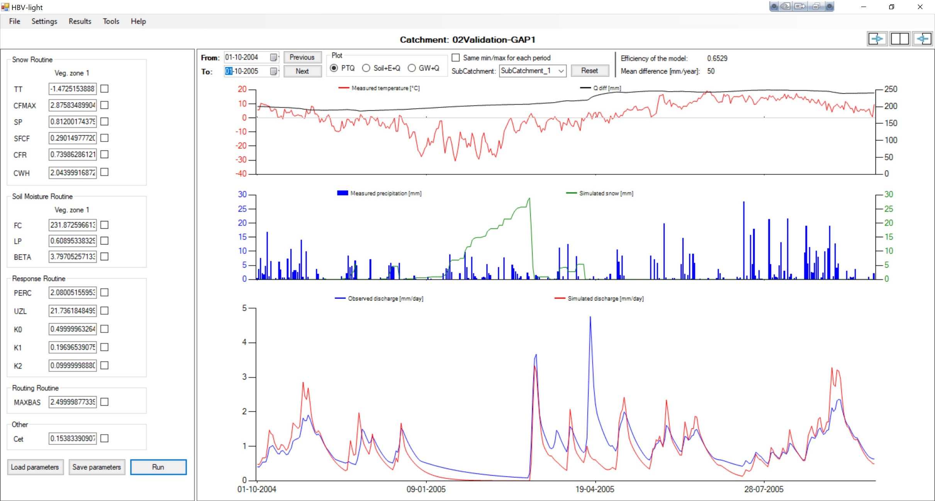
GAP validation
XXVIII Danube Conference, Kyiv, Ukraine, November 6-8, 2019

Slide 30
Conclusions
using of PEST tools - Gauss-Marquardt-Levenberg algorithm with included support:
  SVD
  Tikhonov regularization
  we can successfully estimate thousands of parameters with minimum error variance to objective function.
  using of PEST tools we significantly decrease calibration noise
XXVIII Danube Conference, Kyiv, Ukraine, November 6-8, 2019

