Slide 1
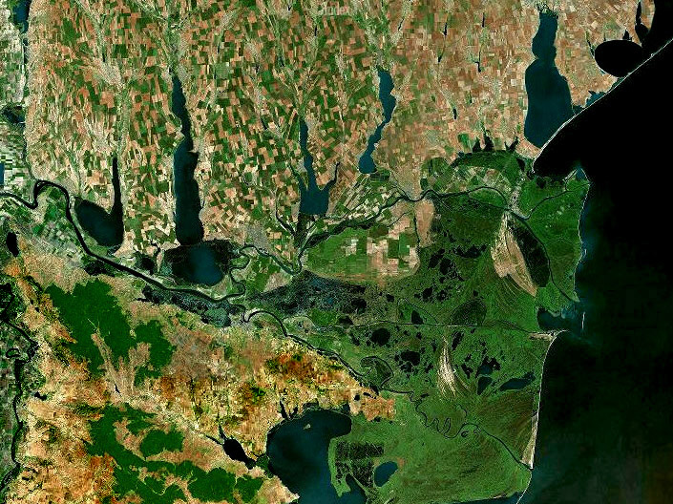
WATER RESOURCES
OF THE LOWER DANUBE RIVER
AND THEIR USE WITHIN
THE TERRITORY OF UKRAINE
V.I. Vyshnevskyi, S.A. Shevchuk, T.V. Matiash
Institute of Water Problems and Land Reclamation, Kyiv, Ukraine

Slide 2
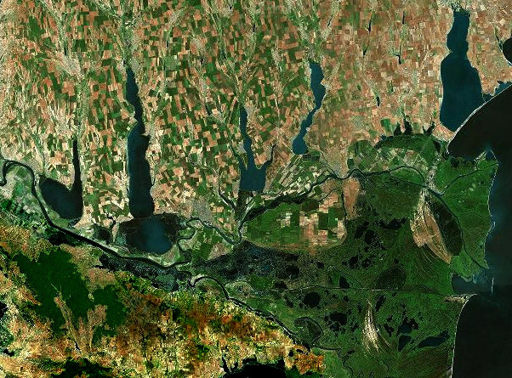
The research area
In the past there was large flood plain on the left bank of the river. In 1960s it was constructed the dam, which protected the territory from the flooding. The hydraulic connection between the river and lakes was carried out by canals with regulative facilities on them.

Slide 3
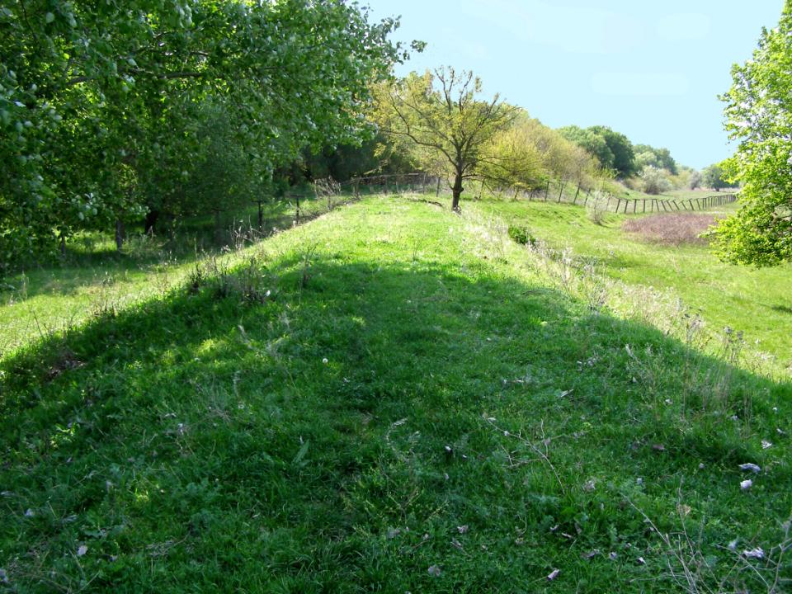
The dam constructed on the left bank
of the Danube River.

Slide 4
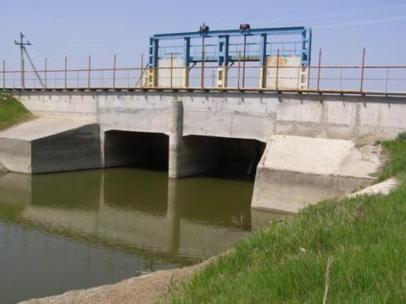
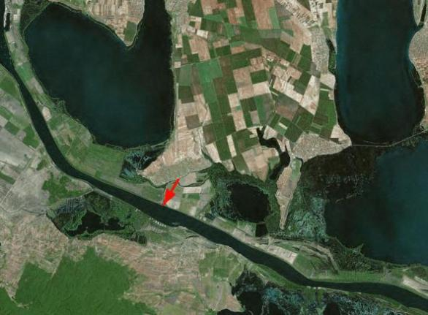
Typical example of regulative facility
Hydraulic structure
“Orlovskyi”
In total there are 12 such structures on the bank of the Danube River

Slide 5
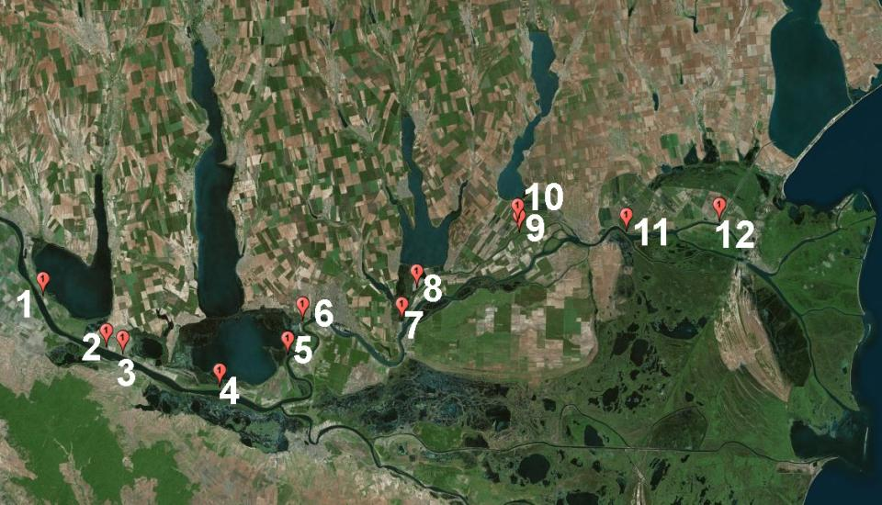
The location of hydraulic structures connecting
the lakes with the Danube River

Slide 6
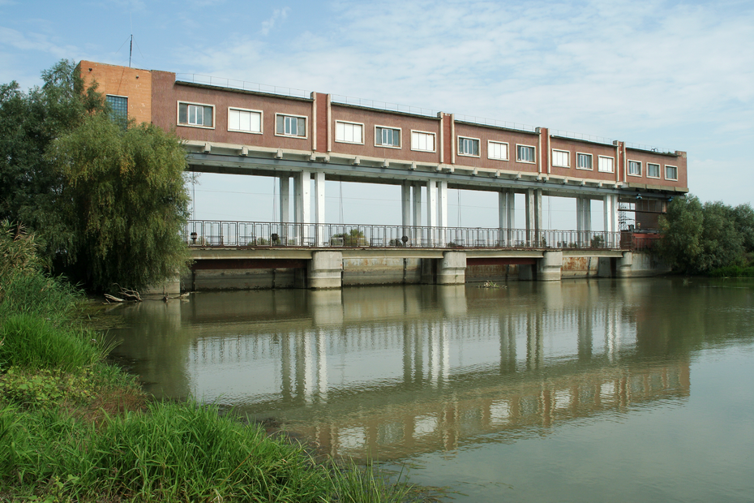
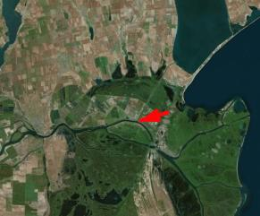
The largest hydraulic structure, which regulates the water intake to lake Sasyk

Slide 7
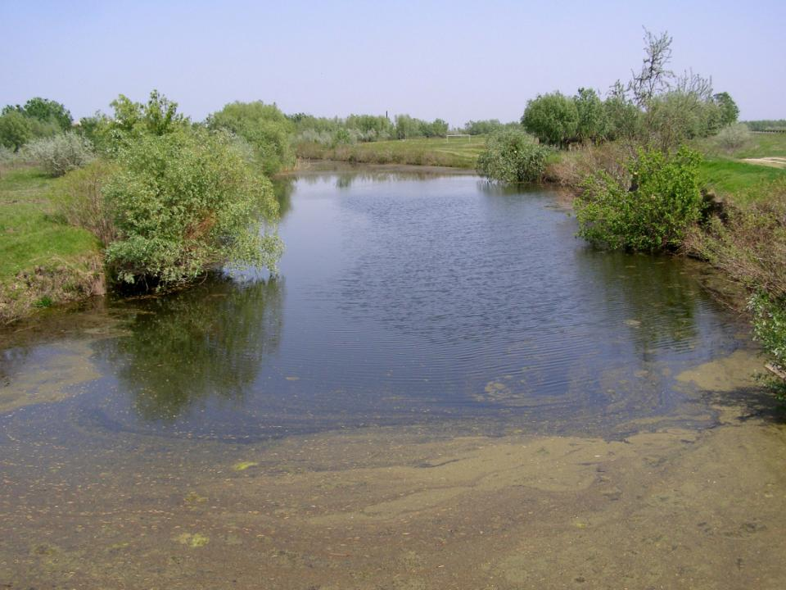
This activity caused essential changes in natural conditions mostly negative

Slide 8
The main tasks of carried out research:
to determine the river basin of the Lower Danube River within the territory of Ukraine;
to determine river basin of the largest rivers, which inflow to the Danube Lakes;
to specify water area of these lakes;
to specify the hydrological features of the Lower Danube River;
to specify the features of the water management of the Lower Danube River within boundaries of Ukraine;
to specify the features of the water quality in the Lower Danube River and in the Danube Lakes;
to develop the tools of research of water bodies, based on the remote sensing data

Slide 9
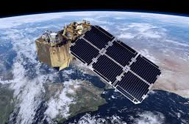
Methodology and data
The main source of data, used in research, were remote sensing data. These data were obtained as a results of surveying land and water by Landsat 8 and Sentinell-2 satellites. The data of Shuttle Radar Topography Mission (SRTM) were used as well. The data processing was carried out using ArcMap 10 and some other programs.

Slide 10
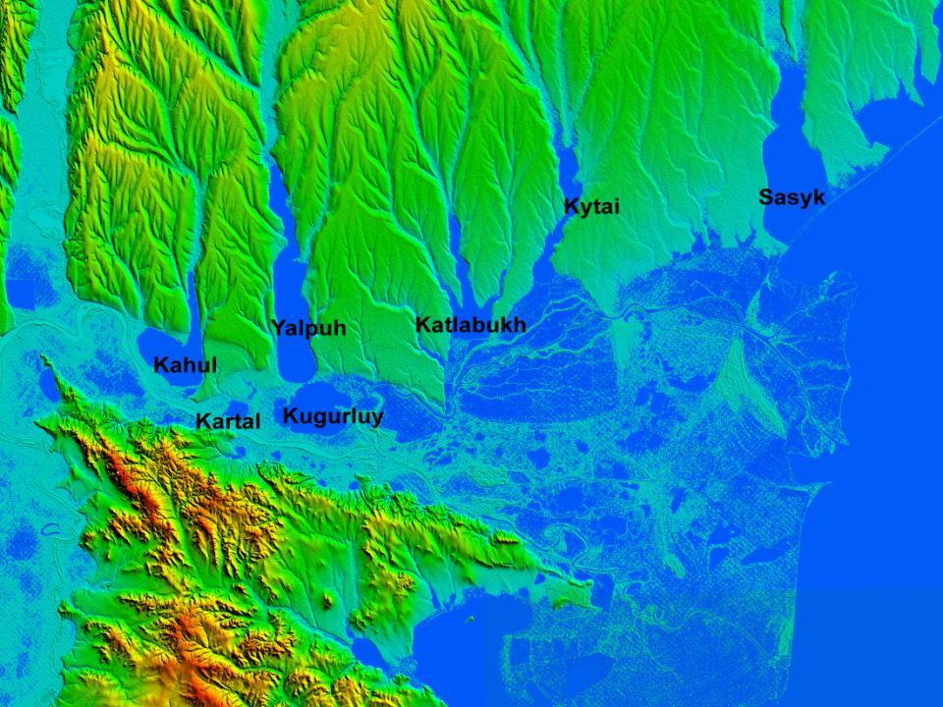
The volumetric image of the Danube Delta, made on the base of SRTM

Slide 11
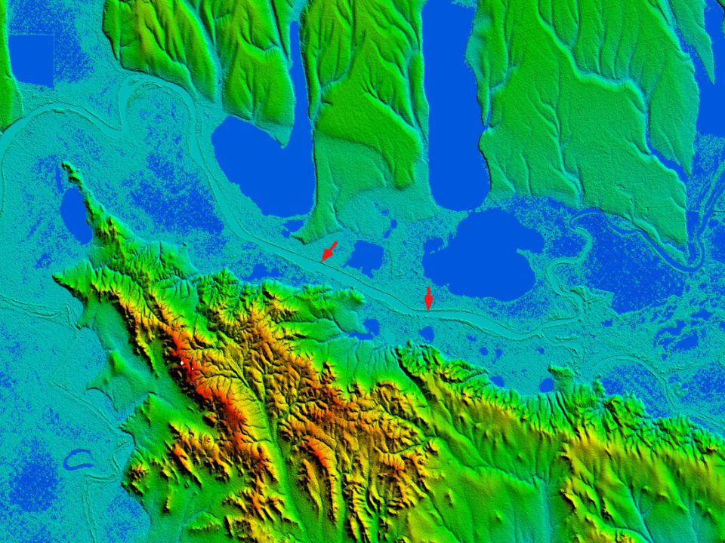
The dam along the Danube River

Slide 12
Hydrographical research
River basin of the Lower Danube River within boundaries of Ukraine, determined on the base of SRTM data
This area is 6454 km² or some less than 1% of whole river basin area, which is considered some larger than 800,000 km².

Slide 13
The Kahul River basin
River basins of the largest rivers,
which inflow to the Danube Lakes
The Yalpuh River basin
605 km²
3280 km²

Slide 14
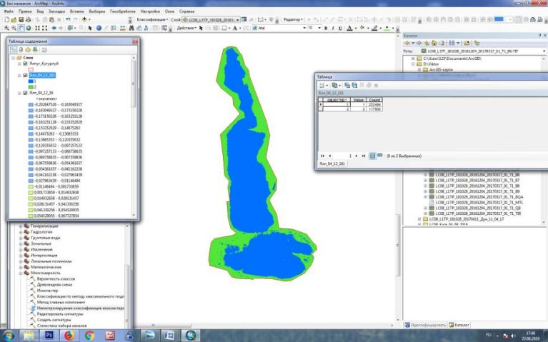
The study of lakes water area
In all cases were used at least two satellite images, obtained in case of small spreading of aquatic plants. It enables to specify the water area at normal water level
F = 0.0009 km² * 252494 = 227.2 km²

Slide 15
The water area of studied lakes with normal water level
Kahul
Yalpuh-Kugurluy
Katlabukh
Kytai
90.6 km²
235 km²
60.7 km²
52.9 km²
In fact this area is about 10% less than it is considered

Slide 16
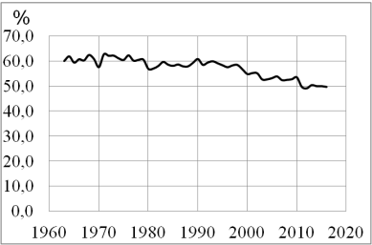
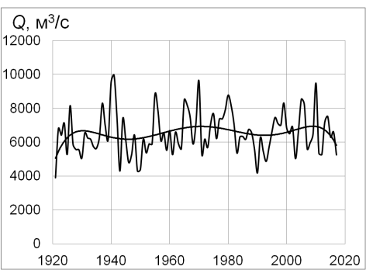
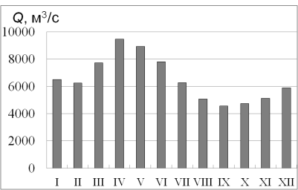
The water runoff of the Danube River
The changes of water runoff of the Kyliya branch of the Danube River
The water runoff of the Danube River at Reni station
The distribution of water runoff during the year
The mean long-term water runoff near Reni station is 6530 m³/sec or 206 km³

Slide 17
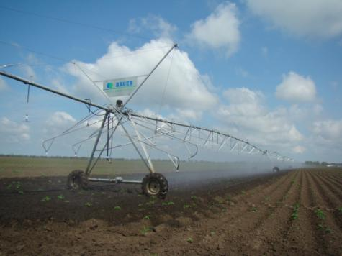
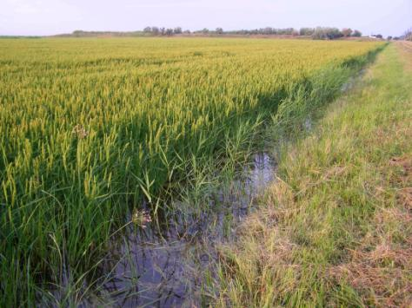
The water management
Water is been taken from the Danube River to the lakes (about 2/3 part of total volume) and directly from the river for the human needs. The largest part of water, which is taken to the lakes, is lost for the evaporation, some part is returned to the river and some small part is used for the human needs.

Slide 18
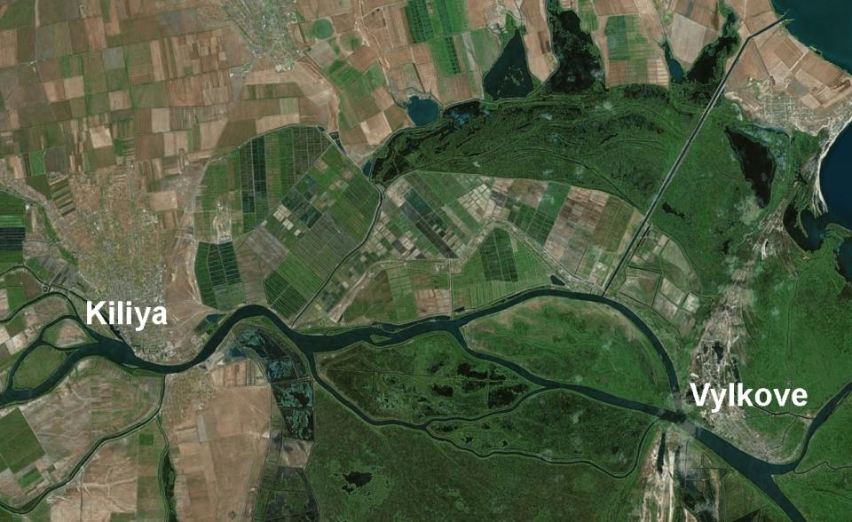
The largest irrigation area between
Kiliya and Vylkove towns

Slide 19
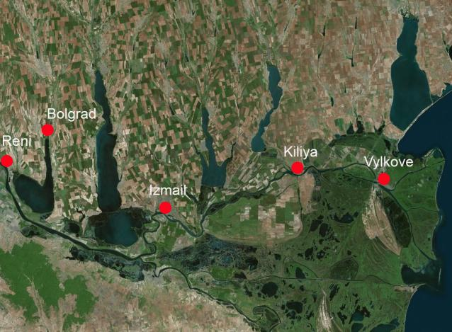
The water intakes for drinking water supply
Reni – underground water, taken from flood plain,
Bolgrad - surface water from lake Kahul,
Izmail - underground water, taken from flood plain,
Kiliya - surface water from the Danube River,
Vylkove - surface water from the Danube River

Slide 20
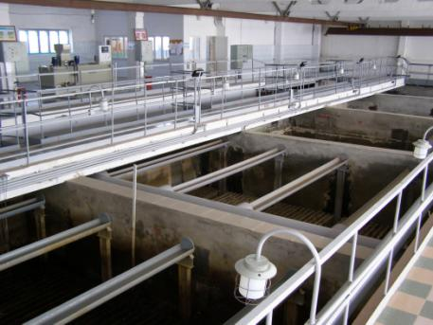
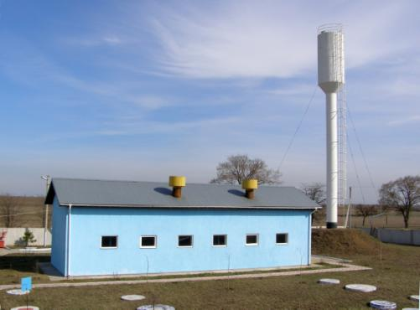
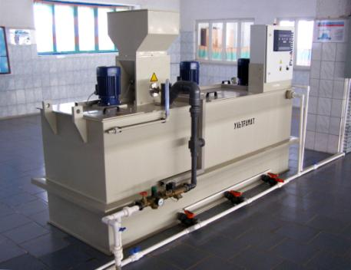
Water treatment station near Kiliya town

Slide 21
The mean water intake and water use within the territory of Ukraine in 2016-2018, mln m³
Water intake from the Danube River |  |  | Water use
to lakes | other | total | total | irrigation
384 | 212 | 596 | 113 | 99
About two thirds of total volume is taken for the filling of lakes. The main water consumer is irrigation.

Slide 22
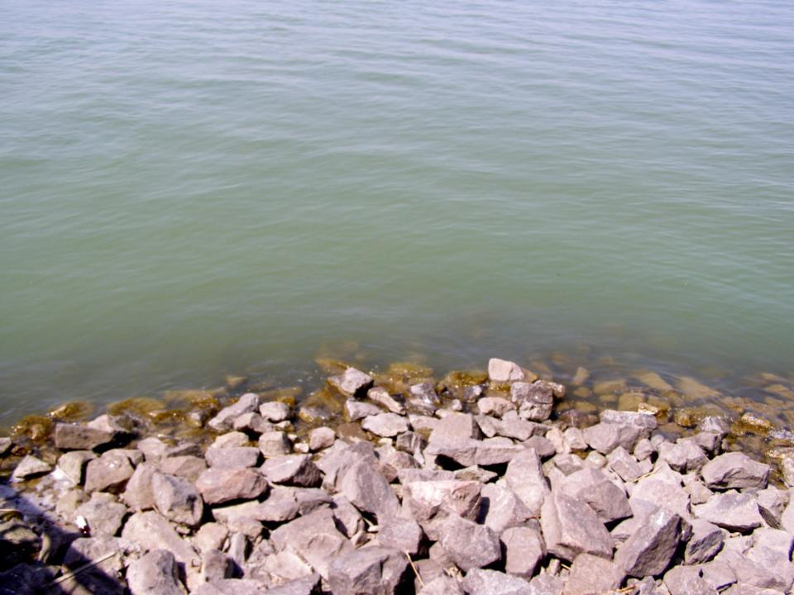
An important problem, which restricts the water use, – the poor water quality, mainly in the lakes

Slide 23
The hydrochemical characteristics of water, mg/dm³
Station | Disolved oxygen | Minera-lization | mgN/dm³ |  |  | Total phospo-rus | BOD | COD
 |  |  | NH₄ | NO₂ | NO₃
Danube–Izmail | 9.36 | 339 | 0.07 | 0.018 | 1.14 | 0.11 | 1.80 | 18.8
Kahul–Nahirne | 9.33 | 568 | 0.08 | 0.009 | 0.32 | 0.10 | 4.12 | 53.6
Yalpuh–Bolgrad | 10.5 | 1234 | 0.11 | 0.008 | 0.17 | 0.08 | 4.07 | 50.8
Yalpuh–Kosa | 9.33 | 957 | 0.07 | 0.006 | 0.16 | 0.09 | 2.90 | 45.8
Kugurluy– Nova Nekrasivka | 10.2 | 708 | 0.10 | 0.006 | 0.15 | 0.09 | 3.41 | 43.2
Katlabukh–Kyslitsa | 9.40 | 1992 | 0.13 | 0.018 | 0.45 | 0.14 | 5.33 | 71.1
Kytai–Chervonyi Yar | 8.46 | 4705 | 0.12 | 0.018 | 0.27 | 0.14 | 7.99 | 146
BOD - biochemical oxygen demand, COD – chemical hydrogen demand
As can be seen, there is great difference in water quality between the Danube River and lakes.

Slide 24
The hydrochemical characteristics of water
Mineralization
biochemical oxygen demand
One of the reason of poor water quality in the lakes is the inflow of small rivers with very poor water quality.

Slide 25
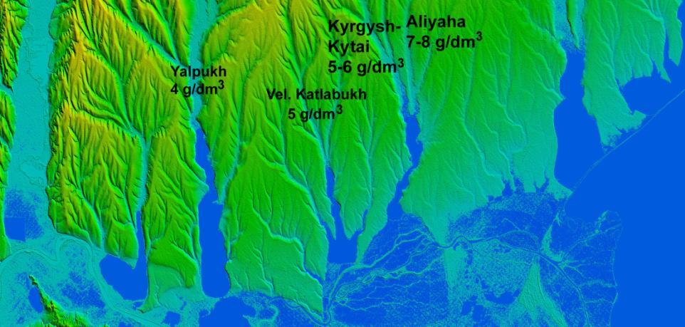
Average mineralization of small rivers, which inflow to the lakes
The poor water quality in lakes in ones term causes the decrease of water use and water intake. The decrease of water intake from the Danube River causes the deterioration in water quality. This process most affected the lake Kytai.

Slide 26
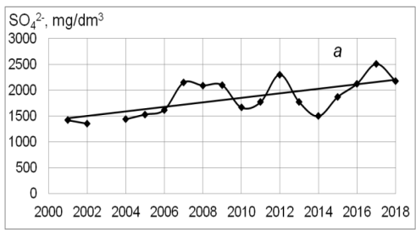
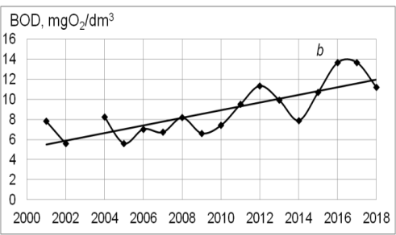
The deterioration of water quality as a result of decrease of water exchange with the Danube River
The long-term changes of water quality in lake Kytai
sulfate concentration
biochemical ohygen demand

Slide 27
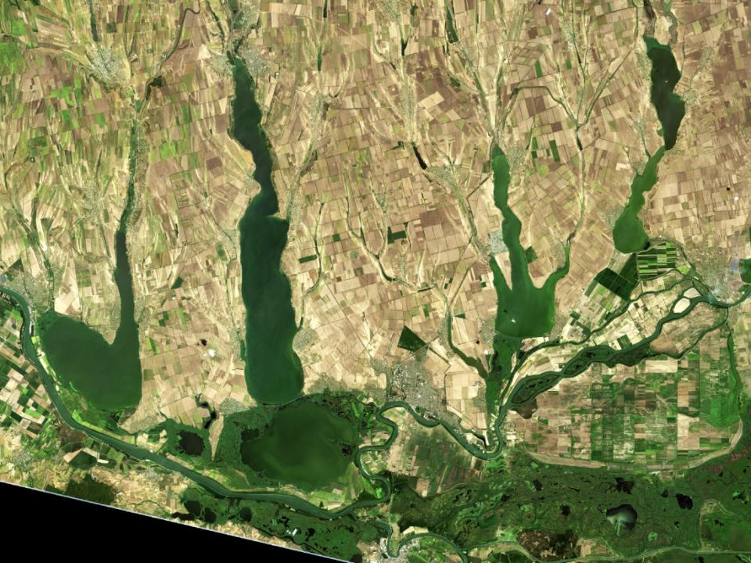
The evaluation of water quality based on remote sensing data

Slide 28
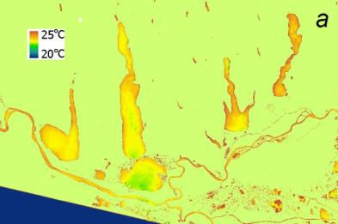
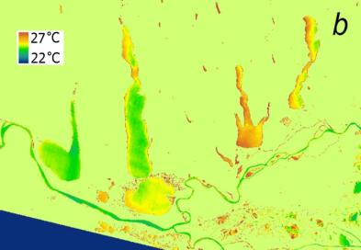
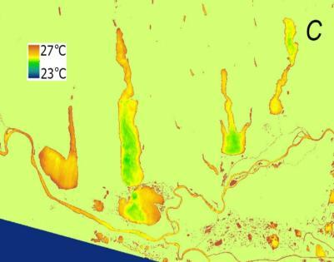
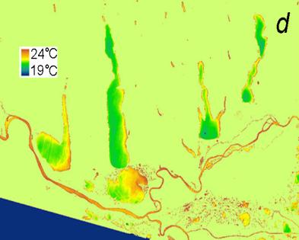
The temperature of water surface in lakes located near the Lower Danube River
13.07.2016
29.07.2016
30.06.2017
07.08.2019

Slide 29
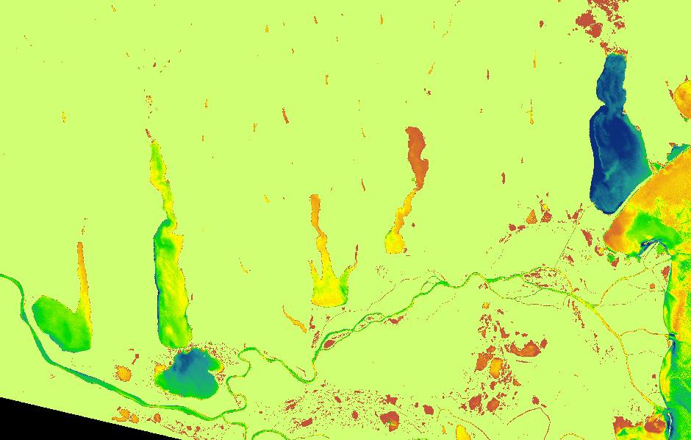
The image created on the base of NDVI index 30.06.2017

Slide 30
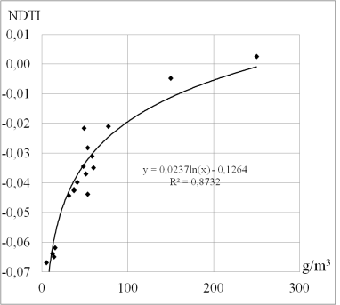
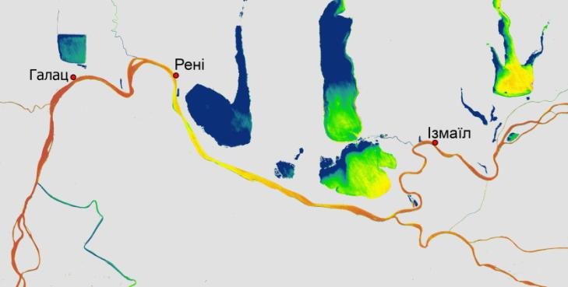
The correlation between water turbidity measured on Reni, Izmail and Vylkove stations and index NDTI
Water turbidity on 02.12.2015

Slide 31
Conclusions
The basin of the Lower Danube River within the territory of Ukraine is the unique region. Besides the Danube River, there are some large lakes, partly transformed into reservoirs. Based on the remote sensing data it was specified the water area of these lakes. This area is about 10 % less than design data.
The volume of water, which is taken annually from the Danube River, is 500–700 mln m³. About 2/3 of this volume is taken for the filling of lakes. The volume of water, which is actually used for human activity, comparable is rather small. The largest volume of water is used for the irrigation, first of all for the growing of rice.
The water quality in these lakes is rather poor – much worse than in the Danube River. There are two main reasons of that: small water exchange between the rivers and poor water quality of local rivers, which inflow to the lakes. As a result, water mineralization in the lakes usually exceeds 2 g/dm³ and can even reach 4.5–5.0 g/dm³ in lake Kytai.
The poor water quality in lakes is the important factor, which restricts the water use in the region. It means that main water consumers are concentrated near the Danube River.

Slide 32
Thank you for your attention!

